Slide 1
MEASURING UK CRIME GANGS
Authors: Giles Oatley, Tom Crick
2014 IEEE/ACM International Conference on Advances in Social Networks Analysis and Mining (ASONAM 2014)
presented by: Aashaar Panchalan
NetID: adp170630
CS 6301: Cyber Security Essentials – Summer 2019

Slide 2
Abstract
Describes the results of a study using Network Analysis to tackle gang related crime problems in the UK.
Data used: Intelligence and routinely gathered data available to UK regional police force.
Span of data: 2000 – 2006 (6 years)
Attempts to detect birth of new gangs using features like modularity, cliques & clustering.
This analysis of features will help in future preemptively identify possible birth of new gangs in the social system.
The study of the dynamics of these networks also reveals that they are not random graphs but small world graphs.

Slide 3
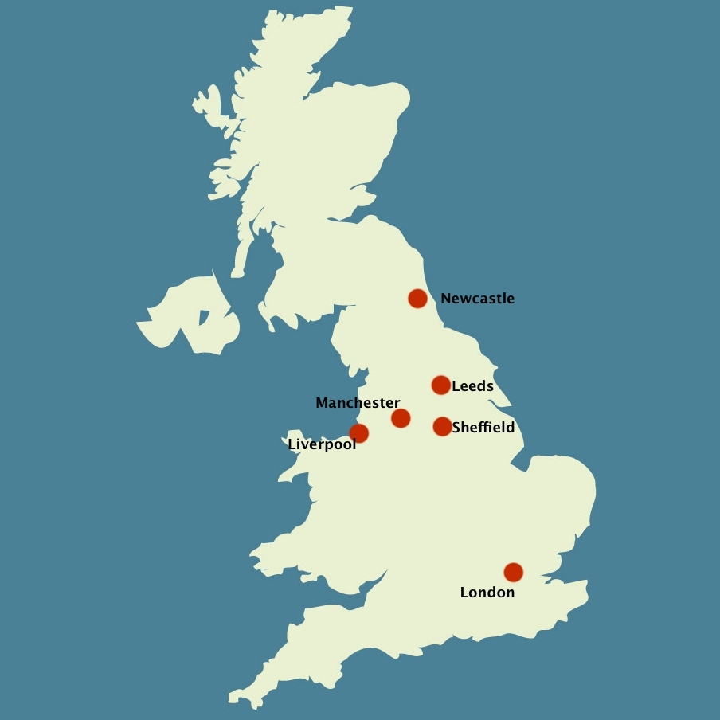
1: Introduction
Used intel gathered by police observations of known gang members & associated criminals.
Perform statistical analysis on network dynamics combining global topology measures & local motifs.
Network motifs are subgraphs that appear more frequently in a real network than could be statistically expected i.e. a recurring pattern.
At a global level, if these networks of associations exhibit clustering behaviour this indicates the presence of gangs.
At a local level, any defined substructures will provide us information about the gang structure.
Such modules will provide information on the structural changes within gangs that lead to birth of new gangs, and predictors of other gang-related behaviour.
Locating Manchester on the map of UK

Slide 4
II: Problem Description and Data
There have been numerous shootings – fatal and non-fatal due to the gangs clashing over drug territories & other disputes.
Most of them were on public streets – some planned acts & some spontaneous events.
Gang Label | Gang Name | Formation
A | Gooch | 1990s
B | Doddington/Pepperhill | 1990s
C | Longsight Crew | 2001
D | Rusholme Crew Gangsters | 2004
Gang Names and their approximate year of formation

Slide 5
II: Problem Description and Data
The report found that 60% of the shootings were gang related.
So in 2001, Manchester Multi-Agency Gang Strategy (MMAGS) was formed which was a joint effort by multiple local authorities to tackle gun crime & deter young people from entering into a gang/gun culture.
The adjacent graph describes dynamics of the relations between the gangs mentioned in the last slide.
A
Turf proximity - tit for tat crimes
B
Mutual enmity with B
A encroached C’s territory for drugs sale
C
D
: Alliance/Friends : Enemies

Slide 6
II: Problem Description and Data
The report also suggests that the criminal activities occur more frequently near gang locations, as shown in the following graphs:

Slide 7

III: Police Databases
For each gang member the police database has information like:
Unique identifier – tattoos, scar marks, etc.
Date of birth
Reason reported for crime(s)
Date of crime(s)
Known associates
Relationship between offenders – brother, sister, friend, spouse, relative, etc.

Slide 8
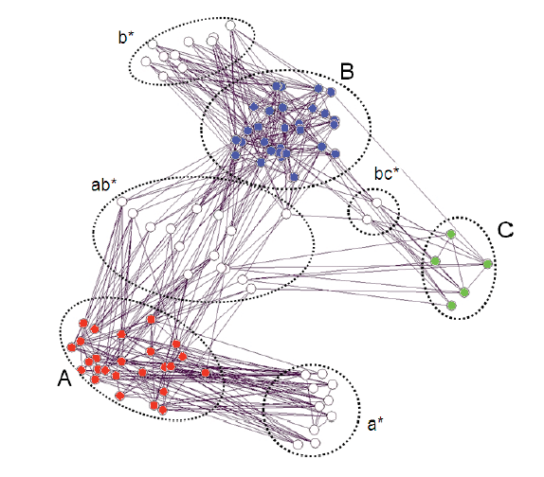
IV: IDENTIFYING COMMUNITY STRUCTURE
The adjacent figure shows data from 2002 between well-formed gangs A & B and newly formed gang C (in 2001).
All the 3 gangs are highly interconnected.
Figure illustrates a large amount of non-gang members or intermediates who are associated with individual gangs, labelled as ab* & bc*.
Individuals who are only connected to one gang and who are highly connected within themselves are labelled a* and b*.
Link reduction, showing Gangs A and B and emergence of Gang C (for 2002).

Slide 9
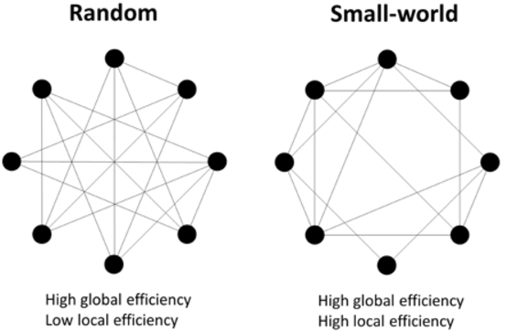
V: NETWORK CHARACTERISATION
A] Small World Networks:
type of mathematical graph
most nodes are not neighbors of one another
but the neighbors of any given node are likely to be neighbors of each other
most nodes can be reached from every other node by a small number of hops or steps.

Slide 10
V: NETWORK CHARACTERISATION
Used clustering coefficient(CC) for each individual year with node and edge counts to describe the network.
Using 1-neighbourhood clustering: For a simple connected graph, CC measures the extent to which vertices linked to any given vertex are also linked to each other.
In other words, are the friends of my friends also my friends?
Using 2-neighbourhood clustering: Little less stringent, it states: are the friends of friends of my friends linked to me?
Notes:
In graph theory, a clustering coefficient is a measure of the degree to which nodes in a graph tend to cluster together. Evidence suggests that in most real-world networks, and in particular social networks, nodes tend to create tightly knit groups characterised by a relatively high density of ties; this likelihood tends to be greater than the average probability of a tie randomly established between two nodes (Holland and Leinhardt, 1971;^{[1]} Watts and Strogatz, 1998^{[2]}).
Two versions of this measure exist: the global and the local. The global version was designed to give an overall indication of the clustering in the network, whereas the local gives an indication of the embeddedness of single nodes.
The global clustering coefficient is based on triplets of nodes. A triplet is three nodes that are connected by either two (open triplet) or three (closed triplet) undirected ties.
The global clustering coefficient is defined as:
C=(number of closed triplets)/(number of all triplets)
The local clustering coefficient of a vertex (node) in a graph quantifies how close its neighbours are to being a clique(complete graph).
Refer: https://en.wikipedia.org/wiki/Clustering_coefficient

Slide 11
V: NETWORK CHARACTERISATION
A small-world network has both local connectivity and global reach & is a simple connected graph with two properties:
Small characteristic path length
Large clustering coefficient
The aim is to find whether observed network is a small world network or a random one.
The authors observed large clustering coefficients & small average path length in the data.
Based on the two criteria, they can concluded that the network has small world characteristics.
Notes:
Small characteristic path length: the presence of short-cut connections between some vertices results in a small characteristic path length L(G).
Large clustering coefficient: each vertex of G is linked to a relatively well-connected set of neighbouring vertices, resulting in a large value for the
clustering coefficient C(G).

Slide 12
V: NETWORK CHARACTERISATION
B] Scale-free Networks:
A scale-free network is a network whose degree distribution follows a power law.
For our graph to be scale free network, the clustering coefficient (as a function of the number of nodes n), should follow the power-law distribution – partially verified
The diameter of the network (longest path length) should be approximately log(log(n)) – verified.
Notes:
In statistics, a power law is a functional relationship between two quantities, where a relative change in one quantity results in a proportional relative change in the other quantity, independent of the initial size of those quantities: one quantity varies as a power of another.

Slide 13
V: NETWORK CHARACTERISATION
C] Emergence of new gangs:
Changes in path lengths and clustering coefficients between 2000 to 2005 show how gangs become closely knit or split apart.
By examining annual links for 2001 and 2004, we might predict that just before/as a gang forms:
the cumulative links decrease
the annual links increase
then both values increase afterwards as everyone becomes linked together.
Per year clustering coefficients for each gang. Gang C was formed in 2001, Gang D in 2004.

Slide 14
VI: discussion
Authors’ take:
The model of two rival sets of gangs is potentially a misrepresentation of the much more complex sets of smaller cliques and fluid changes within the larger gang structures.
Better analysis of link types is required.
Develop a model where individuals learn about crime opportunities by interacting with other peers.
Whether weak ties play an important role in explaining criminal activities especially gang homicide.
The observed values find that weak ties, as measured by friends of friends, have a positive impact on criminal activities and thus verify the model’s theoretical predictions.
Also, it would be interesting to examine the kinds of links within each gang which split apart between 2001 and 2004.

Slide 15
VII: CONCLUSIONS
This paper contains initial findings about the offender/gang networks in Manchester in the UK using Network Analysis.
The uses of this technology in an operational context are significant.
Even using networks merely as visual representations of data in spreadsheets & databases is useful in identifying key offenders.
When further pre-processing is carried out, and the quality of the data collection process is improved, there will be significant future work available with this dataset.
The additional databases of histories and associates of gang offenders are routinely gathered by the UK’s National Crime Agency, who investigate gang and gun related crimes.
These data sources are rich sources of information for CS technologies to deliver crime prevention and detection decision support systems.

Slide 16
REFERENCES
Measuring UK Crime Gangs - Giles Oatley, Tom Crick https://ieeexplore.ieee.org/document/6921592
https://www.linkedin.com/company/greater-manchester-police/
https://mathinsight.org/scale_free_network
https://ukmap.co/manchester-uk-map-england/
https://www.researchgate.net/figure/Examples-of-random-small-world-and-lattice-networks-A-small-world-network-possesses_fig4_286252765
https://en.wikipedia.org/wiki/Small-world_network

Slide 17
Thank You

