Slide 1
Development of a Multi-Computer File Synchronization System using Kernel API and Delta Resolution
Supervised by,
Dr. Asief Javed
Assistant Professor
Department of Mechatronics Engineering
Khulna University of Engineering & Technology, Khulna
Presented by,
Aashab Tajwar Khan
Department of Mechatronics Engineering
Khulna University of Engineering & Technology, Khulna
Roll: 1831019
4th Year 2nd Term

Slide 2



Introduction
v3.0
Projects involve multiple and multiple documents
Documents constantly update
Poor communication is frequent
Leads to document version mismatch
Improper coordination
Extra work to manage
Causes inconsistency, affecting whole projects
v2.0
v1.0
v1.0

Slide 3
Introduction
For consistency, updated information should reach everyone
Transfer should be in real-time
Takes care of itself and not appears as a chore
Multi-Computer File Synchronization aims to achieve this.
v3.0
v3.0
v3.0
v3.0

Slide 4
Literature Review
Title | Authors | Year | Summary
SyncCS: A Cloud Storage Based File Synchronization Approach | Chao Liang, Luokai Hu, Zhou Lei and Jushu Wang | 2014 | File Synchronization model based on cloud storage. Follows a two-stage synchronization and with conflict resolution.
MetaSync: Coordinating Storage Across Multiple File Synchronization Services | Seungyeop Han, Haichen Shen, Taesoo Kim, Arvind Krishnamurthy, Thomas Anderson, and David Wetherall | 2016 | File synchronization that focuses on availability and implements a variant of Paxos algorithm to reach consistency
An Algebraic Approach to File Synchronization | Norman Ramsey, Előd Csirmaz | 2001 | Presents an algebraic operation for reasoning file operations and resolve conflict
Remote File Synchronization Single-Round Algorithms | Deepak Gupta, Kalpana Sagar | 2010 | Study of remote file synchronization protocols and comparison of performance of all these protocols on different data sets.

Slide 5
Objectives
To create a collaboration medium between between multiple users to share documents and other files.
Enable a streaming medium so that files can transfer
To enable real time synchronization between multiple computers used by a single user.
To enable real time synchronization between multiple computers used by multiple users.

Slide 6







Convention Approach
CR
Long Process
Prone to mistakes
Process Repeats for every change
Social Media
Browser
Cloud Service
User
Folder
Lecture.pdf

Slide 7

Proposed System
User (Classmate)
Author (CR)
User (Classmate)
Author (CR), wishes to start a collaboration.
He creates a workspace. E.g. MTE 4100.
A workspace is any folder that contains files.
This automatically creates a remote workspace.
Author adds other users (classmates).
Local Workspace (MTE 4100)
They too now have access to the Remote Workspace.
Remote Workspace

Slide 8
Proposed System
User (Classmate)
Author (CR)
User (Classmate)
Author creates a new file or modifies it.
This is detected by the desktop app. It extracts the changes in data.
Updated
Lecture.pptx
Updated
Lecture.pptx
Updated
Lecture.pptx
It uploads this data to the remote workspace.
The remote workspace also applies these changes and sends them to the connected devices.
The other users that author shared with now have the updated file as well.
Remote Workspace

Slide 9
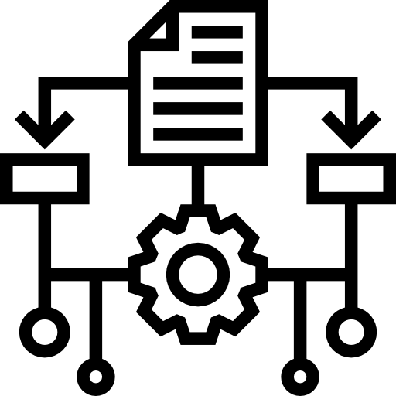


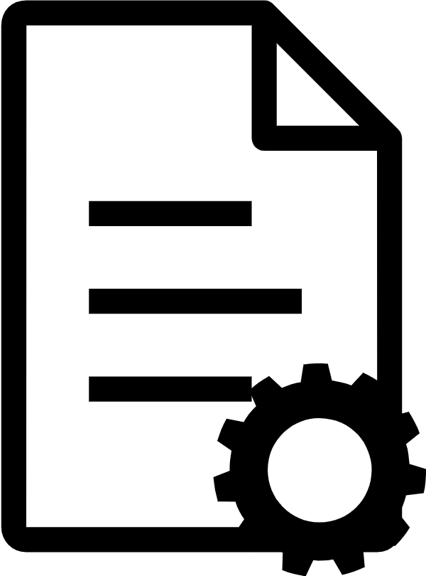
Synchronization Process Stages
Watcher
Identify File
Extract Content
Remote Workspace
Apply Changes
Shared Computers
Apply Changes

Slide 10
Protocol Comparison
Protocols | Advantages | Disadvantages | Use Cases
HTTP | - Simple Implementation - Large Resources | - Unidirectional - Payload is very heavy - Server side dependent | - JSON - File
gRPC | - Lightweight - Fast | - Lack of Maturity - Difficult to maintain - Hard to Implement | - Protocol Buffer - JSON
TCP | - Lightweight - Fast - Reliable - Least Overhead | - Difficult to Implement - Data Agnostic. Difficult to distinguish data | - Reliable Packet Stream - JSON - File - Email
UDP | - Fast - Same Overhead as TCP | - Unreliable - Lower Resources - Frowned Upon | - Live Stream - RT Interactions

Slide 11

The Monitoring Process
Module Name: Watcher
Monitors Folder/FS
Monitors a given folder for events
Events can be CREATE, UPDATE, DESTROY/DELETE
Create
Update
Delete
Once an event happens, full file system tree is traversed
Path of the file is passed to Transfer module
Goes through FS Tree to find full location of the file
Target File Location

Slide 12
The Monitoring Process
Bit Masks For Each Event
Bit Value | Meaning
IN_ACCESS | File was accessed
IN_ATTRIB | File attributes changed(ownership, permissions, etc.)
IN_CREAT | File created inside watched directory
IN_DELETE | File deleted inside watched directory
IN_DELETE_SELF | Watched file deleted
IN_MODIFY | File was modified
IN_MOVE_SELF | File was moved

Slide 13


File Streaming
{
“file_size”: “1359042”
“file_name”: “lecture1”
“created_at”: “12-02-2024”
“workspace”: “MTE”
“type”: “file”
“extension” : “.pdf”
}
Target File
Metadata
File Contents
Data Package
Data Package
Delay Interval (100ms)
TCP Stream (Unique Thread)

Slide 14

File Streaming
TCP Stream
Collect first package from stream
Decode to extract the metadata
Data Package
Check the type of incoming data
Decode the package
{
“file_size”: “1359042”
“file_name”: “lecture1”
“created_at”: “12-02-2024”
“workspace”: “MTE”
“type”: “file”
“extension” : “.pdf”
}
Package Containing File Data
Metadata
Compile the data into file
Send Notification to Queue
Store the file
Store
Compile File
Database

Slide 15
Delta Encoding

Slide 16
Synchronization Algorithm
Get File ID
No
Updat-ed?
Yes
Push to Queue
Extract Modifications
No
No
New File?
Yes
Active?
Yes
Monitor Local Workspace
Extract Full File
Log Changes
Upload to Remote
Client
Starts
Exists?
No
Listen From Local
De-serialize Data
Retrieve Metadata
Create New
Yes
Overwrite

Slide 17
Synchronization Algorithm
Decode and Retrieve
Create New Version
Yes
No
Token?
No
File Exists?
Log Changes
Push to Devices
Receive Data
De-serialize Data
Match File
Yes
Fetch Metadata
Update Version

Slide 18




Server
Backend Server
User Service
Block Service
Metadata Service
Sync Service
Authentication
Authorization
Registration
Handle user data
Handle file streaming
Interact with Block Storage
Handle file metadata
Notify with updates
Organize files
Distribute across all clients

Slide 19



Client
Desktop Client
Watcher
Chunker
Indexer
Watches for changes in workspace
Breaks down files into chunks
Arrange chunks into files
Sends/Receives chunks to server
Handle metadata for files in workspace
Keep track of changes

Slide 20




Storage
Data Store
User Data
Block Storage
Metadata DB
Store and Manage user data
Relate workspace to users
Storage and Retrieval
Write to Disk
Storage and Retrieval
Write to Disk

Slide 21





System Architecture
Message Queue
Meta Service
Notifications
Metadata Storage
TCP Server
Sync Service
Block Storage
User Service
Reverse Proxy
User and Workspace DB

Slide 22





Technology Used
Desktop Client and Server
Main network handling member
Server side
User data store
Server side implementation
File Store
File metadata store
Queuing Notification messages

Slide 23
THANK YOU

