Slide 1




Presenting Git using Git Hub
COLLEGE OF ENGINEERING TRIVANDRUM
Computer Science Department
S4 2017
Presented by,
Sarathchandran S
Saharsh Pruthi
Vishnudev KP

Slide 2
What is VERSION CONTROL?
Version control (or revision control, or source control) is all about managing multiple versions of documents, programs, web sites, etc.
  Almost all “real” projects use some kind of version control
  Essential for team projects, but also very useful for individual projects
Some well-known version control systems are CVS, Subversion, Mercurial, and Git
  CVS and Subversion use a “central” repository; users “check out” files, work on them, and “check them in”
  Mercurial and Git treat all repositories as equal
Distributed systems like Mercurial and Git are newer and are gradually replacing centralized systems like CVS and Subversion

Slide 3
GIT DESIGN GOALS
• Speed
• Simple design
• Strong support for thousands of parallel branches
• Fully distributed
• Able to handle larges projects like Linux kernel effectively
GIT DOESN'T DELETE
• Git generally only adds data
• If you mess up, you can usually recover your stuff
• Recovery can be tricky though

Slide 4
Installing git
In Linux:
sudo package-name git
e.g : ubuntu:- sudo apt-get install git
For Windows
Install git command shell
e.g : git-scm

Slide 5
Making git recognize you
After installing git in your system open terminal and configure your git with your git account(like github,bitbucket or gitlab etc)
git config --global user.name "Sarathchandran"
git config --global user.email sarathchandran@gmail.com

Slide 6
Checking Your Settings
Use the git config --list command to list all the settings Git can find at that point:
$ git config --list
user.name=John Doe
user.email=johndoe@example.com
color.status=auto
color.branch=auto
color.interactive=auto
color.diff=auto

Slide 7
Getting Help
Ever need help while using Git, there are three ways to get the manual page (manpage)
$ git help <verb>
$ git <verb> --help
$ man git-<verb>

Slide 8
Initializing a Repository
Initializing a Repository in an Existing Directory
If you’re starting to track an existing project in Git, you need to go to the project’s directory.
$ git init

Slide 9
Start local version-controlling
cd to the project directory you want to use
Type in git init
  This creates the repository (a directory named .git)
  You seldom (if ever) need to look inside this directory
Type in git add
  git -A can also be used
  git *.c can be used to add all .c files
  The period at the end is part of this command!
    Period means “this directory”
This adds all your current files to the repository
Type in git commit –m "Initial commit"
You can use a different commit message, if you like

Slide 10
Clone a repository from elsewhere
git clone URL
git clone URL mypath
  These make an exact copy of the repository at the given URL
git clone git://github.com/rest_of_path/file.git
  Github is the most popular (free) public repository
All repositories are equal
  But you can treat some particular repository (such as one on Github) as the “master” directory
Typically, each team member works in his/her own repository, and “merges” with other repositories as appropriate

Slide 11
Checking the Status of Your Files
The main tool is to use git status command.
If you run this command directly after a clone, you should see something like this:
$ git status
On branch master
Your branch is up-to-date with 'origin/master'.
nothing to commit, working directory clean

Slide 12
Removing Files
To remove a file from Git, remove it from your tracked files (more accurately, remove it from your staging area) and then commit.
The git rm command does that, and also removes the file from your working directory so you don’t see it as an untracked file the next time around.
$rm a.html;

Slide 13
Viewing the Commit History
To look back to see what has happened. The most basic and powerful tool to do this is the git log command.
git log
commit ca82a6dff817ec66f44342007202690a93763949
Author: Scott Chacon <schacon@gee-mail.com>
Date: Mon Mar 17 21:52:11 2008 -0700
changed the version number
commit 085bb3bcb608e1e8451d4b2432f8ecbe6306e7e7
Author: Scott Chacon <schacon@gee-mail.com>
Date: Sat Mar 15 16:40:33 2008 -0700
removed unnecessary test
commit a11bef06a3f659402fe7563abf99ad00de2209e6
Author: Scott Chacon <schacon@gee-mail.com>
Date: Sat Mar 15 10:31:28 2008 -0700
first commit

Slide 14
Differentiate two commits and show commits
git diff commit_id1 commit id_2
It would represent the change happen between these two commit history
git show
It shows the commit

Slide 15
Create new Branch
$ git branch iss53
$ git checkout iss53
Switch Branch
$ git checkout iss53
Delete Branch
$ git branch -d iss53
Show All Branch
$ git branch -d iss53
iss53
* master
testing
Creating a branch
git branch <branch-name>
Git checkout <branch-name>
Git checkout master

Slide 16
Push pull fetch and merge
Push To remote
$ git push origin branch_name
Fetch & Merge
$ git pull
Fork
$ git fork URL
Merge
$ git merge origin master
Git push and pull command
$git push origin master
$git pull origin master

Slide 17
Some special and useful commands
reflog
$ git reflog
Blame
$ git blame
A useful tool
$ gitk

Slide 18
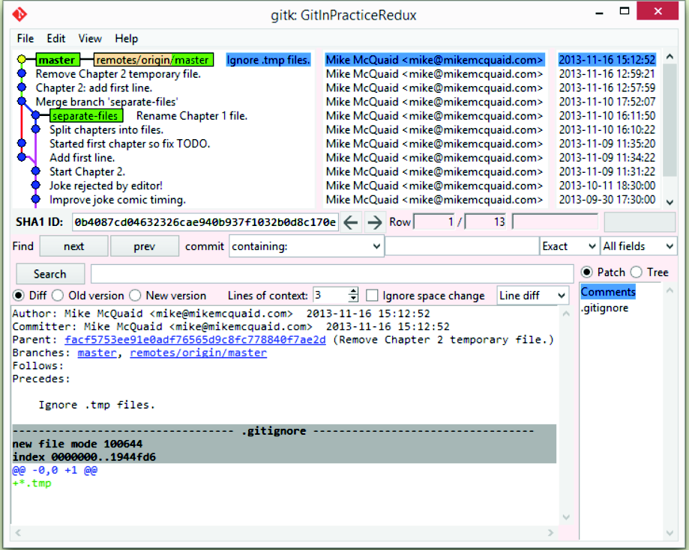

Slide 19
Thank you
And now start using GIT

