Slide 1
BLUESTOCK MUTUAL FUND ANALYTICS
Capstone Project
Tools Used:
Python | Pandas | Jupyter | Tableau | GitHub
Prepared By:
Savni Nukala
Data Analyst Intern
Fintech Division – Analytical and Insights Team

Slide 2
Problem Statement
Mutual fund datasets contain large volumes of NAV, transaction, and performance data. Investors and analysts require an integrated platform to evaluate fund performance, investor behavior, and market trends using data-driven insights.
Objective:
Build an end-to-end analytics solution for mutual fund analysis, risk evaluation, investor analytics, and dashboard reporting.

Slide 3
Data Sources and Project Architecture
Insights
Raw Data
Analytics
Dashboard
Cleaning
Data source
Business Insights
CSV Files
Python ETL
Clean Datasets
EDA & Analytics
Tableau Dashboard
Project Architecture
clean_nav.csv
clean_transactions.csv
clean_performance.csv

Slide 4
EDA Highlights
Small Cap funds showed higher returns.
SIP transactions dominated investor activity.
Direct plans had lower expense ratios.
Key Findings
Small Cap funds delivered the highest returns but with greater volatility.
SIP transactions accounted for the majority of investor activity.
Direct plans generally had lower expense ratios than regular plans.
Mutual fund participation increased steadily across the analysis period.
AUM was concentrated among a few leading fund houses.

Slide 5
Observations
Investment activity showed a positive long-term trend.
Fund performance varied significantly across categories.
Retail investor participation remained strong through SIP investments.
Market growth was reflected in increasing assets under management.

Slide 6
Performance Analytics
Metric | Purpose
CAGR | Annualized growth measurement
Sharpe Ratio | Risk-adjusted return
Sortino Ratio | Downside risk-adjusted return
Alpha | Excess return over benchmark
Beta | Market sensitivity
Max Drawdown | Largest historical decline

Slide 7
Advanced Analytics
Risk & Investor Analytics
Risk Analytics
Historical VaR (95%)
Conditional VaR (CVaR)
Rolling 90-Day Sharpe Ratio
Investor Analytics
Cohort Analysis
SIP Continuity Analysis
At-Risk Investor Identification
Fund Recommendation Engine
Built using Sharpe Ratio and Risk Grade
Recommends top funds based on investor risk appetite
Business Value
Improves investment decision-making
Helps identify investor retention risks
Supports personalized fund recommendations

Slide 8
Dashboard Overview
Tableau Dashboard Features
KPI Monitoring
Fund House Comparison
SIP Inflow Analysis
Investment Trend Tracking
Scheme Distribution Analysis
Benefits
Interactive filtering
Easy comparison of fund performance
Quick identification of market trends

Slide 9
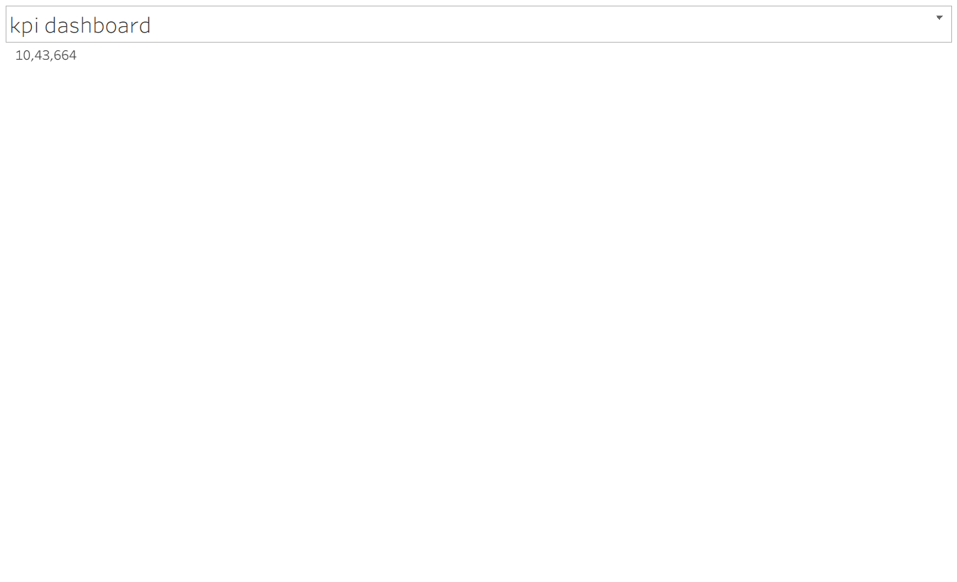
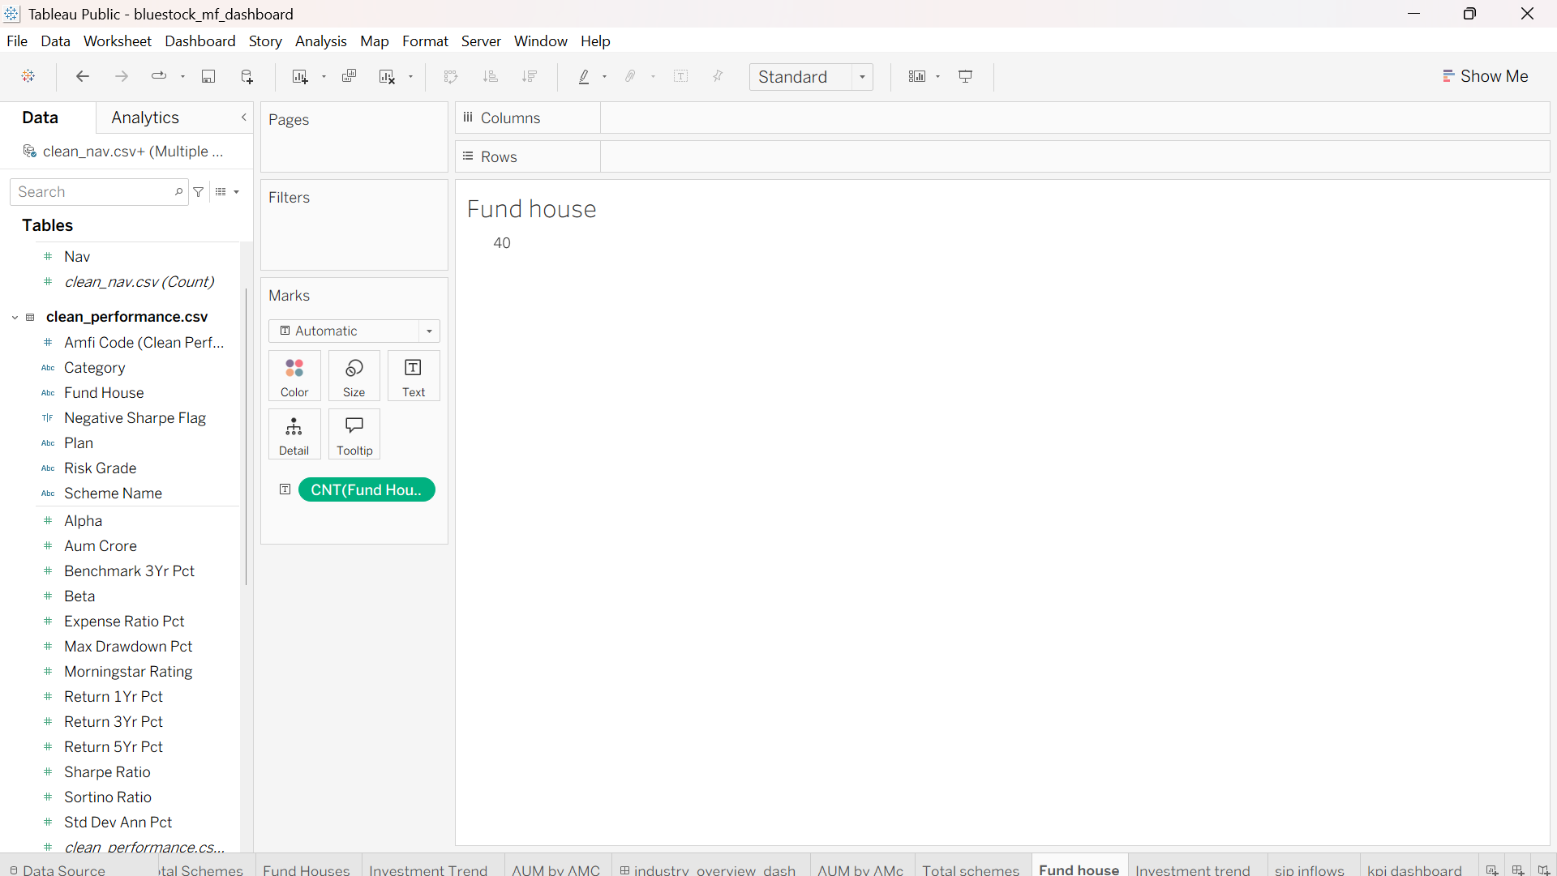

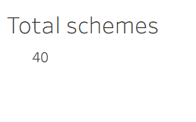
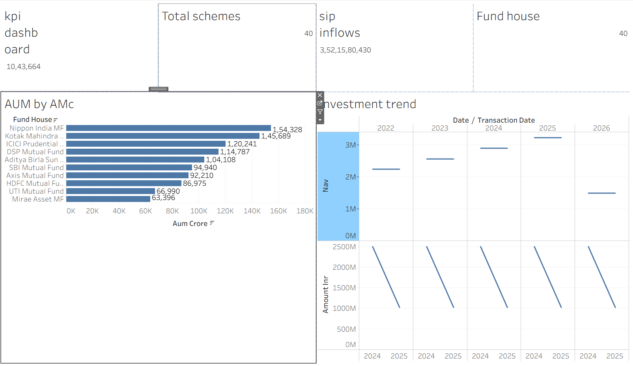
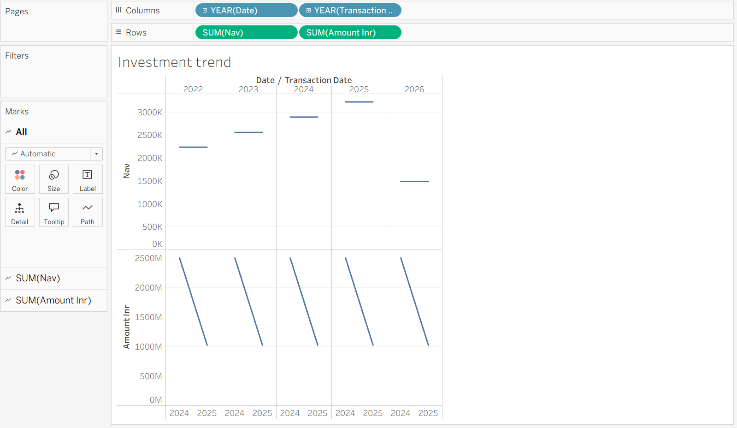
Dashboard Visualizations

Slide 10
Dashboard Insights
Major Insights Generated
SIP participation remained the dominant investment mode.
Leading AMCs controlled a significant portion of total AUM.
Investment trends showed sustained market growth.
Risk-adjusted metrics highlighted high-performing schemes.
Investor participation continued to expand across categories

Slide 11
Recommendations
For Investors
Focus on risk-adjusted returns rather than returns alone.
Maintain SIP continuity for long-term wealth creation.
Diversify investments across fund categories.
For Asset Management Companies
Improve investor engagement to reduce SIP discontinuation.
Promote direct plans for cost-conscious investors.
Use analytics-driven insights for product positioning.
Future Enhancements
Real-time market data integration
Machine Learning-based fund recommendations
Predictive investor churn analysis

Slide 12
Conclusion & Thank You
Project Conclusion
Successfully built an end-to-end Mutual Fund Analytics solution.
Performed ETL, EDA, performance analysis, and advanced risk analytics.
Developed interactive Tableau dashboards for business reporting.
Generated actionable insights into fund performance and investor behavior.

Slide 13
Skills Applied
Skills Applied
Python
Pandas
Data Analytics
Tableau
Business Intelligence
GitHub Version Control
Thank You

