Slide 1

Methadone Case Study
Marc Brooks, Bo Liu, Shirley Mathur, Aasha Reddy

Slide 2
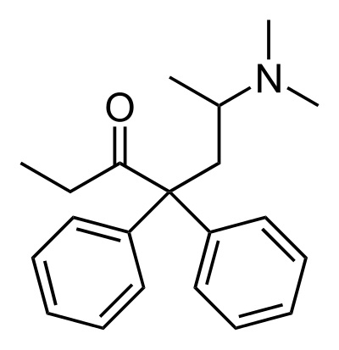
Methadone
Methadone is an opioid medication
Reduces withdrawal symptoms in people addicted to heroin or other narcotic drugs without causing the "high" associated with the drug addiction
Often used as part of drug addiction detoxification and maintenance programs

Slide 3
Data Cleaning Assumptions
Delete observations with missing ppm
Delete levels of mgstr that are not 5, 10, 40
Delete year = 1969
Combine all websites as "internet" for source variable

Slide 4
Exploratory Data Analysis

Slide 5
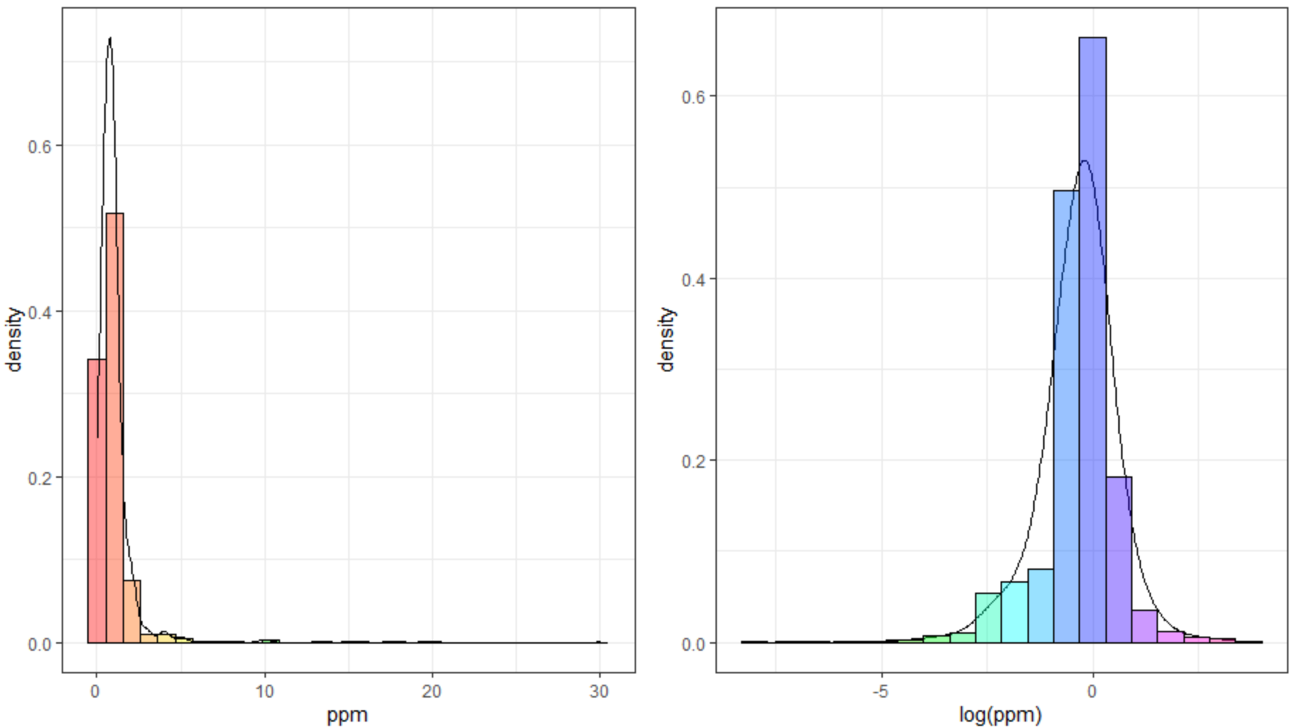
Log Transformation of PPM

Slide 6
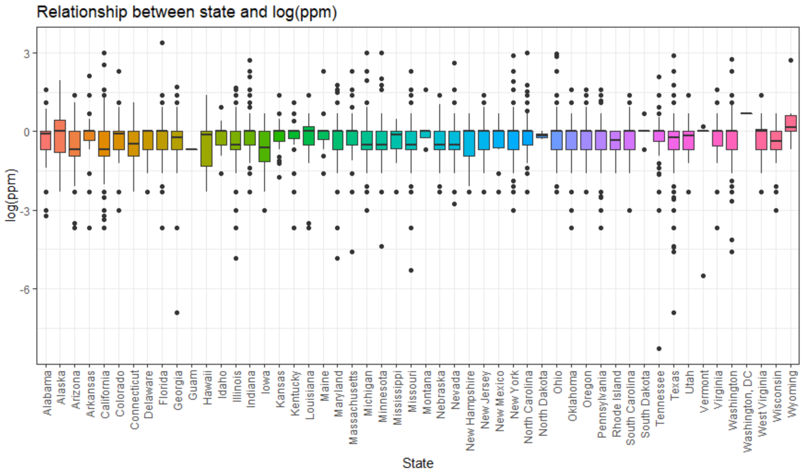
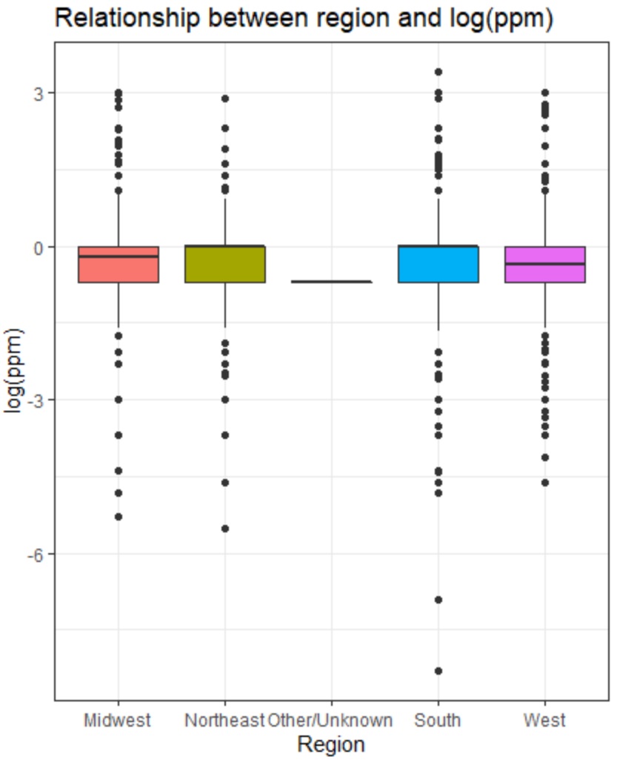
Grouping Variable: State

Slide 7
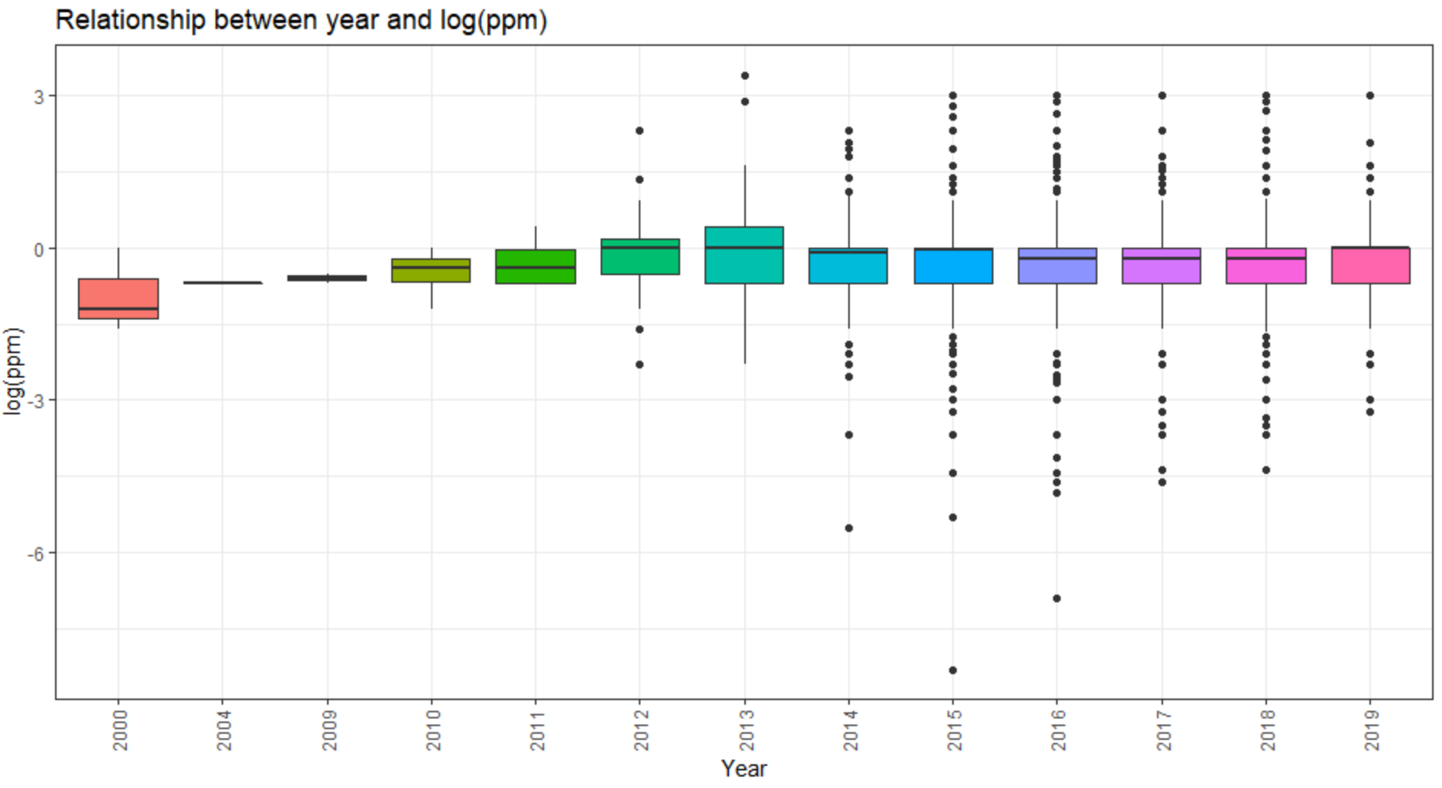
Fixed Effects: Year

Slide 8
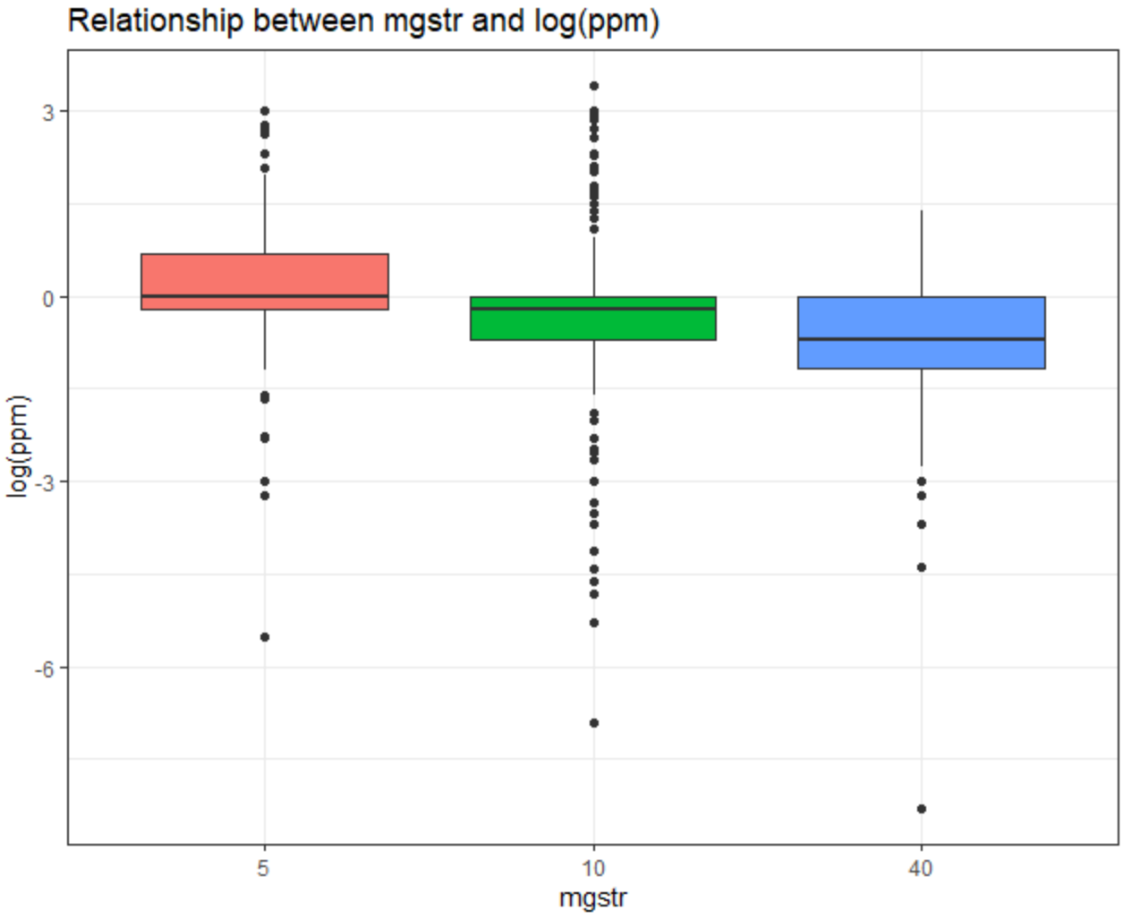
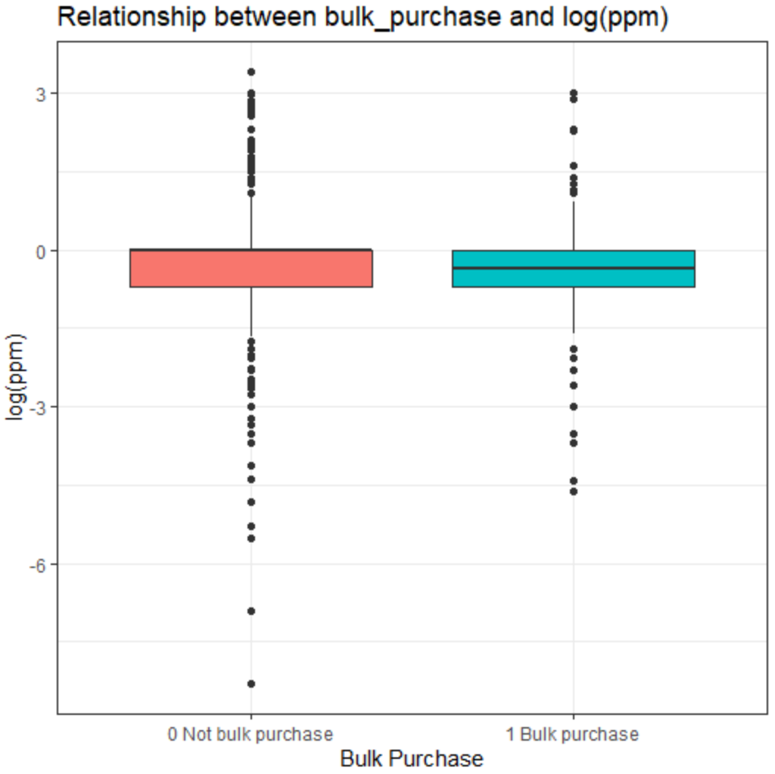
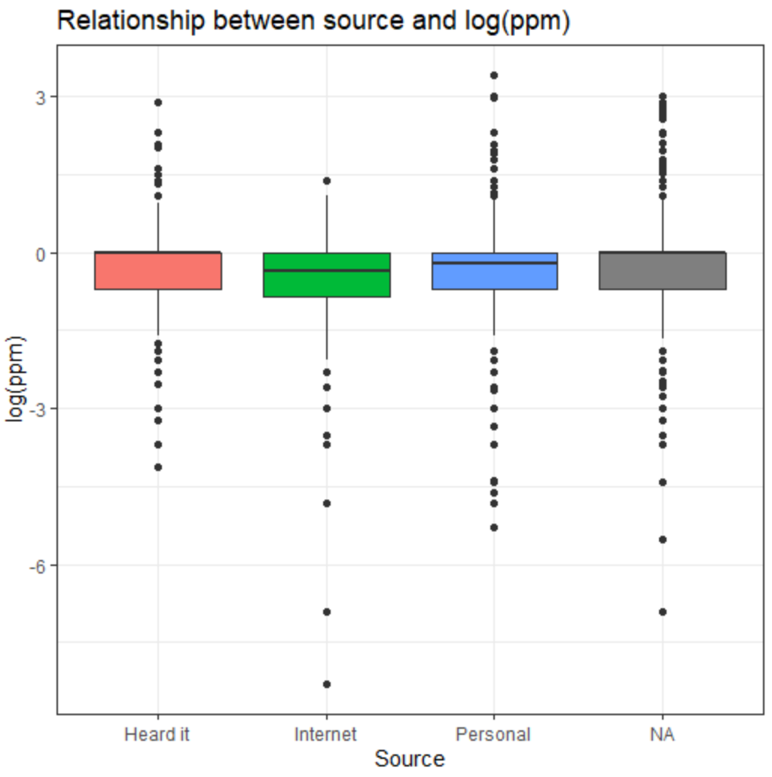
Fixed Effects: MGSTR, Bulk_Purchase, Source

Slide 9
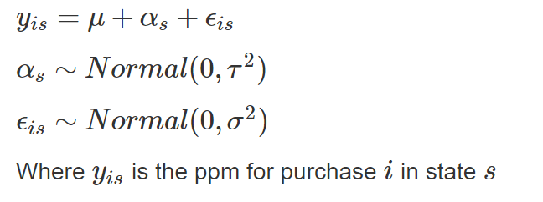
Modeling
We start with the baseline model below and do exhaustive search using BIC to add fixed effects
Choose from the following fixed effects based on EDA: year, mgstr, bulk_purchase, and source
No interaction terms based on EDA

Slide 10
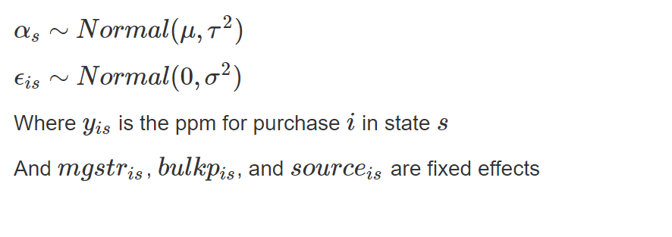
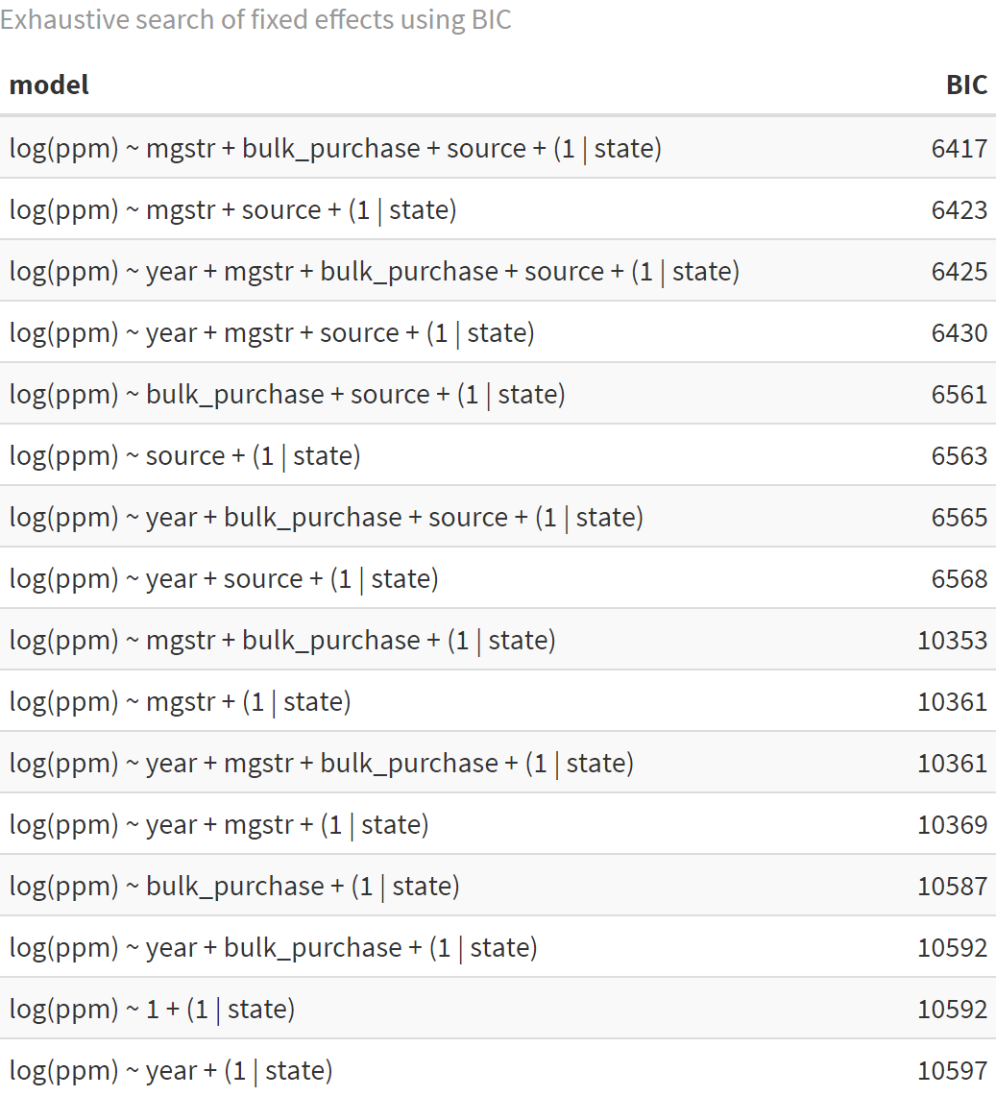
Final Model
Based on exhaustive search, we choose the below final model

Slide 11
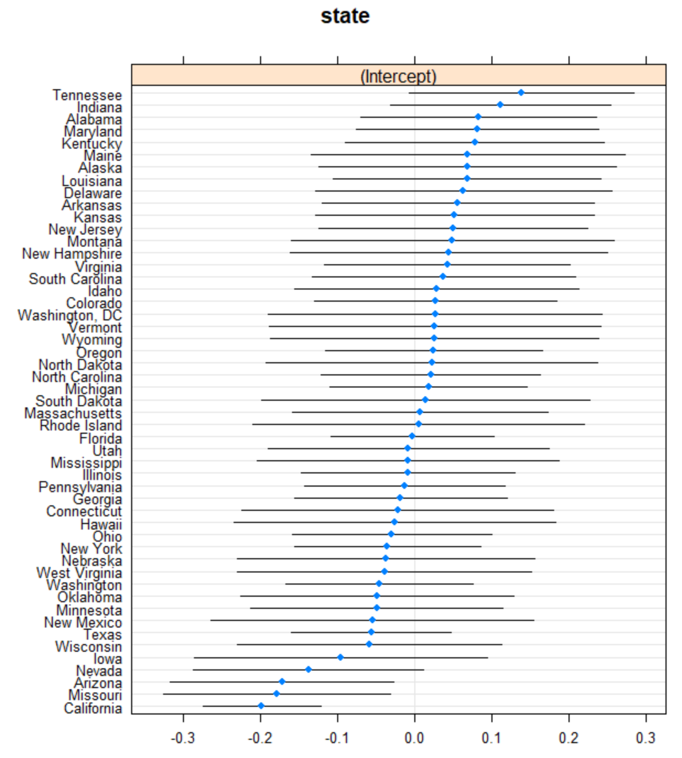
Results: State Ranking
Tennessee has the largest average expected log ppm for Methadone
California has the smallest average expected log ppm for Methadone
Confidence intervals are mostly overlapping

Slide 12
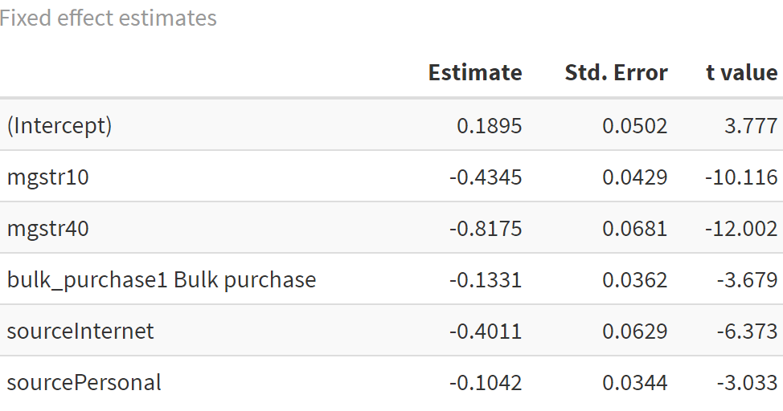
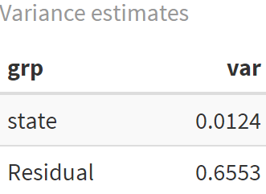
Results: Estimates
Estimate for grand mean of expected log(ppm) is 0.1895
If we decrease the dosage strength from 50 to 10 mg we expect average log(ppm) to decrease by 0.4345
We expect a bulk purchase to decrease expected log(ppm) by 0.1331
We expect a personal purchase to decrease expected log(ppm) by 0.1042 vs. someone who heard of the purchase
Across-group variance = 0.0131 > within-group variance = 0.6719 so there is still much within-group variation that our model does not explain

Slide 13
Appendix

Slide 14
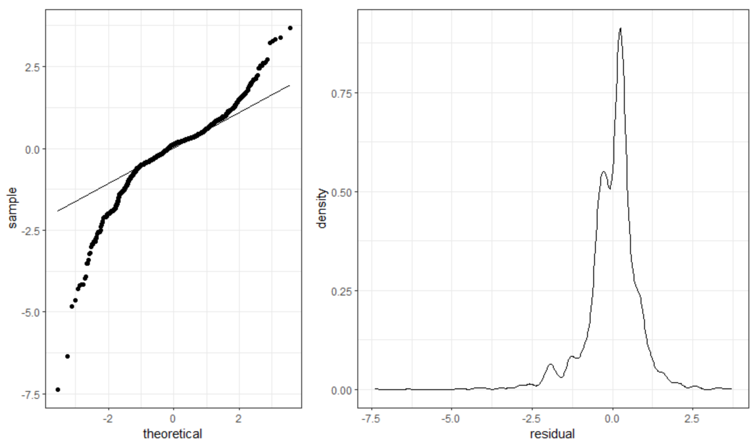
Assumption Check

