Slide 1

Large Language Model (LLM) Building a News Research Tool
Asha Sandeep
Noida
Digicrome Academy
Submission Date: 15th Feb 2025

Slide 2
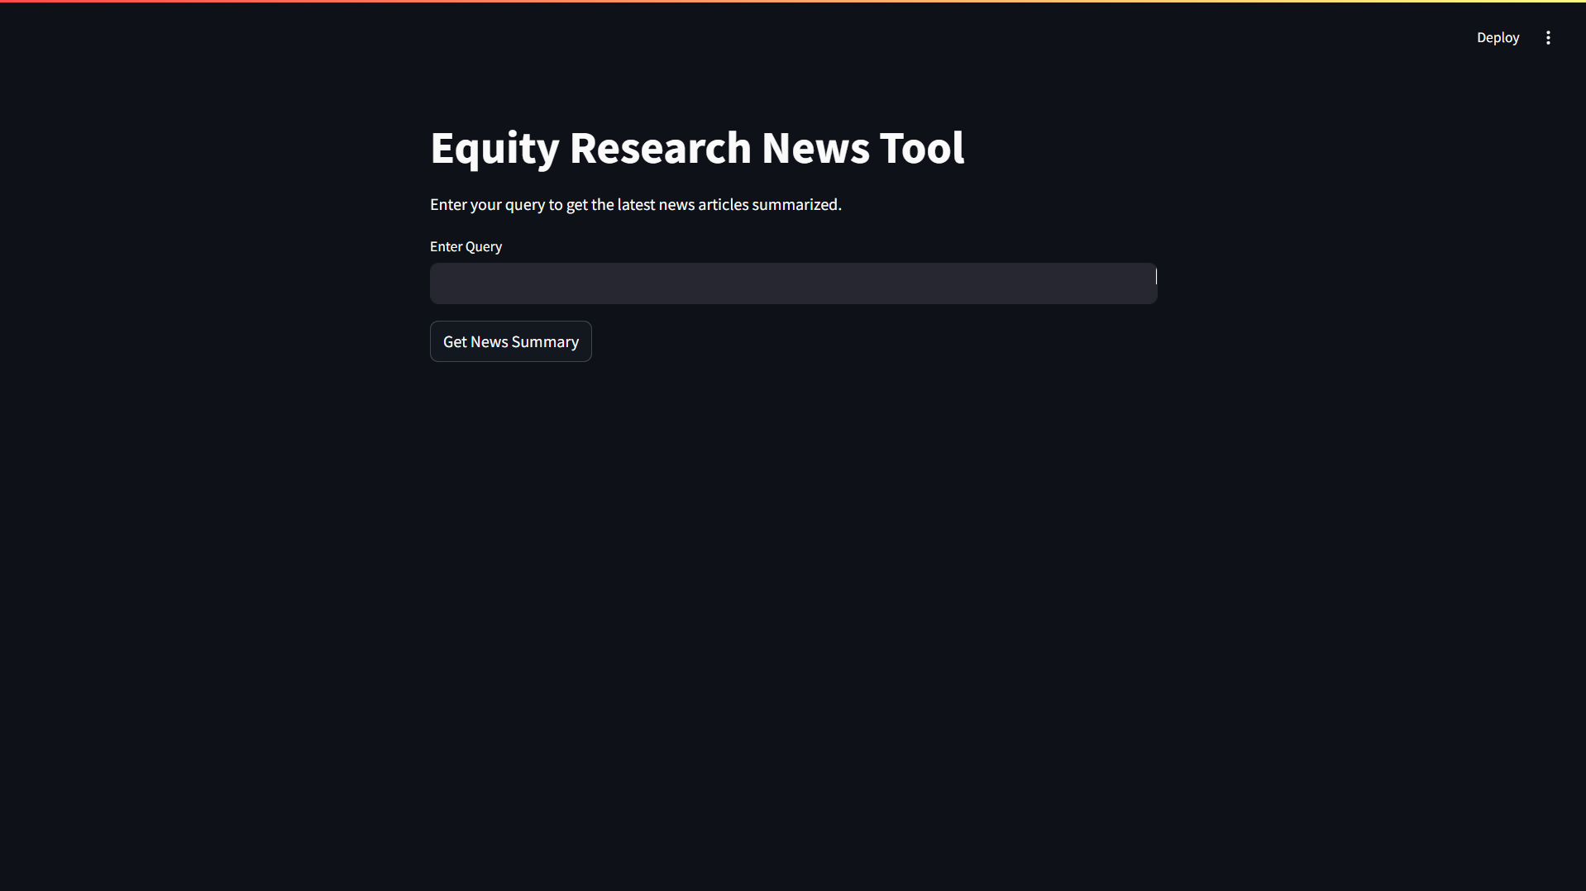
Objective : This project is a tool for summarizing news articles using groq api language models.

Slide 3
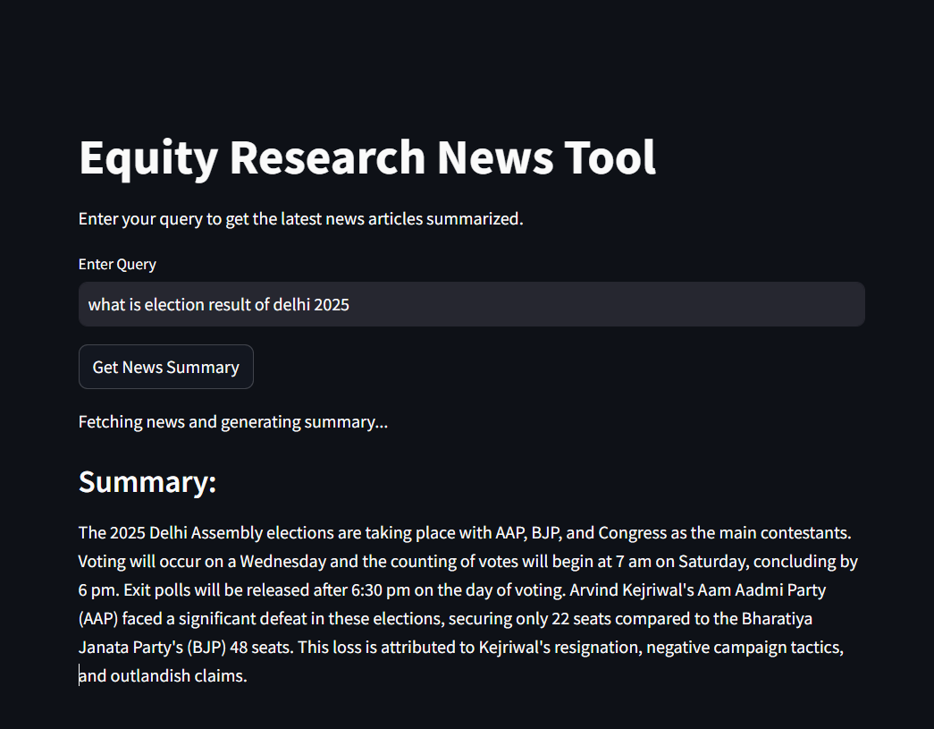
This is my Streamlit code. After running the langchain_config.py file, I ran the app.py file in Streamlit and obtained both the local and network URLs.

Slide 4
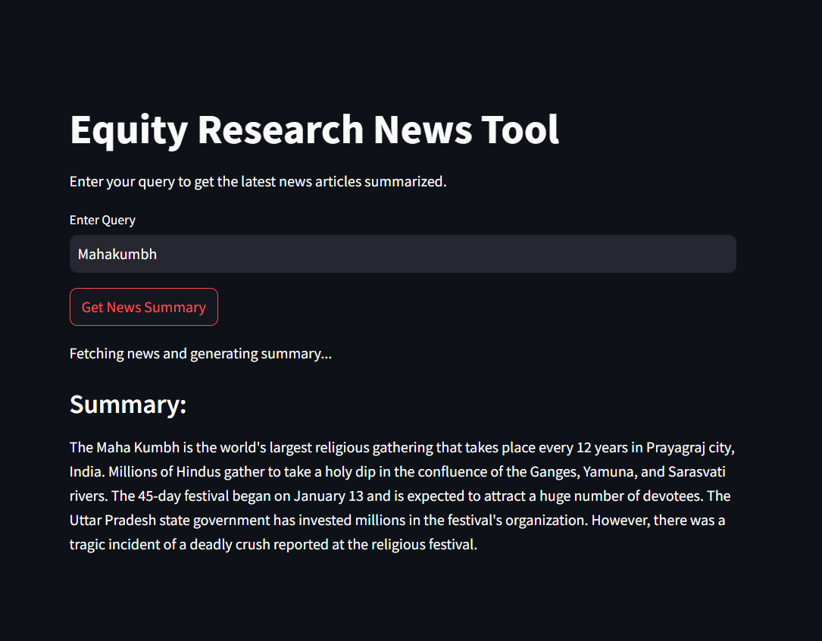
Once again, I tried to write something and entered 'latest news,' and here is the result.

Slide 5
This app is working now on local host url and Network url as well .
http://localhost:8501

Slide 6
Methodology
Components Used:
✅ LLM (Language Model): [Groq_api, News_api]
✅ Prompt Templates: Predefined text prompts to guide responses
✅ Chains: Sequence of operations performed on user input.

Slide 7
Challenged faced
✅1.API Rate Limits – News APIs often have restrictions on free-tier access, limiting data retrieval
✅2.Performance Optimization – Slow response time when processing large volumes of data
✅ 3. Data Quality & Inconsistencies – Different news sources may provide duplicate, biased, or conflicting information, requiring extra filtering and validation.
✅ 4. Real-time Data Handling – Ensuring timely news updates can be challenging, especially with API delays or data latency issues.
✅ 5. Data Preprocessing Complexity – Extracting meaningful insights from unstructured news data (titles, body, metadata) requires text cleaning, tokenization, and NLP techniques.
✅ 6. Cost Constraints – Paid APIs with higher rate limits and better features can be expensive for large-scale use.

Slide 8
Solution
✅ Caching & Rate Limit Handling – Implemented caching techniques to optimize API usage and reduce dependency on real-time calls.
✅ Parallel Processing – Implemented multiprocessing to improve data retrieval speed.
✅ Duplicate Removal – Use hashing techniques (MD5, SHA-256) or similarity measures (TF-IDF, cosine similarity) to identify duplicate articles.
✅ Web Scraping as Backup – If API delays occur, integrate web scrapers (e.g., BeautifulSoup, Scrapy) to fetch news from alternative sources.
✅Sentiment Analysis – Implement VADER (for short texts), TextBlob, or BERT-based models to classify news as positive, negative, or neutral.
✅Use API Rate-Limiting Strategies – Implement adaptive request timing (e.g., exponential backoff) to avoid hitting limits too quickly.
✅We use Groq api which is totally free.

Slide 9
Conclusion for Equity News Research Tool (Using Groq API)
✅ 1. Faster & More Efficient News Processing
Leveraged Groq API to fetch, process, and analyze equity market news with high-speed performance.
✅ 2. AI-Powered News Analysis
Utilized Groq’s advanced AI models to extract key insights, perform sentiment analysis, and summarize financial news.
✅ 3. Optimized API Performance & Cost Management
Managed API rate limits effectively, ensuring smooth data retrieval without excessive costs.
✅ 4. Real-Time Market Intelligence
Enabled instant tracking of stock-related news, helping investors stay ahead of market trends.

Slide 10
Thank You

