Slide 1
Railway Reservation System
C++/SQL
Name: Aashay Shah
Year/Branch: TY Comps
Roll No: 1711047

Slide 2
ACKNOWLEDGEMENT
I am using this opportunity to express my gratitude to Prof Vaibhav Chunekar and Prof Anagha Raich of the IT Department for their aspiring guidance, constructive criticism and friendly advice during this project work. I am sincerely grateful to them for sharing their truthful and illuminating views on this project.

Slide 3
INTRODUCTION
This project introduces railway reservation system. It explains how reservation is being done in the Indian Railways. The project is developed using C++ language and MYSQL database for backend purposes. Amost all the header files have been used Various functions and structures are used to make complete use of this language. Railway Reservation can be easily accompanied with the help of this project.

Slide 4
OBJECTIVE
Develop a simple console application for Railway Reservation System for user authentication, ticket reservation, ticket cancellation and booking enquiry using C++ and database connectivity thereby allowing admin to view the passenger list of any train.

Slide 5
SOFTWARE USED
Frontend: CodeBlocks (C++)
Backend: PHPmyadmin (SQL)

Slide 6
MODULES
We analyse and conclude that the project can be classified into 5 different modules
User Authentication
Ticket Reservation
Ticket Cancellation
Booking Enquiry
Passenger Details

Slide 7
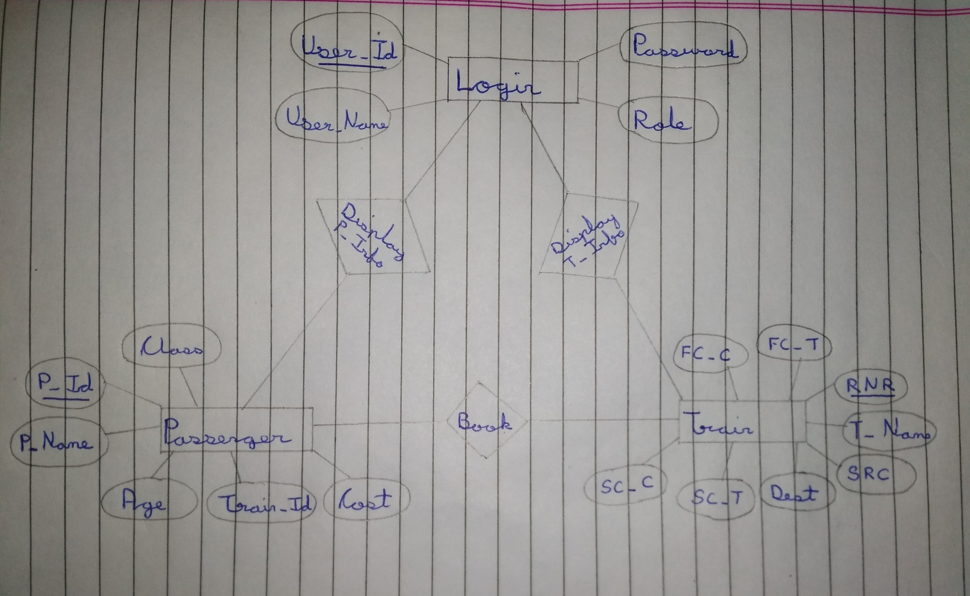
ER Model

Slide 8
C++/SQL Connectivity
The connectivity between C++ and mySQL requires various softwares like Dev-cpp, Xampp, Codeblocks and various header files.
The following link gives a complete explanation of the connectivity:
https://youtu.be/siQCWPxDtMo

Slide 9
C++ Header Files
Iostream: Standard Input/Output Stream Library
Fstream: I/O Stream to operate on Files
Sstream: Stream class to operate on Strings
String: To manipulate Strings and Arrays
Cstdlib: Standard General Utilities Library
Windows.h: Window specific header file which contains declaration of all functions in Windows
Mysql.h: Used for connecting C++ with SQL and perform various operations involving use of database

Slide 10
Thank you

