Slide 1
Project final report Credit Card Fraud Detection Group 9

Slide 2
Introduction:
This research uses a variety of machine learning algorithms to create an efficient model for detecting credit card fraud.
Various models such as Artificial Neural Network, Gradient Boosting, Decision Tree, and Logistic Regression are utilized, each offering distinct perspectives.
Caution signals are encountered in Logistic Regression, but rpart and rpart.plot packages enable Decision Tree visualization.
Gradient Boosting using gbm performs exceptionally well in fraud detection, as measured by the pROC library, with an impressive Area Under the Curve (AUC) of 0.9541.

Slide 3
Project Background:
This study was driven by the goal of using machine learning techniques to detect credit card fraud.
A range of methods, including Decision Trees, Gradient Boosting, Artificial Neural Networks, and Logistic Regression, were used to determine how well they could detect fraudulent transactions.
The goal of this project was to create a solid model that would improve financial systems' fraud detection capabilities.

Slide 4
Data Description:
The dataset spans a comprehensive two-year duration, commencing from January 2019 through December 2020. This extensive timeframe allows for a thorough examination of credit card usage trends and patterns over a significant period.
Encompassing interactions between 1000 customers and 800 distinct merchants, this dataset offers a wide-ranging view of consumer behavior and transactional diversity. It reflects the intricate dynamics of financial interactions across various merchants.
Notably, the dataset includes both legitimate and fraudulent transactions. This incorporation of fraudulent activities presents a valuable opportunity to discern patterns unique to fraudulent behavior, facilitating the development of sophisticated fraud detection models.
Featuring an extensive array of attributes encompassing customer demographics, transaction specifics (such as amounts, timestamps, and merchant identifiers), geographical information, and a significant fraud indicator for model development, this dataset provides a comprehensive foundation for training meticulous fraud detection models using the R programming language.

Slide 5
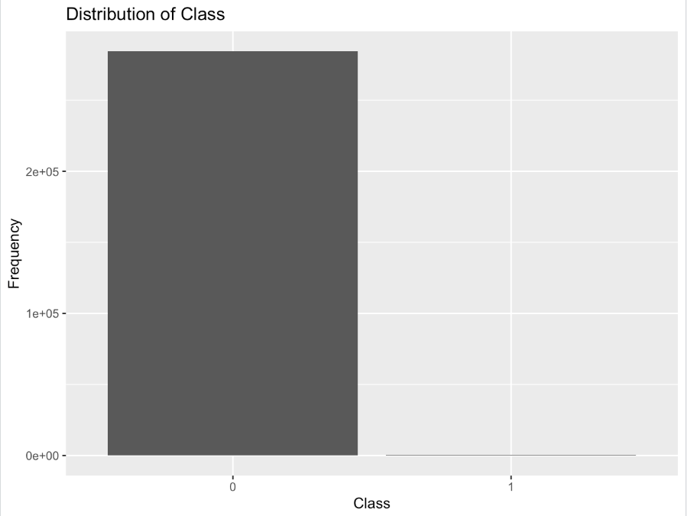
Exploratory Data Analysis
In our Credit Card Fraud Analysis project, we've used R to dissect our dataset through visualizations and statistical tools.
Our first step was understanding the distribution of fraud and non-fraud transactions through a simple bar plot of the 'Class' variable.
This chart revealed the frequency of each transaction type, giving us a fundamental grasp of our dataset's composition.

Slide 6
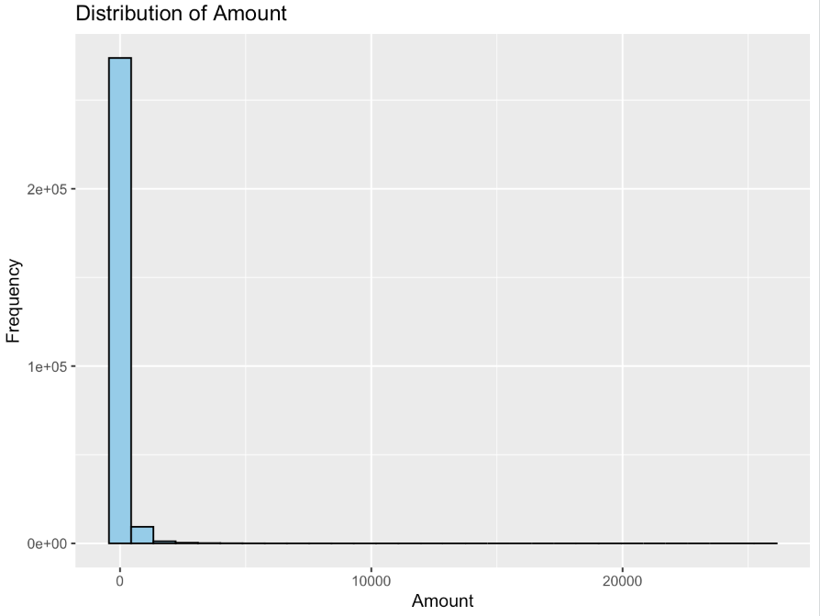
Exploratory Data Analysis
Here, we delved deeper into transaction amounts by creating a histogram with thirty bins.
This visualization helped us grasp the spread and frequency of different transaction values.
It hinted at potential outliers or irregular patterns within these amounts, providing a closer look at this crucial aspect of our data.

Slide 7
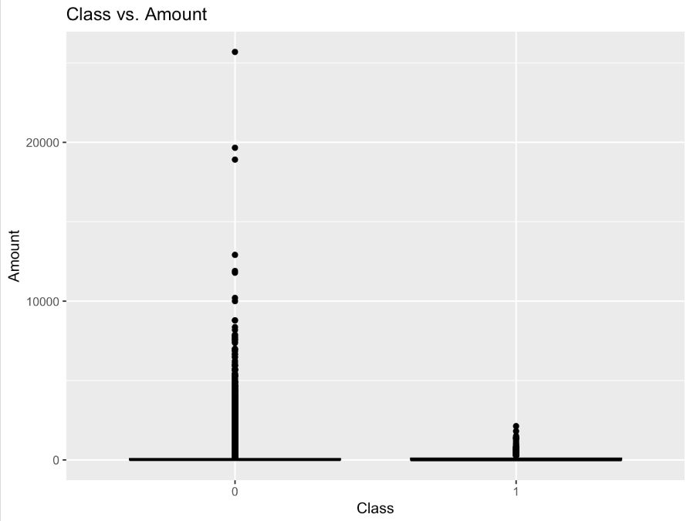
Exploratory Data Analysis
We then explored the relationship between transaction amounts and the 'Class' variable, seeking patterns specific to fraudulent and legitimate transactions.
Using a boxplot, we aimed to spot any significant differences in transaction amounts between the two classes.
This visual aid allowed us to discern potential correlations between transaction values and the likelihood of fraud.

Slide 8
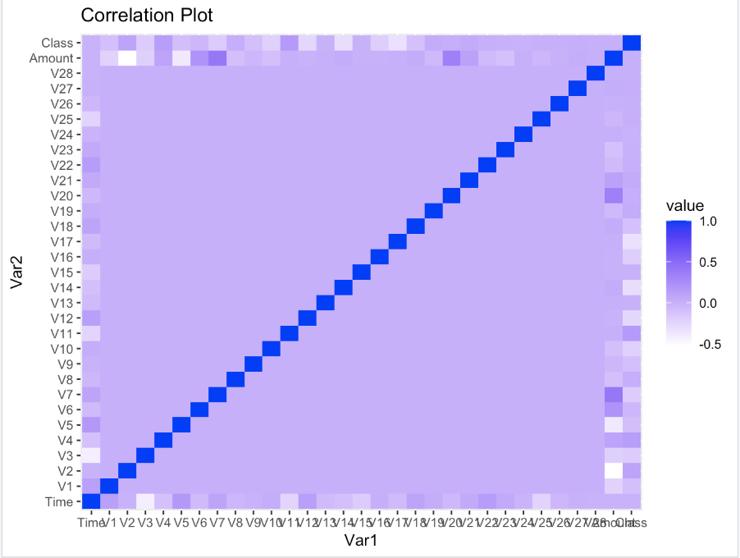
Exploratory Data Analysis
Our final analysis involved investigating correlations between various numeric attributes in the dataset.
Through a correlation matrix transformed into a heatmap, we visualized the interdependencies between these attributes.
This visualization method provided insights into how different variables related to each other, offering potential clues or predictors linked to fraudulent activities.
These steps have been pivotal in unraveling the intricate details of credit card transactions and aiding in our pursuit of data-driven fraud detection strategies.

Slide 9
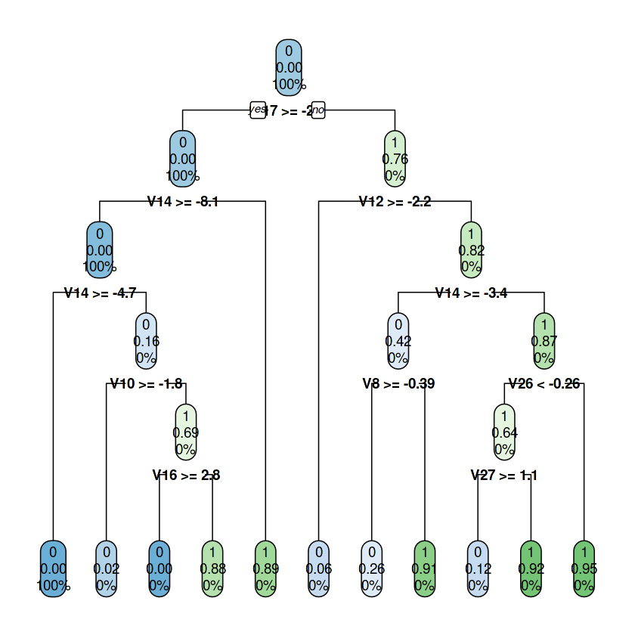
BI Model :
Despite its initial insights, Logistic Regression encountered issues with fitted probabilities, signaling potential convergence problems. Concerns about stability in predicting fraud arose due to this issue, prompting a reevaluation of its reliability in detecting fraudulent activities.
Utilizing rpart and rpart.plot libraries, the Decision Tree model was visually represented, facilitating a comprehensive understanding of its decision-making process. This visualization enhanced interpretability, laying a transparent foundation for fraud detection methodologies.
Gradient Boosting emerged as a standout performer among the models, boasting an exceptional AUC of 0.9541. The meticulous evaluation through the pROC library reaffirmed its robustness in identifying fraudulent transactions.

Slide 10
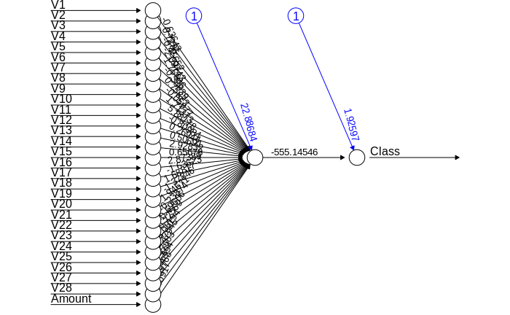
Artificial Neural Network
The development of an intricate ANN model highlighted their capacity to discern complex patterns within transactional data.
The exceptional performance of Gradient Boosting underscored its potential as a vital component in our financial systems to combat fraudulent activities.
This highlighted the importance of in-depth analysis and refinement of models, signaling a promising direction to fortify our credit card fraud detection systems and enhance security within the financial landscape.

Slide 11
Findings:
Despite Logistic Regression's struggles, the Decision Tree visualization offered valuable explanations. It provided alternative insights, enhancing our understanding of the data and contributing unique perspectives to our analysis.
However, the Gradient Boosting model, displaying exceptional performance with an impressive AUC score of 0.9541. This high score indicates its effectiveness in spotting fraudulent activities within credit card transactions reliably.
This project holds importance for financial institutions and online businesses handling transactions. Detecting fraud is crucial for maintaining trust and financial integrity. Our use of machine learning offers a practical way to uncover suspicious patterns, making transactions safer..

Slide 12
Conclusion:
The experiment made it clear how important it is to use a variety of machine learning algorithms when detecting credit card fraud.
Gradient Boosting proved to be a potent model with a high AUC, while Logistic Regression displayed warnings and Decision Tree visualization improved interpretability.
Using the knowledge, managers may want to think about using Gradient Boosting as a strong fraud detection method in financial systems to increase security and reduce fraudulent activity.

Slide 13
Thank you

