Slide 1
E-voting
-Aashay Garg
(F2018A7PS0004P)

Slide 2
E-voting
Electronic voting increases election reliability when compared to manual polling
Most procedures are now are centralized, licensed by the critical authority, controlled, measured, and monitored in an electronic voting system, which is a problem for a transparent voting process in and of itself

Slide 3
The application aims to build a scalable, cost-effective transparent and secure platform for voting

Slide 4
Blockchain
Blockchain is an appealing alternative to conventional electronic voting systems with features such as decentralization, non-repudiation, and security protection
Efforts such as utilizing blockchain technology to secure and rectify elections have recently received much attention

Slide 5
The Application

Slide 6
The application
The application makes use of the ethereum blockchain network to ensure transparency while being highly scalable and secure
The application has been built with the use of javascript to ensure a smooth UI

Slide 7
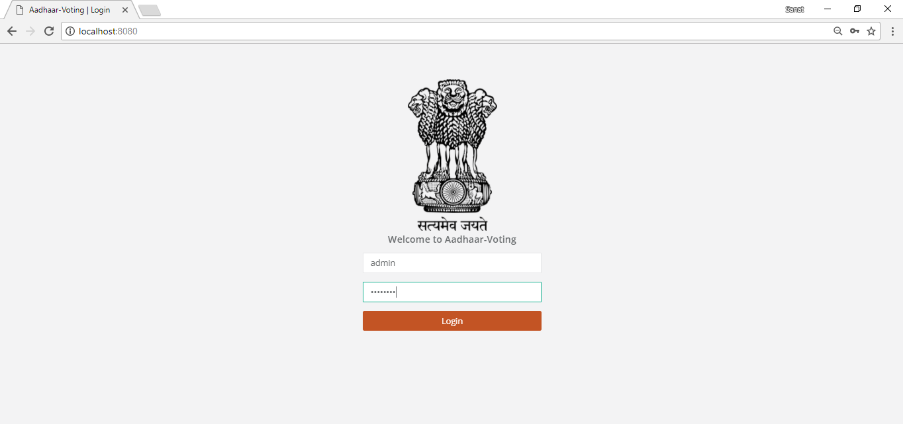
Logging in
The Aadhaar based voting system is developed to overcome the flaws of EVM system.
The authority must login first with the provided session ID.

Slide 8
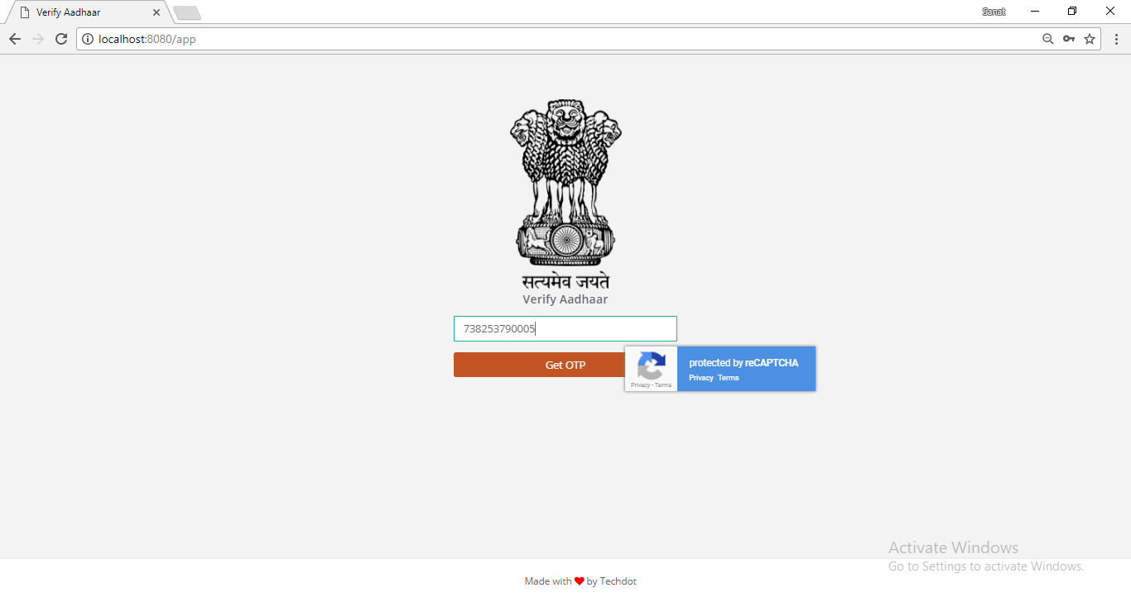
One time Authentication
The voter can now begin the process of voting with proper authentication through OTP(one time password) on the respective linked mobile number.

Slide 9
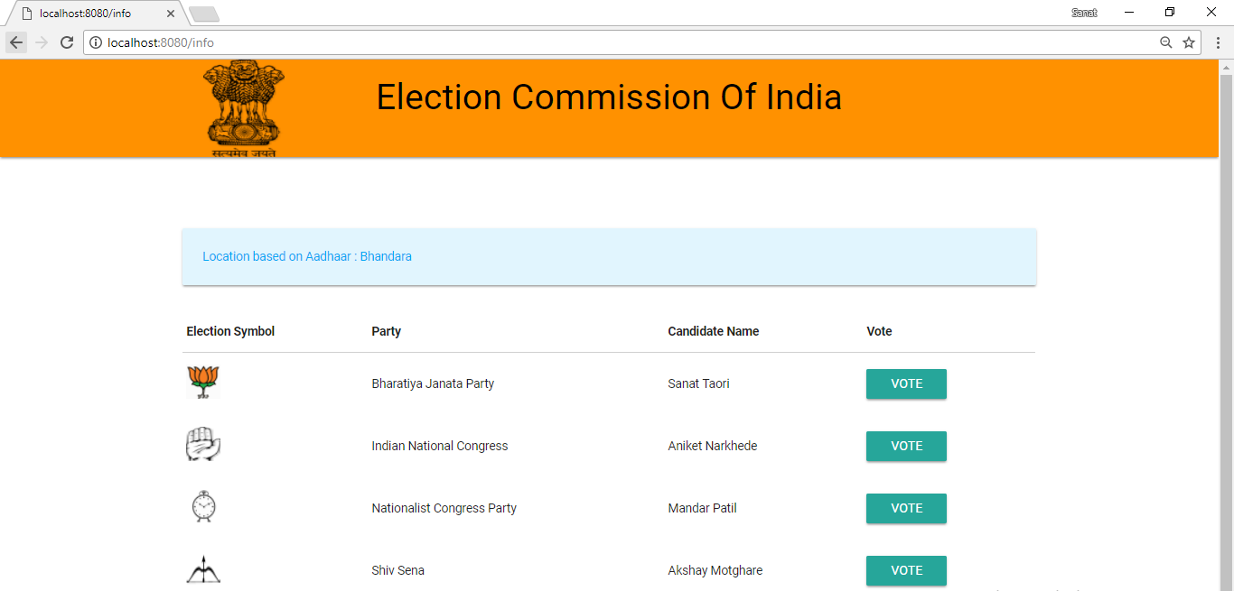
One time Authentication
If the voter is valid then the system will check for for the voters age and the address to which he can give vote. The voting pallete will be opened with candidate names, their parties and logos.

Slide 10
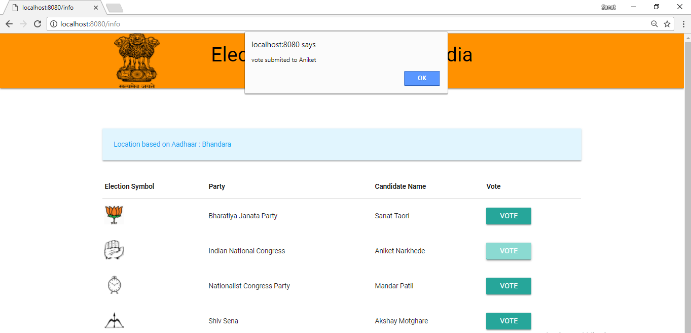
One time Authentication
One voter can vote only once, i.e after one time voting buttons are disabled and the vote is automatically logged out.

Slide 11
Voting
The results can be verified through the created smart contract, only by the owner of the particular application
The votes can be tallied and displayed to everybody for transparency

Slide 12
THE PROCESS IS EASY
AUTHENTICATE
VOTE
TALLY
Authenticate yourself using your aadhaar and OTP
Vote the candidate of your choice in a secure and confidential manner ensuring transparency of results
Tally the results as an admin, in a transparent manner

Slide 13
Conclusions
Electronic voting systems should initially be implemented in limited pilot areas before being expanded
Many security flaws still exist in the internet and polling machines

Slide 14

THANKS!

