Slide 1



Feature-Driven RUL Forecasting for Lithium-Ion Batteries Using dQ/dV Analysis
By Aashi Chatterjee
AICTE Internship ID: INTERNSHIP_175683301568b724f7b9fba

Slide 2

Learning Objectives
Understand the EV battery domain: including how lithium-ion batteries degrade, why RUL matters, and what real-world challenges EV systems face.
Identify and define a meaningful problem statement: by analyzing gaps in battery health monitoring and selecting a research-worthy challenge.
Translate the problem into a machine learning direction: by selecting relevant health indicators (like dQ/dV) and designing an appropriate model approach.
Implement and evaluate an ML solution: using feature engineering, time-series modeling, and validation metrics to test the problem statement in practice.
GOAL
Source :
www.freepik.com/

Slide 3







Tools and Technology used
Jupyter Notebooks/Python: Primary environment for data exploration, feature engineering, and model training.
Pandas/NumPy and TensorFlow/Keras: Core libraries for data manipulation, numerical operations on battery data and the deep learning framework used to build and train the prediction model.
Scikit-learn: Used for data splitting, scaling, and general machine learning utilities.
Ollama: Local large language model (LLM) serving platform used to host the chatbot.
Streamlit: Python framework used to build and deploy the interactive web-based frontend/dashboard.
Requests: Python library used for communication between the Streamlit frontend and the Ollama API backend.

Slide 4
Methodology
Data Acquisition & Preprocessing: Collect raw Li-ion battery cycling data and clean it using filtering, smoothing, and alignment techniques to prepare for feature extraction.
Feature Engineering (dQ/dV Analysis): Transform the noisy charge/discharge curves into physics-based, degradation-sensitive dQ/dV feature vectors using interpolation and Savitzky-Golay signal processing.
Model Selection & Architecture Design: A sequence-learning approach was chosen, and a BiLSTM model was configured to effectively capture and utilize long-term, bidirectional dependencies in the dQ/dV sequences for trend forecasting.
Model Training & Validation: The BiLSTM was trained on the dQ/dV sequences and rigorously evaluated on unseen data using the RMSE (capacity accuracy) and RUL error (lifetime accuracy) to ensure robust predictive performance.
Result Interpretation & Constraint Verification: Prediction behavior was analyzed and integrated into an LLM-supported conversational layer to interpret results and formally validate that explanations adhere strictly to defined project constraints.

Slide 5
Problem Statement:
Solution:
1. The central challenge in predicting the Remaining Useful Life (RUL) of Lithium-ion batteries lies in accurately modeling the non-linear, temporal decay inherent in the data.
2. Current data-driven RUL forecasting methods often suffer from reliance on noisy capacity data, creating a need for a more chemically informed approach.
3. There is a need for a deployable RUL prediction system that provides reliable real-time forecasts and explains its decisions in simple natural language, making it accessible to engineers without deep technical expertise.
1. This project addresses this by establishing a robust RUL prediction framework that leverages the physical insights derived from dQ/dV curve features to train a predictive model with superior generalization capability.
2. From there, we develop and validate a BiLSTM deep learning model that uses sequence-based dQ/dV feature analysis to achieve a more precise and earlier RUL forecast than traditional methods.
3. We then introduce an intelligent RUL prediction system supported by an LLM-powered chatbot that explains battery health and model behavior in simple, on-demand language for non-experts.

Slide 6
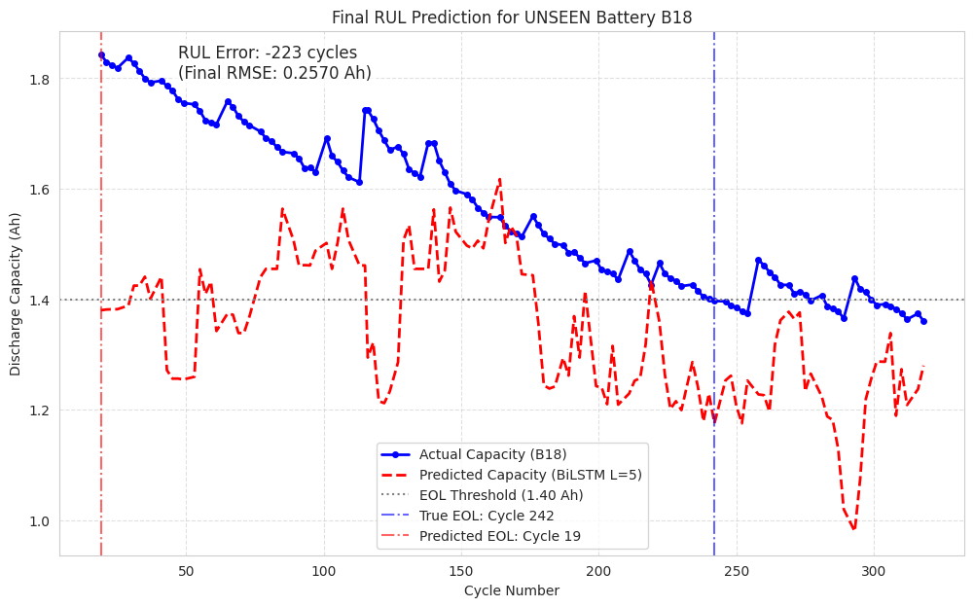
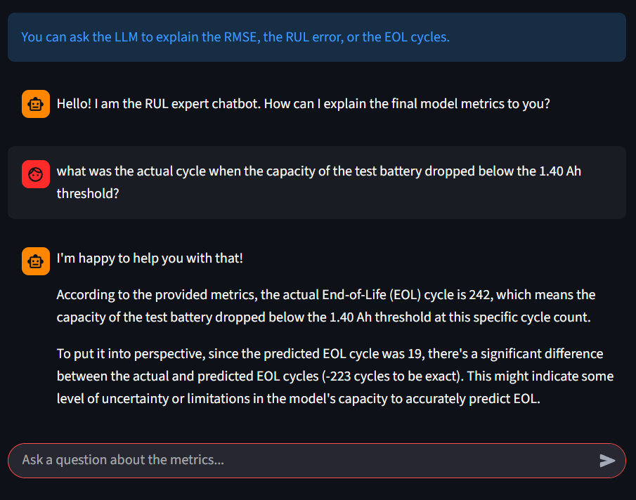
Screenshot of Output:

Slide 7
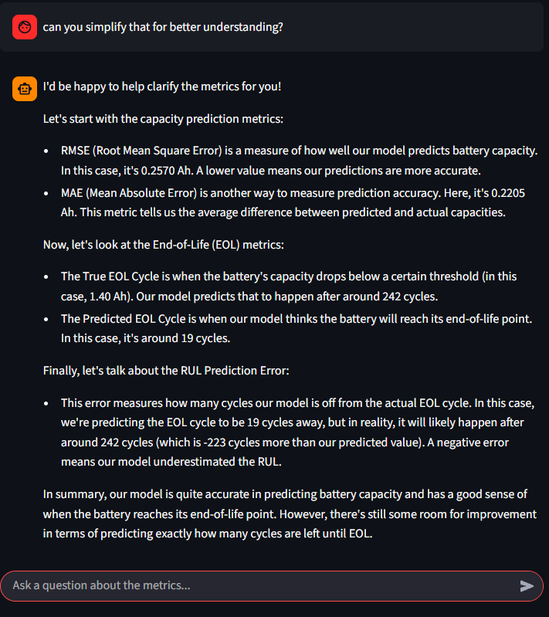
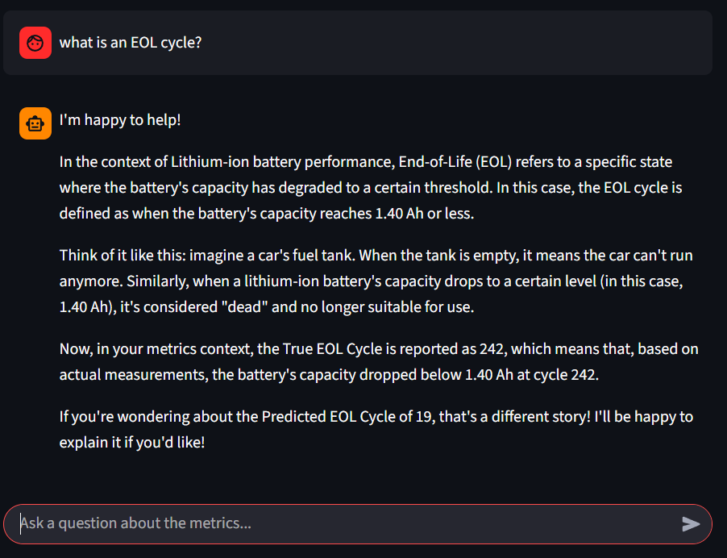

Slide 8
Limitations:
Future Work:
Model trained only on a small, homogeneous NASA dataset (single chemistry + controlled conditions), restricting generalization to other cell types, temperatures, C-rates, or manufacturers.
Despite low short-term RMSE (~0.03 Ah), the model shows a strong pessimistic RUL bias (-223 cycles), failing to capture late-life non-linear degradation behavior.
The dQ/dV feature is extremely dependent on interpolation and filtering parameters; small changes can distort feature shape and lead to unstable model performance.
The deployed Streamlit model is fixed and cannot learn from new data; any change in battery type or conditions requires manual retraining and system updates
The chatbot depends heavily on constraint prompts; although restricted, it can still be vulnerable to prompt-injection attempts that may cause incorrect or unsafe technical outputs.
Implement transfer learning by Pre-training on large heterogeneous datasets, then fine-tuning on B0005–B0007 to extend applicability across chemistries and conditions.
Combine data-driven predictions with physics/empirical models (e.g., exponential decay) for more stable long-term RUL forecasts.
Use hyperparameter tuning (Grid Search/Optuna) to systematically optimize filtering + interpolation settings for robust feature extraction.
Move to AWS/Azure pipelines that support periodic retraining and dynamic model updates to replace the current static deployment.
Implement a Retrieval-Augmented Generation system so the LLM answers only from a secured database, preventing prompt-injection issues.

Slide 9
Conclusion:
The dQ/dV-based approach successfully captured battery degradation, linking electrochemical behavior to capacity fade.
The BiLSTM handled sequential patterns well, achieving a strong validation RMSE of ~0.03 Ah.
On unseen B18 data, the model achieved a final capacity RMSE of 0.2570 Ah, demonstrating practical predictive capability.
A Streamlit + LLM chatbot was deployed, enabling clear, constrained, non-technical explanations of model outputs.
Future work includes Transfer Learning and Hybrid Modeling to reduce long-term RUL bias and improve generalization to broader battery datasets.

