Slide 1
Subject Code -PIS 105
Secure Coding
THAPAR INSTITITUE OF ENGINEERING AND TECHNOLOGY, PATIALA
Security Attacks
Presented To
Dr Ashima Anand
Faculty –CSED TIET Patiala
Presented By
Aashima Madaan & Shreya Gandhi
ME CSE SEM -2

Slide 2
Contents
Introduction to Security Attacks
Categorization of Attacks
Active Vs Passive Attacks
Passive Attacks and Types
Active Attacks
DoS Attack
Significant DoS Attacks and their working
Sloworis Tool
More on security attacks
Summary

Slide 3

What is a Security Attack ?
Any action that compromises the security of information owned by an organization
CNSS Instruction No. 4009 dated 26 April 2010 by Committee on National Security Systems of the United States of America defines an attack as:
“ Any kind of malicious activity that attempts to collect, disrupt, deny, degrade, or destroy information system resources or the information itself.”
An attacker is a person or process that attempts to access resources , data, functions, or other restricted areas of the system or organization without authorization, potentially with malicious intent .Attacker can be an individual or even a group
Example -2022 Cyberattack on Romania.

Slide 4
Categorization of Attacks
Attack can be active or passive
It can be perpetrated by an insider or from outside the organization
  Inside attack -Initiated by an entity inside the security perimeter by an entity that is authorized to access system resources but uses them in a way not approved by those who granted the authorization.
  Outside attack - Initiated from outside the perimeter, by an unauthorized or illegitimate user of the system
Attack can be Physical Attack-Theft or damage of computers or other equipments or Logical Attack that uses software like malwares to force changes in logic that is intended by the intruder

Slide 5
Categorization of Attacks …
Attacks can also be classified according to their origin:
  Conducted using one computer
  Conducted using more computers known as Distributed attack.
A resource (both physical or logical) can have one or more vulnerabilities that can be exploited by a threat that leads an attack and as a result,
  Confidentiality
  Integrity
  Availability of resources may be compromised

Slide 6
Active Vs Passive Attacks

Slide 7
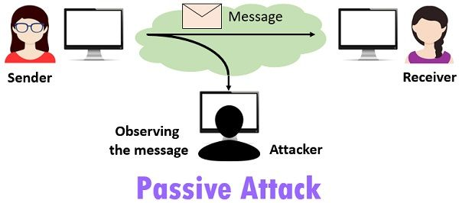
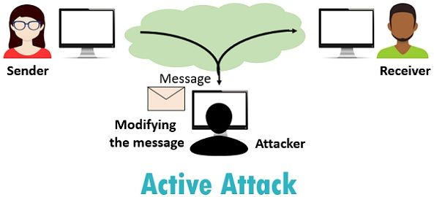
Passive Attacks
Active Attacks
It attempts to learn or make use of information from the system but does not affect system resources
The attack can be active when it attempts to alter system resources or affect their operation
Monitoring and listening to the communication channel by unauthorized entity
Monitoring, listening to and modification of data stream in the communication channel by unauthorized entity
Compromises confidentiality
It compromises integrity or availability

Slide 8
Passive Attacks
An unsecure traffic is observed and looked for clear text passwords and sensitive information, which are being captured by a passive attack and these information can be used in other types of attacks.
The information on the network is not modified or changed in this attack.
Decrypting weakly encrypted traffic, monitoring of unprotected communications, capturing authentication information and traffic analysis are passive attacks.
Hence without the knowledge of the user there occurs a disclosure of information or data files to an attacker.

Slide 9
Types of Passive Attacks
Eavesdropping or monitoring
Camouflage Adversaries
Traffic Analysis

Slide 10
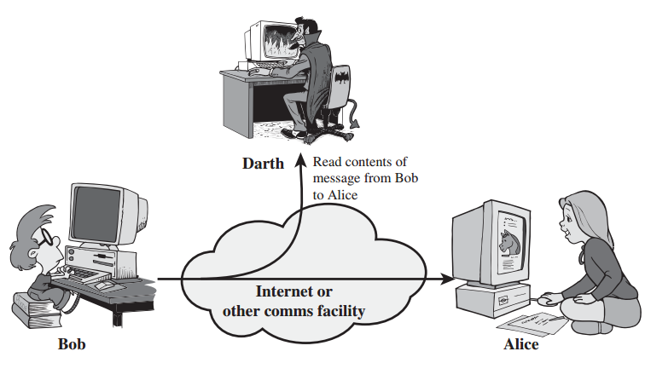
1. Eavesdropping:
Attack against confidentiality .
Commonly happens or done easily in a wireless network as the messages transmitted onto over the links are without any physical control.
Can be avoided easily by encrypting the data that has to be transmitted.
But encryption cannot provide security to the data when attacks occur together with other attack, such as Cryptanalysis (breaking of those secret codes).
This is the most common attack to privacy.
Communication between two or more parties is monitored by an attacker to get possession of the transmitted data.

Slide 11
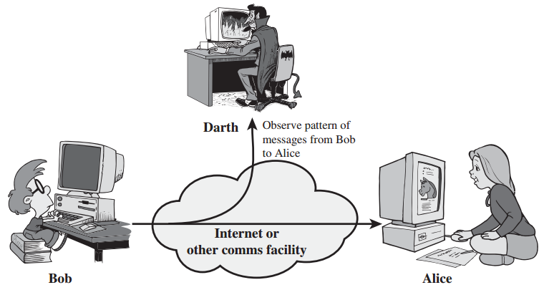
2. Traffic Analysis
Traffic analysis is a serious threat over the network. An attacker can analyse network traffic patterns to infer packet’s content, even though it is encrypted.
Encrypting traffic in most cases only secures the content of the traffic. But an attacker can still obtain some information from it. Like
When and How many messages were sent (frequency) Patterns , host’s identity and doing Advanced Analysis it can be used as base for other attacks

Slide 12
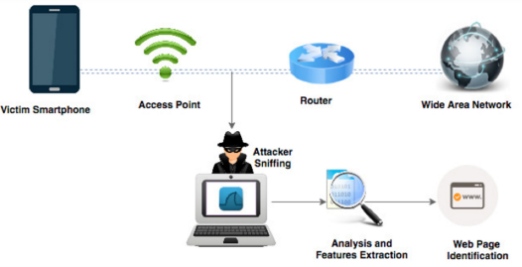
2. Traffic Analysis …..
Paper Title – Traffic Analysis Attack for Identifying Users’ Online Activities
This paper presents a traffic analysis attack to find users’ online smartphone activities.
An attack model is demonstrated that exploits SSL/TLS vulnerabilities to identify visited web pages which is successful against any encrypted tunnel which is performed using only the visible features of encrypted packets exchanged over the network.
Since web applications use client–server architecture, the exchanged packets through the network can be exposed. Passively, an attacker finds traffic patterns by intercepting the flow of the exchange packets. The attack uses timing feature to infer the visited web pages. A huge amount of data is used to train the classifier.
The attacker makes use of the KNN classifier to classify a trace
The proposed method uses the N-fold cross-validation evaluation technique and achieves the accuracy of 96%..

Slide 13
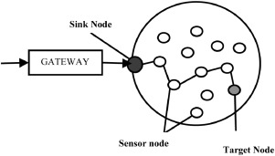
3. Camouflage Adversaries
Sensor node in a WSN is compromised by an adversary or attacker.
This compromised node which is also called as camouflage node of WSN is used to masquerade the rest of the normal sensor node in WSN.
The camouflage node then makes a false advertisement about the routing information in such a way that the further forwarding of packets from other nodes through the compromised node. Once the packets are received they are forwarded to a strategic node
The attacker hides the desired number of nodes in the wireless sensor network and imitates them as a regular node, leading to the packets' misrouting to different communication channels.

Slide 14
Active Attacks
In active attack, an unauthorized attacker monitors, listen to and modifies the data stream in the communication channel.
Here the attackers are no longer passive.
Active measures are taken to achieve control over the network.
Some examples of active attacks are DoS, modification of data, black hole, replay, sinkhole, spoofing, flooding, jamming, overwhelm, wormhole, fabrication, Hello flood, node subversion, lack of cooperation, modification, man-in-middle attack, selective forwarding and false node.

Slide 15
Active Attacks….

Slide 16
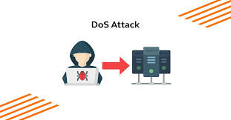
Denial of Service
It is the typical attack against availability
A denial-of-service (DoS) attack occurs when legitimate users are unable to access information systems, devices, or other network resources due to the actions of a malicious cyber threat actor
There are two general forms of DoS attacks: those that crash services and those that flood services.
Denial of Service attacks that crash services are actually more similar to program exploits. Often, these attacks are dependent on a poor implementation by a specific vendor. A buffer overflow exploit gone wrong will usually just crash the target program
A denial-of-service condition accomplished by flooding the targeted host or network with traffic until the target cannot respond , By saturating a targeted server with an overwhelming amount of packets

Slide 17
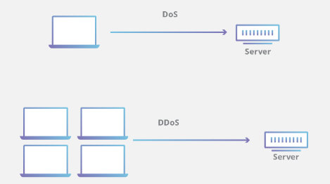
Distributed DoS Attack
DoS attack is characterized by using a single computer to launch the attack.
DDoS is a type of DoS attack that comes from many distributed sources as a botnet
Botnet refers to a group of computers which have been infected by malware and have come under the control of a malicious actor
DoS utilizes a single connection, while a DDoS attack utilizes many sources of attack traffic

Slide 18
Significant DoS attacks
1.SYN Flooding
2.Ping of Death
4.Amplification Attacks
3.Ping Flooding
Smurf Attacks

Slide 19
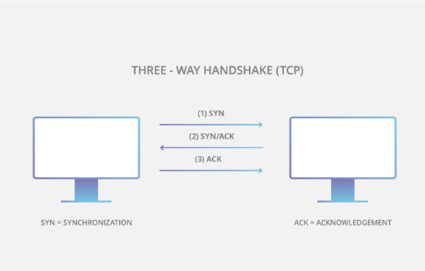
1.SYN Flooding
Half-open attack
SYN flood attacks work by exploiting the handshake process of a TCP connection
To create DoS, an attacker exploits the fact that after an initial SYN packet has been received, the server will respond back with one or more SYN/ACK packets and wait for the final step in the handshake

Slide 20
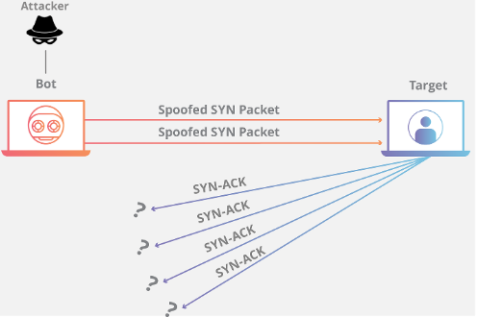
1.SYN Flooding Working
The attacker floods the victim’s system with many SYN packets, using a spoofed source address.
Since a SYN packet is used to initiate a TCP connection, the victim’s machine will send a SYN/ACK packet to the spoofed address in response and wait for the expected ACK response and leaves an open port ready to receive the response . Each of these waiting, half-open connections goes into a backlog queue that has limited space.
Since the spoofed source addresses don’t send back ACK the responses needed to remove these entries from the queue and complete the connections never come.
Instead, each half-open connection must time out, which takes a relatively long time. As long as the attacker continues to flood the victim’s system with spoofed SYN packets, the victim’s backlog queue will remain full, making it nearly impossible for real SYN packets to get to the system and initiate valid connections.
Some operating systems (for example, Linux) use a technique called syncookies to try to prevent SYN flood attacks

Slide 21
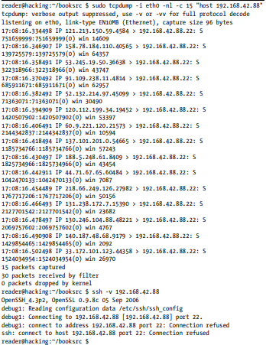
1.SYN Flooding Example
In the example above, the host 192.168.42.88 is a Windows XP machine running an openssh server on port 22 .
The tcpdump output below shows the spoofed SYN packets flooding the host from apparently random IPs. While the program is running, legitimate connections cannot be made to this port.

Slide 22
2.Ping of death attack
Ping of Death is a type of Denial of Service (DoS) attack in which an attacker attempts to crash, destabilize, or freeze the targeted computer or service by sending malformed or oversized packets using a simple ping command.
Many historical computer systems simply could not handle larger packets, and would crash if they received one.
This bug was easily exploited in early TCP/IP implementations in a wide range of operating systems including Windows, Mac, Unix, Linux, as well as network devices like printers and routers.

Slide 23
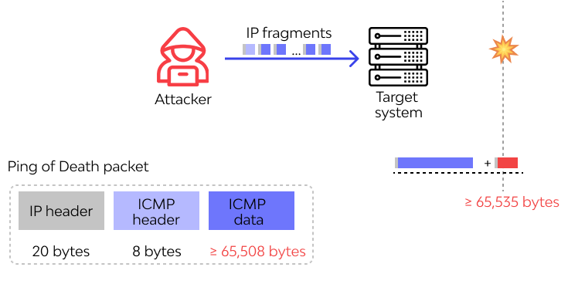
2.Ping of death attack -working
Maliciously large packet is transmitted from the attacker to the target
Attackers would generally send malformed packets in fragments.
When the target system attempts to reassemble the fragments and ends up with an oversized packet, memory overflow could occur and lead to various system problems including crash.
The original ping of death attack is less common today. A related attack known as an ICMP flood attack is more prevalent.

Slide 24
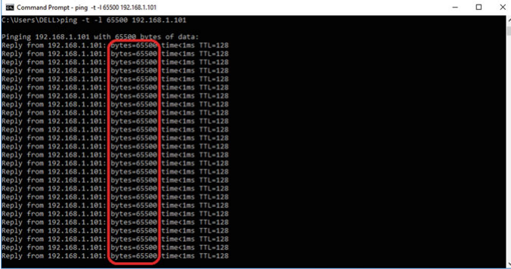

2.Ping of death attack – Example
• “ping” command transfer the data packets to the target
• “XX.XX.XX.XX” is the IP address of the target
• “−t” means sending packets repeatedly
• “−l” specifies the data packet load to be sent to the target.

Slide 25
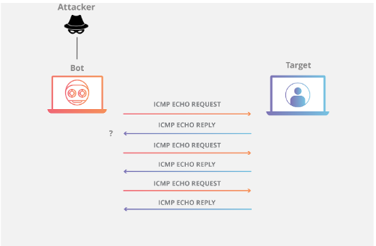
3.Ping Flooding
Flooding DoS attacks don’t try to necessarily crash a service or resource, but instead try to overload it so it can’t respond
The simplest form of flooding is just a ping flood. The goal is to use up the victim’s bandwidth so that legitimate traffic can’t get through.
The attacker sends many large ping packets to the victim, which eat away at the bandwidth The damaging effect of a Ping Flood is directly proportional to the number of requests made to the targeted server of the victim’s network connection.
The damaging effect of a Ping Flood is directly proportional to the number of requests made to the targeted server

Slide 26
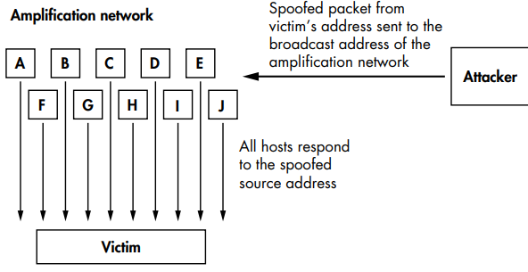
4.Amplification Attacks
It is clever ways to perform a ping flood without using massive amounts of bandwidth.
An amplification attack uses spoofing and broadcast addressing to amplify a single stream of packets by a hundred-fold
If this attack is done with ICMP packets then it is called Smurf Attack
Amplification can also be done using UDP echo packets then it is called Fraggle attacks
“This type of DDoS attack can be thought of metaphorically as a Prankster pretending to be company’s CEO and
calling an office manager asking him to tell each employee to call the executive back on his private number and
give him an update on how they’re doing. The prankster gives the call back number of a targeted victim,
who then receives as many unwanted phone calls as there are people in the office”

Slide 27
4.Smurf Attack (Amplification Attack)
It is a (DDoS) attack in which an attacker attempts to flood a targeted server with ICMP packets.
ICMP Internet Control Message Protocol messages communicate information about network connectivity issues back to the source of the compromised transmission
This attack vector is generally considered a solved vulnerability and is no longer prevalent.

Slide 28
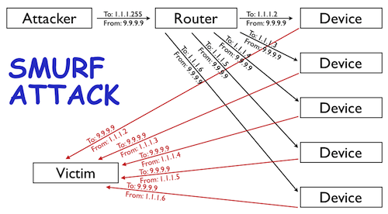
4.Smurf Attack Working
Smurf malware builds a spoofed packet that has its source address set to the real IP address of the targeted victim.
The ICMP packet is then sent to an IP broadcast address of a router , which in turn sends requests to every host device address inside the broadcasting network, increasing the number of requests by the number of networked devices on the network.
Each device inside the network receives the request from the broadcaster and then responds to the spoofed address of the target with an ICMP Echo Reply packet.
The target victim then receives a deluge of ICMP Echo Reply packets, potentially becoming overwhelmed and resulting in denial-of-service to legitimate traffic.
9.9.9.9

Slide 29
Sloworis
Slowloris is a free and Open source tool to perform a denial of service attack .
It’s a framework written in python.
This tool allows a single machine to take down another machine’s web server it uses perfectly legitimate HTTP traffic

Slide 30
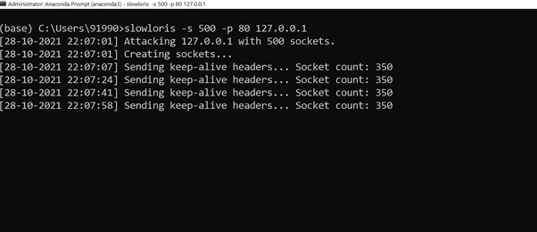
Sloworis Attack
Website running on local host Xampp in your system
In anaconda prompt (administrative) using sloworis tool
-p, --port
  Port of webserver, usually 80
s, --sockets
  Number of sockets to use in the test

Slide 31
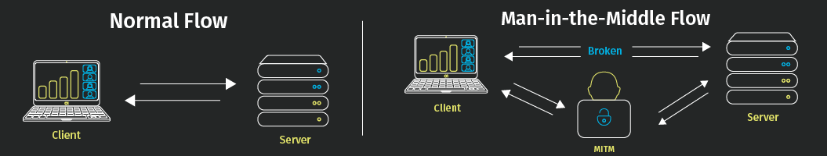
More about Attacks
  Popular Attack -Man in the middle (MITM) attack
    General term for when a attacker positions himself in a conversation between a user and an application either to eavesdrop or to impersonate one of the parties making it appear as if a normal exchange
    Type of eavesdropping attack
    Attackers wishing to take a more active approach to interception may launch one of the following attacks: IP spoofing ,ARP spoofing or DNS spoofing Attacks

Slide 32
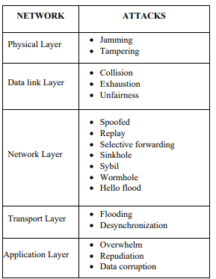
More about Attacks
List of Attacks based on layered architecture is as shown on left side
Effects of attack listed
  Jamming - Resource exhaustion ,Packets collision
  Tampering - Hardware damage
  Selective Forwarding- Packet dropping and Information loss
  Sybil Attack -Threat to geographical routing protocols
  Wormhole Attack - Change in network topology
  Hello flood Attack -Data congestion
To maintain data integrity and authenticity, steps are to be taken to resist active and passive attacks. The cryptographic techniques and the protocols are to be made stronger to avoid the attacks.

Slide 33
Points to summarize
Security Attacks
Passive
Active
Eavesdropping
Traffic Analysis
Camouflauge Adversaries
DoS and Ddos Attack
SYN Flooding
Ping the Death
Ping Flooding
Amplification , Smurf
Swoloris Tool
A resource can have one or more vulnerabilities that can be exploited by a threat that leads an attack due to which Confidentiality , Integrity and Availability of resources may be compromised
Passive Attacks - Monitoring and listening to the communication channel by unauthorized entity
Active Attacks - Monitoring, listening to and modification of data stream in the communication channel by unauthorized entity

Slide 34
References
https://en.wikipedia.org/wiki/Cyberattack#Types_of_attack
https://www.netreo.com/blog/traffic-analysis-attack/
https://www.ijcaonline.org/archives/volume159/number7/santhi-2017-ijca-912972.pdf
https://www.sciencedirect.com/science/article/pii/S2666285X2100073X
https://api.semanticscholar.org/CorpusID:94791427
DOI:10.1109/MITP.2018.2876988Corpus ID: 94791427
Traffic Analysis Attack for Identifying Users’ Online Activities
F. Kausar, Sarah Aljumah, Shorouq Alzaydi, Raghad Alroba less
Published 1 March 2019

Slide 35
Thank You ☺

