Slide 1
CardioHack
Know your heart.

Slide 2
Agenda
Problem
Challenge
Why?
Impact
Solution

Slide 3
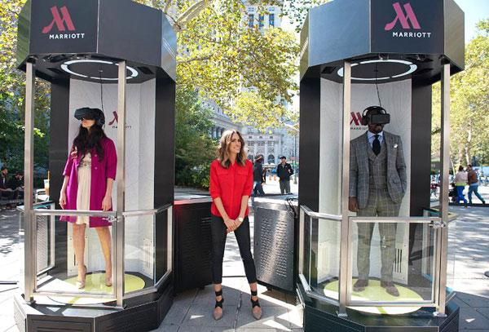
Health Kiosks

Slide 4
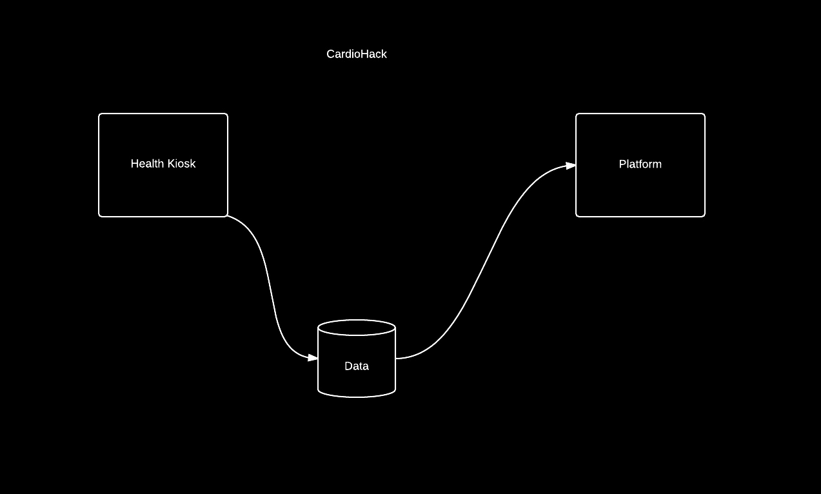

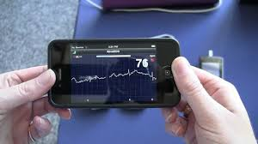


Slide 5
