Slide 1




Prepared for: Data Science / Machine Learning Project Student:
Class/Section: Institution:
Case Study
on
Telecom Communication Using CHAID Decision Tree Model in IBM SPSS Modeler
SUBMITTED TO: SUBMITTED BY:
Mr.Vikas Sir Name:Aashika
Arbab
Aishwarya
Babu Banarasi Das University
Prepared using real dataset: telco x customer data.xlsx

Slide 2

Introduction
The purpose of this project is to build a complete fraud detection system using the C5.0 decision tree algorithm inside IBM SPSS Modeler. Fraud detection is a critical application in telecom, banking, and online transactions. This project demonstrates how to prepare data, partition it, build a predictive model, and evaluate its performance using confusion matrix, ROC curve, accuracy, and gains charts.
Step–by–Step Workflow
Step 1: Importing the Dataset
The dataset 'telco x customer data.xlsx' was imported into SPSS Modeler using the Var. File node. The Preview function was used to confirm accurate loading and field detection.
Step 2: Type Node Configuration
The Type node was used to assign correct roles. The target variable 'is_fraud' was assigned as a Flag (Target), and all other fields were kept as Input fields.
Step 3: Partitioning the Dataset (70/30 Split)
A Partition node was applied to divide the dataset into 70% training data and 30% testing data using system values 1 and 2.
Step 4: Creating Training and Testing Select Nodes
Two Select nodes were created:
Training Node: Condition set as $PARTITION = 1
Testing Node: Condition set as $PARTITION = 2
This ensures that the model is trained only on training data and evaluated on unseen testing data.
Step 5: Building the C5.0 Model
The C5.0 decision tree algorithm was selected. The training Select node was connected to the C5.0 node. The target variable was set to 'is_fraud', and a prediction field such as 'fraud_prediction' was configured.
Step 6: Evaluating the Model
The Evaluate node was connected using two inputs:
The C5.0 model output
The Testing Select node
The evaluation produced accuracy, confusion matrix, ROC curve, lift chart, and gains chart.
Step 7: Interpretation of Results
Model results were examined to understand:
How accurately the model predicts fraud
True Positive and False Negative performance
ROC AUC score to measure discrimination

Slide 3

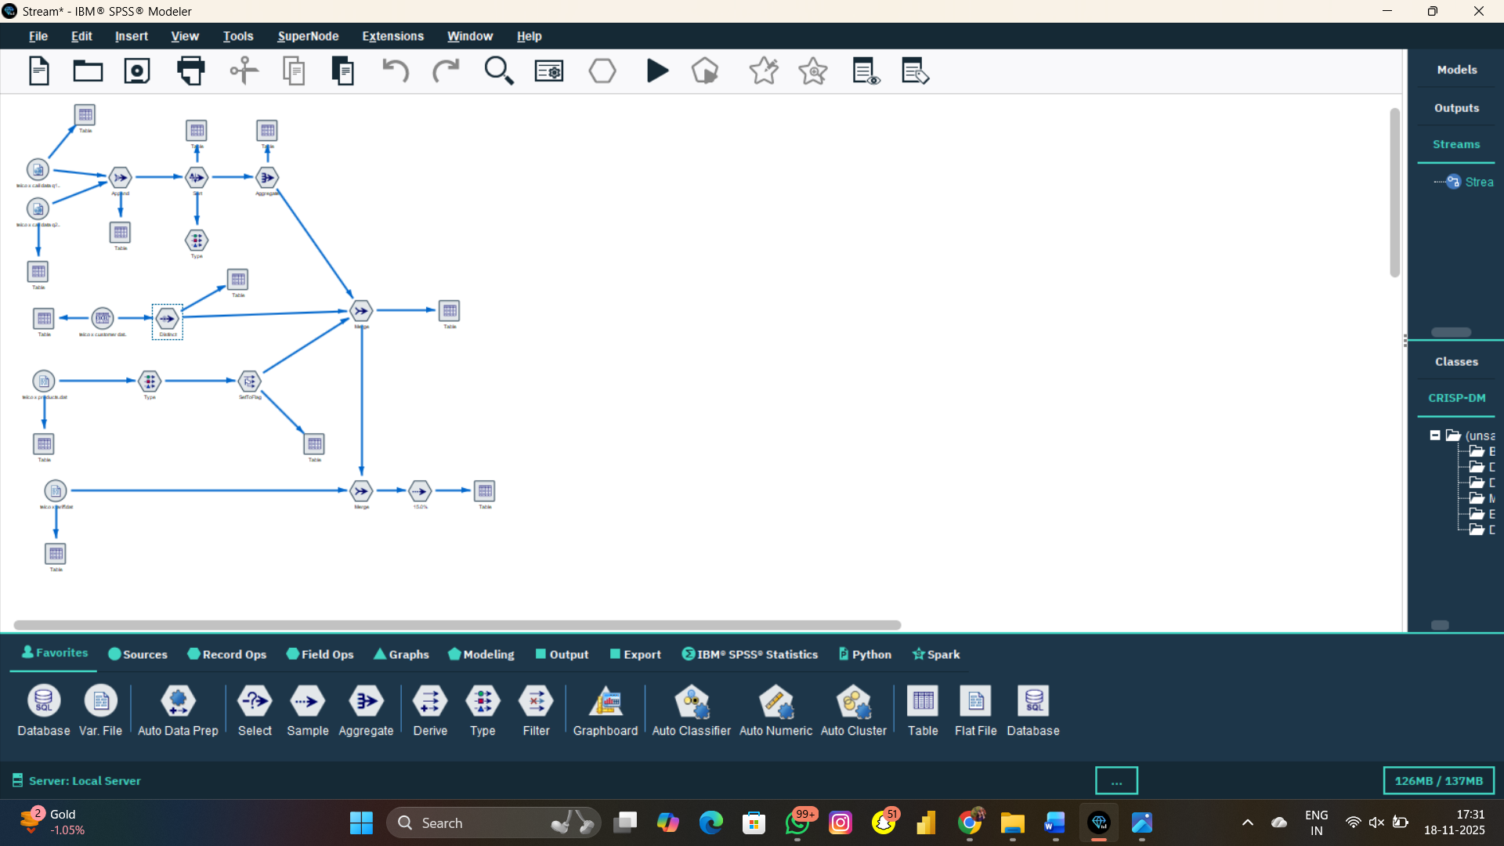
Gains and Lift to assess early fraud detection efficiency

Slide 4

Summary of Findings
The C5.0 model was successfully trained on the telecom dataset. The 70/30 train-test split allows the model to learn patterns in the training data and then be evaluated on unseen records. The evaluation process provided important metrics such as accuracy, precision, recall, and ROC curve. These metrics help determine the model’s real-world effectiveness in identifying fraudulent activity.
Conclusion
Fraud detection is a crucial component in modern business analytics and customer risk management. Using IBM SPSS Modeler and the C5.0 algorithm, this project successfully demonstrated a complete workflow—from data import to model evaluation. The model provides actionable insights and can be further improved by feature engineering, balancing techniques, or ensemble models. This workflow can also be adapted for churn prediction, credit risk, or any classification problem.
End of Report

