Slide 1

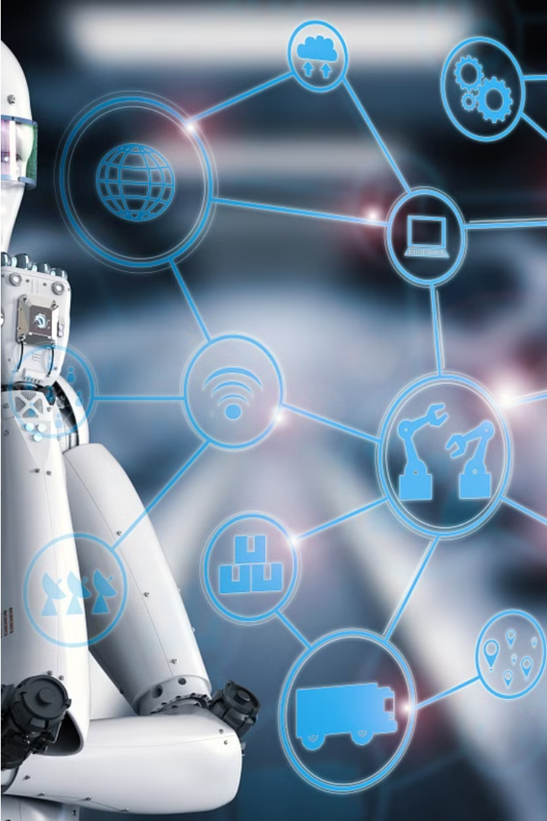

Introduction to Top New Technologies in AI
Explore the cutting-edge advancements in artificial intelligence that are transforming industries and reshaping the future. From machine learning to natural language processing, discover the innovative technologies powering the next generation of AI solutions.

Slide 2



Machine Learning Advancements
Deep Learning
Automated Machine Learning
Transfer Learning
Breakthrough neural network architectures like convolutional and recurrent networks have dramatically improved machine perception and understanding.
The ability to apply knowledge gained on one task to a related task has boosted sample efficiency and performance on many problems.
AutoML tools leverage meta-learning to automate the model selection and hyperparameter tuning process, making ML more accessible.

Slide 3
Natural Language Processing (NLP) Breakthroughs
Transformer Models
Multi-Modal AI
Conversational AI
Neural Machine Translation
Combining vision and language models to understand and generate text that is grounded in visual information, opening up new possibilities for AI-powered multimedia applications.
Transformer-based models like BERT, GPT-3, and T5 have revolutionized natural language understanding and generation, achieving superhuman performance on a wide range of NLP tasks.
Advancements in dialogue systems and chatbots driven by large language models allow for more natural, contextual, and engaging human-AI interactions.
Neural network-based translation models have significantly improved the quality and fluency of automated translation, bridging language barriers and enabling global communication.

Slide 4
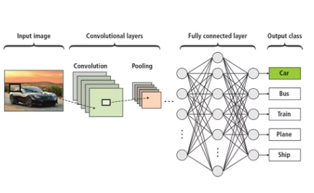
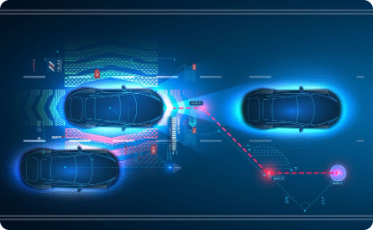

Computer Vision Innovations
Deep Learning Breakthroughs
Autonomous Vehicle Perception
Medical Imaging Analysis
Computer vision algorithms are transforming the field of medical imaging, enabling automated detection and diagnosis of diseases from X-rays, MRI scans, and other medical images.
Advancements in deep learning algorithms have enabled computer vision systems to achieve human-level performance in tasks like image classification, object detection, and image segmentation.
Computer vision is crucial for autonomous vehicles, allowing them to interpret their surroundings, identify obstacles, and make real-time decisions for safe navigation.

Slide 5
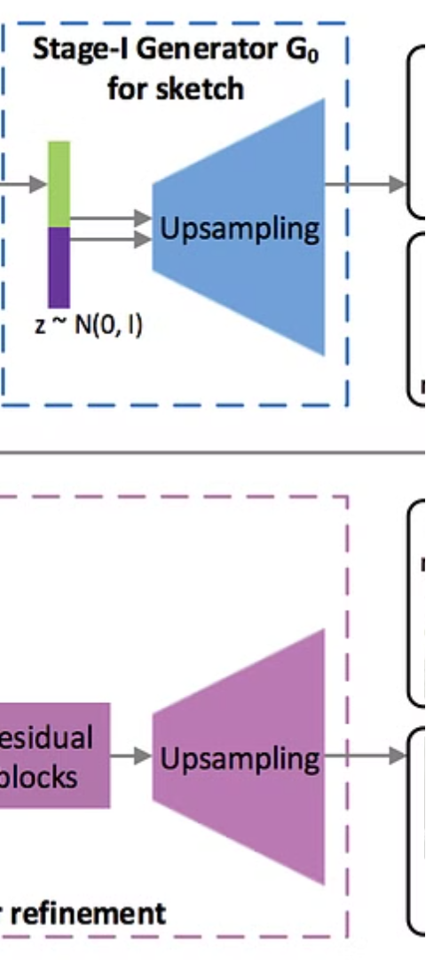
Generative Adversarial Networks (GANs)
Realistic Image Generation
Unsupervised Learning
GANs excel at generating highly realistic and diverse images by pitting two neural networks against each other in a competitive game, leading to increasingly sophisticated and natural-looking outputs.
GANs can learn complex data distributions in an unsupervised manner, allowing them to create new images without relying on labeled training data, which is a significant advantage.
Creative Applications
Beyond realistic image generation, GANs have shown promise in creative applications like art synthesis, image-to-image translation, and even the generation of high-quality fake videos known as "deepfakes".

Slide 6
Reinforcement Learning Developments
1
Reinforcement Learning Breakthroughs
2
Exploration-Exploitation Tradeoffs
Recent advancements in reinforcement learning algorithms have led to breakthroughs in areas like game-playing, robotics, and resource management.
Researchers are developing more sophisticated methods to help AI agents balance the exploration of new strategies with the exploitation of known successful actions.
3
Hierarchical Reinforcement Learning
4
Transfer Learning in RL
The ability to transfer knowledge gained in one reinforcement learning task to accelerate training in a related task is a key area of research.
Hierarchical RL models are enabling AI to break down complex tasks into manageable subtasks, leading to more efficient and robust decision-making.

Slide 7
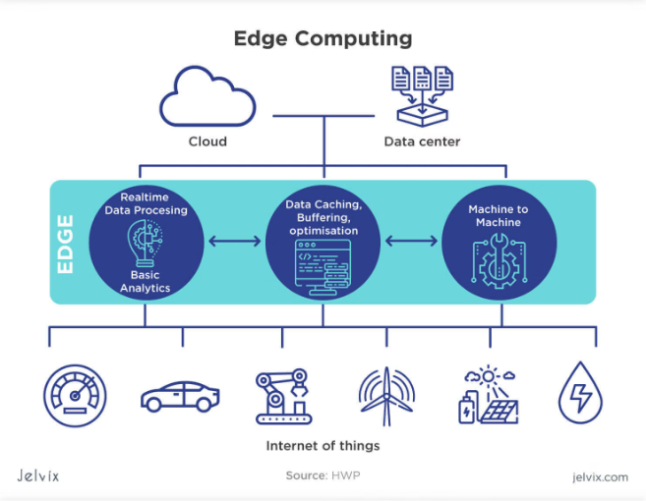
Edge Computing and AI
Edge computing brings AI closer to the data source, reducing latency and improving real-time responsiveness. This enables AI-powered devices to make faster decisions, optimize resource usage, and operate even without a stable internet connection.
Edge AI also enhances privacy and security by processing sensitive data locally instead of sending it to the cloud.

Slide 8
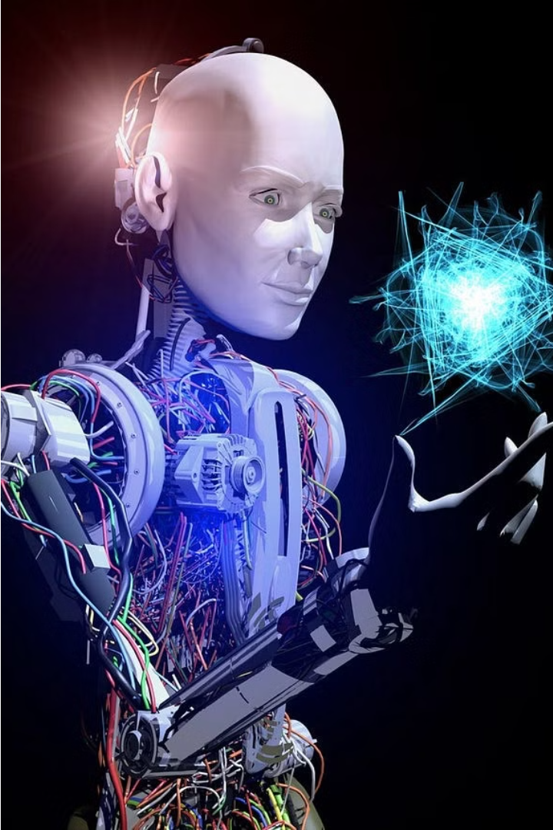
Quantum Computing and AI
The intersection of quantum computing and artificial intelligence is an exciting frontier. Quantum computers have the potential to revolutionize AI by solving complex problems that are intractable for classical computers.
Exploring this synergy could lead to breakthroughs in areas like cryptography, optimization, and simulation, unlocking new possibilities for AI applications.

Slide 9
Ethical Considerations in AI
Transparency & Accountability
Bias & Fairness
Privacy & Security
Human Control
AI models can perpetuate and amplify societal biases if not carefully designed. Ensuring fair and equitable treatment is a key ethical challenge.
As AI becomes more autonomous, maintaining meaningful human control and oversight is essential to preserve human agency and accountability.
As AI systems become more sophisticated, it's crucial that they operate with transparency. Developers must be accountable for the algorithms, data, and outcomes of their AI models.
The collection and use of personal data by AI systems raise complex privacy concerns. Robust data governance policies are needed to protect individual rights.

Slide 10



Future Outlook and Trends
Explainable AI
1
Algorithms that can explain their decisions
Responsible AI
2
Addressing bias and ethical concerns
Embedded AI
3
Integrating AI into everyday devices
As AI continues to evolve, the field is moving towards greater transparency, fairness, and ubiquity. Explainable AI systems will provide insight into their decision-making processes, enabling better trust and accountability. Responsible AI frameworks will mitigate bias and uphold ethical principles. Meanwhile, embedded AI will become seamlessly integrated into our devices and daily lives, transforming how we interact with technology.

Slide 11


