Slide 1
λ
Functional Programming

Slide 2
Agenda
History.
Define functional programming.
Some math.
Some code.
Notes:
Agenda

Slide 3
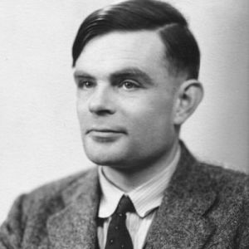
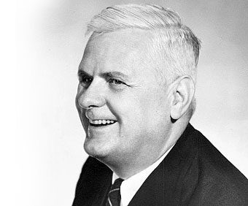
Some Old Dudes
Notes:
Pictures of Alonzo Church, John McCarthy and Alan Turing

Slide 4
Random historical facts..
1930s | Alonzo Church's lambda calculus
1950s | LISP is outlined by John McCarthy, and Steve Russell implements “eval” in an IBM 704.
1960s | LISP continues to develop, with stuff like garbage collection
1970s | Guy L Steele and Gerald Sussman develops Scheme (Lambda Papers) Rob Milner develops ML 1977- Turing Award lecture by John Backus outlines FP formally.
1980s | Haskell standard is laid out. Erlang is born at Ericsson. SQL becomes standard.
1990s | Haskell continues to be developed and released. Racket, Python, Javascript appears on the scene.
2000 and later | Elixir, Scala, Clojure, F# appears. C# 3.0, Java 8, PHP add stuff like first class functions, lambdas and so on. Even C++ 11.
Notes:
Some history.
Around 1930
Lambda Calculus
McCarthy Wrote the paper
Steve Russell implemented it
Why am I talking about LISP ?
It is the earliest conversion of Lambda Calculus into something that could run on a machine

Slide 5
Calculus...Lambda Calculus.
An add function in lambda calculus
λx. λy. x+y
Notes:
The function represents and anonymous function that takes x as a parameter and returns a new function.
This new function takes y as a parameter and returns x + y.

Slide 6
In Javascript...
function add(x){
return function(y) { return x+y } ;
}
add(2)(3)

Slide 7
In Scala...
def add(x:Int) = (y:Int) => { x + y }
add(2)(3)

Slide 8
Fancy diagram #1
A function is : A mapping for any given input to an output
x
f(x)
y

Slide 9
Fancy diagram #2
Fancier way of looking at it
I
J
K
L
1
2
3
4

Slide 10
What does this mean ?
You can replace a function with its value
This is called “Referential transparency”
i.e
val x = add(10,10) + add (5,5)
is the same as
val x = 20 + add(5,5)

Slide 11
Benefits of referential transparency
Since you can replace your entire program with values, it is easier to reason about
Composability.
A pure functional program is thus a single referentially transparent function.

Slide 12
Some features of functional programs
Recursion.
Higher order functions.
Pure functions.
Anonymous functions.

Slide 13
Okay ! Code.
Look at JS procedural code.
Produce JS funcational equivalent.
Try out this in Scala

