Slide 1

Scala

Slide 2
Agenda
Data types.
Literal.
Functions.
Loops and comprehensions.
Control statements.
Some code.
Notes:
Agenda

Slide 3
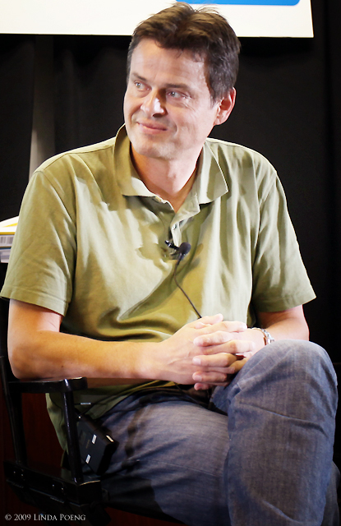
This Dude
Notes:
Pictures of Alonzo Church, John McCarthy and Alan Turing

Slide 4
Statically typed vs Dynamically typed
Statically typed : C, C++, Java, Scala, C#
Dynamically typed : python, perl, javascript, ruby
Notes:
The function represents and anonymous function that takes x as a parameter and returns a new function.
This new function takes y as a parameter and returns x + y.

Slide 5
Basic types – The usual suspects
Byte, Short, Int, Long, Float, Double, Boolean, Char
Please note the uppercasing.
Notes:
The function represents and anonymous function that takes x as a parameter and returns a new function.
This new function takes y as a parameter and returns x + y.

Slide 6
Basic types – The usual suspects
Byte, Short, Int, Long, Float, Double, Boolean, Char
Please note the uppercasing.
Notes:
The function represents and anonymous function that takes x as a parameter and returns a new function.
This new function takes y as a parameter and returns x + y.

Slide 7
Literals
What are literals ?
Integer literals
Floating point literals
Character literals
String literals
XML literals

Slide 8
Defining variables
var keyword
val keyword
‘_’ - the default value character
lazy keyword
Pattern fun with lists

Slide 9
Defining functions
def method_name(param:Type) : returnType = { body }
Note the inversion of declaration from usual convention
Note the “=”

Slide 10
Defining functions
def method_name(param:Type) : returnType = { body }
Note the inversion of declaration from usual convention
Note the “=”
Functions are literals too !
Closures – implementing the “break” keyword

Slide 11
Arrays and Lists
Array
  val someArray = new Array[String](3)
List
  val aList = List[String]

Slide 12
Control flow
If, while, do while etc
for comprehensions
  Imperative
  Sequential (functional)
Pattern matching

Slide 13
Demo : HttpClient

