Slide 1
From Slow, Risky Releases to
Confident Daily Deployments
How High-Growth Engineering Teams Use Harness to Ship Faster Without Breaking Production
Enterprise CI/CD on Kubernetes — Built for Scale, Security, and Speed

Slide 2
Why Software Delivery Is Still a Bottleneck
Most teams don't have a tooling problem — they have a delivery confidence problem.
• Releases take days or weeks → Slower innovation
• Script-driven deployments → Fragile processes
• Limited visibility → Slow recovery
• Too many tools → Operational overhead
• Manual rollbacks → Higher outage risk
• Manual audits → Compliance gaps

Slide 3
Harness: One Platform to Build, Deploy & Operate
Harness replaces fragmented CI/CD tooling with a single, secure, Kubernetes-native platform.
✓ Unified CI & CD in a single platform
✓ Built-in deployment strategies (Canary, Blue-Green, Rolling)
✓ Delegate-based security model — credentials stay in your network
✓ Templates & reusability for enterprise scale
✓ Governance and audit readiness built-in

Slide 4
Lab Demo: What I Built
End-to-end CI/CD implementation with enterprise-grade deployment strategy
Component | Implementation
Infrastructure | Amazon EKS cluster (2 nodes, us-east-1)
CI Pipeline | Build → Test → Push to DockerHub
CD Pipeline | Canary deployment to Kubernetes
Bonus | Reusable step template

Slide 5
Solution Architecture
GitHub → Harness CI → DockerHub → Harness CD → Amazon EKS
Key Components:
• Harness Delegate runs INSIDE the EKS cluster
• Outbound-only connections (enterprise security)
• Credentials never leave the customer's network
• Single platform for CI + CD

Slide 6
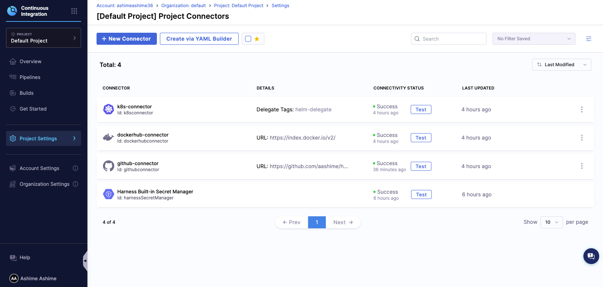
Connectors — Configure Once, Use Everywhere

Slide 7
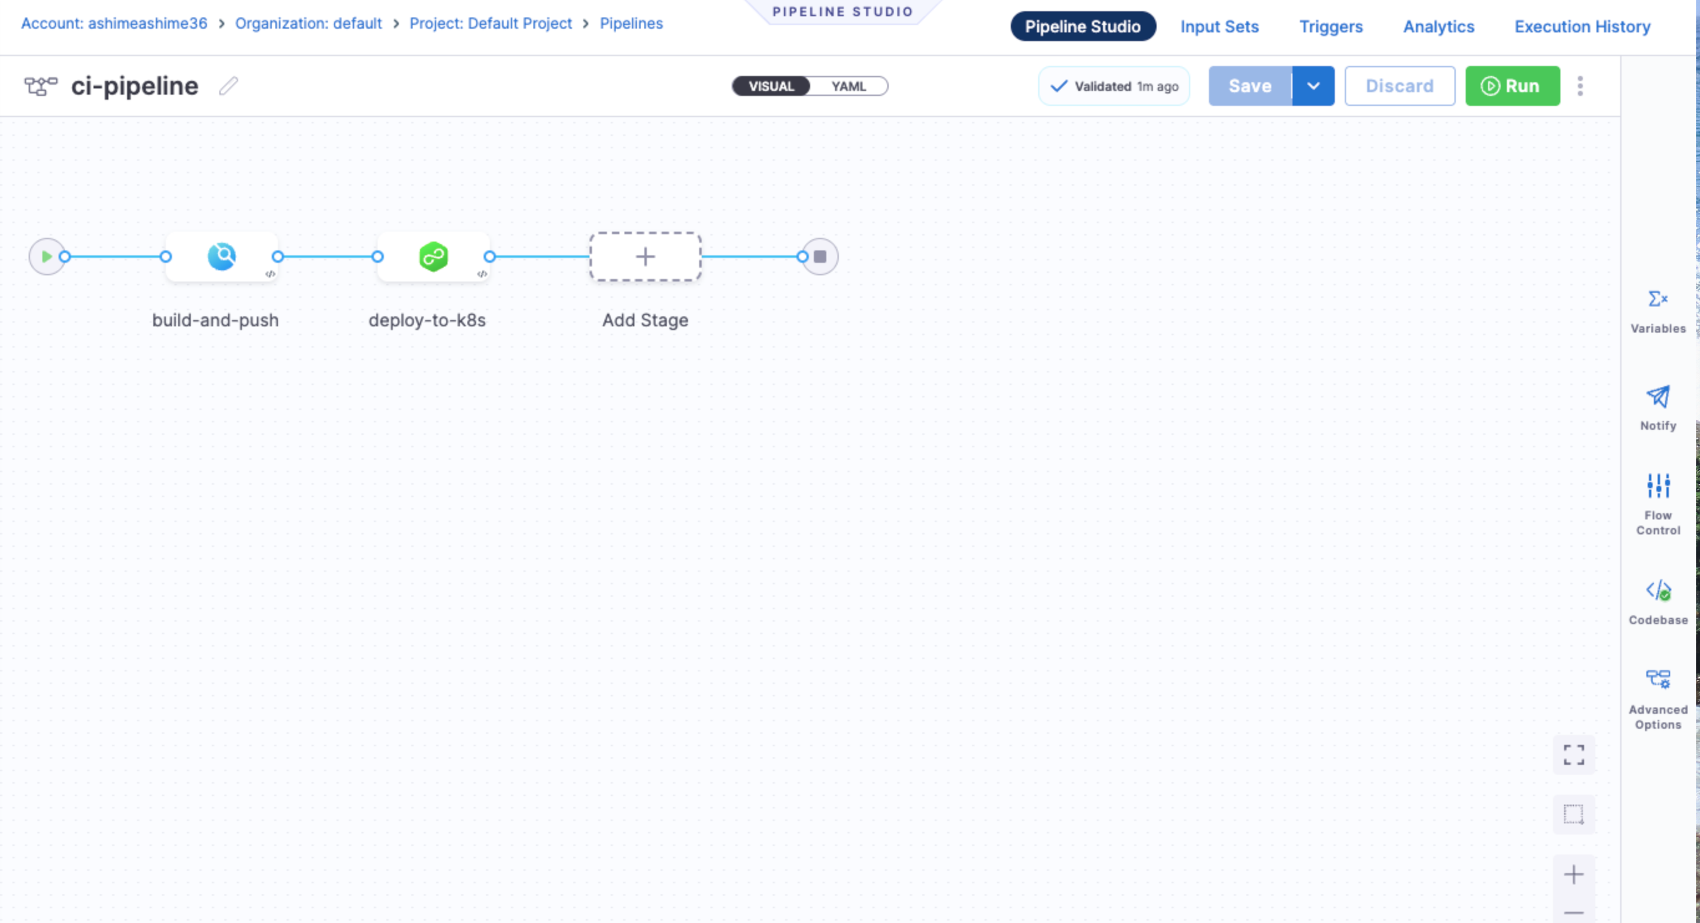
CI/CD Pipeline — Visual + YAML

Slide 8
Canary Deployment — Ship with Confidence
Traditional Deploy | Canary Deploy (Harness)
Deploy to all pods at once | Deploy to 1 pod first
100% blast radius | Minimal blast radius
Manual rollback | Automatic rollback
High risk | Low risk
Flow: Canary (1 pod) → Validate Health → Full Rollout
On Failure → Automatic Rollback
Used by Netflix, Google, and Amazon for production deployments

Slide 9
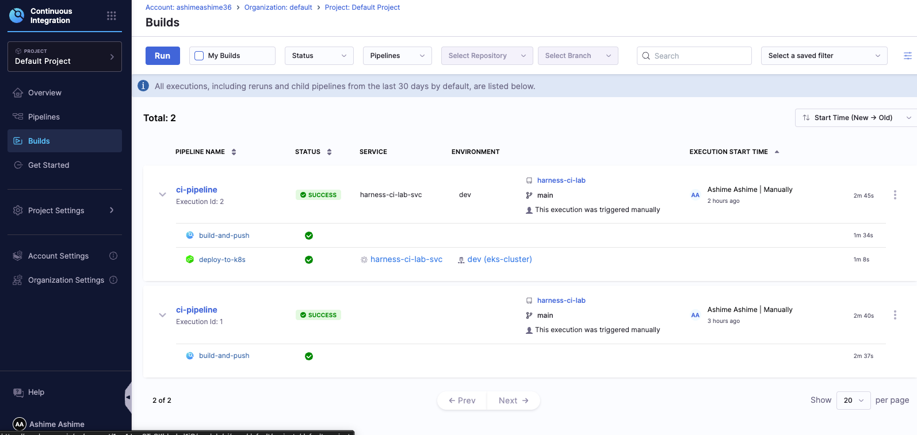
Pipeline Execution — Success

Slide 10
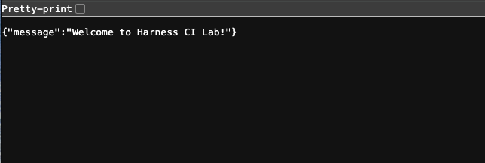
Live Application — Deployed & Running
Live URL: http://af8ff179d9b434e3896b72ce0a902e3d-613870465.us-east-1.elb.amazonaws.com

Slide 11
Templates — Build Once, Reuse Everywhere
Created: nodejs-test-template
Template Config:
• Image: node:18
• Command: npm install && npm test
Enterprise Value:
✓ Reusability — Use in any pipeline with one click
✓ Standardization — Consistent testing across teams
✓ Maintainability — Update once, applies everywhere
✓ Governance — Platform team control

Slide 12
Lab Summary
Task | Status
Kubernetes Cluster (EKS) | ✓ Complete
Harness Delegate | ✓ Complete
CI Pipeline (Build, Test, Push) | ✓ Complete
CD Pipeline (Canary) | ✓ Complete
Templates (Bonus) | ✓ Complete
Resources:
• GitHub: github.com/aashime/harness-ci-lab
• DockerHub: hub.docker.com/r/aashime/harness-ci-lab
• Full Documentation: LAB_SUBMISSION.md

Slide 13
Thank You
Questions?
Ashime | github.com/aashime/harness-ci-lab

