Slide 1

Maze Solver Robot: Navigating with Dijkstra's Algorithm

Slide 2
Concept Overview
Maze as a Graph:
Each intersection or cell = node
Paths between them = edges with weights (usually 1 for simple mazes)
Dijkstra’s Algorithm:
Finds the shortest path from a source node to all other nodes.
Uses a priority queue (or array in Arduino) to track the minimum cost.

Slide 3




Adapting Dijkstra's for Maze Navigation
Mapping Maze Structure
Map the maze structure to the algorithm's graph representation.
Algorithm Adaptation
Adapt the algorithm to the robot's sensor input and movement capabilities.
Real-World Constraints
Handle sensor noise and imperfect turns.

Slide 4
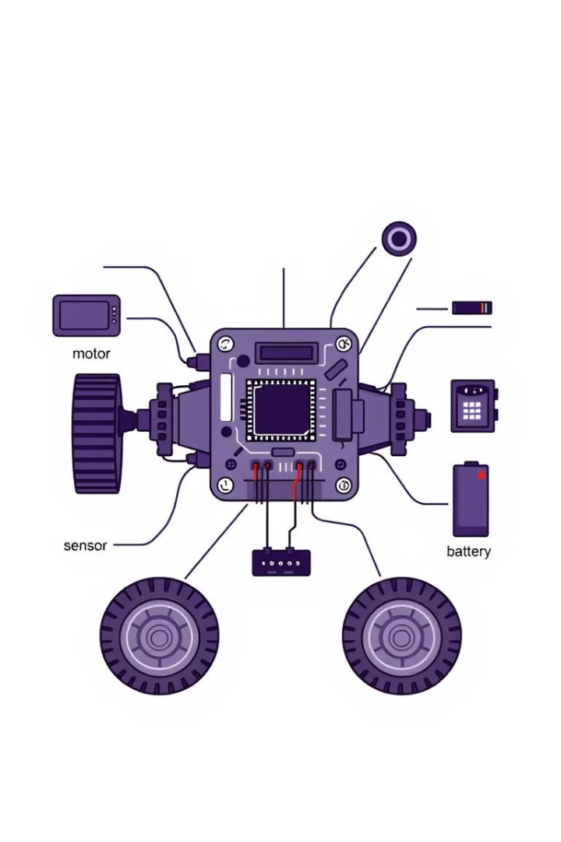



Hardware Components
Arduino UNO
Sensors
Motor Drivers
Controls motors and sensors.
Maps the maze using ir sensors.
Provides movement with DC motors.

Slide 5



Software Implementation
Language
C++ (Arduino IDE)
Data
Adjacency matrix, priority queue
Control
PID for smooth movement

Slide 6
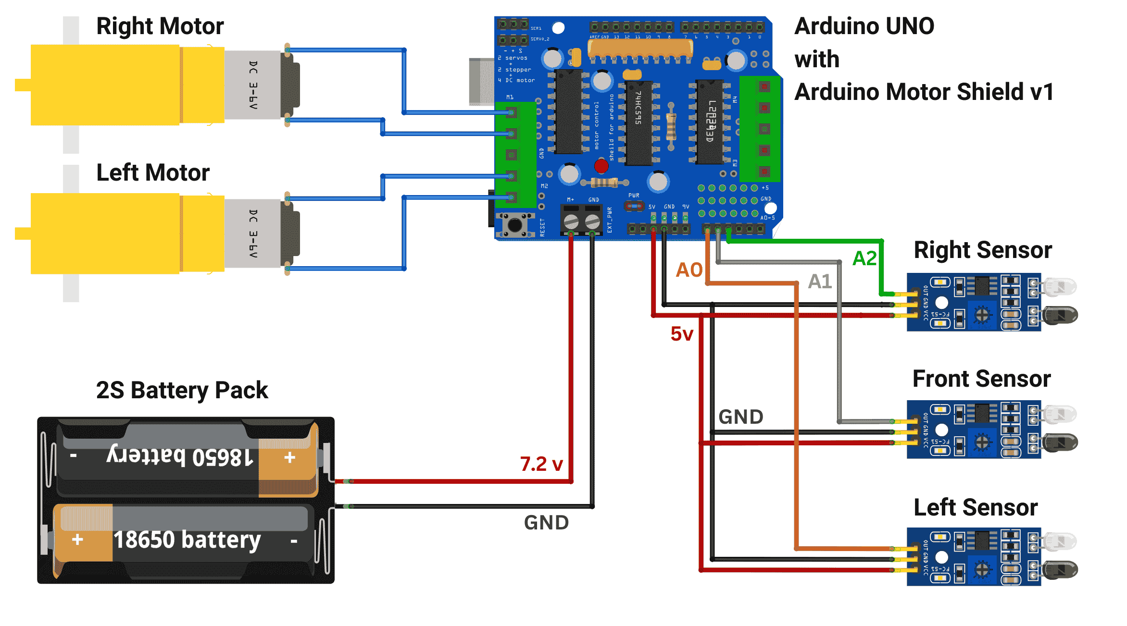
Circuit Diagram

Slide 7
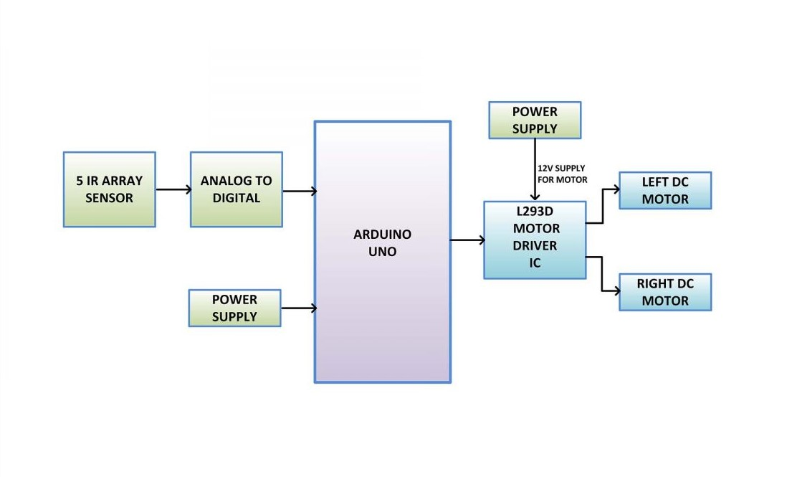
Block Diagram

Slide 8

Conclusion
The maze-solving robot using Dijkstra's algorithm efficiently navigates from a starting point to the goal by calculating the shortest path in a grid-like environment. By modeling the maze as a graph of nodes and edges, the robot makes intelligent decisions rather than relying on brute-force or random movement

