Slide 1
Tsmc 65nm
Design of two stage Miller compensated OTA
Presenter: M.Aashir Imran

Slide 2
Assigned specifications
Parameter | Target Specs
Unity Gain Bandwidth | 90 MHz
Load Capacitance | 9.9 pF
DC Open-Loop Gain | ≥ 75 dB
Power Consumption | < 1 mW
Supply Voltage / Bias | 1.2V / 500nA – 50μA
ICMR / Slew Rate | Maximize / Optimize

Slide 3
Two stage topology
Stage 1 (Differential Transconductance Stage):
Differential NMOS input pair with PMOS active current-mirror load.
Converts differential input voltage to a single-ended output current/voltage.
Provides high differential voltage gain and improves common-mode rejection (CMRR).
Stage 2 (High-Gain Output Stage):
Common-source PMOS driver transistor .
Biased by an NMOS current source acting as an active load.

Slide 4
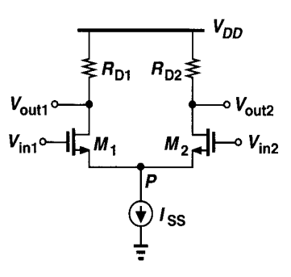
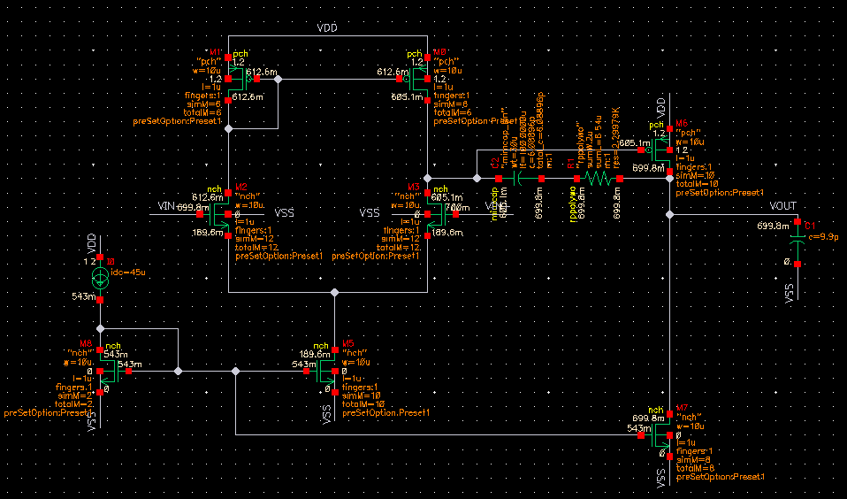
Schematic

Slide 5
Design Specifications
Component Name | Node Connection | Transistor Type | Width (W) | Length (L) | Multiplier (M)
M1,M2​ | Input Differential Pair | NMOS | 10u | 1u | 12
M3,M4​ | Stage 1 Active Load Mirror | PMOS | 10u | 1u | 6
M5​ | Stage 1 Tail Current Sink | NMOS | 10u | 1u | 10
M6​ | Stage 2 Driver | PMOS | 10u | 1u | 2
M7​ | Stage 2 Current Sink | NMOS | 10u | 1u | 8

Slide 6
Design Specifications
Cc​ | Compensation Capacitor | Passive Cap | 6pF
Rz | Zero Nulling Resistor | Passive Res | 2.3k
CL​ | External Output Load | Passive Cap | 9.9pF
Iref​ | Primary Bias Source | Current Source | 45u

Slide 7
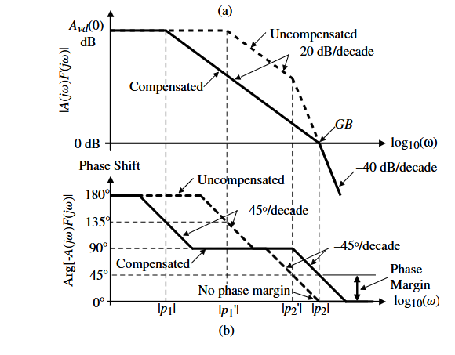
Poles Formed and Miller Effect
Benefit of Miller Effect
1.Pole Splitting
2. Compact Capacitor Size (Saves Silicon Area)
3. Controlled & Predictable Gain-Bandwidth Product ()
Mechanics: Sets primarily as a simple ratio of input transconductance to compensation capacitance ().
GBW can be easily tuned by adjusting Cc

Slide 8


Poles and Transfer function
$$H\left(s\right)=\frac{V_{\text{out}}}{V_{\text{in}}}\left(s\right)=A_{v0}⋅\frac{1+sC_{c}\left({\frac{1}{g_{m6}}−R}_{1}\right)}{\left(1+\frac{s}{ω_{p1}}\right)\left(1+\frac{s}{ω_{p2}}\right)}$$
$$ω_{p1}≈\frac{1}{R_{\text{out1}}⋅\left(1+g_{m6}R_{\text{out2}}\right)⋅C_{c}}≈\frac{1}{R_{\text{out1}}⋅g_{m6}R_{\text{out2}}⋅C_{c}}$$
$$ω_{p2}≈\frac{g_{m6}}{C_{L}+C_{\text{parasitic}}}$$

Slide 9
Phase margin and Slew Rate
Phase Margin:
A measure of relative stability in a closed-loop system, evaluated at the unity-gain frequency (UGBW).
Target=45 degrees
Slew Rate:
The maximum rate of change of output voltage when a large input signal is given.
Target=20v/u sec
Notes:
active current mirrors why we need pmos current mirror as it increases the vout

Slide 10
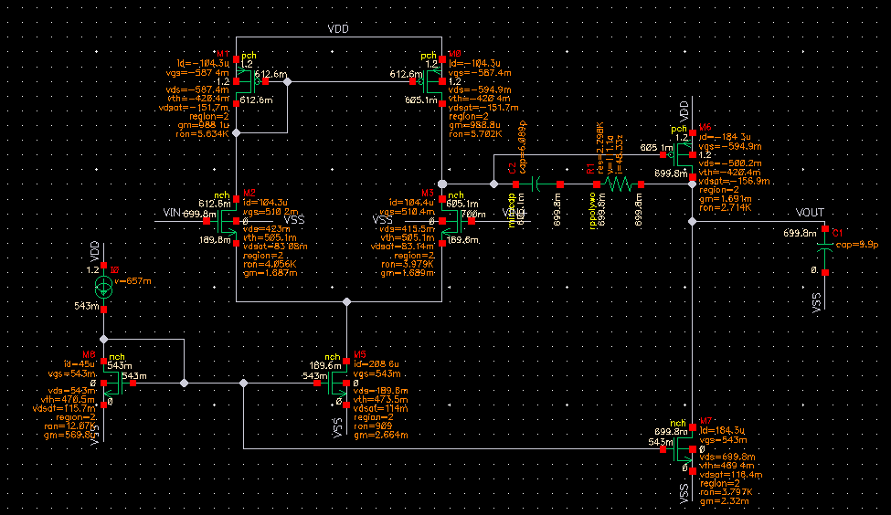


Input Common Mode Range
Vicm,max= 1.117 V Vicm,min = 0.6242

Slide 11
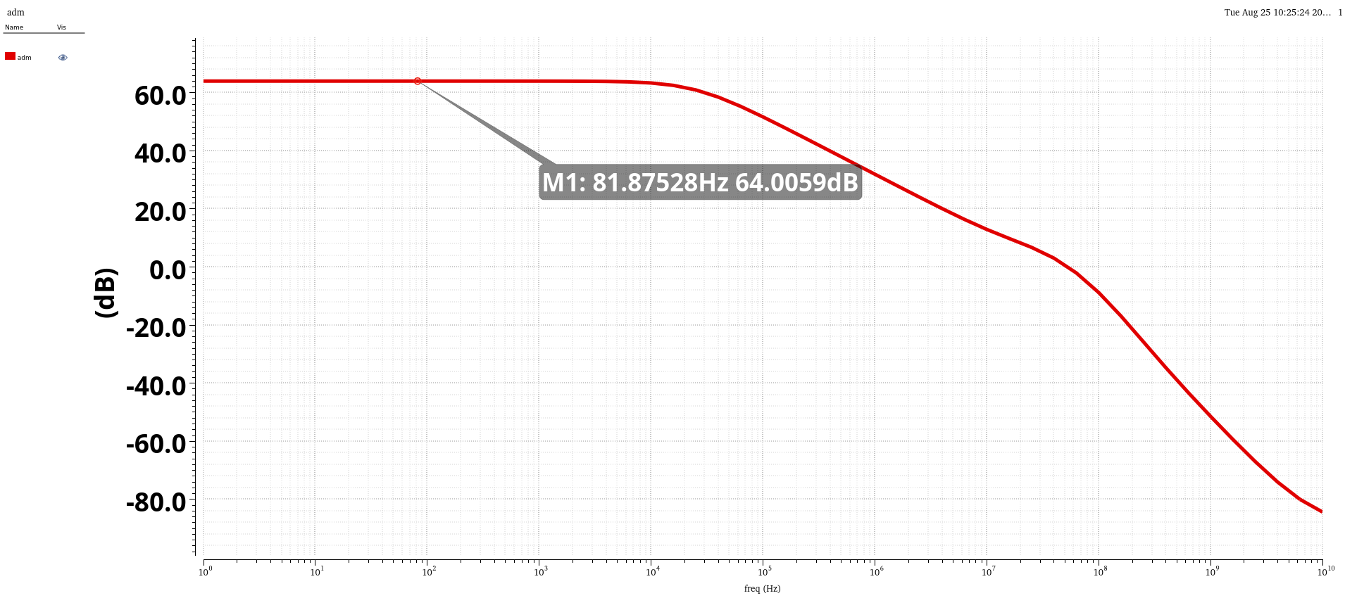
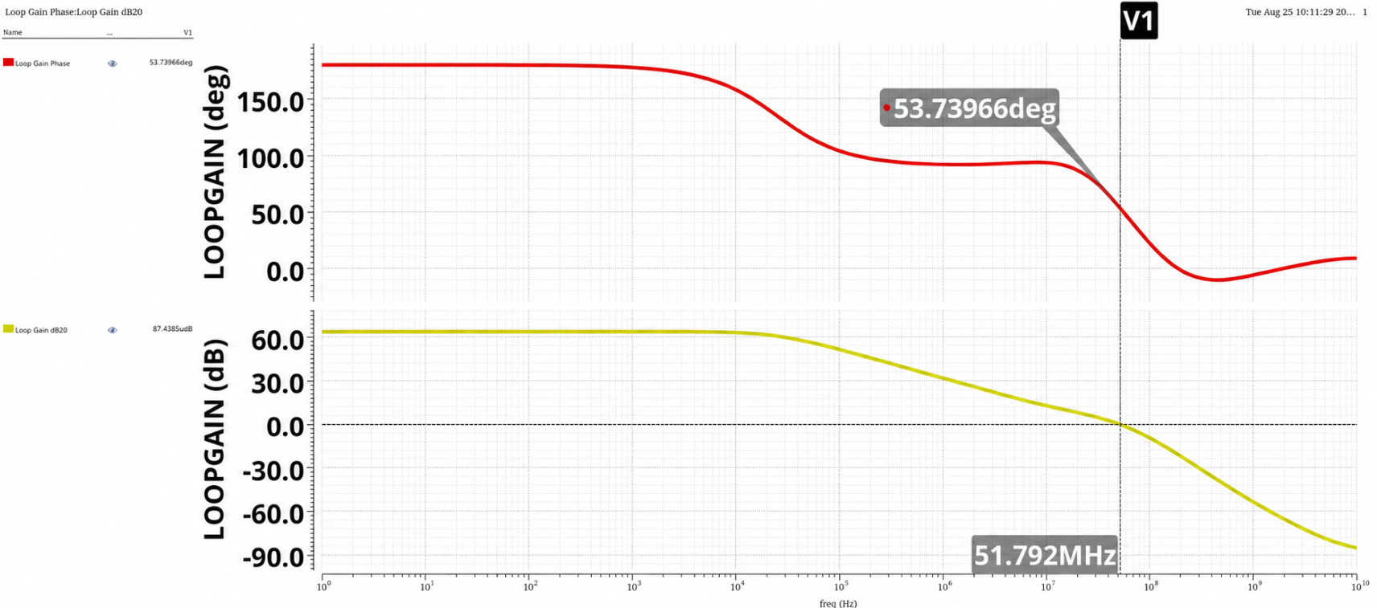
Open loop gain and UGBW

Slide 12
Phasemargin And UGBW(achieved)

Slide 13
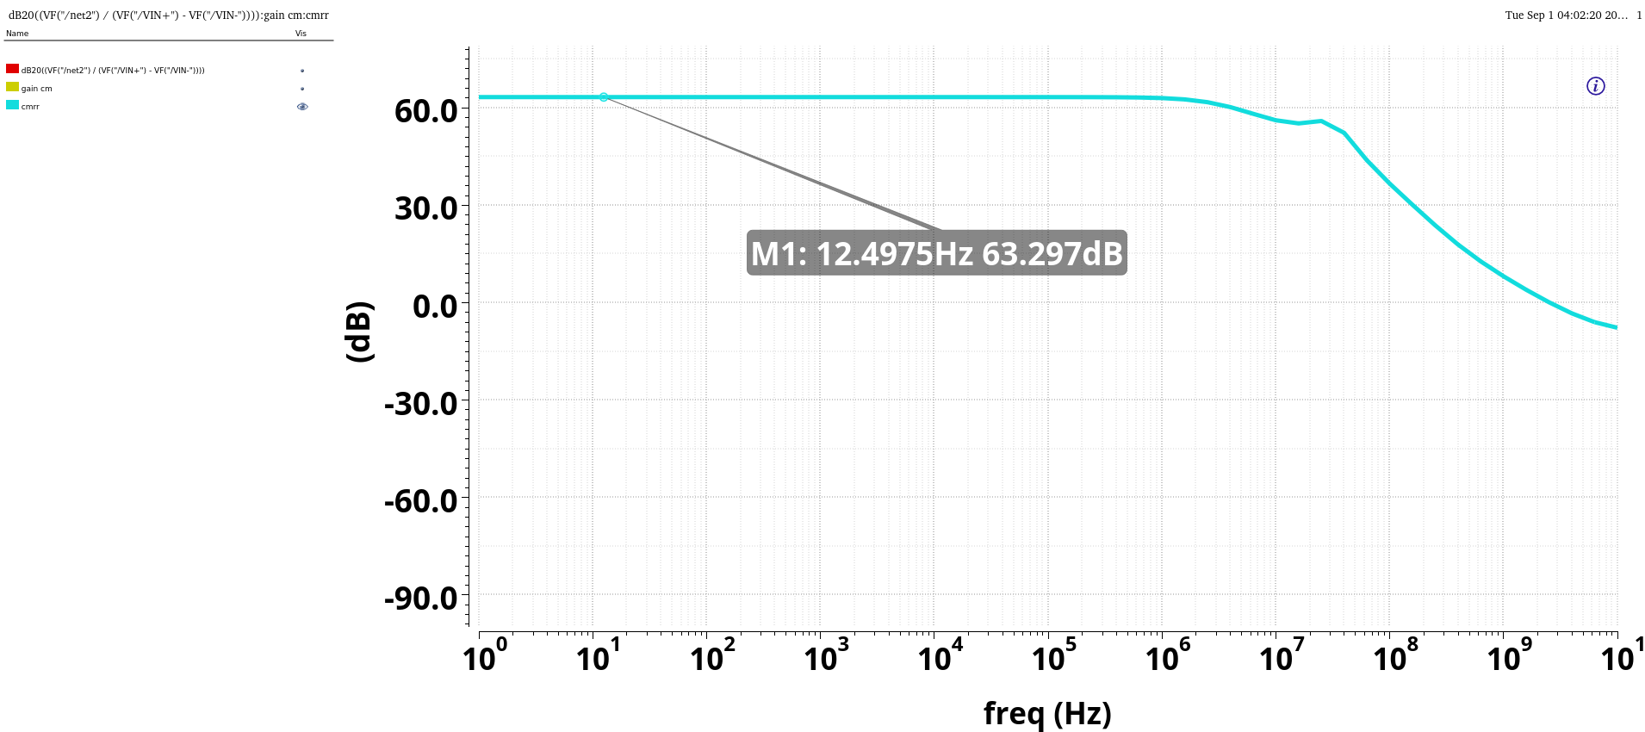
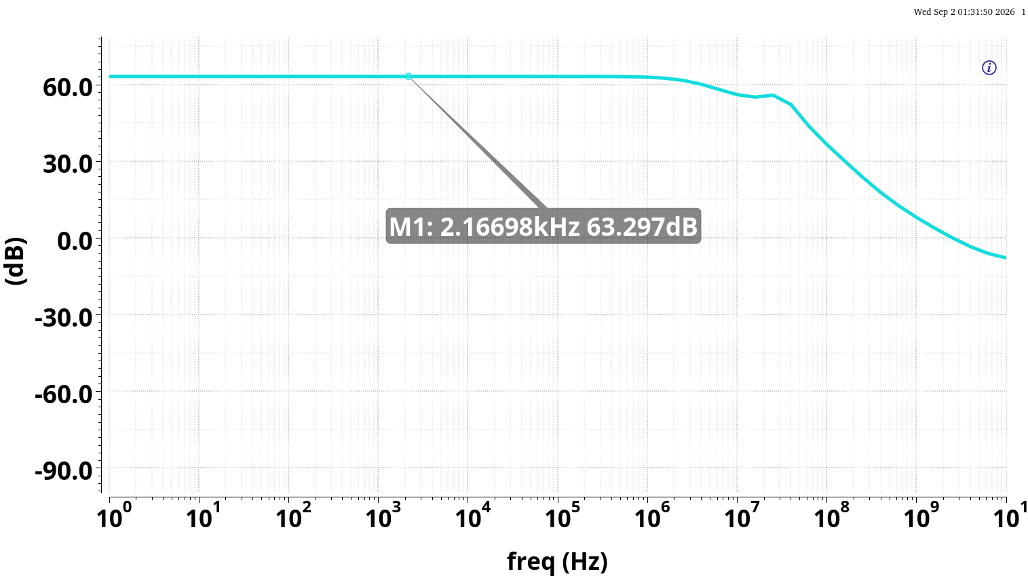
CMRR

Slide 14
Target Vs Results
Parameter | Target | Achieved
Open-Loop DC Gain (Av​) | >75.0 dB | 64.0 dB
Unity-Gain Bandwidth (UGBW) | 90.0 MHz | 51.79 MHz
Phase Margin (PM) | >45.0 degrees | 53.74 degrees
Slew Rate (SR) | 20v/u sec | 29.0 V/u sec
Total Power Consumption | <1.0 mW | 0.47 mW

Slide 15

Tradeoffs
1. Gain-Bandwidth (GBW) vs. Stability (PM)
Higher Bandwidth (UGBW) → Needs smaller Cc
Higher Stability (PM) → Needs larger Cc​ (enhances pole splitting)
2.Slew rate VS Phase margin
For high slew rate – less Cc
For higher phase margin – more cc
3.Gain VS Bandwidth
Bandwidth=(UGBW / Gain)

Slide 16
Layout Learnings
Floor plans:
Placed in symmetrical manner
Each transistor exposed to similar environment
Symmetrical changes in properties (Vth,Vgs etc)
D D D D
D A B D For PMOS current source load
D D D D
D D D D D D D D D D
D A B B A A B B A D For NMOS differential input amplifier
D D D D D D D D D D

Slide 17
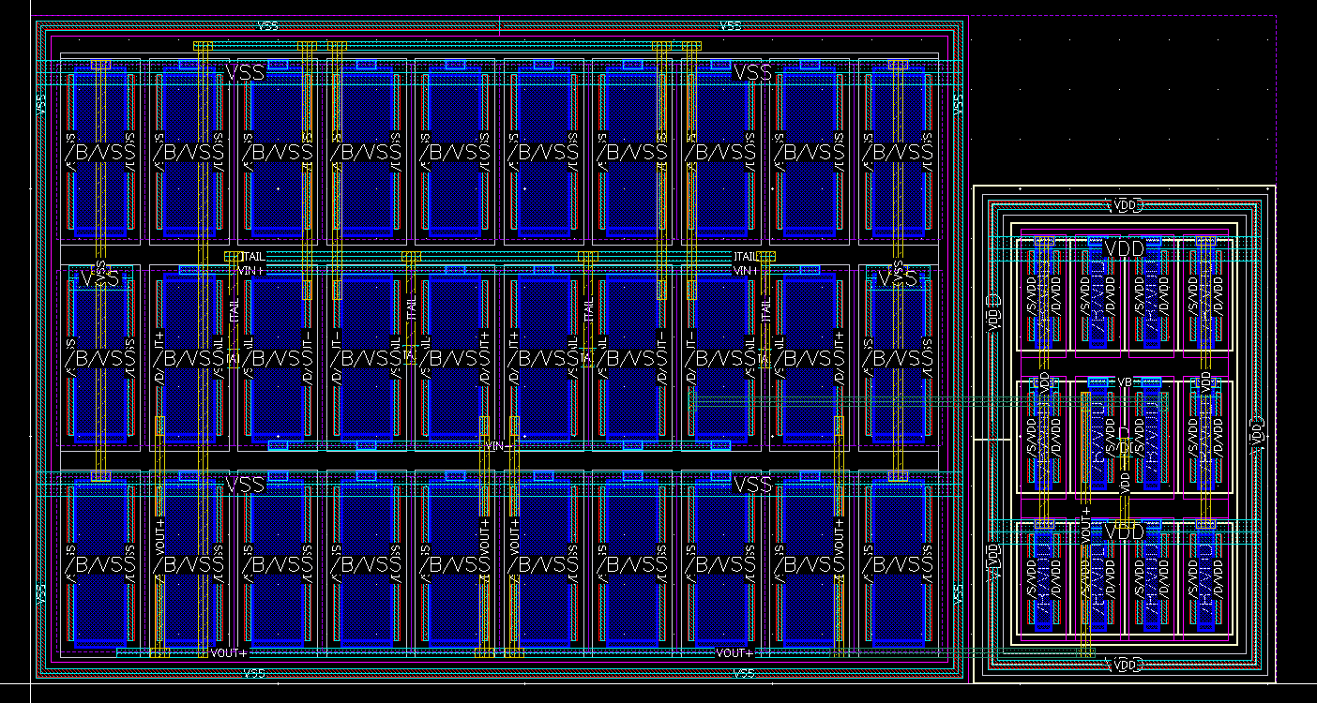
Layout

Slide 18

Layout Learnings
Basics:
Vertical Connections
Horizontal Connections:
Vias/Contacts
Horizontal spacing
Vertical spacing
Guard rings:
A continuous ring of metal and substrate contacts surrounding a set of transistors to shield sensitive circuit nodes from substrate noise
Tests
DRC (Design Rule Check)
LVS LVS Quantus

Slide 19
Layout Flow
Alignment of transistor
DRC , LVS , LVS Quantus
Post layout simulations
Connections

Slide 20
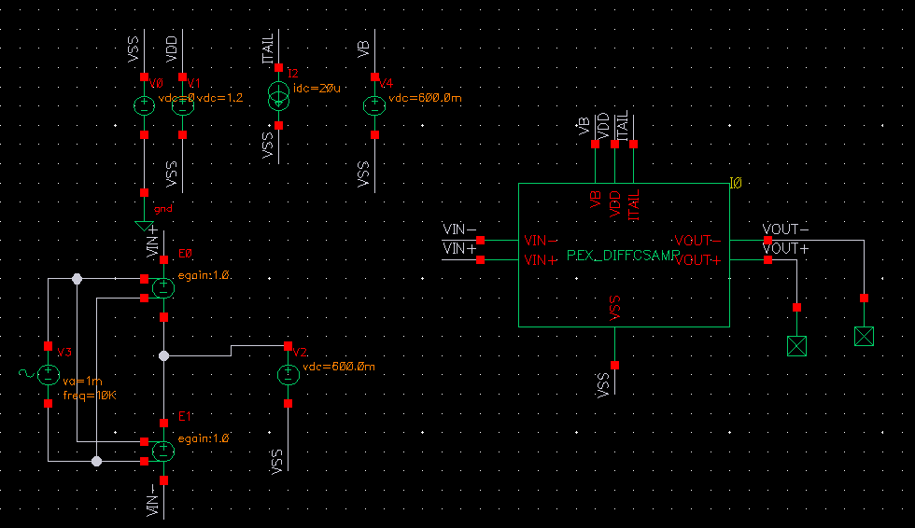
Post layout simulation setup

Slide 21
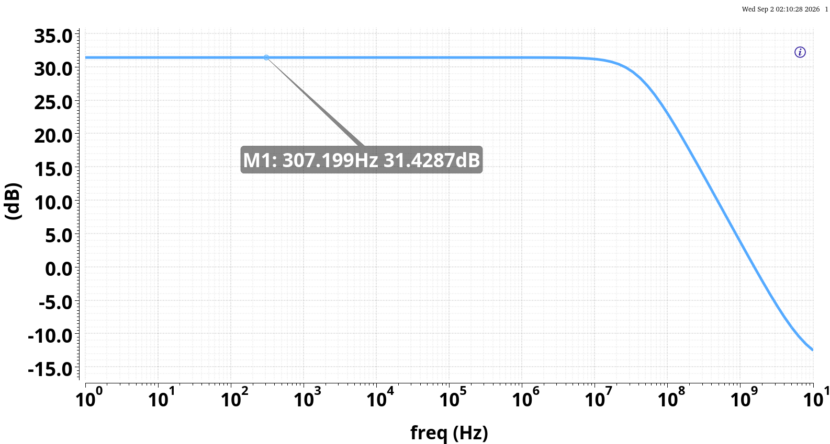
Post layout simulation results
Schematic gain=31.2dB

