Slide 1


Reddit Stock Analysis using AWS Cloud Analytics Services
By Group Husky-6
Anubhav Saha
Ashishkumar Bidap
Ashlesha Kshirsagar
Priyanka Nagesh Adiga
Nikhil Sanjay Thorat
ITC6460 Northeastern University,Boston

Slide 2
Index
Objective
Introduction
Execution Summary
Assumptions
Architecture Design
AWS Services
Demo
Challenges and Future Scope
Conclusion
ITC6460 Northeastern University,Boston

Slide 3
Objective
Finding out about stocks before they make the news using Reddit Data , Nasdaq Data & Cloud Analytics Services from Amazon Web Services.
ITC6460 Northeastern University,Boston

Slide 4
Introduction
Reddit and WallStreetBets blew up Gamestop’s Stock
Identifying the stocks which are being discussed on Reddit.
Understanding the sentiment of the overall conversation.
Automating the workflow for seamless user experience
AWS Cloud Analytical Services
Serverless Architecture
ITC6460 Northeastern University,Boston

Slide 5
Executive Summary
User Chatbot interaction
Reddit data and Nasdaq data
Stocks Names and overall Sentiment of discussions
Interactive Dashboard to understand market trend
ITC6460 Northeastern University,Boston

Slide 6
Assumptions
Redditors on the channel “/WallStreetBets” discuss only about stocks & option trading.
We are analyzing the top 100 trending posts of reddit only assuming the top 100 posts are the ones which are highly upvoted and active on the “/WallStreetBets” channel.
Nasdaq has been the place for the fast-growing stocks thus we have considered Nasdaq stocks data in our analysis.
ITC6460 Northeastern University,Boston

Slide 7
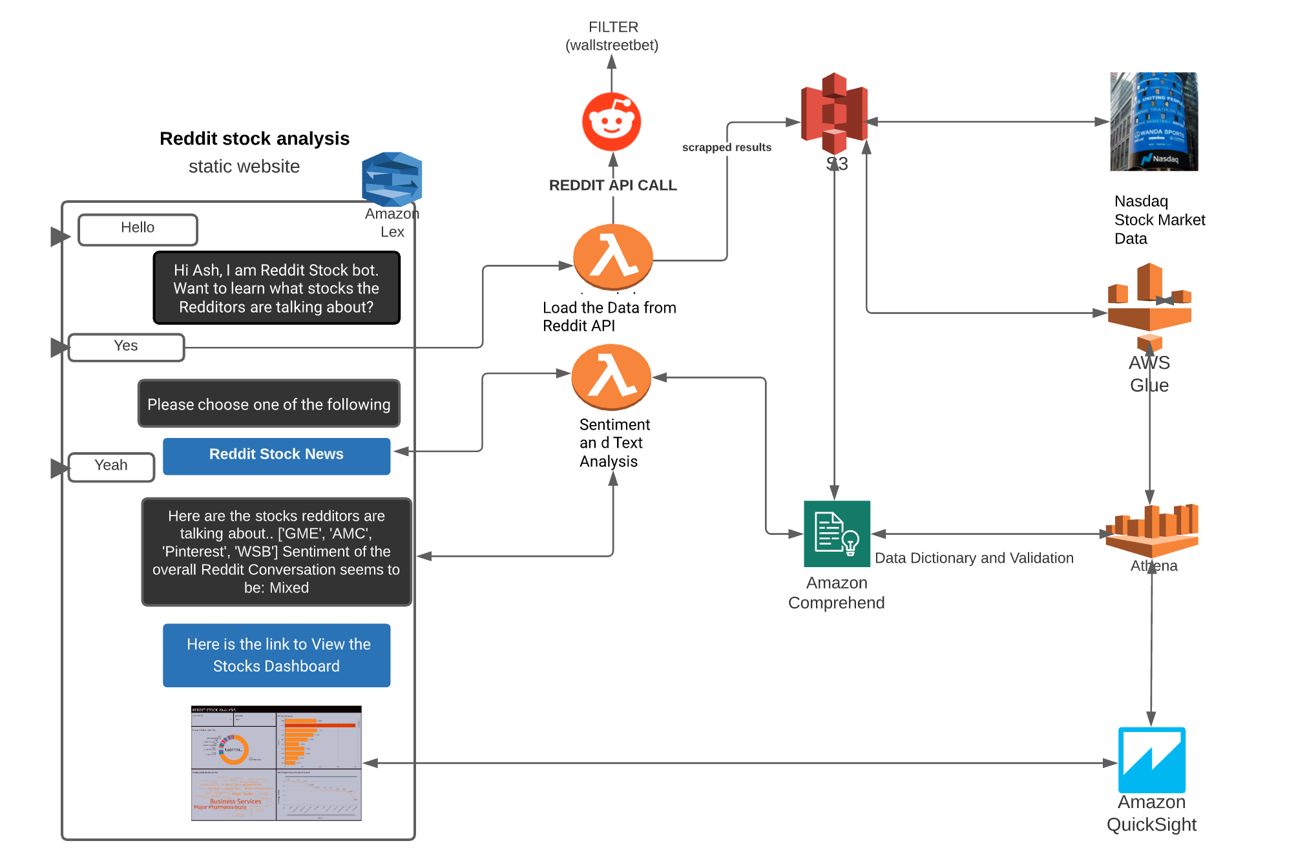
Architecture Design
ITC6460 Northeastern University,Boston

Slide 8







AWS Services
Amazon Lex : Conversational User Interface
AWS Lambda : Lambda Triggers to collect data from Reddit upon specific Lex Intent.
Amazon Comprehend : Text Analytics [Detect Entities & Detect Sentiment ]
Amazon S3 : Storage of the Output files [reddit scrapped data & nasdaq stock data]
AWS Glue & AWS Athena : Athena Table for the Nasdaq Stocks Data
Amazon QuickSight : Interactive dashboard allowing users to visualize the stock data attributes.
ITC6460 Northeastern University,Boston

Slide 9
DEMO
ITC6460 Northeastern University,Boston

Slide 10
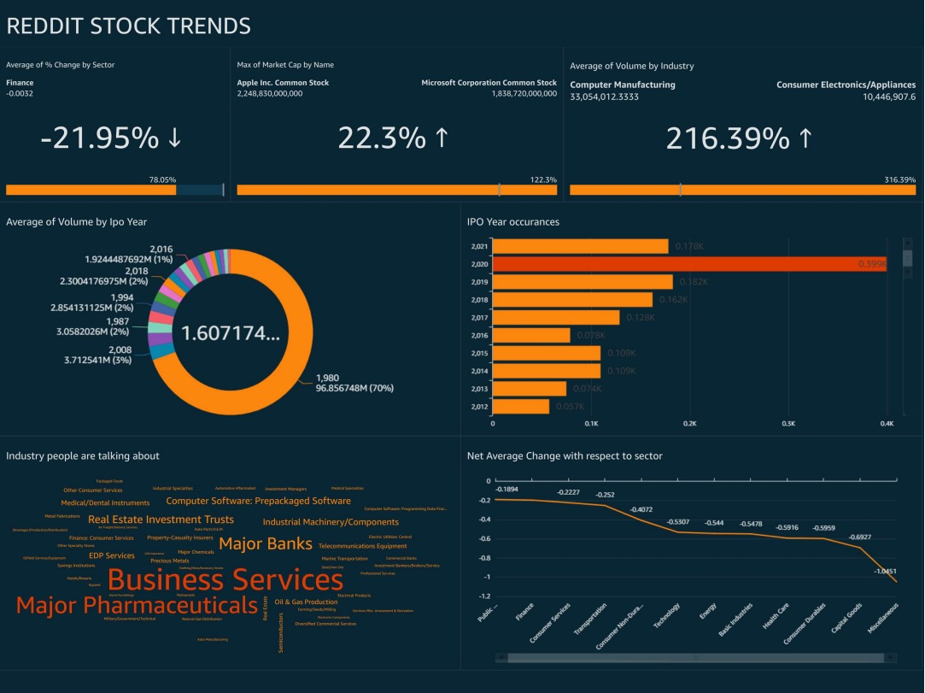
Dashboard Visualizations
ITC6460 Northeastern University,Boston

Slide 11
Challenges
Limitations in the size of data that can be analyzed at a time by Comprehend.
Limitations on the execution time of the lambda function used in fulfilling an intent.
Limitation with the publicly shareable quicksight dashboard , as these links come only with premium subscription.
ITC6460 Northeastern University,Boston

Slide 12
Future Scope
Adding additional stock data attributes to the workflow allowing the user to deep dive into the history of the respective stock.
Adding NYSE stock data along with the existing NASDAQ stocks data.
Can Incorporate more intents related to a specific stock over the conversational Interface.
Provide sufficient data for decision making.
Near Real Time Stock data collection and Analysis
ITC6460 Northeastern University,Boston

Slide 13
Conclusion
Thus our solution delivered
Provides a Conversational User Interface deployed on a webpage
Allows the User to understand the stock trends on Reddit
Allows visualizing the Stock Attributes using Interactive Dashboard
Is a Intent Driven Data Flow Pipeline
Is a Serverless Architecture
Utilizes the AWS Cloud Analytics Services
ITC6460 Northeastern University,Boston

Slide 14
References
[1] Phillips, Lorenz, ( Jan 27, 2021). GameStop vs. Wall Street. Retrieved from
https://www.nytimes.com/2021/01/27/business/gamestop-wall-street-bets.html
[2] AWS (n.d.). Featured Services. Retrieved from https://aws.amazon.com/#
[3] AWS Comprehend: Guidelines and Quotas
https://docs.aws.amazon.com/comprehend/latest/dg/guidelines-and-limits.html
ITC6460 Northeastern University,Boston

Slide 15
Thank You
Questions?
ITC6460 Northeastern University,Boston

