Slide 1
Leads' In!
Sangram Kapre
November 8th, 2013

Slide 2
Contents
Introduction
Architecture
Back End (Flask - Python)
Front End (AngularJs - Javascript)
Deployment (Nginx - UWSGI)
Demo
Current Issues
Future Work

Slide 3


Technologies Used

Slide 4
Why AngularJS?
HTML – only static views
Alternatives provide an imperative way
Extensible
Two way Data binding
MVC
Good support, designed with testability in mind
...in other words, it's everything you need.

Slide 5
AngularJS
By Google
First release in 2010, latest stable version: v1.0.7 (monochromatic-rainbow)
Client side MVC framework
Open Source
Declarative, not Imperative
Two way Data-binding

Slide 6
Front end Structure
$rootScope
Services
Template
controllers
controllers
controllers

Slide 7
DEMO

Slide 8
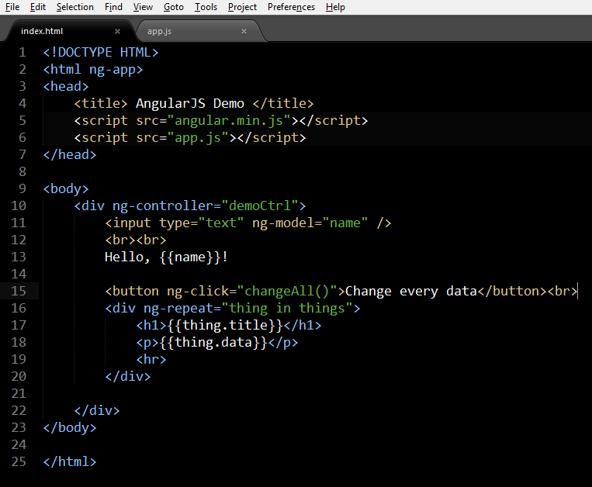
The 'M', the 'V' and the 'C' in Angular
View.

Slide 9
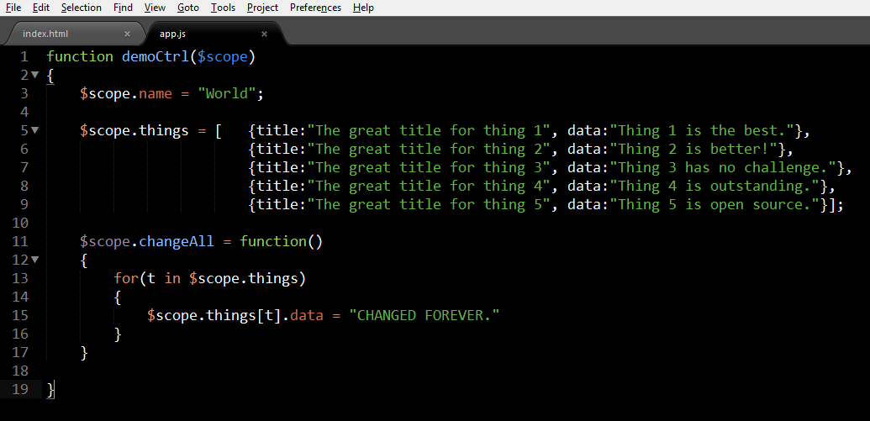
The 'M', the 'V' and the 'C' in Angular
Model.

Slide 10
The 'M', the 'V' and the 'C' in Angular
Controller

Slide 11
Dependency Injection
aka “Hey, I need X”
function EditCtrl($scope, $location, $routeParams)
{
// Something clever here...
}

Slide 12
Directives
Extending HTML
So that something like
  <item title=”ThisItem” cost=”200” image=”/path/img.jpg”> Item text </item>
  Or
  <carousel interval=”2000”>
    <slider width=”200” height=”400”>
    <div>...</div>
    </slider>
    </carousel>
is Possible.

Slide 13
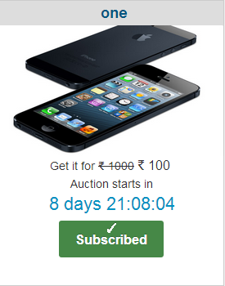
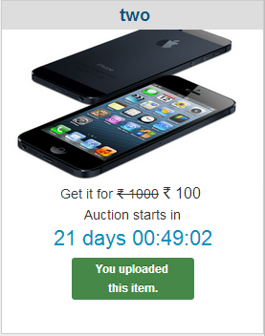
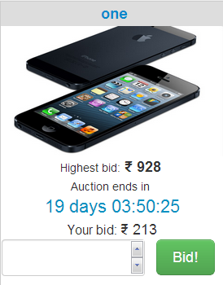
Dynamic updates
Changes depending of state of an auction
Changes depending on state + role of the user

Slide 14
Problems I faced
When CSS becomes the villain
Angular – Jquery clash
Angular's Dirty read mechanism
API bug
If...else in HTML!
Reuse is not always good
New everything – Technologies, way of working, serious deadlines, Definite structure

Slide 15
Future plans in Front end
Structural improvements
Alerts handling
More Dynamism
Better UX
More categories – better navigation
Documentation, etc

Slide 16
Questions?

