Slide 1
Ray Tracing the Real and the Unreal
By:
Ivan Oropeza
Aashish Sheshadri

Slide 2
Ray Tracing the Real and the Unreal
Our new ray tracer
Adaptive Sampling
Texture Mapping
Bump Mapping
Depth of Field
A non-photo realistic illumination model
Edge rendering algorithm

Slide 3
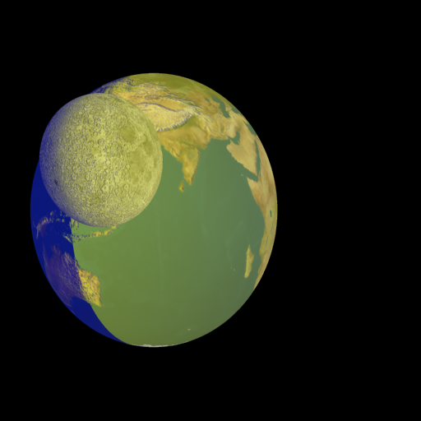
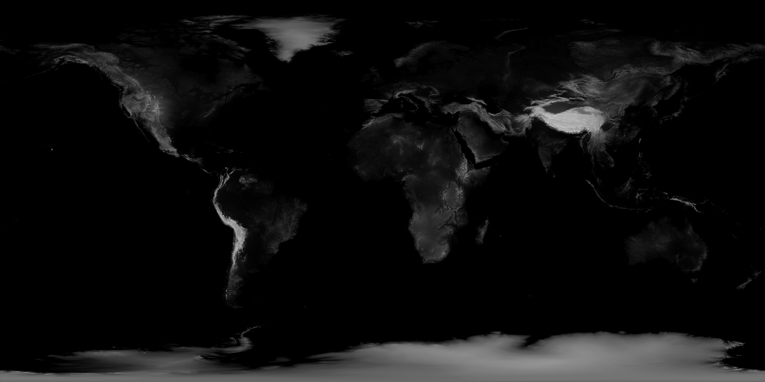
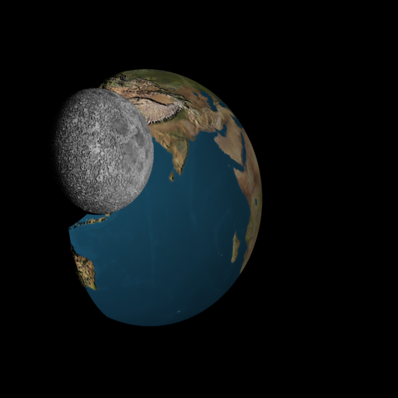
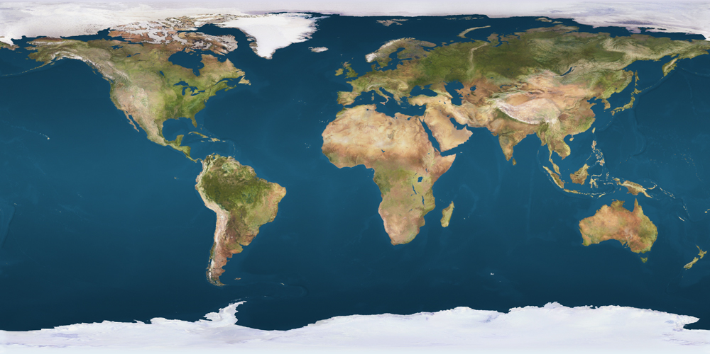
Texture and Bump Mapping
UV coordinates

Slide 4
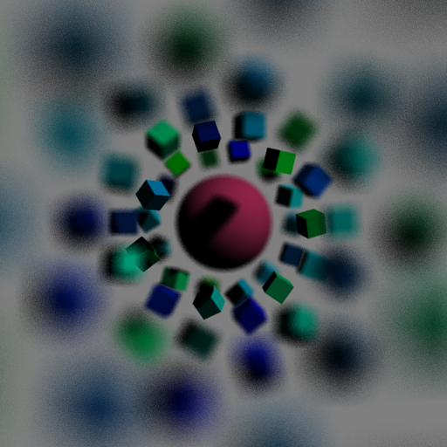
Depth of Field
Blurring effect caused by the lens of the camera
Stronger effect as the diameter of lens increases

Slide 5
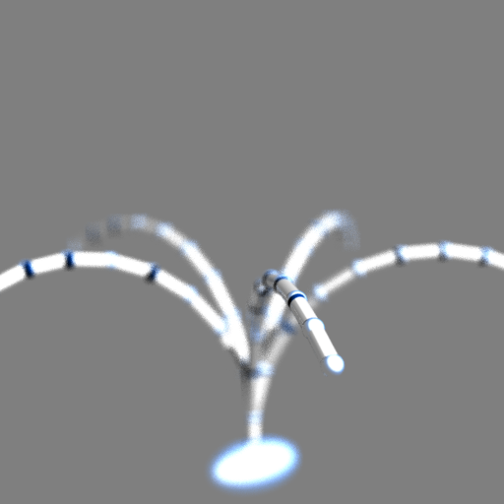
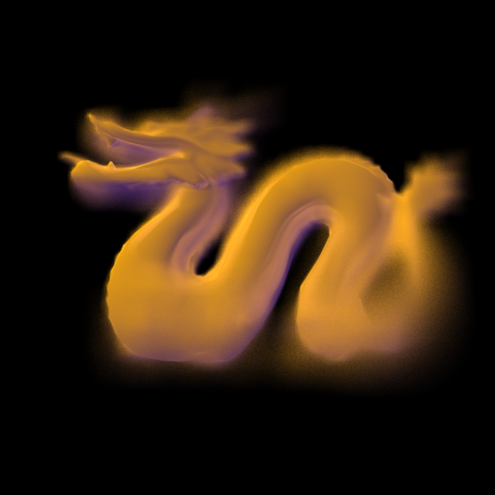
Depth of Field

Slide 6

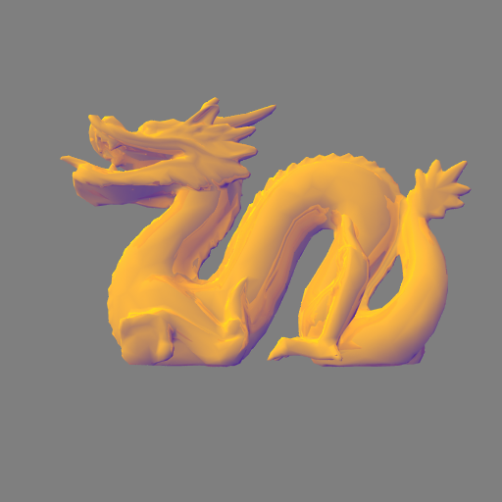
Illumination Model
Use of edges
Use of warmness and coolness
Lack of shadowing
Anisotropic renditions of metal objects

Slide 7

Edge Drawing
A pixel X is part of an edge if there exists a pixel Y in the neighborhood such that:
depth is above a predetermined threshold
high variance in view angel
view angle approaches 90

Slide 8
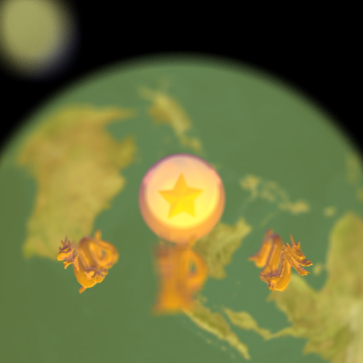
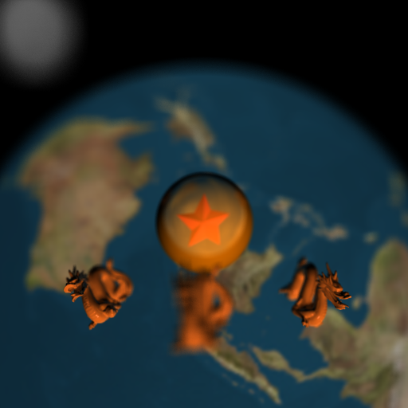
Thank you

Slide 9
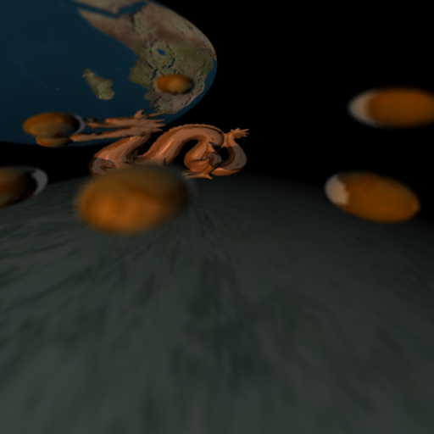
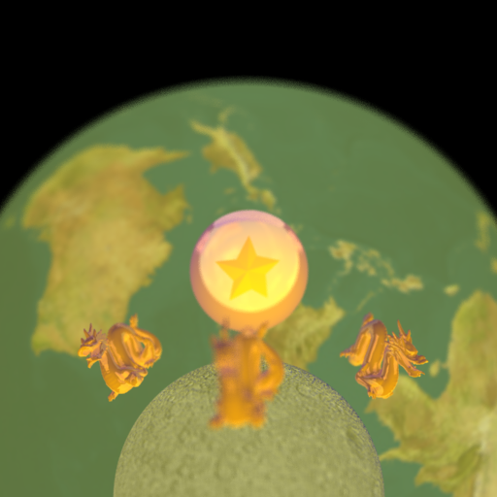
Questions?

