Slide 1
Historical Stock Market
Algorithm Analyzer
Maximum subarray and Top-K on the Kaggle S&P 500 history
Aashish Joshi Aron Dardouri
Bhartendra Kumar Mandal Brian Lucero
CPS 3440 Analysis of Algorithms · Kean University
Notes:
Aashish Joshi opens. See SPEAKER_SCRIPT.md, slide 1.

Slide 2
Two questions, one price file
Best single buy and a later sell: the maximum subarray of daily adjusted-close changes.
That sum is the profit per share. Ties keep the earliest window. A fully negative series means do not trade.
Largest movers: Top-K under the order (higher return, then earlier ticker).
On Apple in this file, every window algorithm returns the same trade: buy 8 October 2002 at $0.20, sell 2 December 2025 at $285.92, profit $285.72 per share.
Among 472 stocks, NVDA leads buy-and-hold return at 210,811.11 percent.
Aashish Joshi · CPS 3440
2 / 13
Notes:
Aashish Joshi. See presentation/SPEAKER_SCRIPT.md for the timed lines on this slide.

Slide 3
The downloaded Kaggle file
Source: jacksaleeby/s-and-p500-historical-data, file SP500_Historical_Data.csv.
Columns: Ticker, Date, Open, High, Low, Close, Adj Close, Volume.
2,703,531 rows, 472 tickers, 3 January 2000 through 20 February 2026.
2,703,059 daily changes, stored as integer micro-dollars so the three window algorithms compare the same integers.
Scaling inputs are prefixes of 1,000, 10,000, 100,000, and 1,000,000 records from that file.
python3 -m analyzer reads this CSV by default. --fetch is an optional Yahoo Finance fallback and was not used for the measurements.
Aashish Joshi · CPS 3440
3 / 13
Notes:
Aashish Joshi. See presentation/SPEAKER_SCRIPT.md for the timed lines on this slide.

Slide 4
What the tool checks
prices.py loads adjusted closes and turns them into daily changes.
max_subarray.py runs brute force, divide and conquer, and Kadane on one ticker.
top_k.py ranks the universe with a full sort, a size-K heap, and quickselect.
The command line prints both groups and says whether they agree.
On the Kaggle file they do agree: one Apple window, and the same top 10 movers.
Unit tests cover the CLRS example, all-negative arrays, ties, and the offline sample.
Aashish Joshi · CPS 3440
4 / 13
Notes:
Aashish Joshi. See presentation/SPEAKER_SCRIPT.md for the timed lines on this slide.

Slide 5
Brute force examines every window
Build a prefix array, then score every start and end with one subtraction.
Every nonempty window is considered once, so the best pair is the best window.
Best, average, and worst time are all Θ(n²). The loops do not stop early.
Extra space is the prefix, Θ(n).
Measured medians, 5 trials: 60.184 ms at 1,000 records and 17.65 s at 10,000.
The log-log slope on that decade is 2.47. The model value is 2. The pair count is exactly n(n+1)/2.
Aron Dardouri · CPS 3440
5 / 13
Notes:
Aron Dardouri. See presentation/SPEAKER_SCRIPT.md for the timed lines on this slide.

Slide 6
What was timed, and what was projected
Each cell is the median of 5 trials of the production function on one fixed prefix.
The second metric is an operation count: pairs, element reads, or comparisons.
Brute force is executed only through 10,000 records. One trial there is already 17.65 seconds.
100,000 records projects to 29.4 min projected.
1,000,000 records projects to 49.0 h projected.
Those two times were not measured. The dashed line on the figure is the n² projection. The pair count at those sizes is still exact.
Aron Dardouri · CPS 3440
6 / 13
Notes:
Aron Dardouri. See presentation/SPEAKER_SCRIPT.md for the timed lines on this slide.

Slide 7
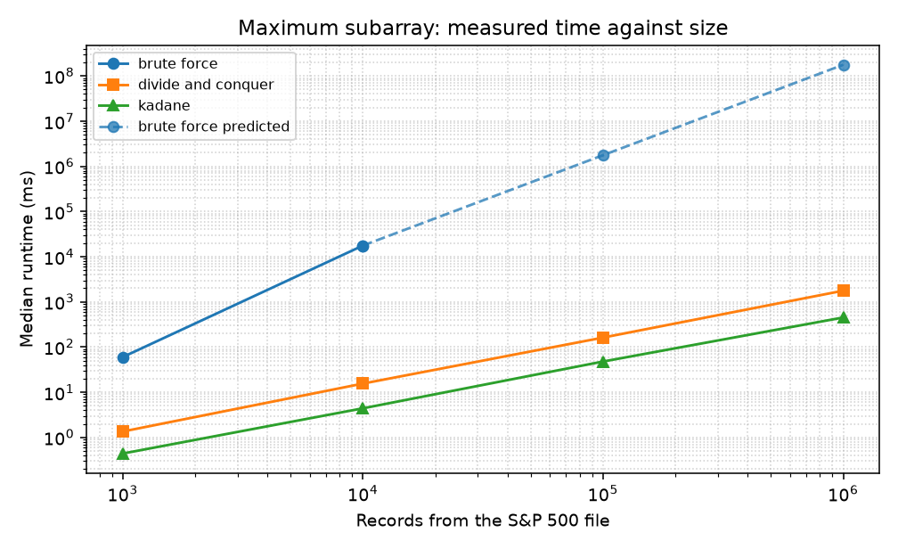
The window algorithms, on the clock
At 10,000 changes:
Brute force 17.65 s
Divide and conquer 15.562 ms
Kadane 4.415 ms
Brute force is about 3,997× Kadane at that size.
At 1,000,000 changes Kadane takes 451.386 ms.
The brute-force cell there is 49.0 h projected, and it was not run.
Solid marks were timed. The dashed brute-force segment is the projection from the 10,000-record median.
Aron Dardouri · CPS 3440
7 / 13
Notes:
Aron Dardouri. See presentation/SPEAKER_SCRIPT.md for the timed lines on this slide.

Slide 8
Divide and conquer
An optimal window is entirely on the left, entirely on the right, or it crosses the midpoint.
The crossing window is a maximum suffix of the left half plus a maximum prefix of the right half.
That case is what makes the induction work. Ties keep the earlier index.
Recurrence: T(n) = 2T(n/2) + Θ(n). The Master Theorem gives Θ(n log n) on every input.
Extra space is the Θ(log n) recursion stack.
At 1,000,000 records the dry run counts 20,951,424 element reads. The measured median is 1.77 s.
Bhartendra Kumar Mandal · CPS 3440
8 / 13
Notes:
Bhartendra Kumar Mandal. See presentation/SPEAKER_SCRIPT.md for the timed lines on this slide.

Slide 9
The clock and the recurrence
Kadane keeps a running sum and drops it when it goes negative. One pass, Θ(n) in every case, Θ(1) extra words.
Its wall-clock slope from 1,000 to 1,000,000 records is 1.00. The median at one million records is 451.386 ms.
Divide and conquer's read count grows like n log n. Its wall-clock slope from 10,000 to 1,000,000 is 1.03, because each Python call allocates a result.
The reads follow the Master Theorem. The clock says which algorithm to ship.
At one million records that choice is Kadane at 451.386 ms, against divide and conquer at 1.77 s.
All three algorithms agree on every prefix where brute force was executed, and Kadane agrees with divide and conquer at the two larger sizes.
Bhartendra Kumar Mandal · CPS 3440
9 / 13
Notes:
Bhartendra Kumar Mandal. See presentation/SPEAKER_SCRIPT.md for the timed lines on this slide.

Slide 10
Sort versus a size-10 heap
Both algorithms use one total order: higher score, then earlier name. The tests require the same K names, including ties.
Timsort is Θ(n) on one long run and Θ(n log n) on average and in the worst case. Extra space is Θ(n).
The heap holds the K weakest-at-the-root survivors. Worst-case time is Θ(n log k). Best-case time is Θ(n + k log k). Extra space is Θ(k).
Market order, one million daily moves, k = 10:
Full sort 595.979 ms and 13,709,082 comparisons.
Binary heap 176.620 ms and 1,000,374 comparisons.
Brian Lucero · CPS 3440
10 / 13
Notes:
Brian Lucero. See presentation/SPEAKER_SCRIPT.md for the timed lines on this slide.

Slide 11
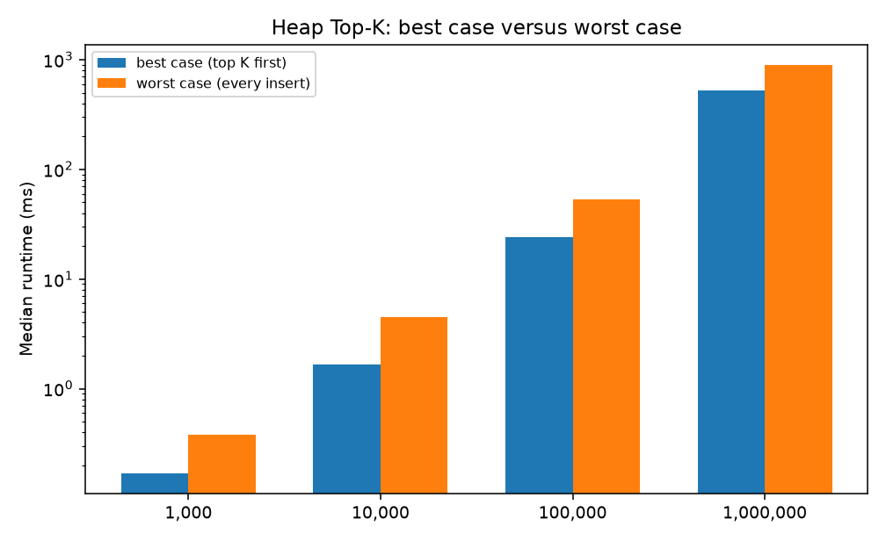
Best case, worst case, and the clock
Comparison counts at one million records:
Heap, top K first: 1,000,009
Heap, market order: 1,000,374
Heap, every insert: 4,399,965
Clocks: market 176.620 ms, prepared best case 521.392 ms, worst case 893.913 ms.
The prepared arrays are permutations, so the best-case clock is slower than market order. The comparison count is the case split.
On a sorted run Timsort drops to n − 1 comparisons. At one million records the clock barely moves.
Log scale. Worst case stays above best case at every size. Market order, not shown here, is faster in wall-clock time at the large sizes.
Brian Lucero · CPS 3440
11 / 13
Notes:
Brian Lucero. See presentation/SPEAKER_SCRIPT.md for the timed lines on this slide.

Slide 12
Algorithmic Efficiency versus Computational Hardness
Efficiency is a property of an algorithm. Hardness is a property of a problem.
Brute force for this window is a correct polynomial. It is the wrong polynomial. Kadane puts maximum subarray in P.
The dashed line is an efficiency statement: this Python brute force projects to 49.0 h projected at one million records. That trial was not run. Kadane finishes the same input in 451.386 ms.
Cardinality-constrained mean-variance portfolio selection is NP-hard. The chosen names interact through a covariance matrix.
Top-K does not solve that problem. A heap of size K is optimal only when the score of a set is the sum of the scores of its members.
A faster language multiplies the constant on the double loop. It does not put the portfolio problem in P.
Bhartendra Kumar Mandal · CPS 3440
12 / 13
Notes:
Bhartendra Kumar Mandal. See presentation/SPEAKER_SCRIPT.md for the timed lines on this slide.

Slide 13

The site, the paper, and the repository
GitHub Pages serves docs/: the tables, the four figures, and the paper.
Brute force at 100,000 and 1,000,000 records is labeled projected on the site and in the PDF.
The paper is 10 pages. It includes the efficiency-versus-hardness section and CLO reflections A through D.
Slides and this script live in presentation/. Resume lines are in CONTRIBUTIONS.md.
https://aashish000000.github.io/CPS3440-Stock-Algorithm-Analyzer/
Scan for the project site
Aashish Joshi · CPS 3440
13 / 13
Notes:
Aashish Joshi. See presentation/SPEAKER_SCRIPT.md for the timed lines on this slide.

