Slide 1


Name-Aashish Bhardwaj
Roll no.-2110990022
Group-G5
Year-3rd (5 Semester)
Instructor-Lavish Arora

Slide 2

College Marketplace Website Design
An engaging college marketplace website made with HTML, CSS, JavaScript, and Bootstrap. Experience seamless navigation with 10 pages including homepage, store, advertisement, contact us, and more.

Slide 3

All about College Marketplace
Facebook Marketplace and amazon are great but often times you have to drive a long way to meet up and pay for shipping . Student marketplace lets you know what is available at your college.
It is safer and easy to use.
We only sell and buy verified users.
100% college audience which allows less or none scams.

Slide 4
Store
You can buy and sell anything , For example-
Clothing
Shoes
Explore a trendy collection of clothing items for students, from stylish apparel to comfortable loungewear.
Discover a wide range of footwear options to suit every style and occasion, from sneakers to formal shoes.
Watches
Book Hub
Stay on time and in style with our selection of watches, ranging from classic designs to modern smartwatches.
Find all the textbooks and e-books you need for your courses, conveniently sorted by subject and title.

Slide 5
Advertisement
Boost Your Sales
Reach a diverse audience of college students and promote your products through personalized advertisements.
Special Offers – Yearly , Monthly and Weekly packages
Expand your reach and establish a strong presence in the college market with targeted advertising campaigns.
Increase Brand Visibility
Stand out from competitors and create brand recognition among college students with eye-catching ads.

Slide 6

Contact Us
Have a question, feedback, or need assistance? Our dedicated team is available to assist you. Get in touch with us today!

Slide 7

About Us
After a scare using Facebook Marketplace his freshman year of College, We have the idea for a college ONLY marketplace. This would be a platform where students would not have to worry about dangerous individuals or scammers while buying and selling items online and in their campus community. It would be the perfect accessory for anyone's college experience.

Slide 8

We Also Provide Learning Courses
1
Explore New Topics
Broaden your knowledge and skills with our diverse range of online learning courses taught by industry experts.
2
Interactive Learning
Engage in interactive lessons, quizzes, and discussions to enhance your understanding and retention of course material.
3
Earn Certificates
Complete courses and earn certificates to showcase your achievements and enhance your resume.

Slide 9

Sign Up
1
Create an Account
Join our community by creating a personalized account to access exclusive features and benefits.
2
Save Your Preferences
Customize your shopping experience by saving your preferences and receiving personalized recommendations.
3
Keep Track of Orders
Track your orders, manage your wishlist, and have easy access to your purchase history.

Slide 10
Sign In
1
Secure Access
2
Quick Checkout
3
Access Account Features
Log in to your account securely using your email or social media credentials for a hassle-free experience.
Simplify the purchasing process with saved payment details and shipping addresses.
Update your profile, manage notifications, and explore additional account features with ease.

Slide 11


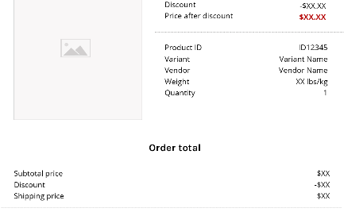
Payment
Secure Online Payment
Accepted Payment Methods
Order Confirmation
Enjoy peace of mind knowing that your transactions are protected with advanced security measures.
Receive instant confirmation and detailed order summaries for every purchase.
Choose from a variety of payment options, including credit cards, digital wallets, and more.

