Slide 1
Ad Click Prediction
(DataViz + ML Pipeline) Using AWS S3, Sagemaker, and Quicksight
Group 1: Aashish Gulabani, Akshita Srivastava, Jiarui Hu, Runan Cao, Shashwat Khare
Notes:
Hi everyone, we are here to present to a Ad click prediction pipeline which leverages big data platforms like AWS S3, Sagemaker and Quicksight. I am Aashish and you’ll hear from my teammates —----

Slide 2

Introduction
Background:
Avazu is a global online marketing company specializing in multi-channel advertising.
Click-through rate (CTR) is a very important metric for evaluating ad performance, click prediction systems are essential and widely used for sponsored search, consumer econometrics and ROI management.
Our Goal:
We aim to provide a robust data exploration and ML pipeline that can be readily utilized by users across the business spectrum for their predictive needs.

Slide 3

Data Description
Source: Kaggle
Columns: 21 features
Banner ad position
Timestamp of click
Site: domain/ category
App: domain/ category
Device: IP /model/ type
Anonymized categorical variables
Records: 41 Million
Training : 10 days of click-through data
Testing : 1 day of ads to predict clicks
Size: 6 GB

Slide 4



Which AWS services are chosen and why?
Amazon S3 (Simple Storage Service)
Object storage built to store and retrieve any amount of data from anywhere.
Amazon Quicksight (Data Visualization)
Cloud-scale business intelligence (BI) service that can be used to deliver easy-to-understand insights through dynamic and interactive dashboards.
Amazon Sagemaker (Python Libraries for creating ML Pipelines)
Helps data scientists and developers to prepare, build, train, and deploy high-quality machine learning models quickly by bringing together a broad set of capabilities purpose-built for machine learning.

Slide 5

Process Flow
- How AWS services integrate in our solution?
Visualization (Dashboard)
Data Storage
Quicksight
Key summaries & Feature exploration
Data
Wrangler
Raw data
S3
Predictive Models
(ML Pipeline)
ML
Models
Sagemaker
Python

Slide 6
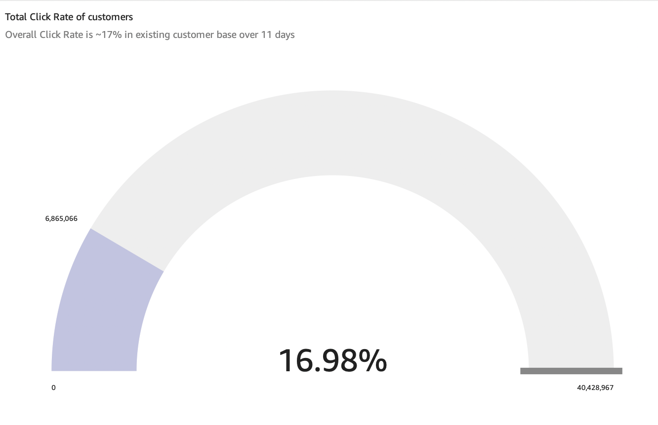
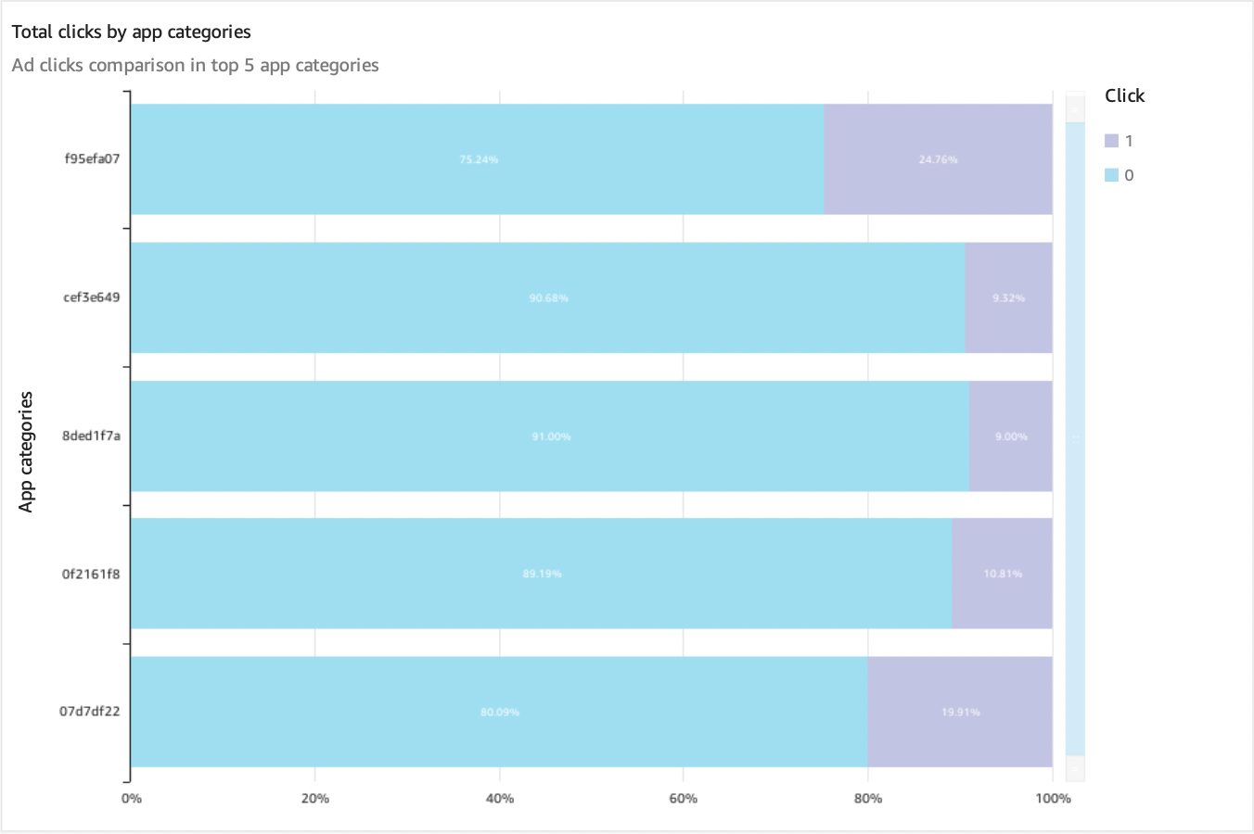
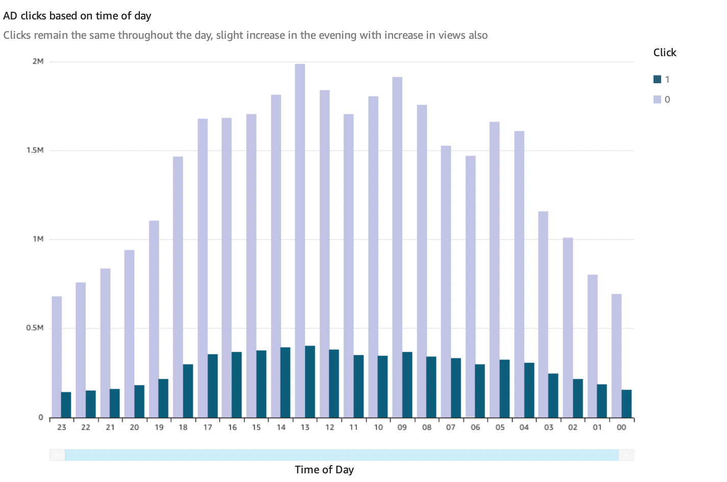
AWS Quicksight Dashboard
- for Data Visualization & Key Trends & Insights
Total users clicking on the ads out of total targeted users
Comparison of app categories getting maximum clicks
Visualization depicting the time of day fetching maximum clicks
Aids business intelligence through dynamic and easy-to-use visuals of key trends & patterns in the data
Uses SPICE “Super-fast, Parallel, In-memory, Calculation, Engine” to provide visualizations, dashboards
Offers easy and direct accessibility to multiple AWS services
“Pay-per-session” advantage over other BI platforms
Notes:
For data visualization and discover the key trends and insights, we utilized

Slide 7
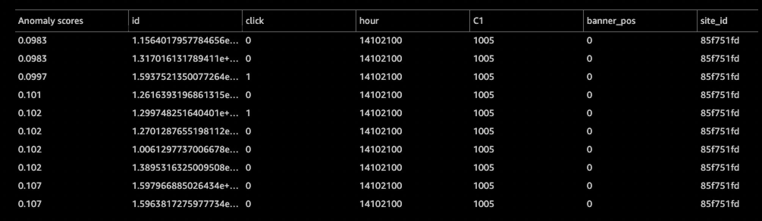
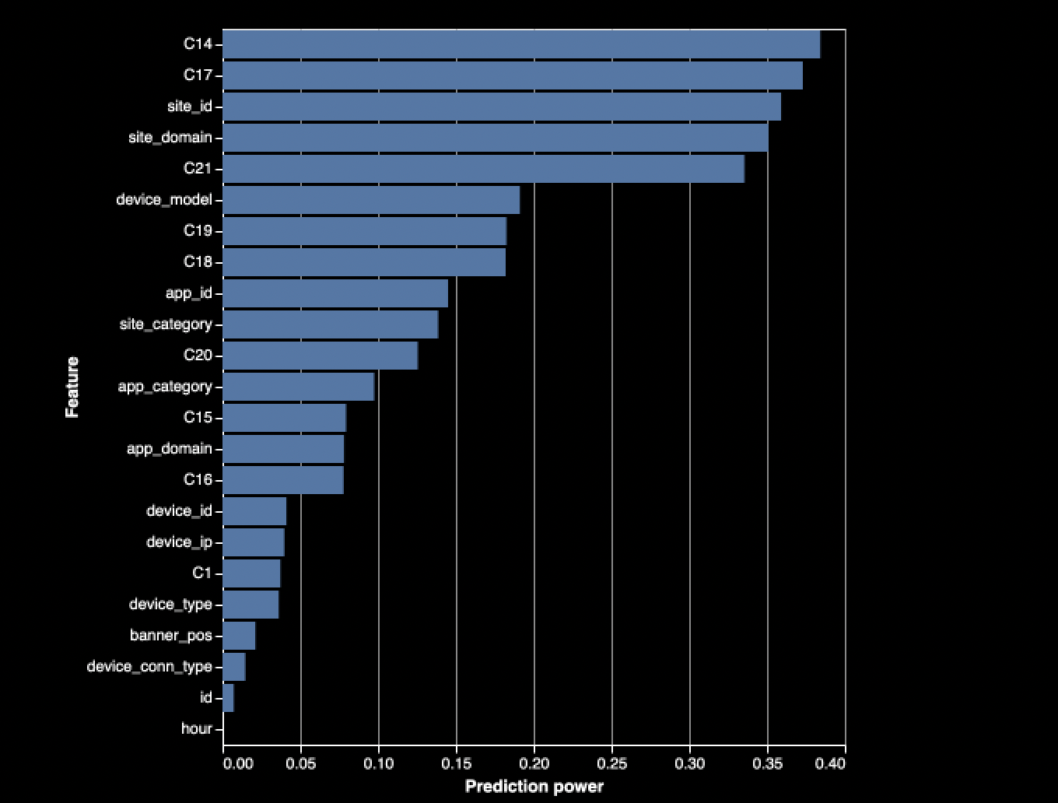
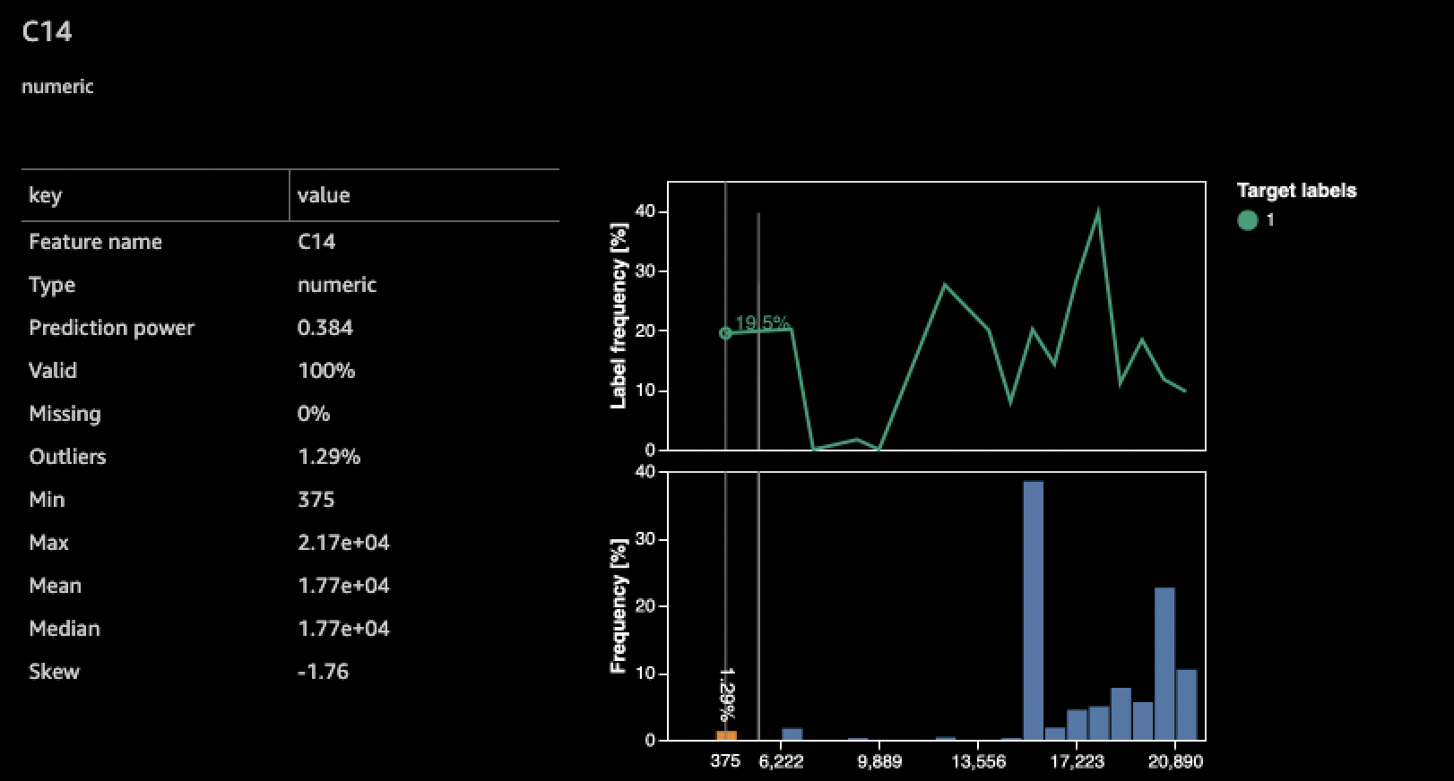
Data Wrangler
- for Feature Exploration and Data Summaries
Anomaly Detection
Feature Importance
Detailed ‘Feature-Level’ summaries
High precision anomaly detection using ‘Isolation Forest’ algorithm
Calculates relative feature importance by fitting a model for each feature
Provides detailed statistical summaries for each feature, along with the histogram distribution plot.

Slide 8
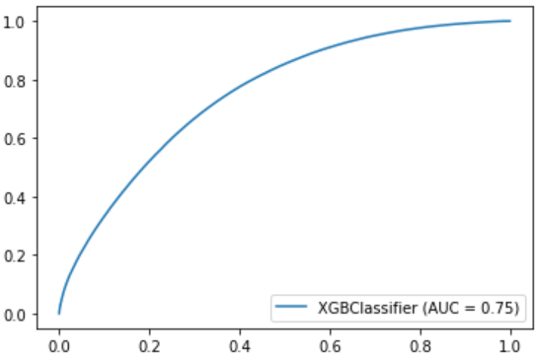
AWS Sagemaker
- for building ML model using Python libraries
ML Building Steps
Split data into training and test sets
Initialize XGBoost model in Sagemaker
Fit the model to the training data
Make predictions on testing data
Model Results
S3
Sagemaker + Python
The model predicts ad clicks with 56% precision
Yields an overall accuracy of 83%

Slide 9
The business value driven by this solution
Dynamic & user friendly
Easy to use
Interactive dashboard for quick insights
A broad set of capabilities purpose-built for ML
Secure, cost-efficient & collaborative
Secure data storage
Allow collaboration
Conduct the whole project in AWS ecosystem
Grow business revenue
Better target the potential customers.
Help different ad channels to achieve monetization.
Improve ROI management.

Slide 10
Thank you!

