Slide 1

DATA ANALYST INTERNSHIP
TASK 1: HR DATA ANALYSIS
By
Aashish Raj

Slide 2
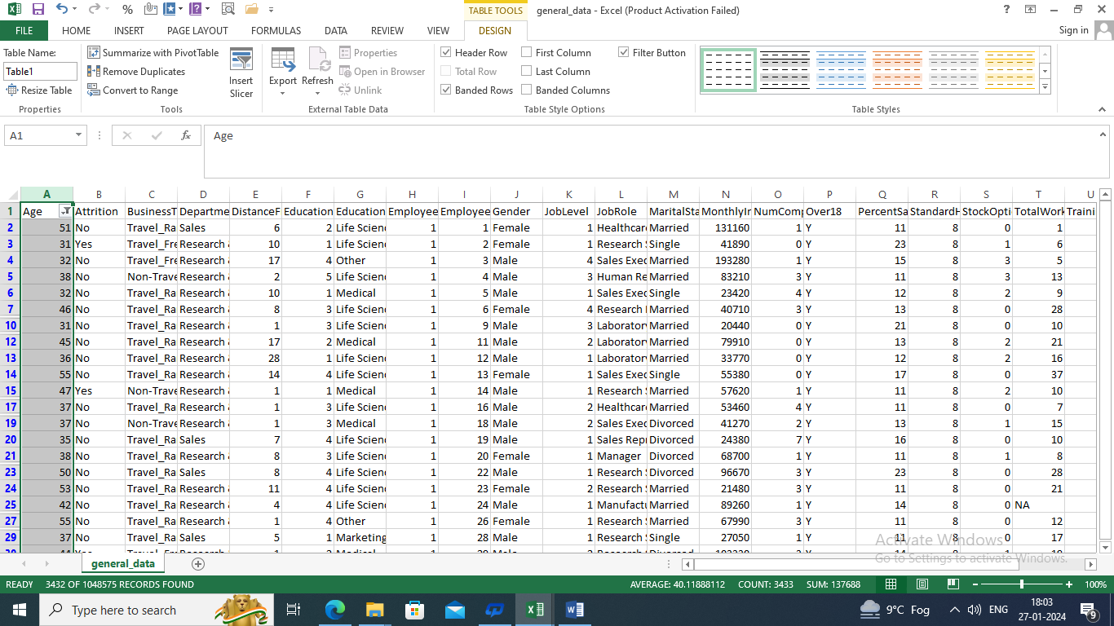
Q1. Using Excel, how would you filter the dataset to only show employees aged 30 and above?

Slide 3
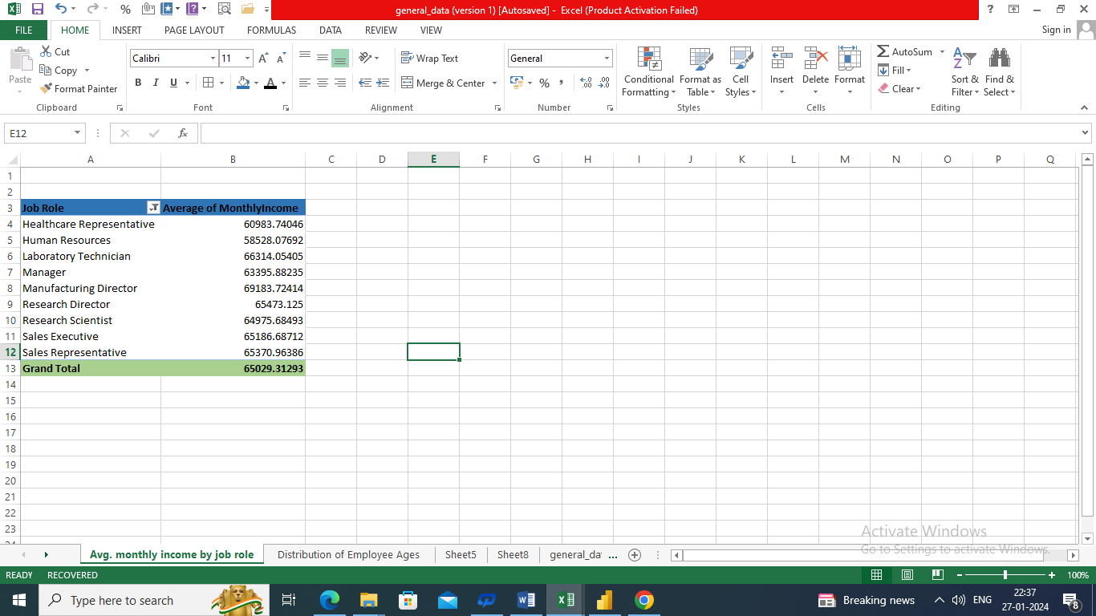
Q2. Create a pivot table to summarize the average Monthly Income by Job Role.

Slide 4
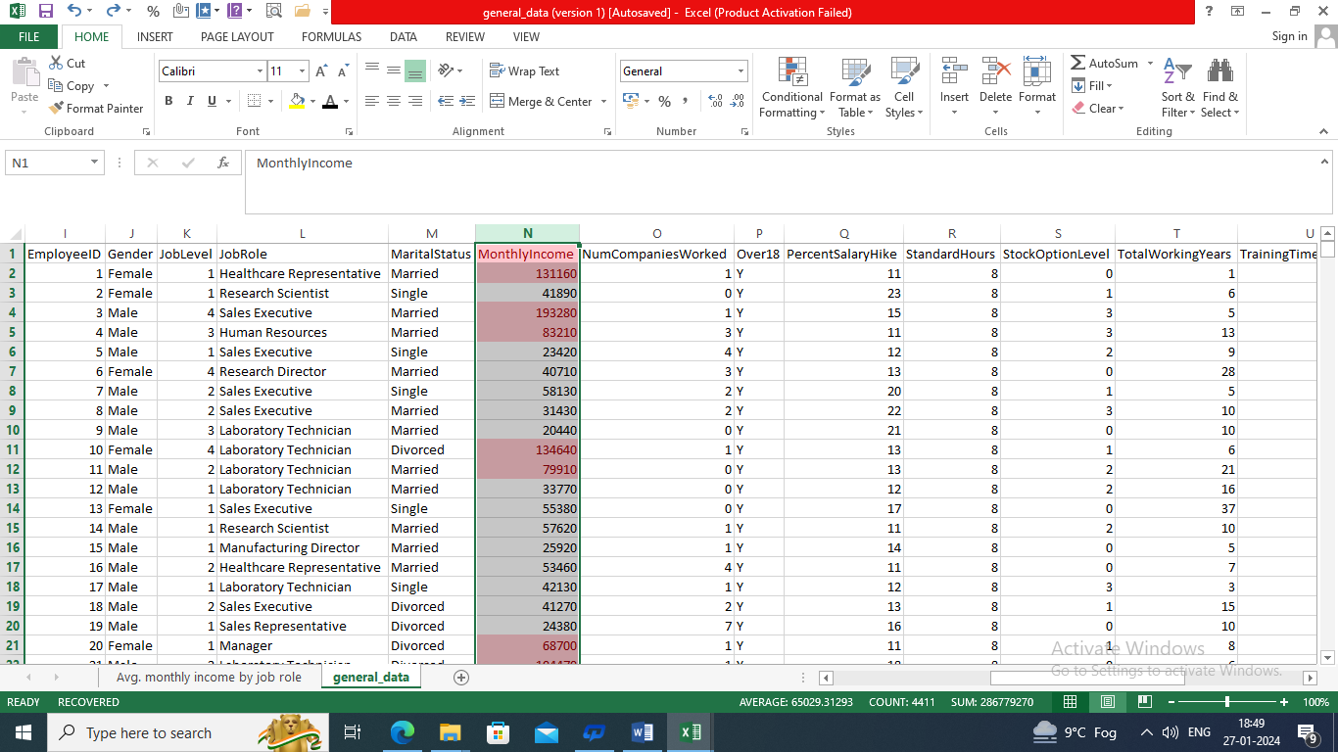
Q3. Apply conditional formatting to highlight employees with Monthly Income above the company's average income.

Slide 5
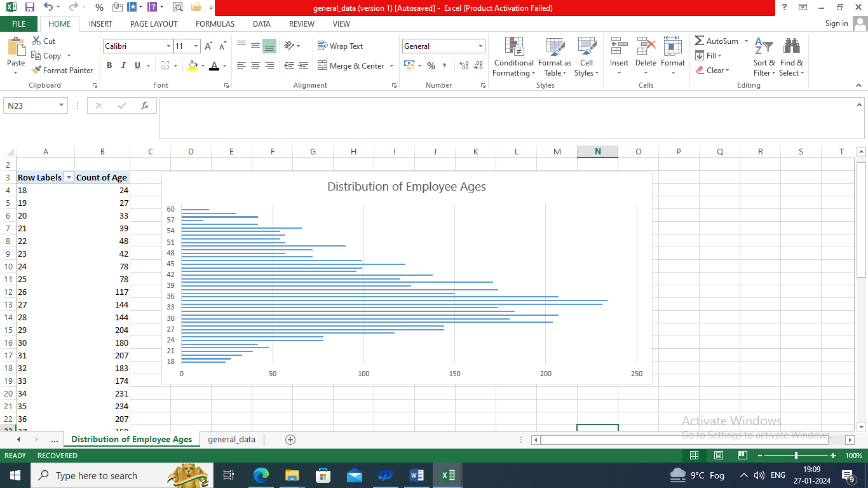
Q4. Create a bar chart in Excel to visualize the distribution of employee ages.

Slide 6
Q5. Identify and clean any missing or inconsistent data in the "Department" column.
No missing or inconsistent data in the Department column

Slide 7
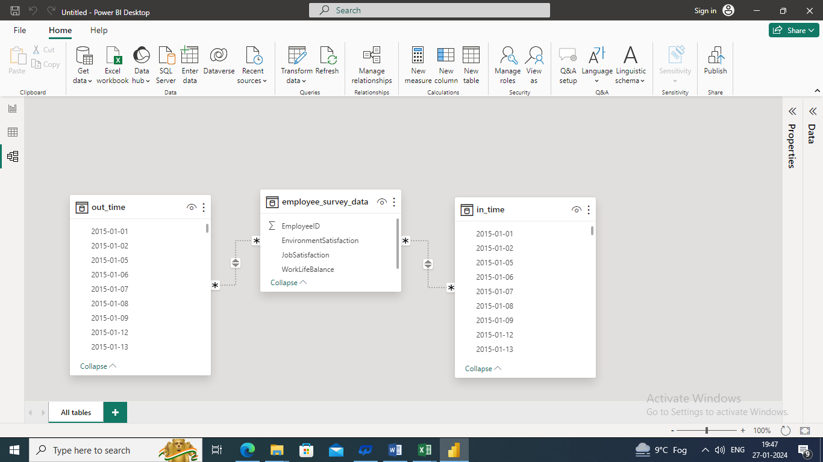
Q6. In Power BI, establish a relationship between the "EmployeeID" in the employee data and the "EmployeeID" in the time tracking data.

Slide 8
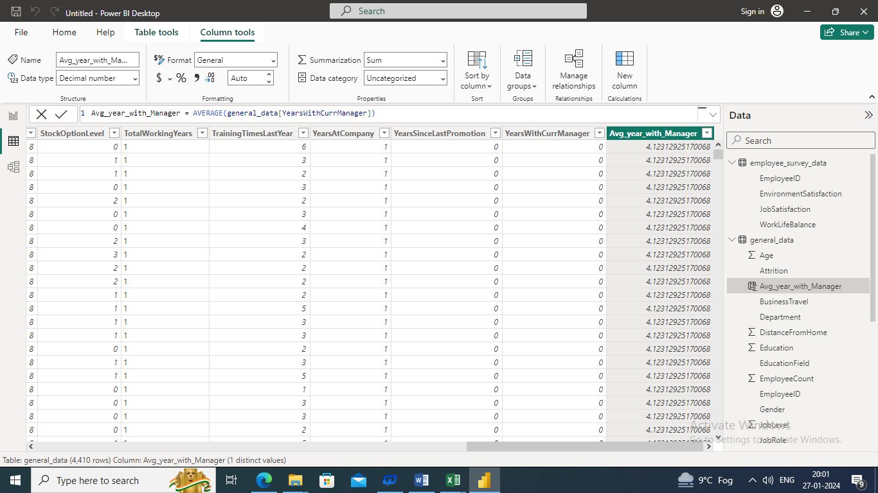
Q7. Using DAX, create a calculated column that calculates the average years an employee has spent with their current manager.

Slide 9
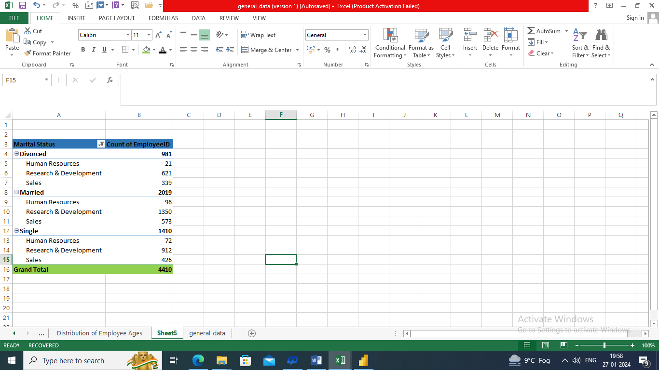
Q8. Using Excel, create a pivot table that displays the count of employees in each Marital Status category, segmented by Department.

Slide 10
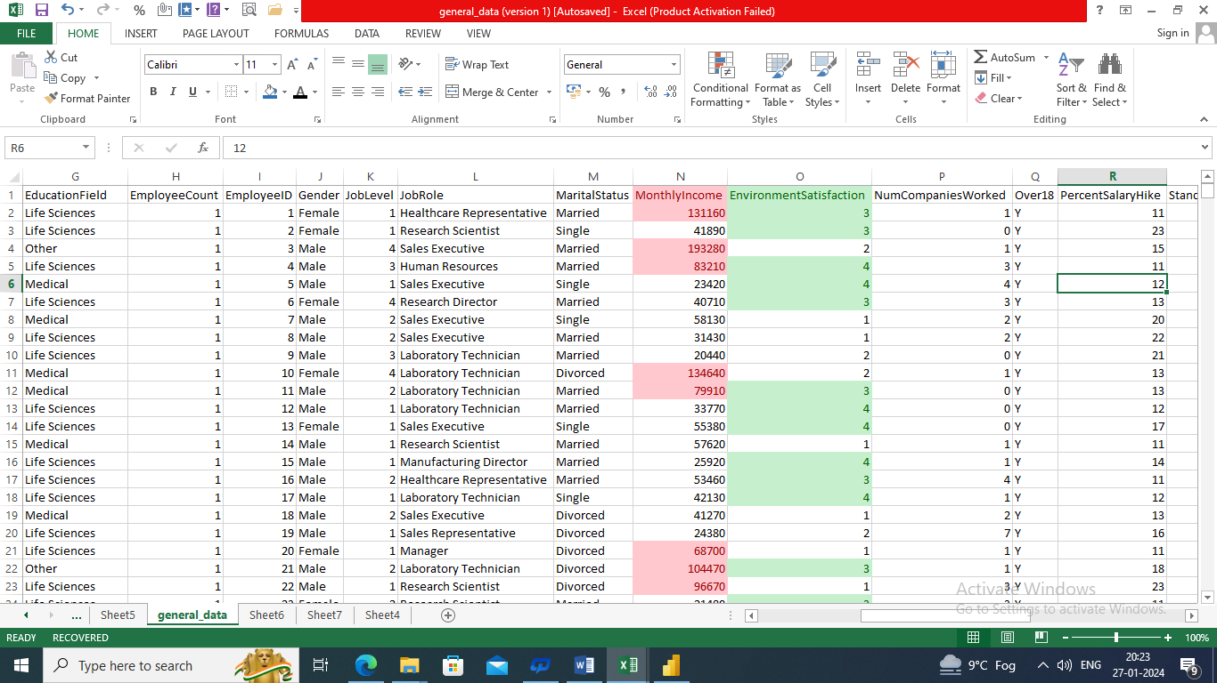
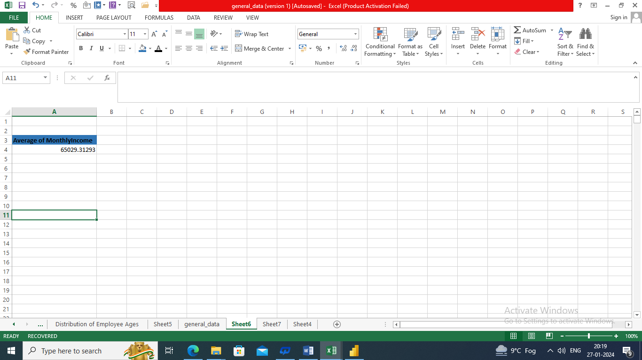
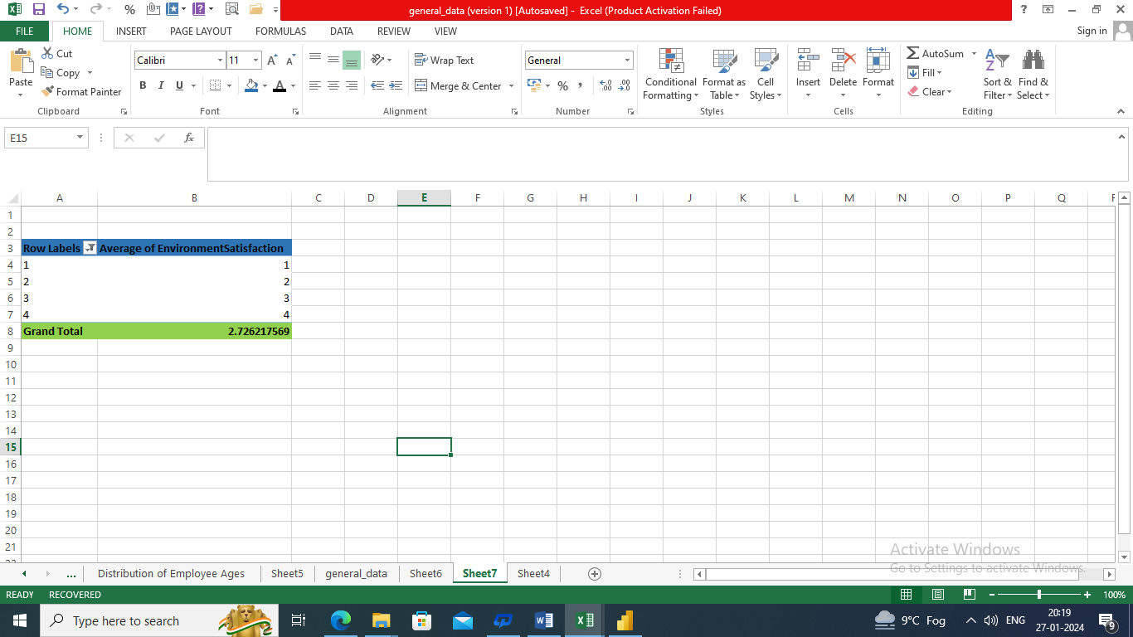
Q9. Apply conditional formatting to highlight employees with both above-average Monthly Income and above-average Job Satisfaction.

Slide 11
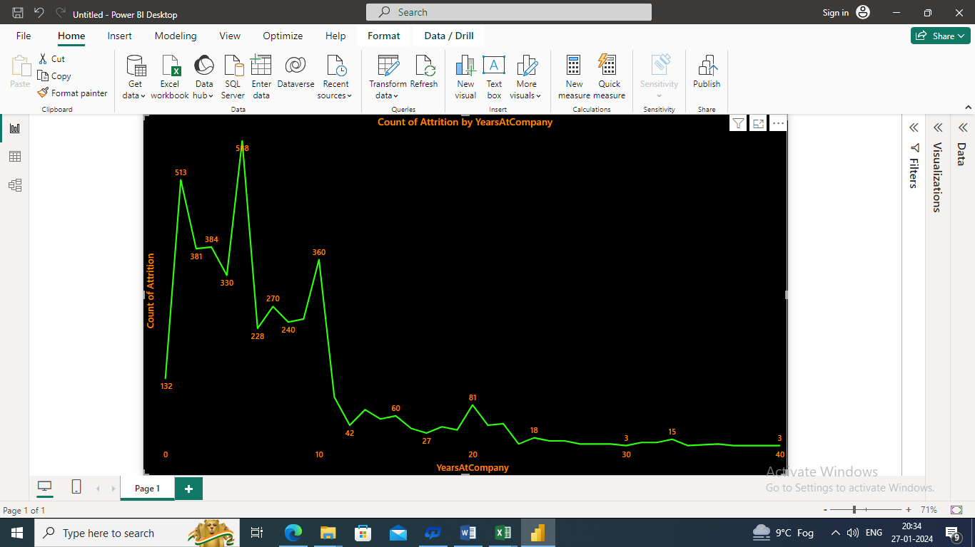
Q10. In Power BI, create a line chart that visualizes the trend of Employee Attrition over the years.

Slide 12
Q11. Describe how you would create a star schema for this dataset, explaining the benefits of doing so.
We can create “Star Schema” using following steps:-
1. Import data
2. Go to “Model view”
3. Create Measures
4.Visualization
Benefits:-
Simple and easy to understand: The star like structure make it easy to visualize the relationships between data points.
Query Performance: Queries can be executed efficiently due to the denormalized nature of the fact table and well-defined relationship
Scalability: Star schema can handle large large dataset effectively.
Flexibility: It’s easy add new dimensions or measures without significantly altering the existing structure.

Slide 13
Q12. Using DAX, calculate the rolling 3-month average of Monthly Income for each employee.
Rolling 3-Month Average =
Rolling 3-Month Average Monthly Income =
VAR CurrentEmployeeID = 'Employee'[EmployeeID]
RETURN
AVERAGEX(
FILTER(
ALL('Date'),
'Date'[Date] <= EARLIER('Date'[Date]) &&
'Date'[Date] > DATEADD(EARLIER('Date'[Date]), -3, MONTH)
),
CALCULATE(
SUM('Sales'[MonthlyIncome]),
'Employee'[EmployeeID] = CurrentEmployeeID
)
)

Slide 14
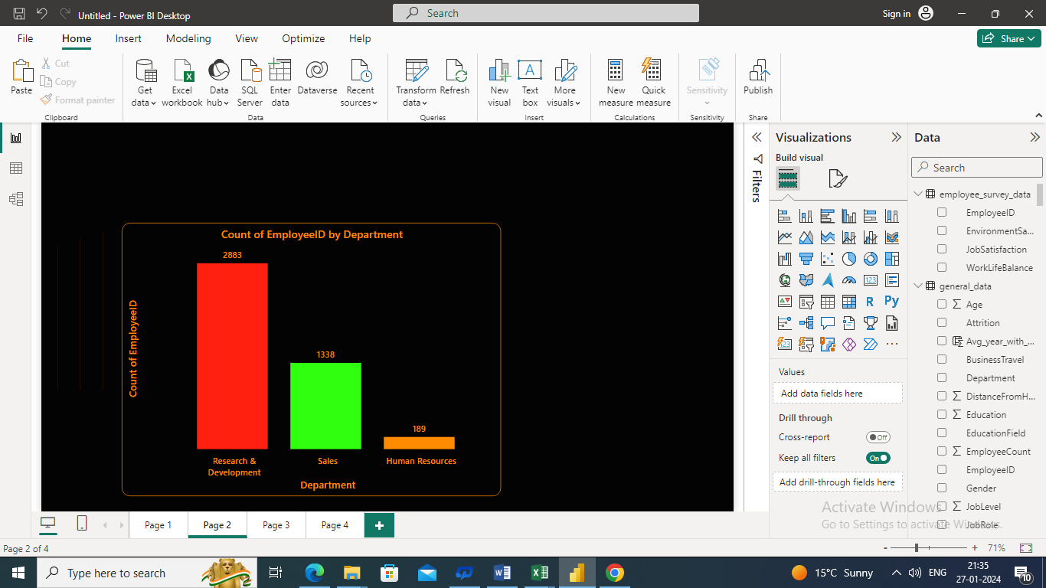
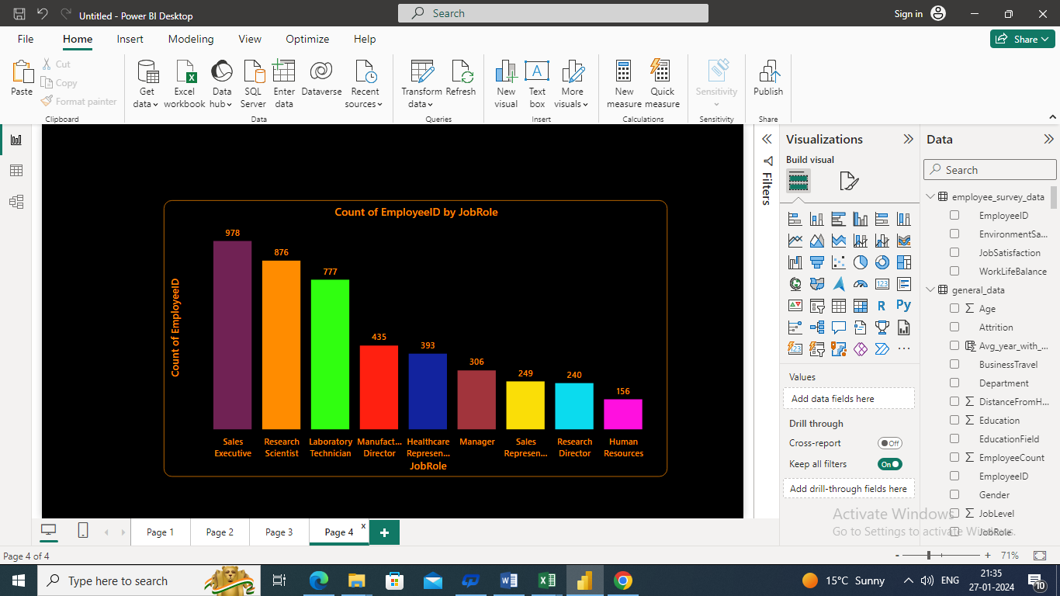
Q13. Create a hierarchy in Power BI that allows users to drill down from Department to Job Role to further narrow their analysis.

Slide 15
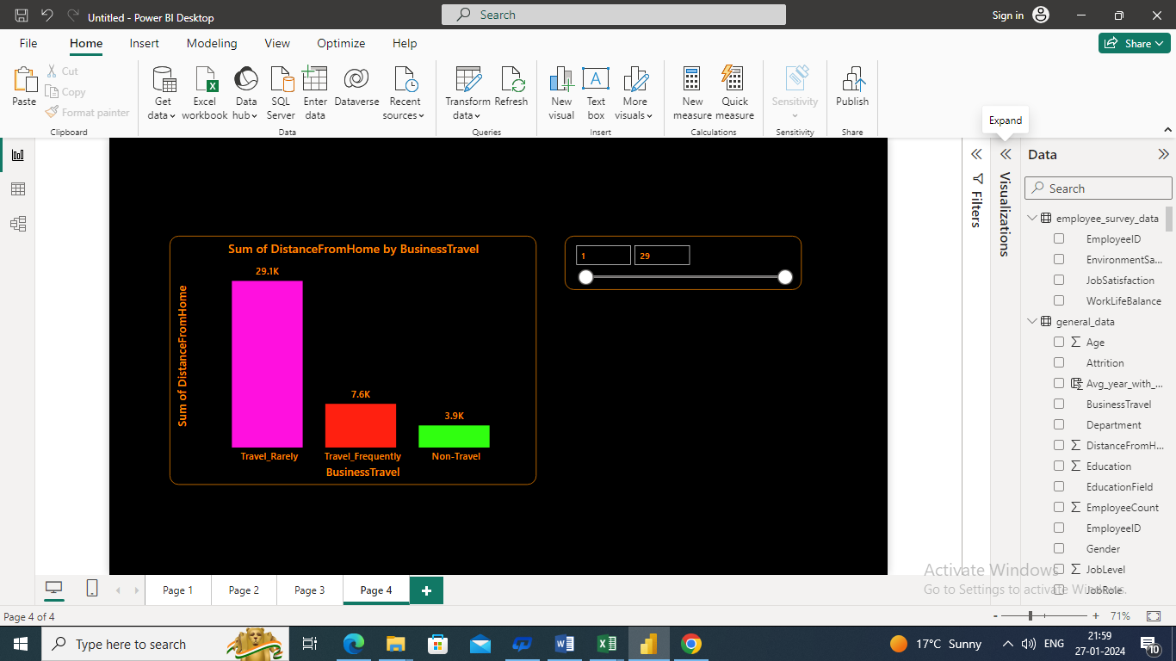
Q14. How can you set up parameterized queries in Power BI to allow users to filter data based 2 of 2 on the Distance from Home column?

Slide 16
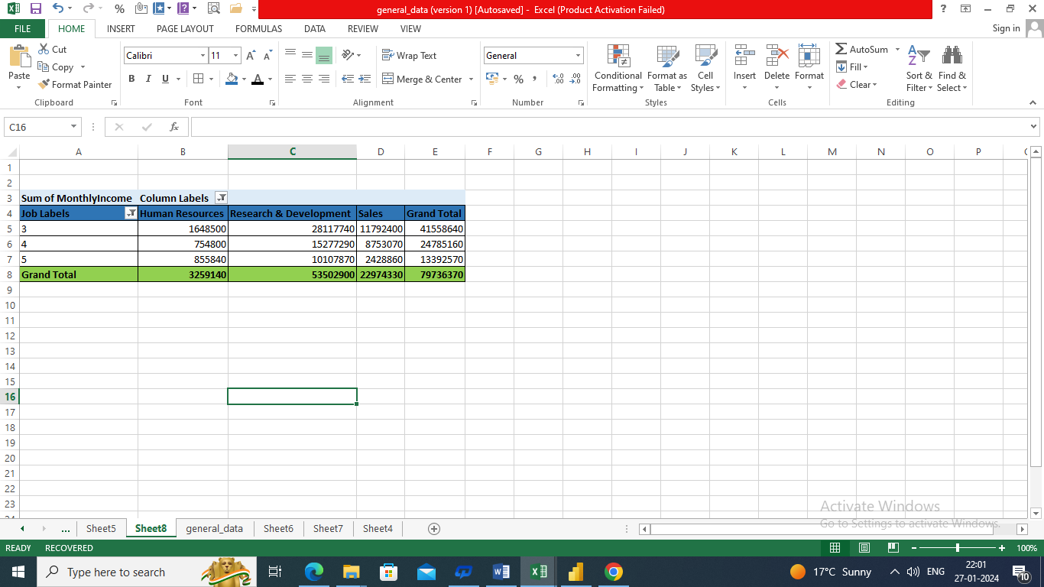
Q15. In Excel, calculate the total Monthly Income for each Department, considering only the employees with a Job Level greater than or equal to 3.

Slide 17
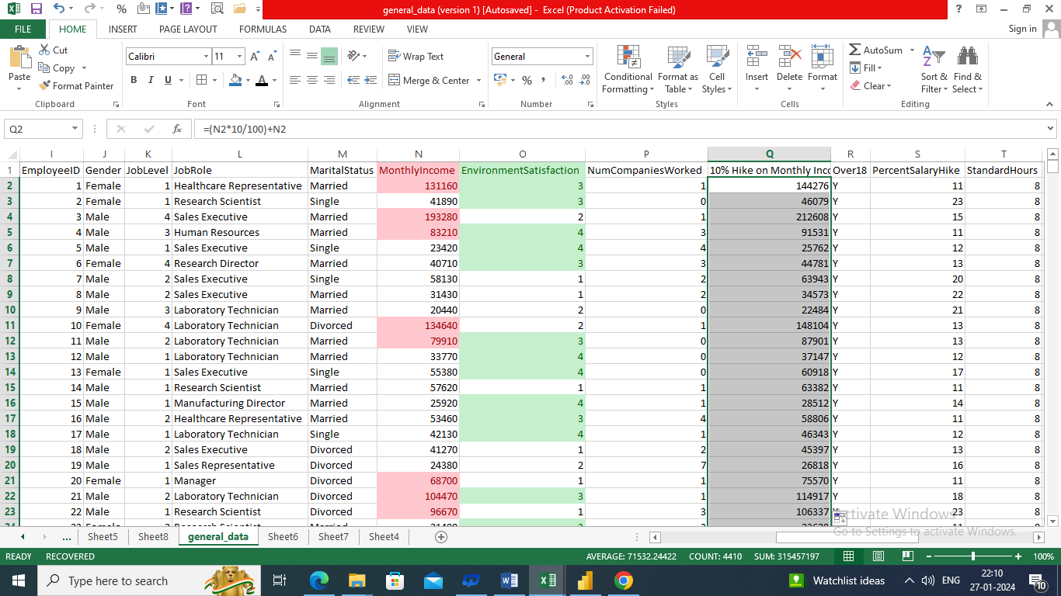
Q16. Explain how to perform a What-If analysis in Excel to understand the impact of a 10% increase in Percent Salary Hike on Monthly Income.

Slide 18
Q17. Verify if the data adheres to a predefined schema. What actions would you take if you find inconsistencies?
Check the data against the established schema. Compare the restrictions, types, and structure. Find discrepancies such as duplicates, wrong kinds, or missing values. Analyse the root cause. Clean up data, fix mistakes, and transform as necessary. Put quality control procedures into action. Record conclusions and actions. Engage in dialogue with interested parties. Repeat to ensure continuous data integrity.

Slide 19
