Slide 1

Ayodhya Ram Temple SQL Analysis

Slide 2

Challenge Overview
The challenge is to craft SQL queries to extract insights from the Ayodhya Ram Temple database.

Slide 3
Tables
01 Deity
02 Temple
03 ConstructionPhase
04 Architecture
05 Donations
06 Events
07 TempleEvents

Slide 4
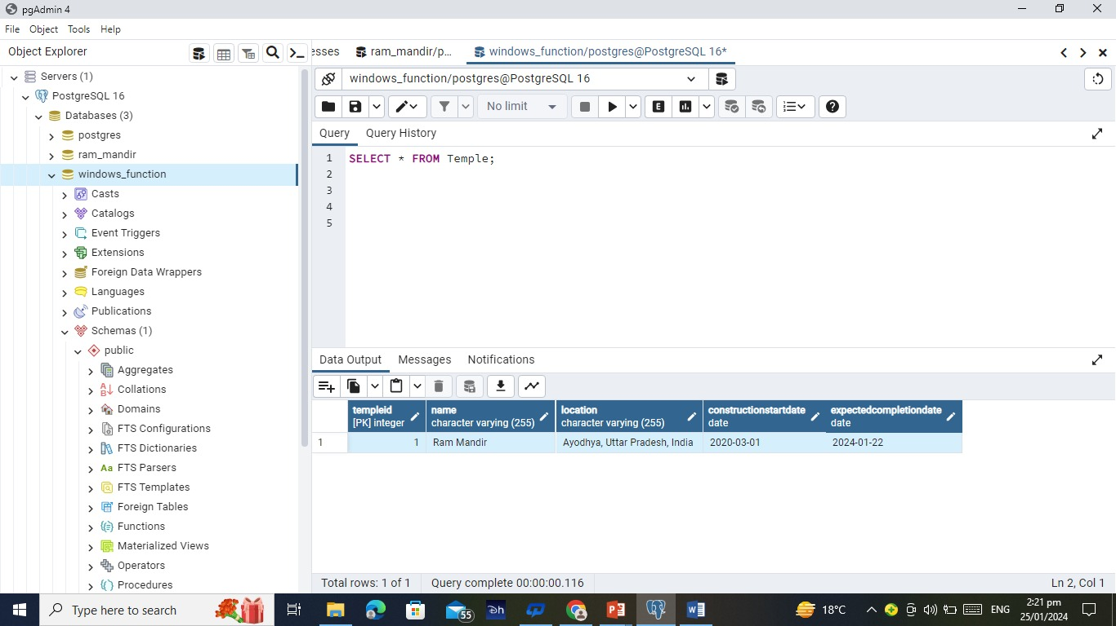
1) Retrieve information about the Ram Mandir?
SELECT * FROM Temple;
Output

Slide 5
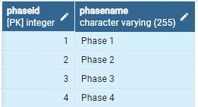
2) List all construction phases for the Ram Mandir?
SELECT phaseid, phasename FROM ConstructionPhase;
Output

Slide 6
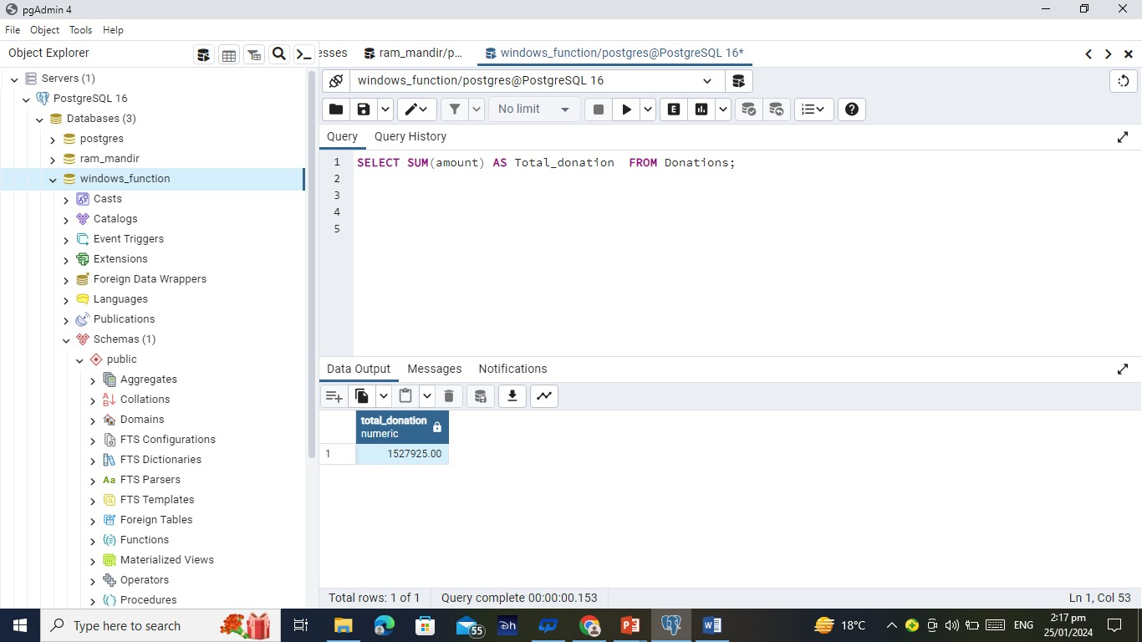
3) Find the total amount of donations received for the Ram Mandir?
SELECT SUM(amount) AS Total_donation FROM Donations;
Output

Slide 7
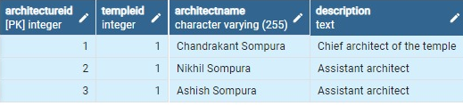
4) Get details about the architecture of the Ram Mandir?
SELECT * FROM Architecture;
Output

Slide 8
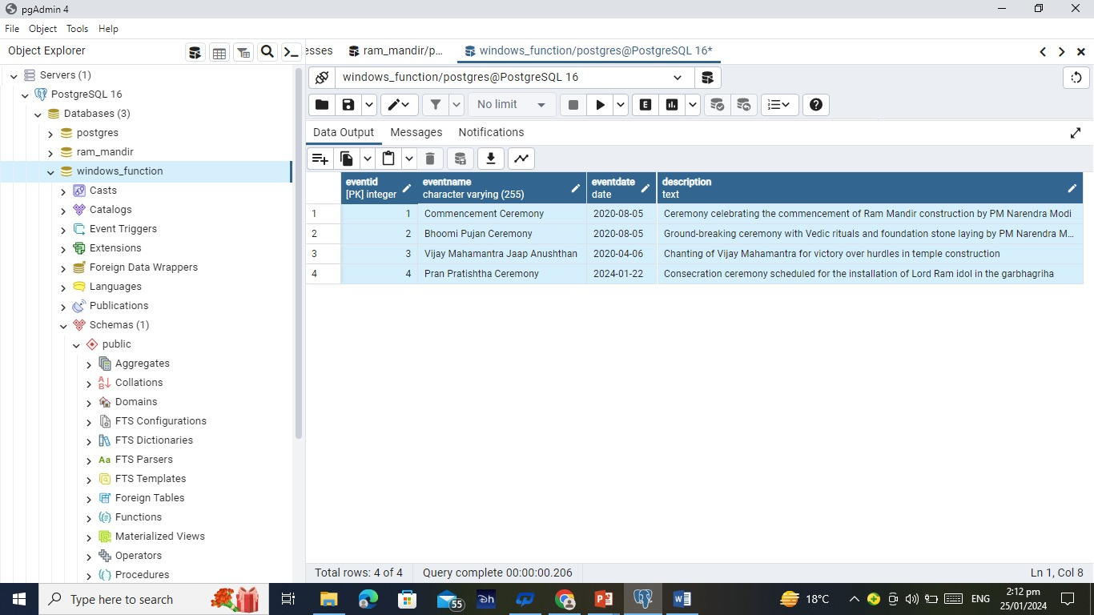
5) Retrieve events associated with the Ram Mandir?
SELECT * FROM Events;
Output

Slide 9
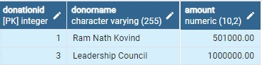
6) Find donors who contributed more than 50000 towards the Ram Mandir?
SELECT donationid, donorname, amount FROM Donations where amount>50000;
Output

Slide 10
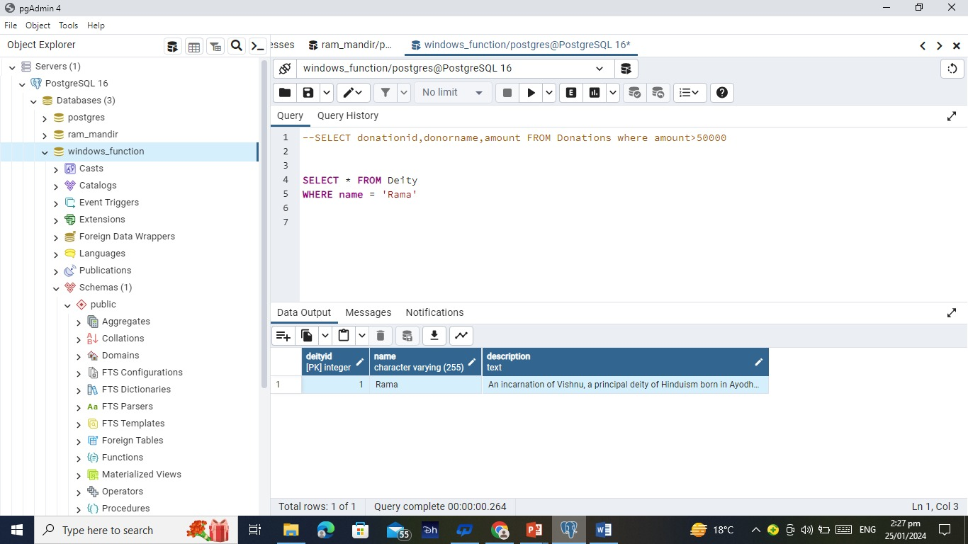
7) Retrieve details about a specific deity (e.g., Rama)?
SELECT * FROM Deity WHERE name = 'Rama‘;
Output

Slide 11
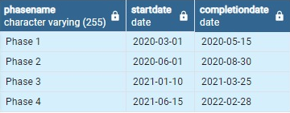
8) Find the start and end dates of the construction phases for the Ram Mandir?
SELECT phasename, startdate, completiondate FROM ConstructionPhase;
Output

Slide 12

9) Count the number of events associated with each temple?
SELECT COUNT(*) AS Number_of_Events FROM Events;
Output

Slide 13
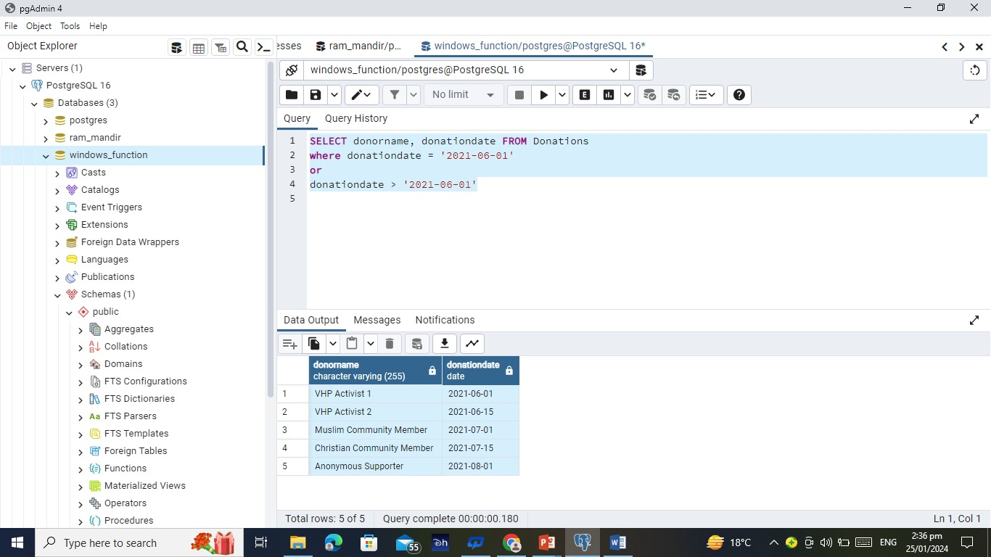
10) Find the donors who made contributions on or after 2021-06-01'?
SELECT donorname, donationdate FROM Donations where donationdate = '2021-06-01‘ or donationdate > '2021-06-01‘;
Output

Slide 14
Thank you

