Slide 1
MOVIE TICKET BOOKING
DONE BY:
A.T.PRANAV VARSHAN

Slide 2
INTRODUCTION
BOOKING MOVIE TICKETS
You can book your tickets by ticket booking app
You can have more option like AC or NON AC
You can also book with high quality of music effect with more fun
You can also book theatre which is can have snacks for enjoying

Slide 3
FUNCTION
It works on the basic principle of the linking python and a database .
At first , the command will be given in python software afterwards the command will be sent to the database.
There in the database the command will fetch the demanded data and it will it to the python software.
Then the required output will be shown the python software.

Slide 4
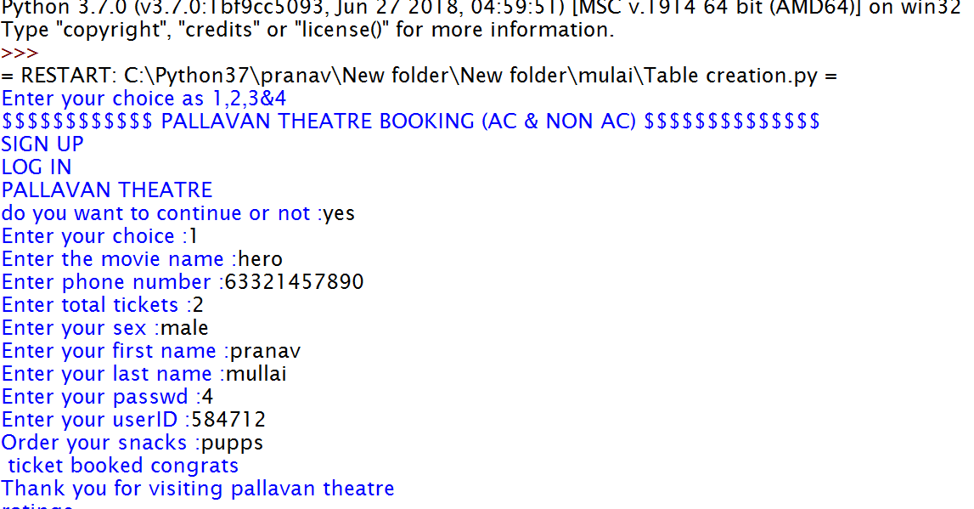
OUTPUT

Slide 5
FUTURESCOPE
If this software is developed with help of a big database like oracle , the software’s demand will further increase.
As this software is very cheap, its affordability will be more.
In future this software will be in more demand

