Slide 1


Slide 2

Startups in India Analysis
Project: Web Scraping with EDA
Title: Startups in India

Slide 3

Our Team
Rohit Sahare:
B.E. Mechanical Enginnering
Aashish Kasar:
B.E. Electrical Enginnering
Batch No: 168, Innomatics Research Labs, Hyderabad

Slide 4
LIBRARIES USED IN THIS PROJECT :
01
BEAUTIFULSOUP
04
PANDAS
BeautifulSoup is a python package for parsing HTML documents
Pandas is a python library for data analysis.
02
REQUESTS
05
MATPLOTLIB
Requests will allow you to send HTTP requests using python
Matplotlib is a comprehensive library for creating static, animated and interactive visualization in python.
03
NUMPY
06
SEABORN
Seaborn is a library for making stastical graphics in python.
Numpy is a python library used for working with arrays

Slide 5
STEPS INVOLVED IN THIS PROJECT
01
INTRODUCTION
04
DATA CLEANING
02
PROBLEM STATEMENT
05
EDA
06
CONCLUSION
03
DATA SCRAPING

Slide 6

INTRODUCTION :
Startup India is a flagship initiative of the Government of India, intended to build a strong ecosystem that is conducive for the growth of startup businesses, to drive sustainable economic growth and generate large scale employment opportunities.
In terms of entrepreneurship and business, India has evolved into one of the top emerging countries in the world.
Hundreds of startup companies have been founded there in the last years, many of which are enjoying incredible success.

Slide 7
PROBLEM STATEMENT :
PROBLEM STATEMENT :
1. Find the count of city of the startups.
2. Most of the startups started in which city.
3. Top 5 sartups in india.
4. Find out the maximum and minimum funding amount of the sartups.
5. Most of the startups started in which year.

Slide 8
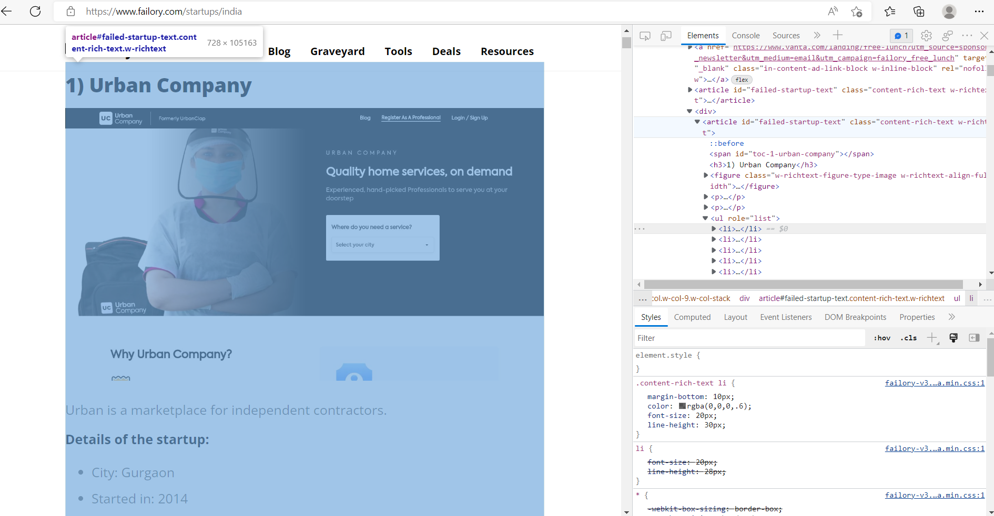
DATA EXTRACTION :
SOURCE: FAILORY

Slide 9
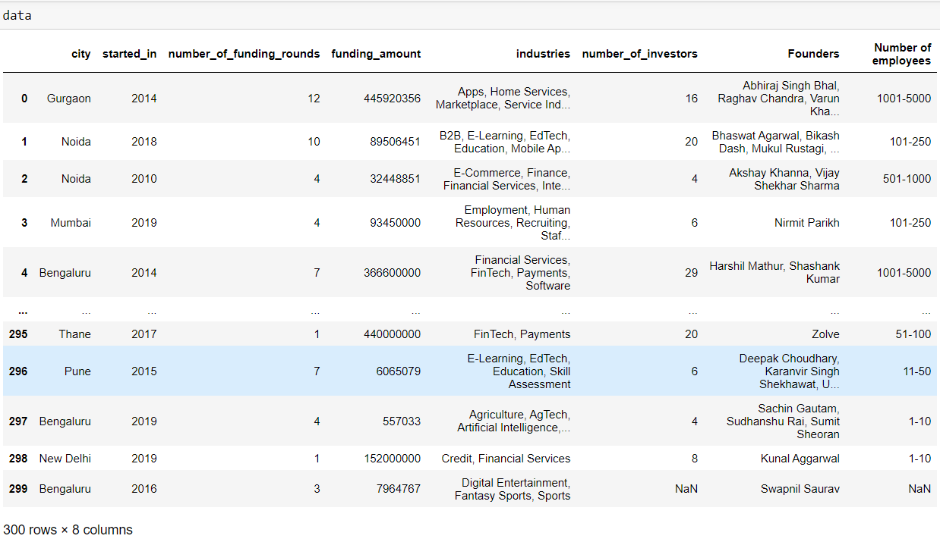
SCRAPED DATA :

Slide 10
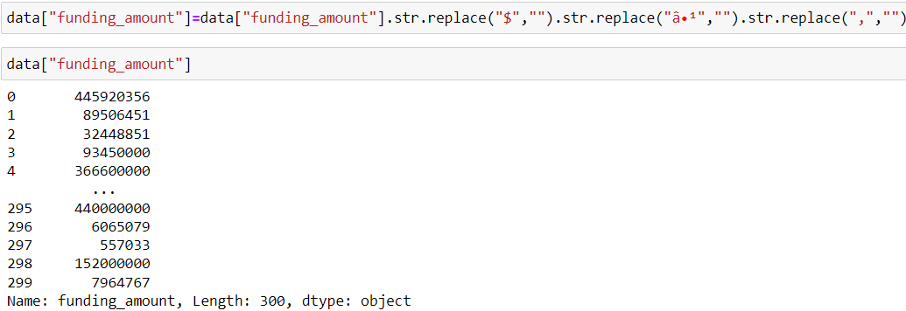
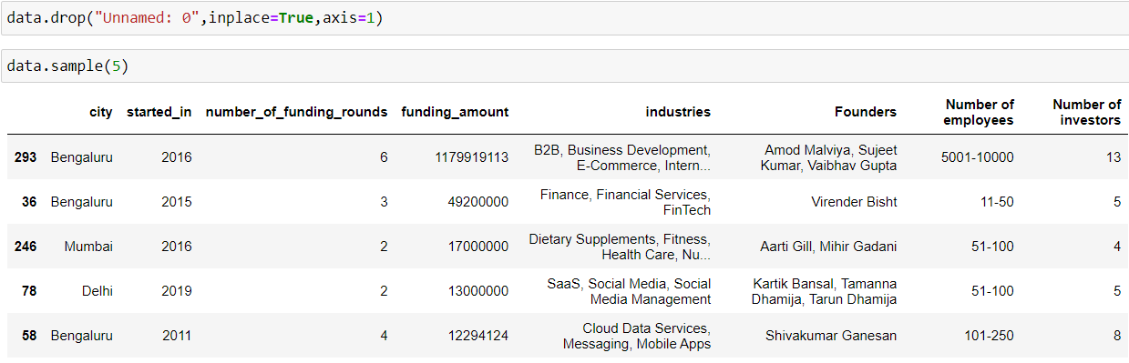
DATA CLEANING :

Slide 11
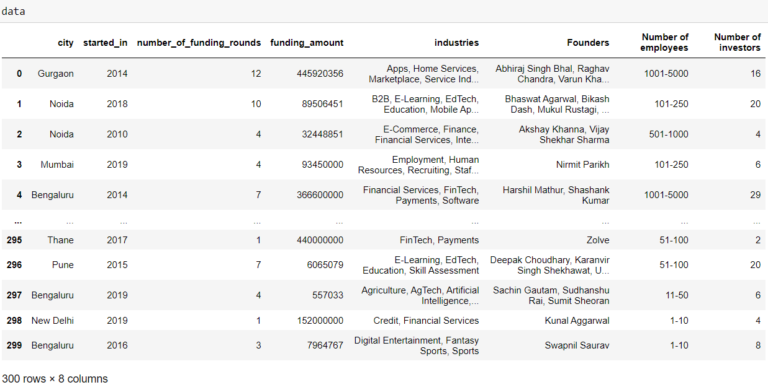
CLEANING DATA :
RESOURSES:
NUMPY +
PANDAS +
DATAFRAME

Slide 12
CHALLENGES FACED:
Finding the HTML tags to scrap the data.
While cleaning the data we got hold of unwanted data and replaced with required data.
Replacing all NAN(Not a Number) values with mean and mode.
To get accurate figure size while visualization of the data.

Slide 13
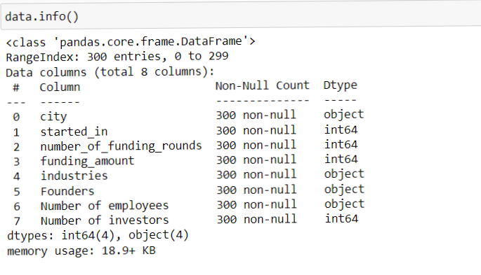
(EDA) EXPLORATORY DATA ANALYSIS :
USING MATPLOTLIB AND SEABORN
Insight :
The info() method gives the information of the data.
This shows names and number of columns.
There are no null values.
Started in, number of funding rounds, funding amount and number of investors are in “int” data type.

Slide 14
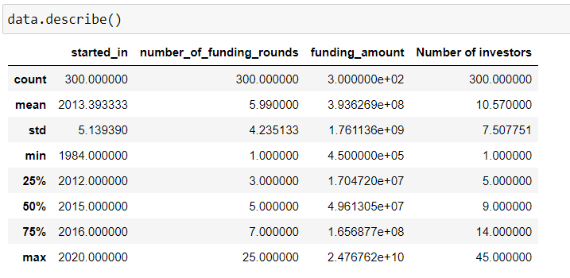
Insight :
As we have found from the describe data the latest startup is in 2020 and oldest startup in 1984.
50% of the startup are started in 2015.

Slide 15
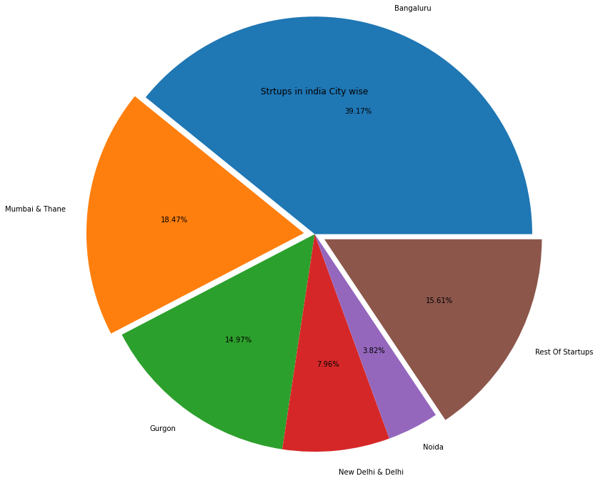
Pie-plot :
We find the City wise percentage startups in India.
We found most of the companies are from Bengaluru 39.17%, and 2nd position in Mumbai 18.47%.
As we found the 15.61% companies are in rest of India.

Slide 16
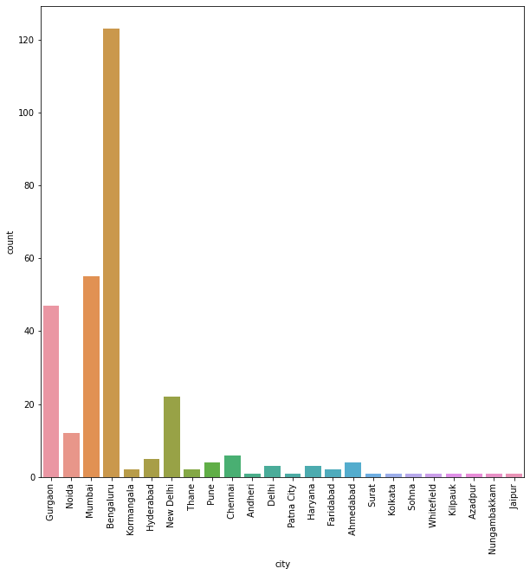
COUNT PLOT :
We See in the count plot 100+ Startup companies in Bengaluru Then Mumbai is a second place between 50 to 60

Slide 17
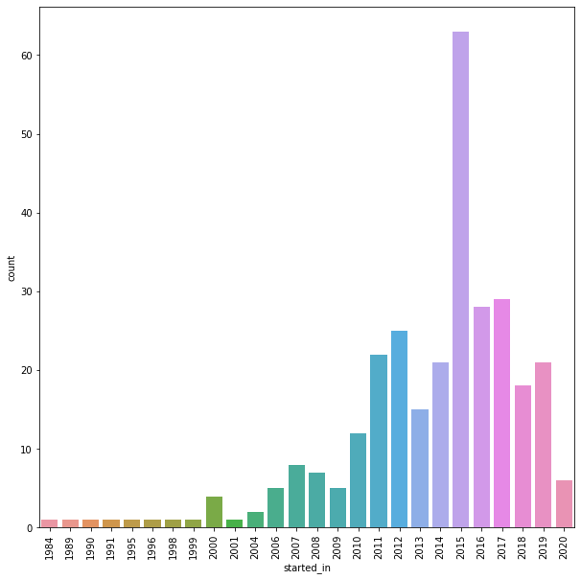
Count plot
we see in the plot there are lots of startups in the year 2015

Slide 18
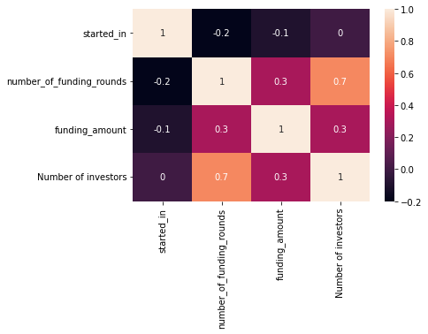
we see in the heat map when the number of investors increases the funding Amount also increases.

Slide 19
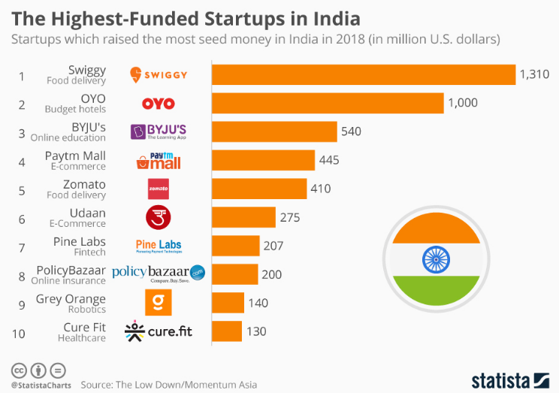
Top 10 Highest funded statups in india.

Slide 20
CONCLUSION :
Overall we can say that lots of companies are trying to build their startups in Bengaluru.
We found most of the startups are started in 2015.
We found city wise startups in all over india.
We found maximum and minimum funding amount to the companies all over in india.

Slide 21

Any Questions ?

Slide 22

Thank you

