Slide 1

Lending Club Case Study
Submitted By:
Ashish Mudgal

Slide 2
Business Understanding
Background: Lending Club is the largest online loan marketplace, facilitating personal loans, business loans and financing of medical procedures. It's largest source of credit loss is lending loans to ‘risky’ applicants.
Problem Statement: Lending Club wants to identify the risky loan applicants, so that such loans can be reduced thereby cutting down the amount of credit loss. Our aim is to find the driving factors behind loan getting default.

Slide 3
Problem solving methodology
Data Understanding : By Referring Data Dictionary and using panda observing data before starting working on this
Data Cleaning : Identify and removing the null valued columns, unnecessary variables, Unique columns which are not useful for analysis and checking the null value percentage , removing the respective rows and Imputing values in columns where required.
Univariate Analysis: Analyzing each column using charts, plotting the distributions of column and observed analysis.
Segmented Univariate Analysis: Analyzing the continuous data columns with respect to the categorical column and observed factor for that.
Bivariate Analysis: Analyzing the two-columns behavior like term and loan status with respect to loan amount.
Recommendations : Analyzing all plot charts and based on observation we can provide recommendations for reducing the loss of business by detecting key factor columns which contribute to loan defaulters.

Slide 4
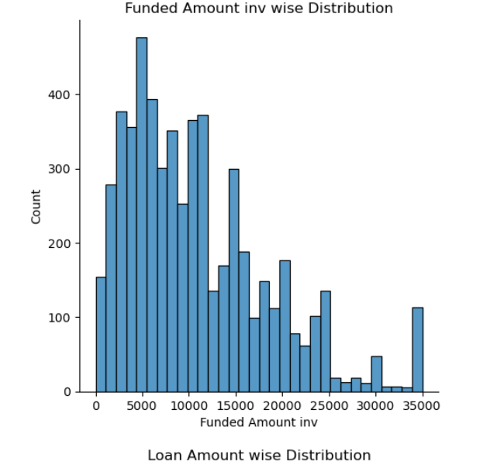
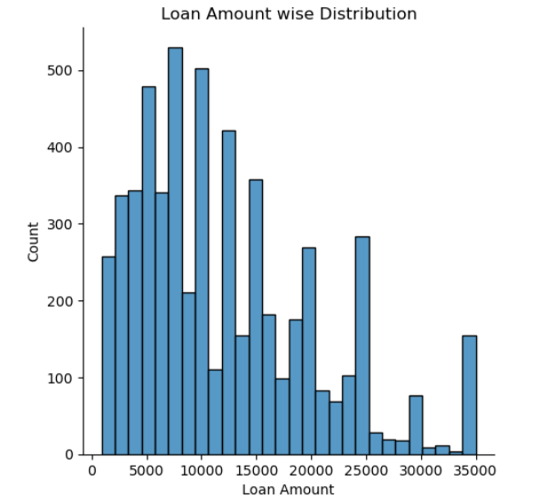
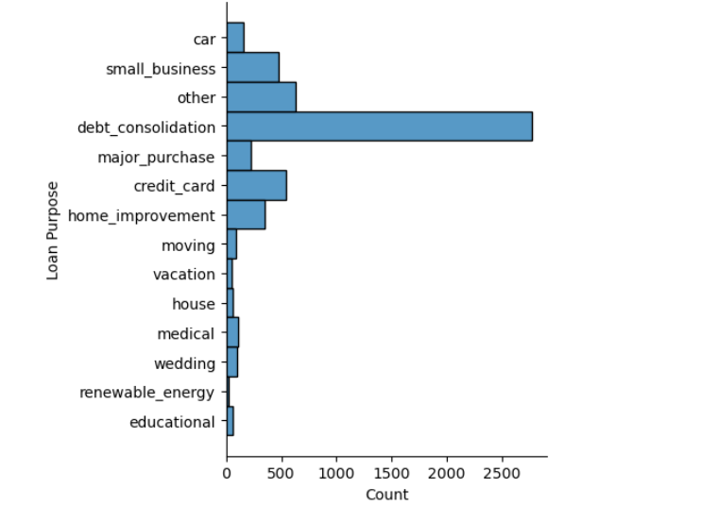
Data analysis - Loan Funded Amount & Loan Amount
Funded Amount Inv
Loan Amount

Slide 5
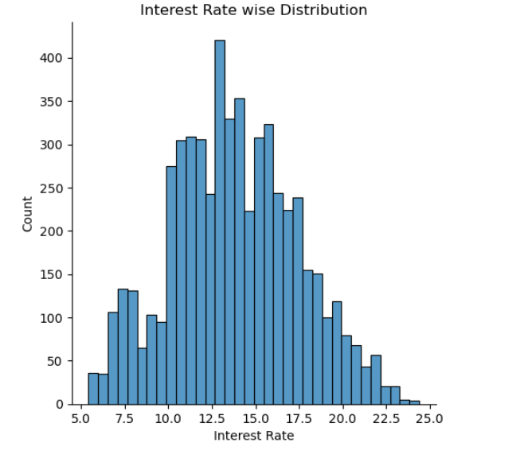
Data analysis - Loan Purposes & Interest Rates
Distribution Plot for Interest Rate
Loan Purpose chart for Defaulters

Slide 6
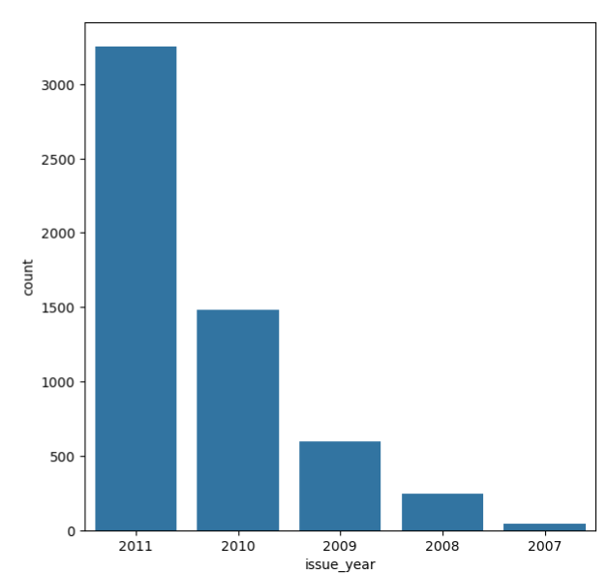
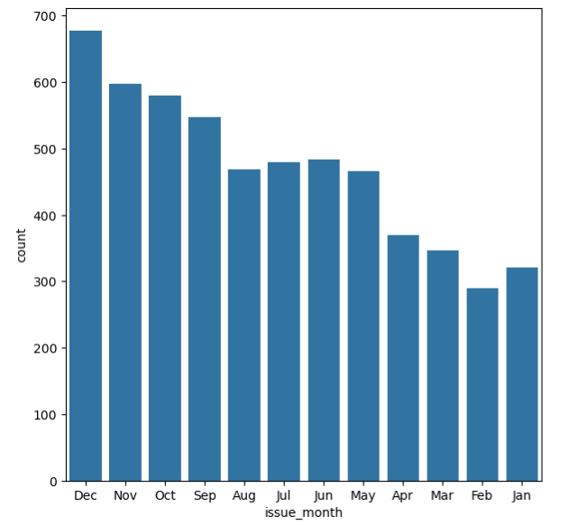
Data Analysis – Loans issued
Month wise Loans Issues to Defaulters
Year wise Loans Issued to Defaulters

Slide 7
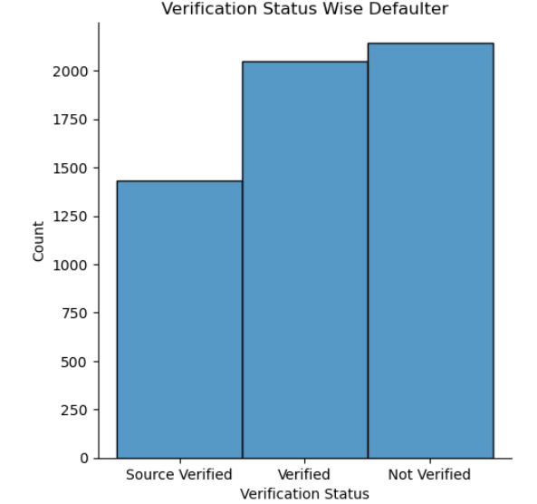
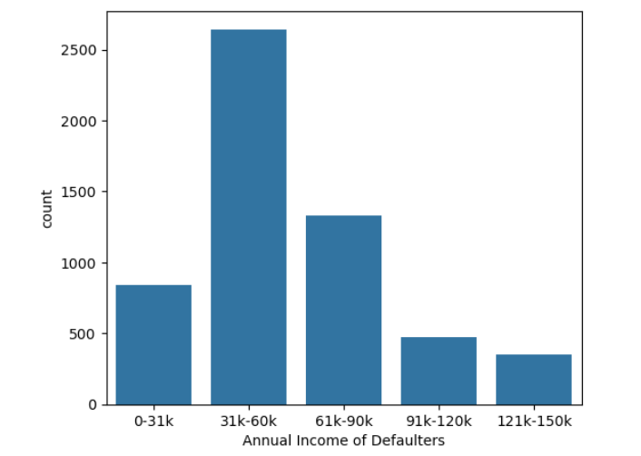
Data Analysis – Loans issued
Verification Status for defaulter
Annual Income of Defaulters

Slide 8
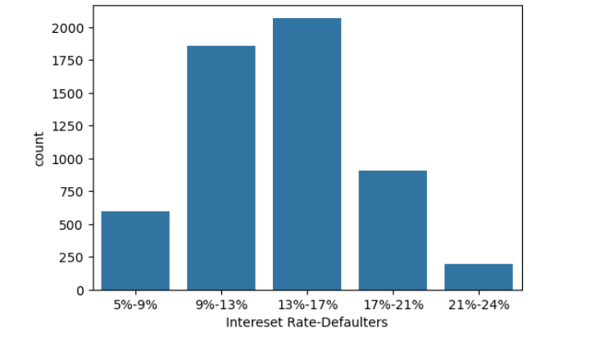
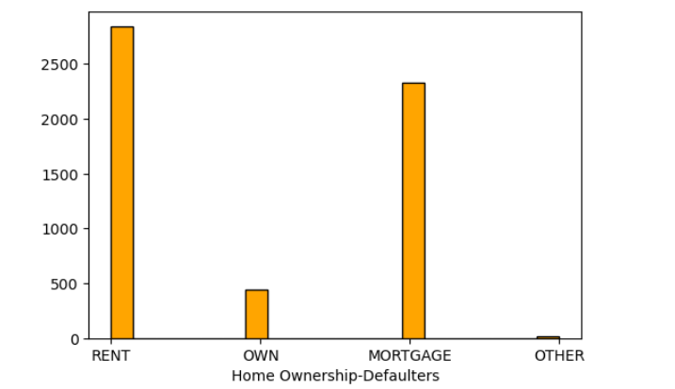
Data Analysis – Loans Interest Rate and Home Ownership of Defaulter issued
Loan Interest rate of defaulter
Home ownership of Defaulters

Slide 9
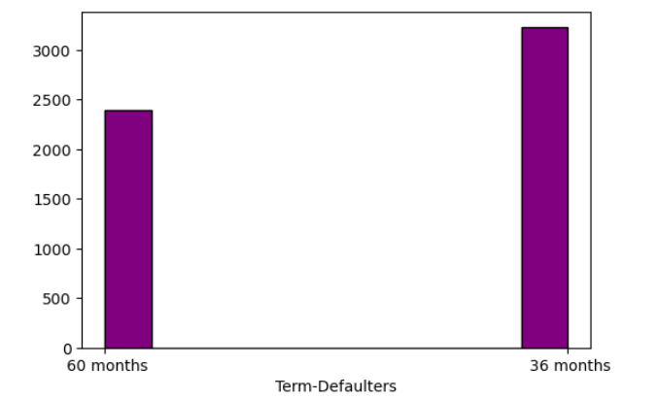
Data Analysis – Loans Term and Home Ownership of Defaulter issued
Loan Term
Home ownership of Defaulters

Slide 10
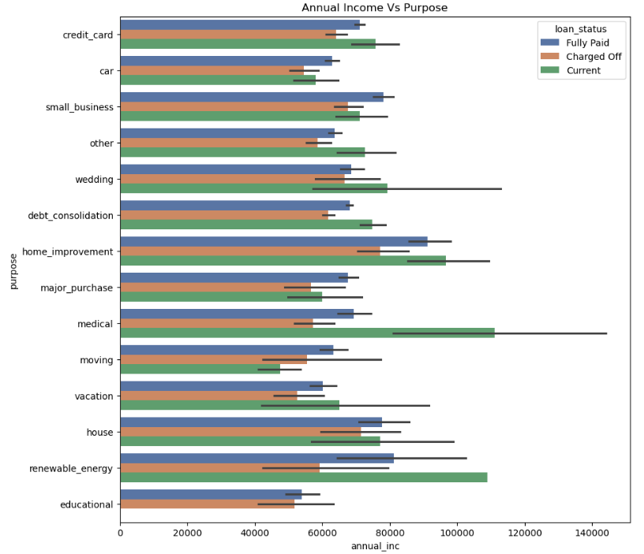
Data Analysis – Annual Income , Loan Purpose & Loan Status

Slide 11
Conclusion – case study
Defaulter applicants who received loan mostly on interest at the rate of 13-17%
Mostly defaulter applicants having house_ownership as 'RENT'
Defaulter applicants who have an income of range "31K-60K"
Defaulter applicants funded amount by investor is between "5000-10000"
Defaulter applicants loan amounts is between "5000 - 10000"
Defaulter applicants term of "36 months"
Mostly Defaulter applicants loan status is "Not verified"
Defaulter applicants mostly purpose is 'debt_consolidation'
Applicants with higher salary mostly applied loans for "home_improvment", "house", "renewable_energy" and "small_businesses".Annual income of those who applied isnot the highest.

