Slide 1
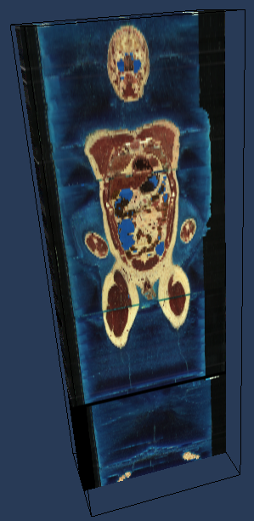
Visible Male Example
The approximately 7.5 megabyte axial anatomical images are 2048 pixels by 1216 pixels, with each pixel being .33mm in size. The anatomical cross-sections are at 1mm intervals to coincide with the CT images. There are 1,871 cross-sections for both CT and anatomical images.
(version)
6
(box)
0 2047 0 1215 0 1877 0 0 0 0
(physic_box)
0 675.84 0 401.28 0 1871.00
(fields)
vismale 3*uint8
(bits)
V012012012012012012012012012012012
(bitsperblock)
16
(blocksperfile)
256
(filename_template)
./data/%02x/%04x.bin

Slide 2
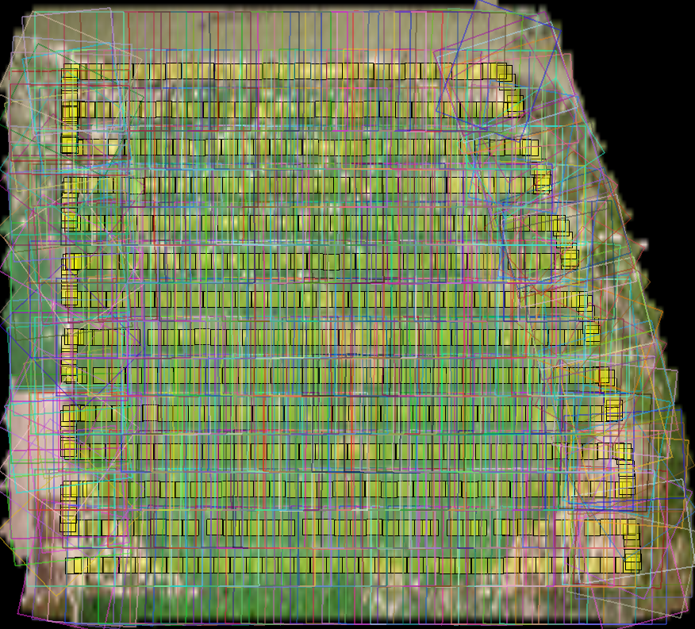
VisusSlam Example (with annotations)
You can now specify transformations (even perspective transformations) in the file, like in a opengl push-pop scenegraph.
<midx logic_
logic_box='0 23948 0 21455'
physic_box='0.18896629281070026 0.18901013744880685 0.62809283682841488 0.62813226782572662'>
<!-- how to go from LOGIC to PHYSIC -->
<translate x='0.18896629281070026' y='0.62809283682841488'>
<scale x='1.8307910333212097e-09' y='1.8377914924375777e-09'>
<svg >
<g>
<poi point='2639.273193,2267.315918' />
...
</g>
<g>
<polygon points='1614.48,4528.61 754.396,649.038 3664.07,3.97851 4524.15,3883.55' />
...
</g>
</svg>
<dataset url='./idx/0000.idx' quad='1614.48 4528.61 754.396 649.038 3664.07 3.97851 4524.15 3883.55' ... />

Slide 3
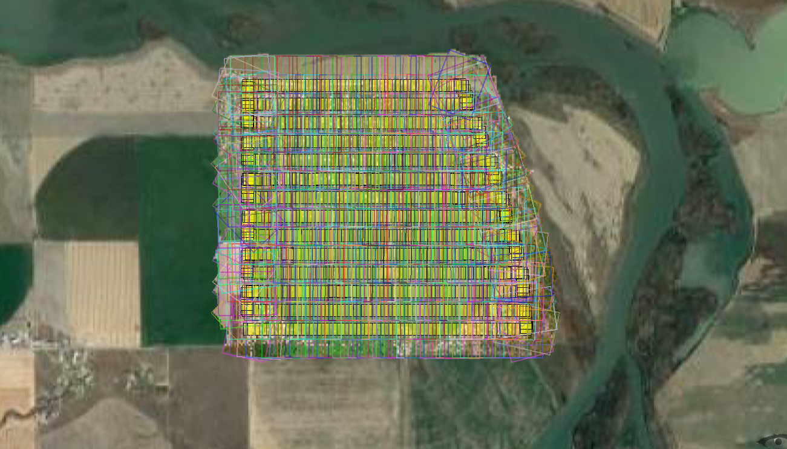
Google earth examples (with annotations)
Compose VisusSLam sequences on-top of google earth
<dataset name="slam" typename='IdxMultipleDataset'>
<field name="voronoi">
<code>output=voronoi()</code>
</field>
<!-- logic dimensions 1073741824^2 -->
<dataset name='google'
url='http://mt1.google.com/vt/lyrs=s?nlevels=22'
physic_box="0.0 1.0 0.0 1.0" />
<!-- physic_box is in [0,1] range and comes with annotations too -->
<dataset name='slam' url='E:\google_sci\visus_slam\TaylorGrant\VisusSlamFiles\visus.midx' />
</dataset>

