Slide 1
Visus mod_visus compilation & installation

Slide 2
Prepare for installation
Create a directory /inetpub/wwwroot/visus
Create a file /inetpub/wwwroot/visus/visus.log
Create /inetpub/wwwroot/visus/visus.config with the following content:
<?xml version="1.0" ?>
<visus>
<dataset name="cat" permissions="public"
url="file:///inetpub/wwwroot/visus/dataset/cat/visus.idx" />
</visus>

Slide 3
Install Visus IIS module
Stop IIS
net stop W3SVC
Uninstall the old mod_visus. From an “Administrator Prompt “ : (Command Prompt / Run as administrator)
%systemroot%\system32\inetsrv\appcmd.exe uninstall module mod_visus
For a Administrator prompt (for Debug, use mod_visusd.dll):
%systemroot%\system32\inetsrv\appcmd.exe install module /name:mod_visus /image:c:\visus\Release\mod_visus.dll
You will get a message like:
GLOBAL MODULE object "mod_visus" added
MODULE object "mod_visus" added

Slide 4
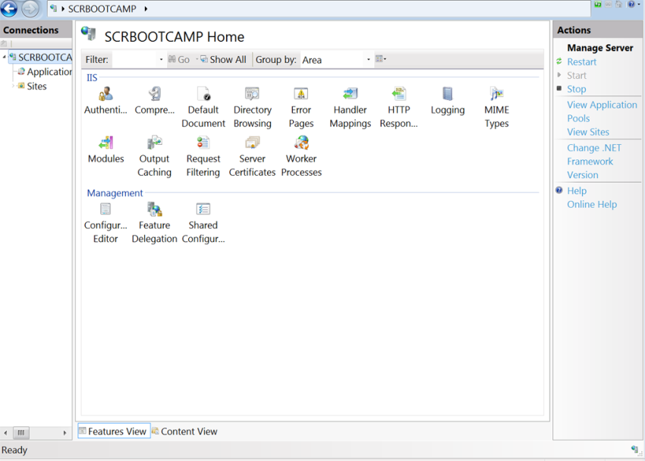
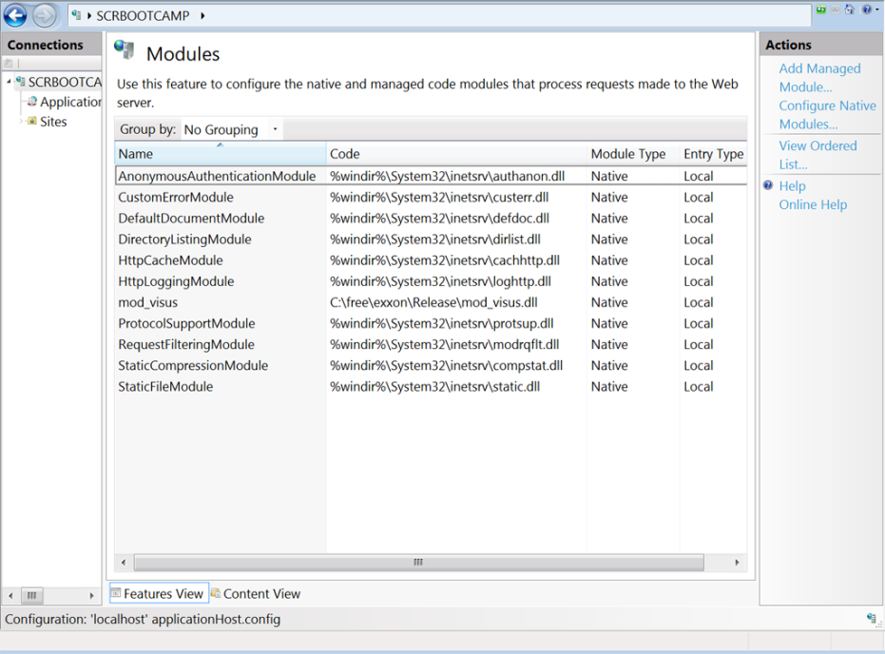
Check IIS modules
Open IIS manager
Double click on “modules”
Check that “mod_visus” is there with the right path

Slide 5
Enable mod_visus in Default web site
Default Web site/ Modules/Configure Native modules…. Check ‘mod_visus’ and press ‘OK’

Slide 6
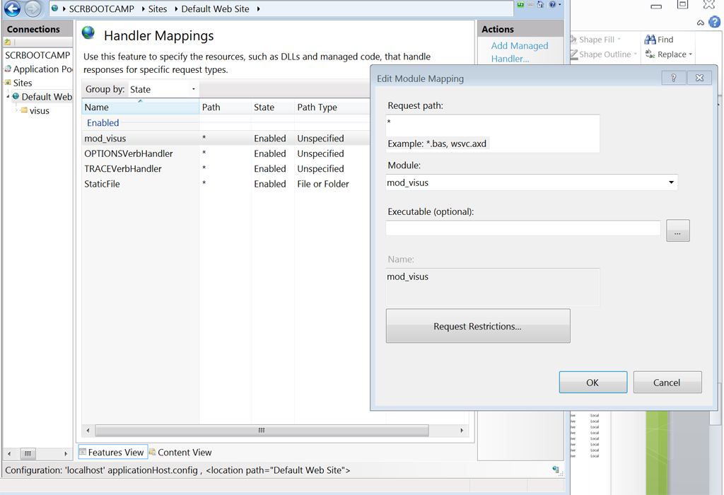
Configure handler mapping
[Default web site] / [Handler mapping] / /[Right Panel: Actions] / [Add module mapping…]
Request path: *
Module: mod_visus
Executable: leave blanck
Name: mod_visus

Slide 7
Start the server and check it is working
Checklist before:
DefaultAppPool/.Net Framework version must be ‘.Net framework v4.0.030319’
DefaultAppPool /Managed pipeline mode must be ‘Integrated’.
Default Web site/Manage web site/Advanced settings/Application pool must be ‘DefaultAppPool’
In case you don’t see anywhere “.Net framework v4.0”: %windir%\Microsoft.NET\Framework64\v4.0.30319\aspnet_regiis.exe –I
Start IIS:
net start W3SVC
Checklist after:
IIS is running
[Application Pool]/ [Default Application pool] is running
[sites] / [Default web site]/is running
Open a browser, type http://localhost/mod_visus?action=list

