Slide 1
Next Goals
Data conversion on demand
Generate IDX2 files for progressive data access
Data visualization in staging
Data-local generation of visualization based on requested slices
Autonomous adaptation of transformation and analysis tasks
Data-side vs Scientist-side vs Hybrid
(Potentially) Proactive triggers based on analytics
Automatically detect data of interest and pre-generate IDX2 transformation (or perform other analytics).

Slide 2
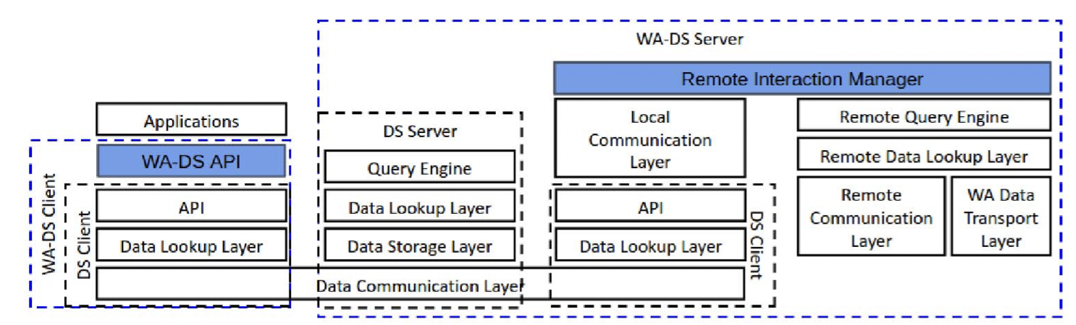
DataSpaces Staging Framework
Client/server architecture for accessing scientific data
Designed for large, potentially distributed data sets
Provides an execution space for “active staging” of data
Analytics/Visualization
Trigger-based transformation
Pull-based data access and subscription-based data pushes
Notes:
https://www.dropbox.com/s/aggc44dolssb0im/Zhe-Wang-defense_45mins-final.pptx?dl=0

Slide 3
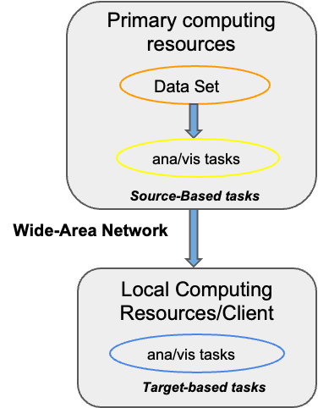
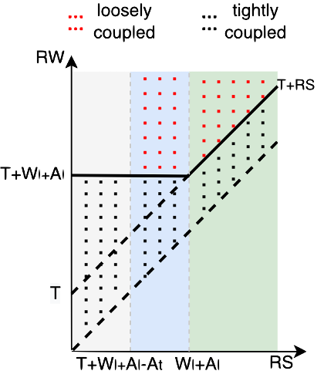
Adaptive Transformation/Visualization
Modes of transformation/viz execution:
Run at data source (tightly-couple data and compute)
Run at data client (loosly-couple data and compute)
Hybrid
Redistribute analysis and visualization tasks based on system resources:
CPU resources
Available memory
WAN transfer time
Autonomous model for task placement:
Prediction transformation/viz run time
Performance modeling of overall data pipeline
Autonomous placement of task execution

Slide 4

R-Pulsar Programming system
Lightweight middleware and runtime for data-driven analytics
Designed for programmable reactive behaviors
Provides a workflow execution driven by user-defined metrics
Triggers can be value, trends (statistical) based on resources and data
Allows for specifications of tradeoffs and/or selected service configurations
Cost/Quality/Deadline –oriented runtime policies

