Slide 1
Unit 4: JDBC
JDBC stands for Java Database Connectivity which is a technology that allows Java applications to interact with relational databases and execute SQL queries against the databases
JDBC is a java API to connect and execute query with the database.
JDBC API uses jdbc drivers to connect with the database.
The JDBC API is a Java API that can access any kind of tabular data, especially data stored in a Relational Database.

Slide 2
Contd…
JDBC helps to write Java applications that manage these three programming activities:
Connect to a data source, like a database
Send queries and update statements to the database
Retrieve and process the results received from the database in answer to your query

Slide 3
Contd….
Fundamentally, JDBC is a specification that provides a complete set of interfaces that allows for portable access to an underlying database.
Java can be used to write different types of executable, such as −
Java Applications
Java Applets
Java Servlets
Java ServerPages (JSPs)
Enterprise JavaBeans (EJBs).
All of these different executable are able to use a JDBC driver to access a database, and take advantage of the stored data.

Slide 4
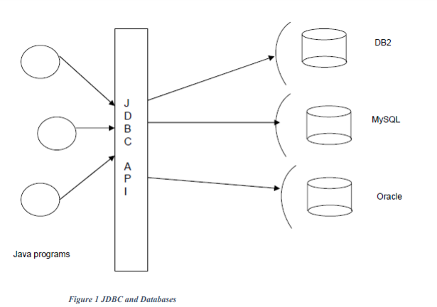
Contd….

Slide 5
How JDBC talks with Databases?
Databases are proprietary applications that are created by noted companies like Oracle, Microsoft and many more. These could be developed in any language like C, C++ etc by these vendors.
Every database will expose something called Driver through with one can interact with database for SQL operations.
A driver is like a gateway to the database.
Therefore, for any Java application to work with databases, it must use the driver of that database.

Slide 6
Database Drivers
A driver is not a hardware device. It’s a software program that could be written in any language.
Every database will have its own driver program.
Given a driver program of a particular database, the challenge is how to use it to talk with database.
To understand this, we need to know the different types of drivers.

Slide 7
ODBC
(Open Database Connectivity) is a standard database access method developed by Microsoft Corporation.
ODBC makes it possible to access data from any application, regardless of which database management system (DBMS) is handling the data.

Slide 8
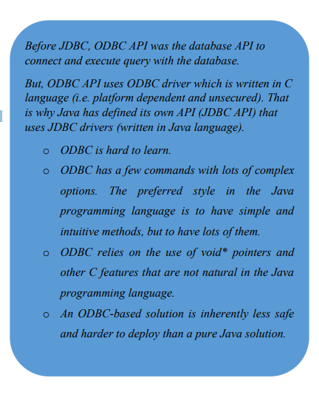

Slide 9
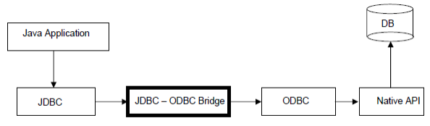
JDBC Divers Type
There are basically 4 different types of database drivers as described below:
1. JDBC-ODBC Bridge Driver (Type -1 driver)

Slide 10
Contd….
This is also called as Type-1 driver
As you can notice from the above figure, this driver translates the JDBC calls to ODBC calls in the ODBC layer.
The ODBC calls are then translated to the native database API calls.
Because of the multiple layers of indirection, the performance of the application using this driver suffers seriously.
This type of driver is normally used for training purposes and never used in commercial applications.
The only good thing with this driver is that you can access any database with it.
In simple words, with this driver for JDBC to talk with vendor specific native API, following translations will be made JDBC - > ODBC -> Native .It’s a 2 step process.
The JDBC-ODBC Bridge that comes with JDK 1.2 is a good example of this kind of driver.

Slide 11
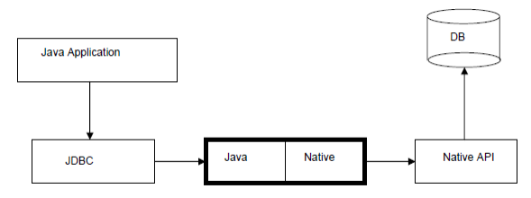
Partly Java and Partly Native Driver (Type -2 driver)

Slide 12
This is also called as Type-2 driver
As the name suggests, this driver is partly built using Java and partly with vendor specific API
With this driver, the JDBC calls are translated to vendor specific native calls in just one step. It completely eliminates the ODBC layer. Because of this ODBC layer elimination, the applications using this driver perform better.
The Oracle Call Interface (OCI) driver is an example of a Type 2 driver

Slide 13
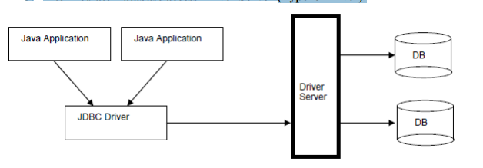
3. Intermediate Database access Driver Server (Type -3 Driver)

Slide 14
This is also called as Type-3 driver
If you look at the Type-2 driver configuration, we only access one database at a time. However there will be situations where multiple Java programs need to access to multiple databases. This is where Type-3 driver is used.
It acts as a middleware for the applications to access several databases. The Type-3 configuration internally may use Type-2 configuration to connect to database
IDS JDBC Driver is an example

Slide 15
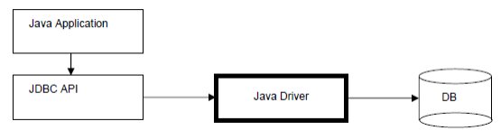
4. Pure Java Drivers (Type -4 Drivers)

Slide 16
These are called as Type-4 drivers.
Because of the widespread usage of Java, to facilitate easy and faster access to databases from Java applications, database vendors built the driver itself using Java like good friends helping each other. This is really cool as it completely eliminates the translation process.
JDBC is Java based technology, and with the driver also written in Java, it can directly invoke the driver program as if it were any other Java program.
This is the driver that all the J2EE applications use to interact with databases.
Because this is a Java to Java interaction, this driver offers the best performance.
MySQL's Connector/J driver is a Type 4 driver.

Slide 17
Which Driver should be Used?
If you are accessing one type of database, such as Oracle,MYSQL, Sybase, or IBM, the preferred driver type is 4.
If your Java application is accessing multiple types of databases at the same time, type 3 is the preferred driver.
Type 2 drivers are useful in situations, where a type 3 or type 4 driver is not available yet for your database.
The type 1 driver is not considered a deployment-level driver, and is typically used for development and testing purposes only.

Slide 18
Driver JAR Files
You need to obtain the JAR file in which the driver for your database is located (e.g. for Derby database, you need the file derbyclient.jar)
Include the driver JAR file on the class path
Launch programs from the command line with java –classpath .;driverJar ProgramName

Slide 19
JDBC API JDBC technology is nothing but an API.
It is a set of classes and interfaces that our Java programs use to execute the SQL queries against the database.
The fundamental idea behind JDBC is that, Java programs use JDBC API, and JDBC API will in turn use the driver to work with the database.
Therefore, to work with MySQL database, we need to configure the JDBC with all the MySQL information. This information is nothing but:
Name of the MySQL driver class
URL of the database schema.
In simple words, for a Java program to work with the database, we first need to configure JDBC with the above database info and then make the Java program use the JDBC.

Slide 20
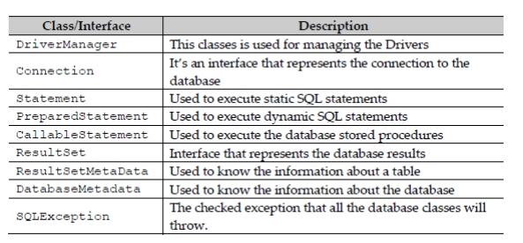
Few class and interfaces of JDBC API are as follows:

Slide 21
JDBC programming is the simplest of all.
There is a standard process we follow to execute the SQL queries. Following lists the basic steps involved in any JDBC program.
Import necessary packages
Load and Register the Driver
Establish the connection to the database
Create the statements( using Statement/ PreparedStatement/ CallableStatement)
Execute the statements
Process the results
Close the statements
Close the connection.

Slide 22
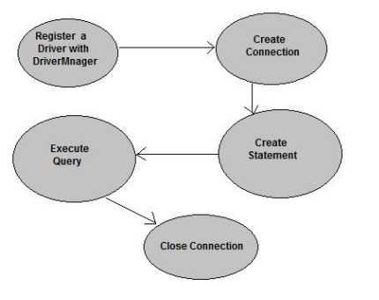

Slide 23
1. The forName() method of Class class is used to register the driver class.
This method is used to dynamically load the driver class.
Syntax of forName() method
public static void forName(String className)throws ClassNotFoundException
Example: Class.forName(“com.mysql.cj.jdbc.Driver");

Slide 24
2. The getConnection() method of DriverManager class is used to establish connection with the database.
Syntax of getConnection() method
1) public static Connection getConnection(String url)throws SQLException
2) public static Connection getConnection(String url,String name,String passwrd) throws SQLException
Example:
Connection con=DriverManager.getConnection("jdbc:mysql://localhost:3306/world","root","Prithvi123#");

Slide 25
3. The createStatement() method of Connection interface is used to create statement.
The object of statement is responsible to execute queries with the database.
Syntax of createStatement() method
public Statement createStatement()throws SQLException
Example to create the statement object Statement stmt=con.createStatement();

Slide 26
4. The executeQuery() method of Statement interface is used to execute queries to the database.
This method returns the object of ResultSet that can be used to get all the records of a table.
Syntax of executeQuery() method
public ResultSet executeQuery(String sql)throws SQLException
Example to execute query ResultSet rs=stmt.executeQuery("select * from emp");
while(rs.next())
{
System.out.println(rs.getInt(1)+" "+rs.getString(2));
}

Slide 27
By closing connection object statement and ResultSet will be closed automatically.
The close() method of Connection interface is used to close the connection.
Syntax of close() method
public void close()throws SQLException
Example to close connection
con.close();

Slide 28
Database URLs
Database URL Formulation After you've loaded the driver, you can establish a connection using the DriverManager.getConnection() method.
For easy reference, let us list the three overloaded DriverManager.getConnection() methods −

Slide 29
getConnection(String url)
getConnection(String url, Properties prop)
getConnection(String url, String user, String password)
Here each form requires a database URL. A database URL is an address that points to your database. Formulating a database URL is where most of the problems associated with establishing a connection occurs.

Slide 30
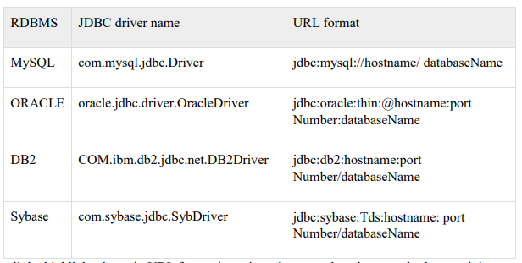
Following table lists down the popular JDBC driver names and database URL.

Slide 31
For MySQL Connection:
Driver class: The driver class for the mysql database is com.mysql.jdbc.Driver.
Connection URL: The connection URL for the mysql database is jdbc:mysql://localhost:3306/mydb where
jdbc is the API,
mysql is the database,
localhost is the server name on which mysql is running, we may also use IP address,
3306 is the port number and
mydb is the database name..
Username: The default username for the mysql database is root.
Password: Password is given by the user at the time of installing the mysql database.

Slide 32
Reading Data:
Executing SQL statements
For SELECT queries, use
ResultSet rs = statement.executeQuery("SELECT * FROM Books")
Process ResultSet object using
while (rs.next())
{
// look at a row of the result set
}
Inside each row, get field value using
String isbn = rs.getString(1); // using column index
double price = rs.getDouble("Price"); // using column name

Slide 33
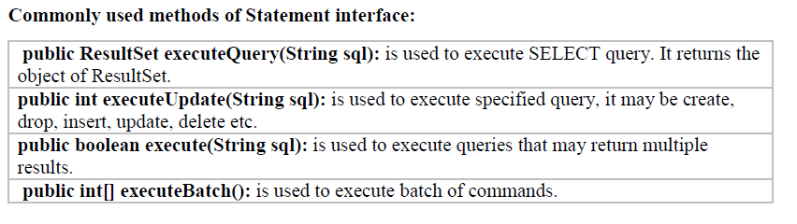

Slide 34
Reading Data Example
import java.sql.*;
public class App {
public static void main(String[] args) throws Exception {
try
{
Class.forName("com.mysql.cj.jdbc.Driver");
Connection con=DriverManager.getConnection("jdbc:mysql://localhost:3306/world","root","Prithvi123#");
Statement stmt=con.createStatement();
ResultSet rs=stmt.executeQuery("select name from country where population<10000");
while(rs.next())
{
System.out.println(rs.getString(1));
}
stmt.close();
Con.close();
}
catch(Exception e)
{
System.out.println(e);
}
}
}

Slide 35
Contd….
This is the most important and widely performed operation. In order to retrieve the data, we use the following method on the statement object:
public ResultSet executeQuery (String sql )
The above method takes the query and returns a ResultSet object that contains all the records returned by the database. We should then iterate over it and display the data. To retrieve the data from the ResultSet, there are several get methods available based on the type of the data.
We use the executeQuery() method to execute the SELECT query. This method will return a ResultSet object as shown below:
ResultSet rs = stmt.executeQuery(myquery);

Slide 36
Contd….
A resultset object can be imagined like a table of records with a pointer at the beginning of the table as shown below:
To read the records, we need to move the pointer to the record using the next() method until the pointer reaches the end of the records. This is what the while loop does. Once we are in the loop, we need to read the record that the pointer points using the get methods.
The get methods can either take the column number starting from 1 or the column name itself.
In our example, the column numbers have been used.
Following are the most commonly used get methods:
public String getString() //Used for VARCHAR columns
public int getInt() //Used for NUMERIC columns
public Date getDate() //Used for DATE columns.

Slide 37
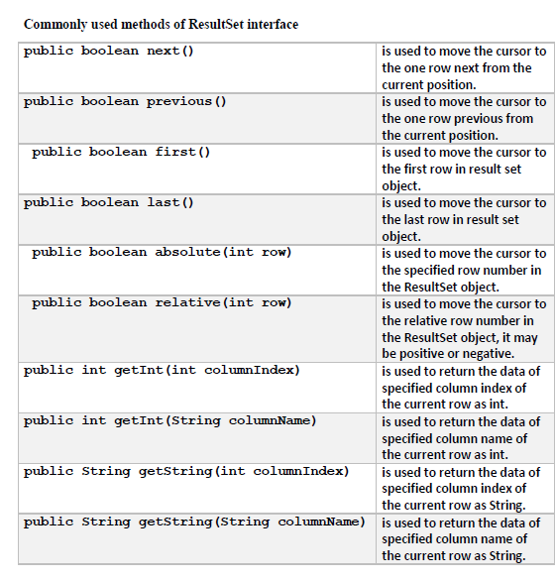

Slide 38
Writing Data
Note:If the query is SELECT, use the executeQuery() method. For all other queries (CREATE, INSERT, DELETE, UPDATE etc) use the executeUpdate() method.

Slide 39
Writing Data Example
import java.sql.*;
public class App {
public static void main(String[] args) throws Exception {
try
{
Class.forName("com.mysql.cj.jdbc.Driver");
Connection con=DriverManager.getConnection("jdbc:mysql://localhost:3306/student","root","Prithvi123#");
Statement stmt=con.createStatement();
int re=stmt.executeUpdate("insert into user(name,email,phone) values('shyam','xyz@gmail.com',123456)");
System.out.println(re +"row(s) inserted");
stmt.close();
con.close();
}
catch(Exception e)
{
System.out.println(e);
}
}
}

Slide 40
Task1:
Write a java program that allows a user to insert values to a table of particular database (Suppose database is in MySql server ). The program should take the values to insert from console.
Task2:
WAP using JDBC to display the records from a table of given database (Suppose database is in MySql server ). Assume the following table : result(roll_no , course_name ,marks_obtained)
The program should read the roll number value from console and display the corresponding record.

Slide 41
PreparedStatement
Once a connection is obtained we can interact with the database.
The JDBC Statement, CallableStatement, and PreparedStatement interfaces define the methods and properties that enable you to send SQL or PL/SQL commands and receive data from your database.

Slide 42
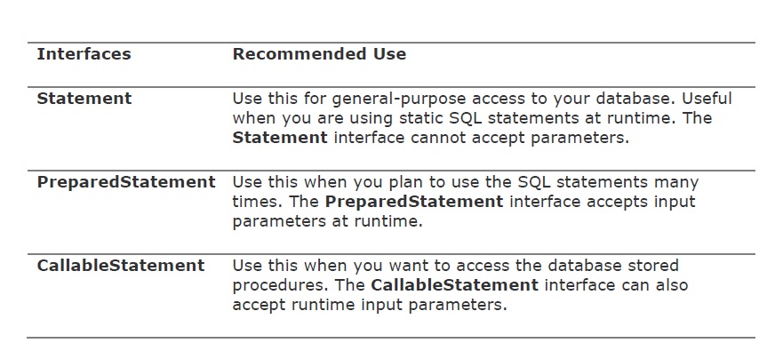
Contd….

Slide 43
The PreparedStatement interface is a subinterface of Statement. It is used to execute parameterized query.
If you want to execute a Statement object many times, it usually reduces execution time to use a PreparedStatement object instead.
We should use PreparedStatement when we plan to use the SQL statements many times. The PreparedStatement interface accepts input parameters at runtime.
The main feature of a PreparedStatement object is that, unlike a Statement object, it is given a SQL statement when it is created.
The usage of PreparedStatement is pretty simple. It involves three simple steps as listed below:
1. Create a PreparedStatement
2. Populate the statement
3. Execute the prepared statement.

Slide 44
The basic idea with PreparedStatement is using the ‘?’ symbol in the query where ever the data is to be substituted and then when the data is available, replace the symbols with the data.
Step1:
To create a prepared statement we use the following method on the Connection object as shown below:
PreparedStament prepareStatement (String sql );

Slide 45
The SQL query to be passed to the above method will look as shown below:
String myQuery = “INSERT INTO students VALUES ( ?, ?, ?, ?, ?)”;
Since we need to insert data into five columns, we used five question marks.
If you notice the query, there are no single quotes like we had in earlier examples.
Once we have the above SQL query , we create the prepared statement as shown below:
PreparedStatement stmt = con.prepareStatement ( myQuery );

Slide 46
Step 2: Now that we created a prepared statement, its time to populate it with the data.
To do this, we use the setXXX() which methods bind values to the parameters, where XXX represents the Java data type of the value you wish to bind to the input parameterr.
If you forget to supply the values, you will receive an SQLException.
Example:
stmt.setInt(1,101);//1 specifies the first parameter in the query
stmt.setString(2,"Ratan");

Slide 47
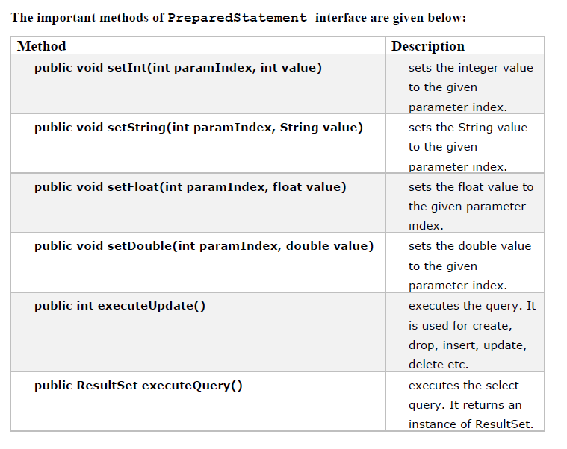

Slide 48
Example: Prepared Statement
import java.sql.*;
public class PSExample1 {
final String DRIVER_NAME = "com.mysql.jdbc.Driver";
final String DB_URL ="jdbc:mysql://localhost:3306/java2lab";
final String DB_USERNAME = "root";
final String DB_PASSWORD = "";
void connectMeAndFireQuery(){
try{
Class.forName(DRIVER_NAME);
Connection con;
con = DriverManager.getConnection(DB_URL, DB_USERNAME, DB_PASSWORD);
String myQuery = "INSERT INTO students VALUES(?,?,?,?,?)";
PreparedStatement pstmt;
pstmt = con.prepareStatement(myQuery);
pstmt.setInt(1, 101);
pstmt.setString(2,"Ratan");
pstmt.setString(3,"Yadav");
pstmt.setLong(4,984100000);
pstmt.setString(5, "Saptari");
int n;
n=pstmt.executeUpdate();
System.out.println("Thank you "+ n+ " record is added!");

Slide 49
pstmt.close();
con.close();
} catch (Exception e){
System.out.println(e);
}
}
public static void main(String[] args) {
PSExample1 pse1 =new PSExample1();
pse1.connectMeAndFireQuery();
}
}

Slide 50
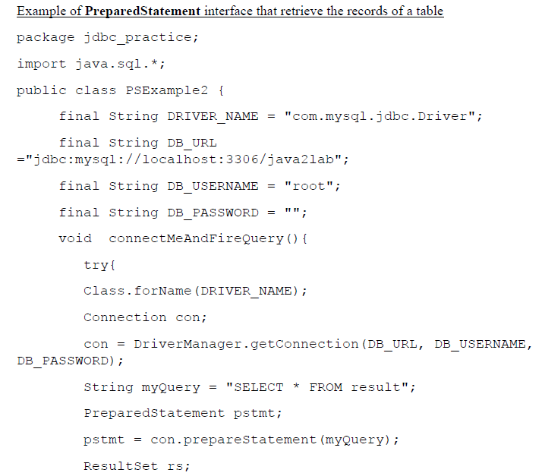

Slide 51
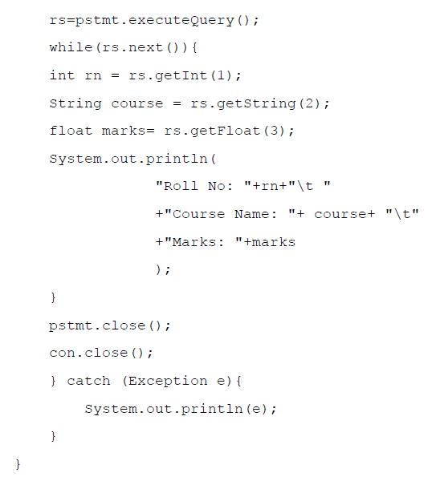

Slide 52
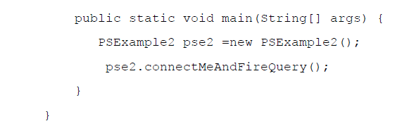

Slide 53
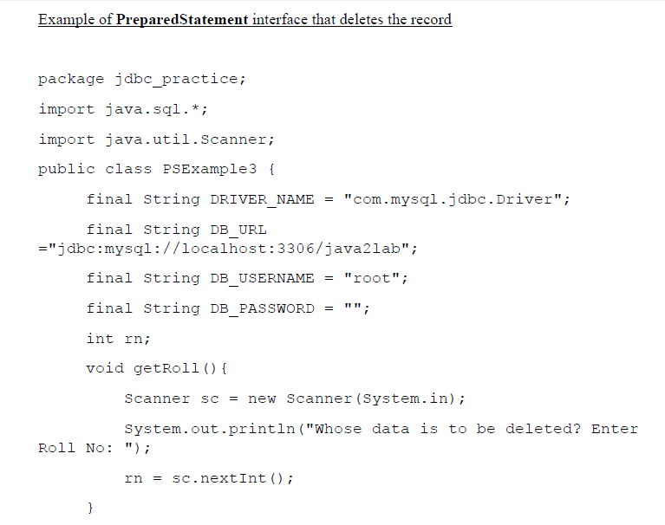

Slide 54
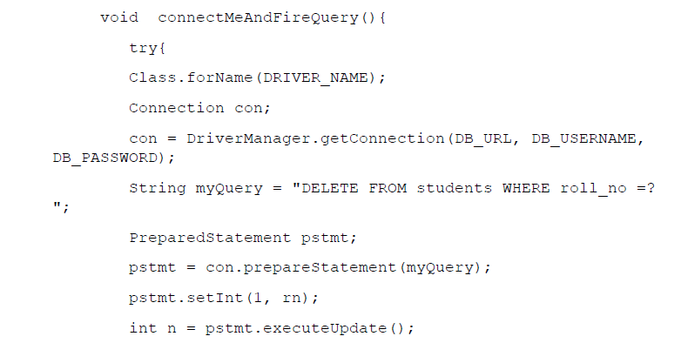

Slide 55
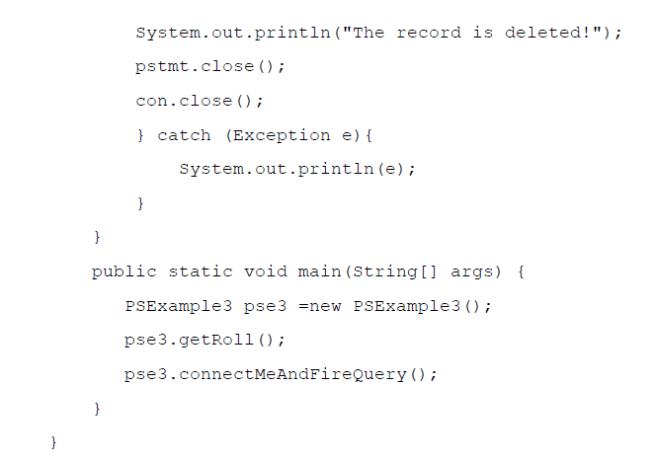

Slide 56
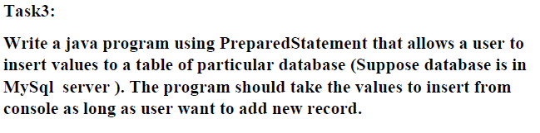
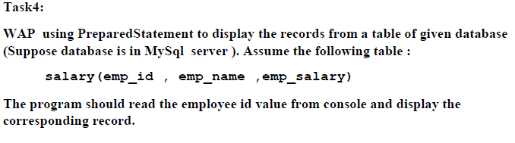
Tasks

Slide 57
Connection Pooling
Establishing a database connection is a very resource-intensive process and involves a lot of overhead.
Connection pooling is a mechanism to create and maintain a collection of JDBC connection objects.
The primary objective of maintaining the pool of connection object is to leverage re-usability.
A new connection object is created only when there are no connection objects available to reuse.
This technique can improve overall performance of the application
Connection pooling mechanism manage the connections effectively and efficiently by optimizing the usage of database connections
The connection pooling program comes along when we download the drivers for a particular database
The way the connection pooling works is,
1. It initializes a pool of connections with the database.
2. When a connection is requested by the application, it returns a connection from the pool.
3. The application after using the connection returns it back to the pool.

Slide 58
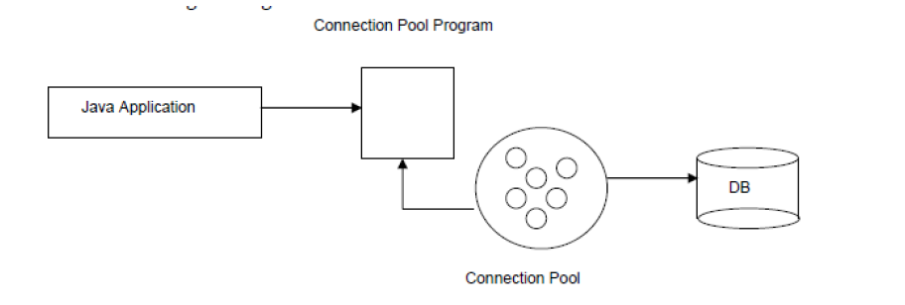

Slide 59
Connection pooling will be implemented in such a way that all the details are hidden behind the scenes.
The only change we as application developers need to make is the way we retrieve the connection object.
Once we get a connection object, the rest of the program will be the same.
Connection pooling is usually used with large scale enterprise applications where thousands of processes need to access the database at the same time.
In such situations the application server will be configured to use the connection pooling.

Slide 60
Why should we close the database connection?
Usually, every database has limited number of connections.
Let’s say a database supports only 10 connections, and if your program doesn't close the connection every time it ran, the 11th time you run, database will refuse to give you a connection.
If you don't close a connection after using it, from database point of view somebody is still using the connection, and it will not reuse this connection until the connection is closed.
You need to shut down the database and restart it to release all the connections which is not good.
So, always make sure you close the database connection.

