Slide 1
Unit 2:User Interface Components with Swing
2.1. Introduction:
Concept of AWT,
AWT vs Swing,
Java Applets,
Applet Life Cycle,
Swing Class Hierarchy,
Component and Containers

Slide 2
Graphical user interface (GUI)
graphical user interface (GUI) presents a user-friendly mechanism for interacting with an application.
A GUI gives an application a distinctive “look and feel.”
GUIs are built from GUI components.
These are sometimes called controls or widgets—short for window gadgets.
A GUI component is an object with which the user interacts via the mouse, the keyboard or another form of input, such as voice recognition.

Slide 3
Concept of AWT
The Abstract Window Toolkit (AWT) was Java’s first GUI framework, and it has been part of Java since version 1.0.
It contains numerous classes and methods that allow you to create windows and simple controls.
AWT contains large number of classes and methods that allows us to create and manage graphical user interface ( GUI ) applications, such as windows, buttons, scroll bars, etc.

Slide 4
AWT Classes
The AWT classes are contained in the java.awt package.
It is one of Java’s largest packages.
The AWT package contains different classes :
GUI Component classes, such as Button, TextField, and Label.
GUI Container classes, such as Frame and Panel.
Layout managers, such as FlowLayout, BorderLayout and GridLayout.
Event Handling Classes, such as AWTEvent, AWTEventMultiCaster
Custom graphics classes, such as Graphics, Color and Font

Slide 5
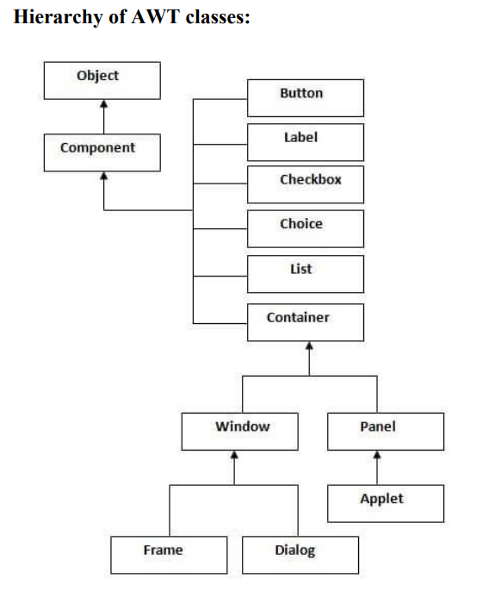

Slide 6
Window Fundamentals
The AWT defines windows according to a class hierarchy that adds functionality and specificity with each level.
The two most common windows are those derived from Panel, which is used by applets, and those derived from Frame, which creates a standard application window.
Component
At the top of the AWT hierarchy is the Component class. Component is an abstract class that encapsulates all of the attributes of a visual component.
Except for menus, all user interface elements that are displayed on the screen and that interact with the user are subclasses of Component.
A Component object is responsible for remembering the current foreground and background colors and the currently selected text font.
Components are elementary GUI entities, such as Button, Label, and TextField.

Slide 7
Container
The Container class is a subclass of Component.
It has additional methods that allow other Component objects to be nested within it.
Other Container objects can be stored inside of a Container (since they are themselves instances of Component).
This makes for a multileveled containment system.
A container is responsible for laying out (that is, positioning) any components that it contains.
It does this through the use of various layout managers.
Containers, such as Frame and Panel, are used to hold components in a specific layout (such as FlowLayout or GridLayout).
A container can also hold sub-containers.

Slide 8
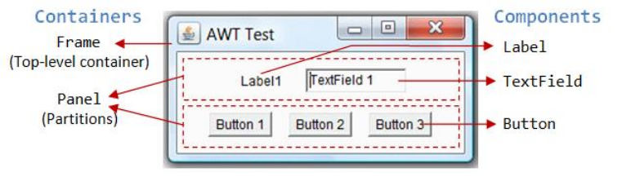

Slide 9
AWT Sample Program
import java.awt.*;
public class awtExample {
Frame main;
Panel p;
Label name, address;
TextField tname,taddress;
Button submit;
awtExample(){
main=new Frame("Main");
main.setSize(500,500);
main.setLayout(null);
name=new Label("Name");
name.setBounds(50,100,50,20);
main.add(name);
tname=new TextField();
tname.setBounds(150,100,150,20);
main.add(tname);
address=new Label("Address");
address.setBounds(50,150,50,20);
main.add(address);
taddress=new TextField();
taddress.setBounds(150, 150, 150,20);
main.add(taddress);

Slide 10
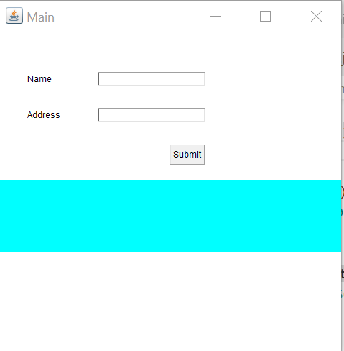
Example contd….
submit=new Button("Submit");
submit.setBounds(250,200,50,30);
main.add(submit);
p=new Panel();
// p.setSize(500,100);
p.setBounds(0,250,500,100);
p.setBackground(Color.CYAN);
main.add(p);
main.setVisible(true);
}
public static void main(String[] args) {
new awtExample();
}
}
Output

Slide 11
Java Swing
Java Swing is a part of Java Foundation Classes (JFC) that is used to create window-based applications.
It is built on the top of AWT (Abstract Windowing Toolkit) API and entirely written in java.
Unlike AWT, Java Swing provides platform-independent and lightweight components.
The javax.swing package provides classes for java swing API such as JButton, JTextField, JTextArea, JRadioButton, JCheckbox, JMenu, JColorChooser etc.

Slide 12
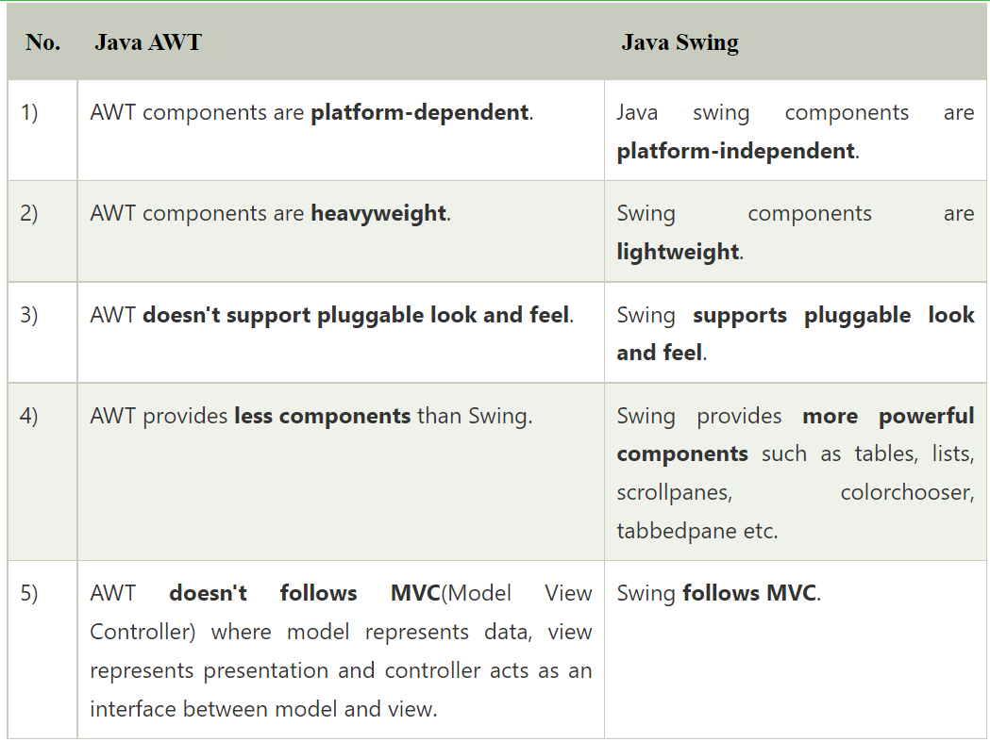
AWT vs Swing

Slide 13
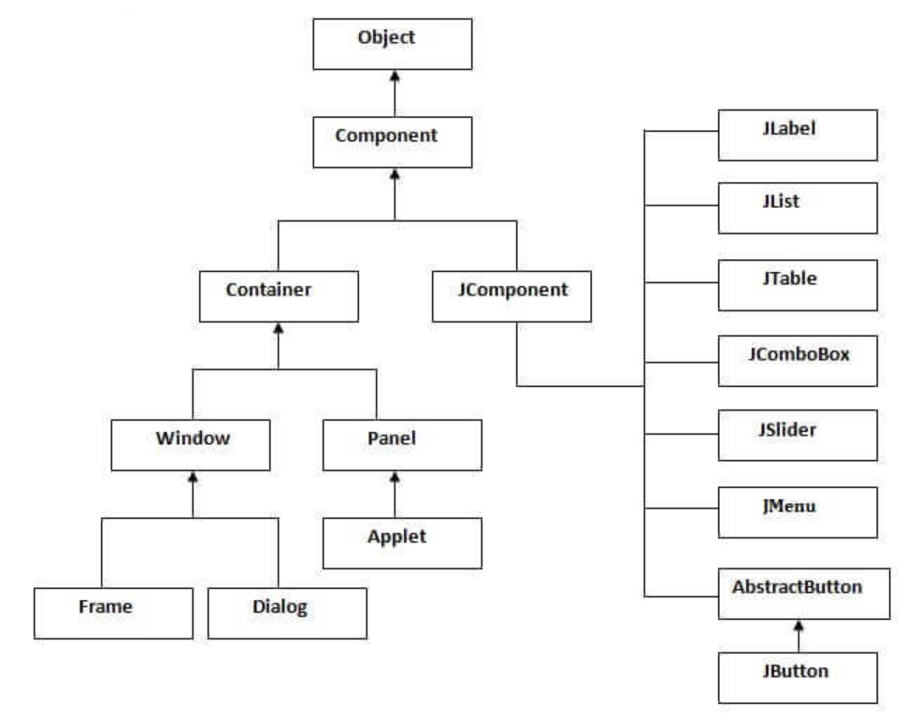
Hierarchy of Java Swing classes

Slide 14
Swing top level Containers
Swing provides three generally useful top-level container classes: JFrame, JDialog, and JApplet.
When using these classes, you should keep these facts in mind:
To appear onscreen, every GUI component must be part of a containment hierarchy. A containment hierarchy is a tree of components that has a top-level container as its root.
Each GUI component can be contained only once. If a component is already in a container and you try to add it to another container, the component will be removed from the first container and then added to the second.
Each top-level container has a content pane that, generally speaking, contains (directly or indirectly) the visible components in that top-level container's GUI.
You can optionally add a menu bar to a top-level container. The menu bar is by convention positioned within the top-level container, but outside the content pane.

Slide 15
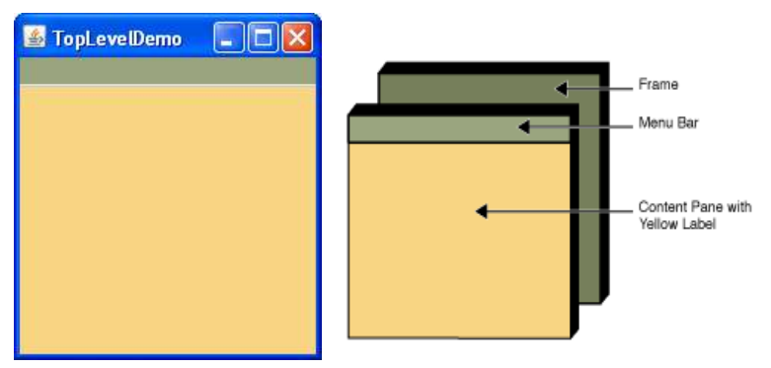

Slide 16
Each program that uses Swing components has at least one top-level container.
This top-level container is the root of a containment hierarchy — the hierarchy that contains all of the Swing components that appear inside the top-level container
As a rule, a standalone application with a Swing-based GUI has at least one containment hierarchy with a JFrame as its root.
For example, if an application has one main window and two dialogs, then the application has three containment hierarchies, and thus three top-level containers.
One containment hierarchy has a JFrame as its root, and each of the other two has a JDialog object as its root.

Slide 17
Creating JFrame
There are two ways to create a frame:
By creating the object of Frame class (association)
By extending Frame class (inheritance)

Slide 18
Example: By Association
import javax.swing.*;
public class FirstSwingExample {
public static void main(String[] args) {
JFrame f=new JFrame();//creating instance of JFrame
JButton b=new JButton("click");//creating instance of JButton
b.setBounds(130,100,100, 40);//x axis, y axis, width, height
f.add(b);//adding button in JFrame
f.setSize(400,500);//400 width and 500 height
f.setLayout(null);//using no layout managers
f.setVisible(true);//making the frame visible
}
}

Slide 19
Example: By Inheritance
import javax.swing.*;
public class Simple Extends JFrame {
Simple(){
JButton b=new JButton("click");//creating instance of JButton
b.setBounds(130,100,100, 40);
add(b);//adding button in JFrame
setSize(400,500);//400 width and 500 height
setLayout(null);//using no layout managers
setVisible(true);//making the frame visible
}
public static void main(String[] args) {
new Simple();
}
}

Slide 20
Java Applets
An applet is a Java program that runs in a Web browser.
An applet can be a fully functional Java application because it has the entire Java API at its disposal.
There are some important differences between an applet and a standalone Java application, including the following
An applet is a Java class that extends the java.applet.Applet class.
A main() method is not invoked on an applet, and an applet class will not define main().
Applets are designed to be embedded within an HTML page.
When a user views an HTML page that contains an applet, the code for the applet is downloaded to the user's machine.

