Slide 1
Unit 2: User Interface Components with Swing (10 Hrs.)
2.1. Introduction: Concept of AWT, AWT vs Swing, Java Applets, Applet Life Cycle, Swing Class Hierarchy, Component and Containers
2.2. Layout Management: No Layout, Flow layout, Border Layout, Grid Layout, Gridbag Layout, Group Layout.
2.3. GUI Controls: Text Fields, Password Fields, Text Areas, Scroll Pane, Labels, Check Boxes, Radio Buttons, Borders, Combo Boxes, Sliders
2.4. Menu, Menu Item, Icons in Menu Items, Check Box and Radio Buttons in Menu Items, Pop-up Menus, Keyboard Mnemonics and Accelerators, Enabling and Disabling Menu Items, Toolbars, Tooltips
2.5. Option Dialogs, Creating Dialogs, File Choosers, Color Choosers, Internal Frames, Frames, Tables, Trees, and Tables.

Slide 2
2.3. GUI Controls:
Text Fields,
Buttons
Password Fields,
Text Areas,
Scroll Pane,
Labels,
Check Boxes,
Radio Buttons,
Borders,
Combo Boxes,
Sliders

Slide 3
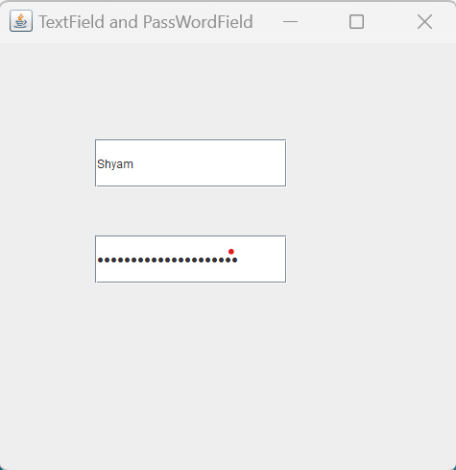
JTextField and JPasswordField
import javax.swing.*;
public class JtextandJpass {
JFrame f; Output:
JTextField name;
JPasswordField pass;
JtextandJpass(){
f=new JFrame("TextField and PassWordField");
f.setSize(500,500);
name=new JTextField();
name.setBounds(100,100,200,50);
f.add(name);
pass=new JPasswordField();
pass.setBounds(100,200,200,50);
f.add(pass);
f.setLayout(null);
f.setDefaultCloseOperation(JFrame.EXIT_ON_CLOSE);
f.setLocationRelativeTo(null);
f.setVisible(true);
}
public static void main(String[] args) {
new JtextandJpass();
}
}

Slide 4
JTextArea
The object of a JTextArea class is a multi line region that displays text.
It allows the editing of multiple line text.
It inherits JTextComponent class
Class Declaration
public class JTextArea extends JTextComponent

Slide 5
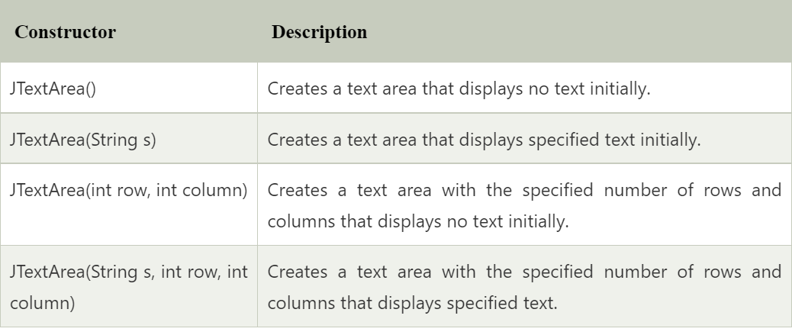
Constructors

Slide 6
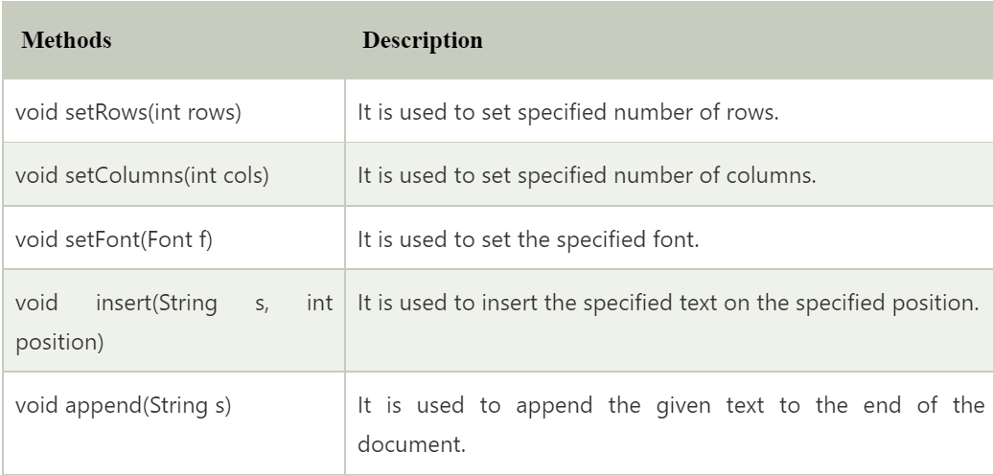
Commonly Used Methods

Slide 7
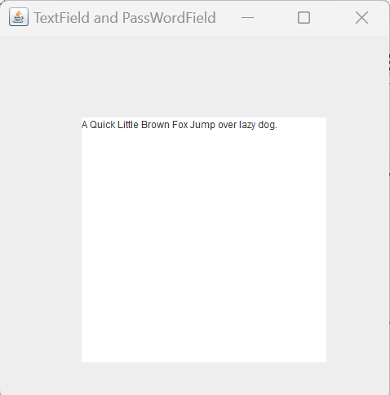
JTextArea: Example
import javax.swing.*;
public class jTextArea {
JFrame f;
JTextArea screen;
jTextArea(){
f=new JFrame(“Text Area");
f.setSize(500,500);
screen=new JTextArea();
screen.setBounds(100,100,300,300); OUTPUT:
f.add(screen);
f.setLayout(null);
f.setDefaultCloseOperation(JFrame.EXIT_ON_CLOSE);
f.setLocationRelativeTo(null);
f.setVisible(true);
}
public static void main(String[] args) {
new jTextArea();
}
}

Slide 8
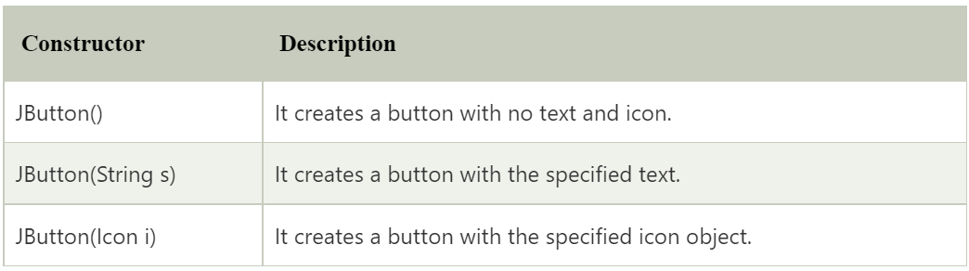
JButton
The JButton class is used to create a labeled button that has platform independent implementation. The application result in some action when the button is pushed. It inherits AbstractButton class.
Jbutton Class declaration
public class JButton extends AbstractButton implements Accessible
Constructors of Jbutton Class

Slide 9
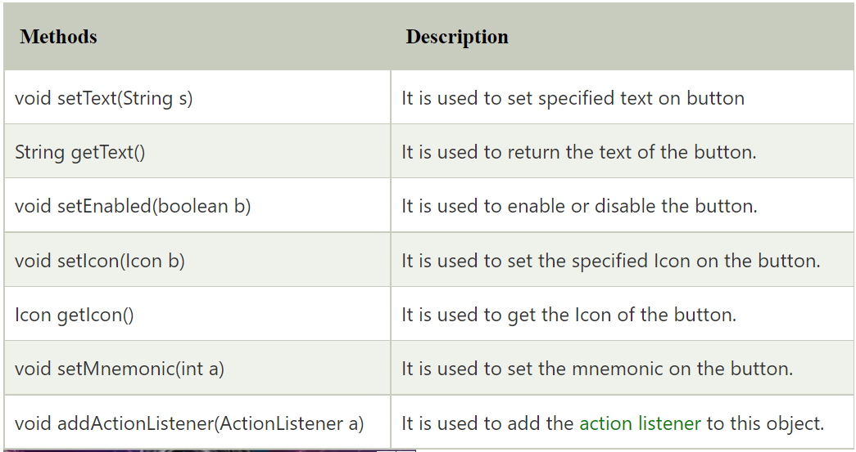
Methods of Abstract Button

Slide 10
Button Example: ImageIcon
import javax.swing.*;
public class ButtonExample{
ButtonExample(){
JFrame f=new JFrame("Button Example");
JButton b=new JButton(new ImageIcon("D:\\buttonIcon.png"));
b.setBounds(100,100,70, 70);
f.add(b);
f.setSize(300,400);
f.setLayout(null);
f.setVisible(true);
f.setDefaultCloseOperation(JFrame.EXIT_ON_CLOSE);
}
public static void main(String[] args) {
new ButtonExample();
}
}

Slide 11
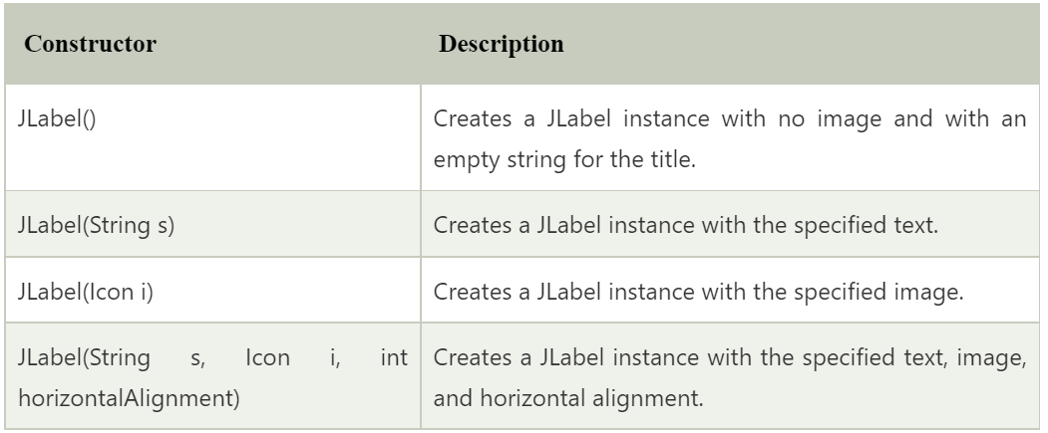
JLabel
The object of JLabel class is a component for placing text in a container.
It is used to display a single line of read only text.
The text can be changed by an application but a user cannot edit it directly.
It inherits JComponent class.
Declararion of Jlabel Class:
public class JLabel extends JComponent implements SwingConstants, Accessible

Slide 12
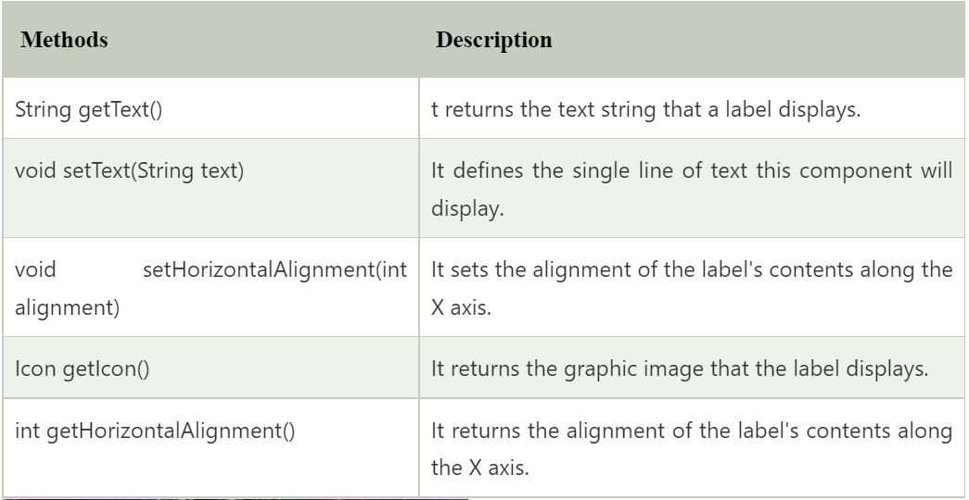
Commonly Used Methods:

Slide 13
JCheckBox
The JCheckBox class is used to create a checkbox.
It is used to turn an option on (true) or off (false).
Clicking on a CheckBox changes its state from "on" to "off" or from "off" to "on ".
It inherits JToggleButton class.
Declaration:
public class JCheckBox extends JToggleButton implements Accessible

Slide 14
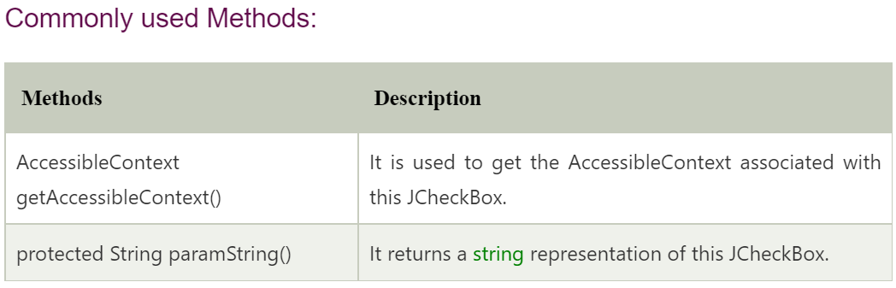
Constructors of JCheckBox
Constructors | Description
JCheckBox() | Creates an initially unselected check box button with no text, no icon.
JCheckBox(String s) | Creates an initially unselected check box with text.
JCheckBox(String text, boolean selected) | Creates a check box with text and specifies whether or not it is initially selected.
JCheckBox(Action a) | Creates a check box where properties are taken from the Action supplied.

Slide 15
JRadioButton
The JRadioButton class is used to create a radio button.
It is used to choose one option from multiple options.
It is widely used in exam systems or quiz.
It should be added in ButtonGroup to select one radio button only.
Declaration:
public class JRadioButton extends JToggleButton implements Accessible

Slide 16
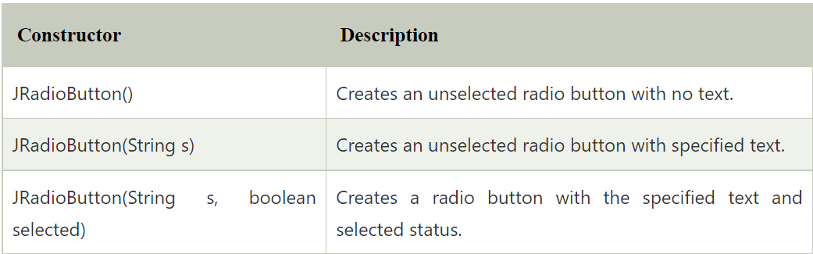
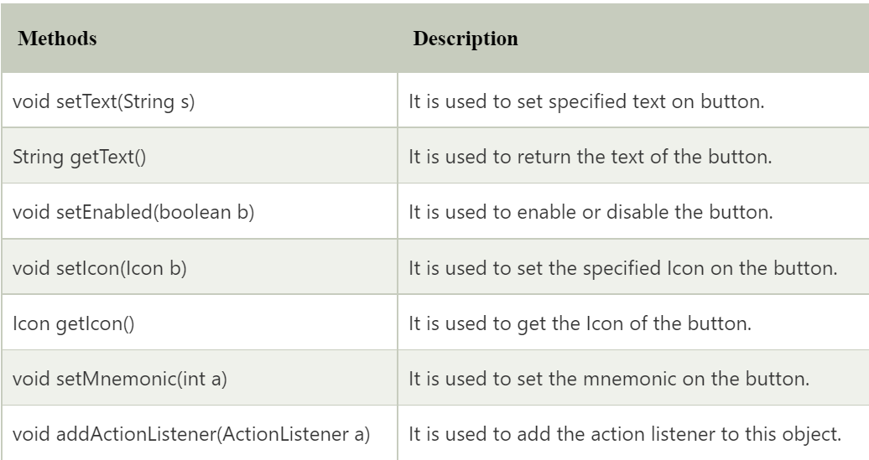
Constructors:
Common Methods

Slide 17
JComboBox
The object of Choice class is used to show popup menu of choices.
Choice selected by user is shown on the top of a menu.
It inherits JComponent class.
Declaration:
JComboBox extends JComponent implements ItemSelectable, ListDataListener, ActionListener, Accessible

Slide 18
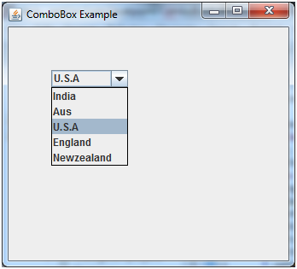
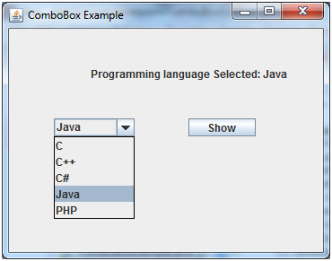

Slide 19
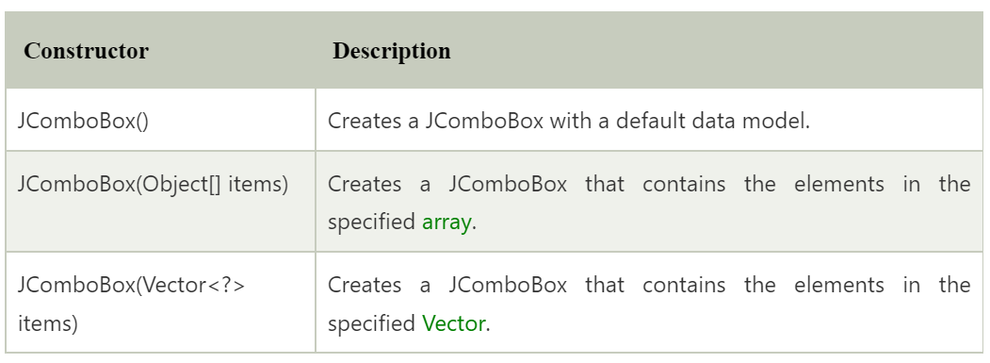
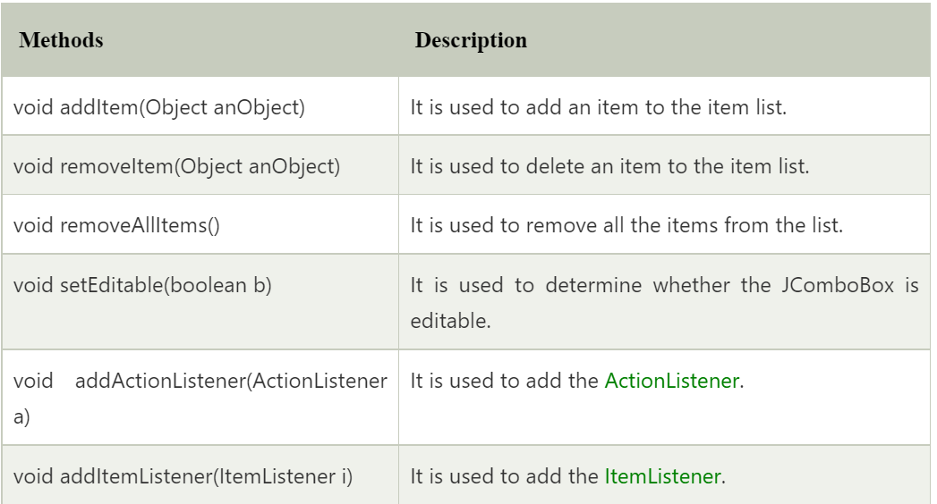
Constructors:
Common Methods:

Slide 20
Example: JRadioButton, JCheckBox,JComboBox
import javax.swing.*;
public class radioButtonExample {
JRadioButton male, female;
ButtonGroup g;
JFrame main;
JCheckBox term;
JComboBox select;
radioButtonExample(){
main=new JFrame("Main");
main.setLayout(null);
main.setSize(500,500);
g=new ButtonGroup();
male=new JRadioButton("male");
male.setBounds(100,200,100,50);
female=new JRadioButton("female");
female.setBounds(200, 200, 100,50);
g.add(male);g.add(female);
main.add(male);main.add(female);

Slide 21
String country[]={"Nepal","India","Bangladesh","Butan","Srilanka"};
select=new JComboBox(country);
select.addItem("Japan");
select.setBounds(200,300,100,50);
main.add(select);
term=new JCheckBox("terms and Condition");
term.setBounds(200,400,350,50);
main.add(term);
main.setDefaultCloseOperation(JFrame.EXIT_ON_CLOSE);
main.setLocationRelativeTo(null);
main.setVisible(true);
}
public static void main(String[] args) {
new radioButtonExample();
}
}

Slide 22
JScrollPane
A JscrollPane is used to make scrollable view of a component.
When screen size is limited, we use a scroll pane to display a large component or a component whose size can change dynamically.

Slide 23
JScrollPane: Example
import javax.swing.JFrame;
import javax.swing.JScrollPane;
import javax.swing.JTextArea;
public class jScrollPane {
JFrame f;
JTextArea area;
JScrollPane spane;
jScrollPane(){
f=new JFrame("Scroll Pane");
area=new JTextArea(20,20);
spane=new JScrollPane(area);
f.add(spane);
f.setSize(500,500);
f.setVisible(true);
f.setDefaultCloseOperation(JFrame.EXIT_ON_CLOSE);
}
public static void main(String[] args) {
new jScrollPane();
}
}

Slide 24
Borders into JPanel
import javax.swing.*;
import javax.swing.border.Border;
import java.awt.*;
public class BorderToPanel {
JFrame f;
BorderToPanel(){
f=new JFrame("Border to Panel");
f.setSize(500,500);
f.setLayout(null);
createUI(f);
f.setDefaultCloseOperation(JFrame.EXIT_ON_CLOSE);
f.setLocationRelativeTo(null);
f.setVisible(true);
}
public void createUI(JFrame f){
JPanel p=new JPanel();
Border blackLine=BorderFactory.createLineBorder(Color.BLACK);
p.setBounds(50,100,300,100);
p.setBackground(Color.cyan);
p.add(new JLabel("hello i am java Programming"));
p.setBorder(blackLine);
f.add(p);
}
public static void main(String[] args) {
new BorderToPanel();
}
}

Slide 25
JSlider
import javax.swing.*;
public class SliderExample1 extends JFrame{
public SliderExample1() {
JSlider slider = new JSlider(JSlider.HORIZONTAL, 0, 50, 25);
JPanel panel=new JPanel();
panel.add(slider);
add(panel);
}
public static void main(String s[]) {
SliderExample1 frame=new SliderExample1();
frame.pack();
frame.setVisible(true);
}
}

Slide 26
JButtonJava JLabel
JTextField
JTextArea
JPasswordField
JCheckBox
JRadioButton
JComboBox
JTableJava Jlist
JOptionPane
JScrollBar
JMenuItem & JMenu
JPopupMenu
JCheckBoxMenuItem
JSeparator
JProgressBar
JTree
JColorChooser
JTabbedPane

Slide 27
JSlider
JSpinner
JDialog
JPanel
JFileChooser
JToggleButton
JToolBar
JViewport
JFrame
JComponent
JLayeredPane
JDesktopPane
JEditorPane
JScrollPane
JSplitPane
JTextPane
JRootPane

