Slide 1
IoT Device for Crop Recommendation using AI
Team Members:
Aashish Pant (31253)
Kaustub Niraula (31262)
Rajendra Baskota (31271)
Rijan Ghimire (31272)
Under the Supervision of
Er. Saroj Shakya
Department of Electronics and Computer Engineering
Institute of Engineering, Thapathali Campus
March 9, 2023

Slide 2
Outline
Motivation
Introduction
Objectives
Scope of Project
Project Applications
Methodology
Results
Analysis
Future Enhancements
Conclusion
References

Slide 3
Motivation
Agriculture industry engages around 70% of the total population of Nepal.
Traditional farming methods restricting full potential.
Technology can serve as the main accelerator in this area.
Precision farming

Slide 4
Introduction
An IoT device interconnected with multiple sensors capable of connecting to the internet.
By combining IoT devices with AI, farmers can receive personalized recommendations about what to plant.
A system to ease agriculture and recommend crops based on soil parameters and environment.

Slide 5
Objective
To make a prototype model of 3 nodes using different sensors with the help of WSN.
To build an AI model using SVM and recommend the best crop.
To build a simple UI for farmers.

Slide 6
Scope of Project
Project Capabilities
Measurement of soil parameters
Web App and data communication
Predict and recommend a suitable crop from the collected data
Project Limitations
Training Dataset is not collected by ourselves.
This system does not include irrigation, spraying pesticides and size of crops.
Notes:
Measurement of soil parameters:
PH value, temperature value and humidity from the field.
Web App and data communication
Take NPK values as input from web app.
Data communication from field to the server.
Recommend the predicted crop for plantation from the collected data.

Slide 7
Project Applications
Identify the soil properties
Avoids the experimentation hassle
Financially beneficial farming
It can be used to minimize risk of low crop yield
Essential nutrients monitoring
The correct amount of nutrients needed for plants is calculated with ease
Smart farming solution
This model may be further developed into a smart farming solution with automated irrigation, pest control and fertilization
Notes:
The system can be further developed to incorporate market values of crops according to seasons and calculate the total value of the planted produce. This can be used to find the correct amount of nutrients needed for the plants according to the soil, rather than a bucket load of fertilisers.
This model can be further developed into a smart farming solution with automated irrigation, pest control, and fertilisation, revolutionizing stone age farming techniques in Nepal and other countries, improving quality of living and growing the economy.
This project helps farmers identify the correct crops to be planted during different seasons for maximum production and minimal resource use. It avoids the need to try various crops or experimentation, allowing plants to be planted without hassle.

Slide 8
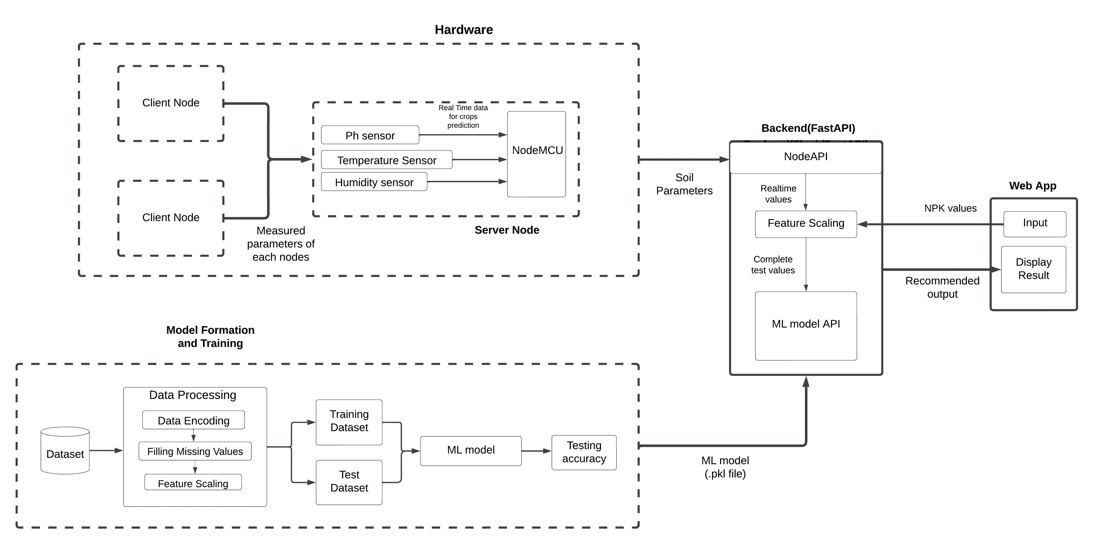
Methodology : Block Diagram
Figure 1 : Block Diagram

Slide 9
Methodology - Working Principle
NodeMCU takes input pH, temperature and humidity from the field.
Collected data is formatted into JSON format in NodeMCU.
Input of NPK values are taken from web app.
Data is fetched through FastAPI into the backend server.
Received data is fed into a trained SVM model.
Model predicts most suitable crop.
Predicted Crop is displayed in frontend.

Slide 10
Methodology - Hardware Requirements
NodeMCU esp8266
Main microcontroller unit
Compact size, low cost, and built-in Wi-Fi connectivity.
DHT11 Sensor
Measures the temperature and humidity of the environment.
pH Sensor
Measures pH value of soil.

Slide 11
Methodology - Software Requirements
Scikit-learn
Machine learning library for python programming language
Jupyter notebook
Jupyter Notebook is a popular and useful tool for data analysis, scientific computing, and education.
ReactJS
An open-source JavaScript library used for building user interfaces
FastAPI
FastAPI is a modern, fast (high-performance), web framework for building backend

Slide 12
Methodology - Training ML model
Dataset collection​
Data preprocessing​
Data encoding​
Filling missing values​
Feature scaling​
Divide the dataset into train and test set​.
Use the train set to train different Machine Learning algorithms: Support Vector Machine, Logistic Regression​ and Artificial Neural Network
Accuracy testing and analysis.

Slide 13
Dataset Description
Source of Dataset : kaggle (Crop Recommendation Dataset)
The dataset comprised of 2200 data points
Number of classes: 22 crops
Each crops has 100 data points
Features used from the dataset: N, P, K, pH, Temperature and Humidity
The dataset was split into train test set in the ratio of 80:20

Slide 14
Methodology - Logistic Regression
Model for binary classification.
Uses sigmoid function to map inputs to output of 0/1.
Uses one-vs-one or one-vs-all method for multiclass classification.
Regularization to control overfitting by reducing large weights.

Slide 15
Methodology - Neural Network
Modeled after the human brain structure.
Consists of interconnected nodes called neurons.
Consists of input, hidden and output layer with multiple neurons.
Performs forward propagation and backward propagation
Learns by adjusting parameters using gradient descent
Adjusts the parameters using the computed gradient to reduce overall cost

Slide 16
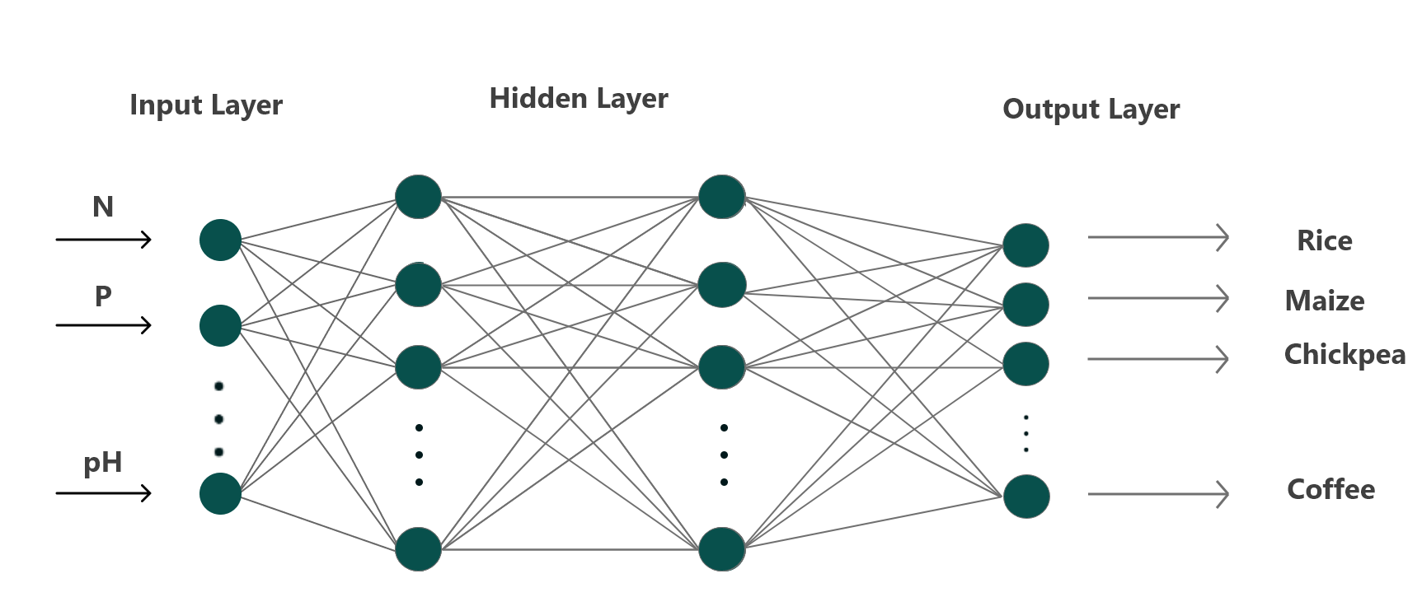
Methodology - Neural Network
Figure 2 : Artificial Neural Network

Slide 17
Methodology- Support Vector Machine
A supervised learning algorithm used for classification and regression analysis.
Finds the best hyperplane between classes in high dimensional space.
Maximizes the distance between the separating hyperplane and the support vectors.
Uses a kernel function to transform the input data into a higher dimensional space.

Slide 18
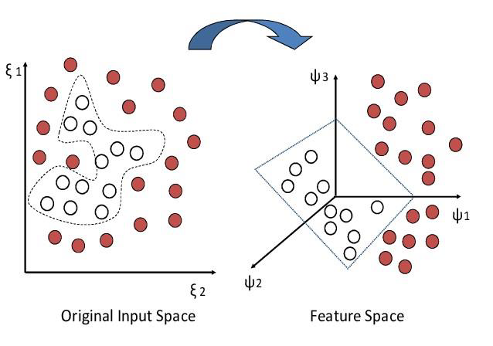
Methodology - Support Vector Machines
Figure 3 : Support Vector Machine

Slide 19
Methodology - WSN
Client-Server Architecture
Server node uses STA-AP mode for communication.
Client nodes only use STA mode.
Client nodes fetches soil parameters and sends data server node.
Server node sends the parameter to database server and backend.
ESP web server
ESP8266 enables web server creation.
GET request retrieves data, POST request pushes data.
ESP NOW
Connects multiple devices for data sharing.
Uses vendor-specific action frame for data transfer.
Pairing required before communication.
Supports one-way and two-way communication, limited peers.

Slide 20
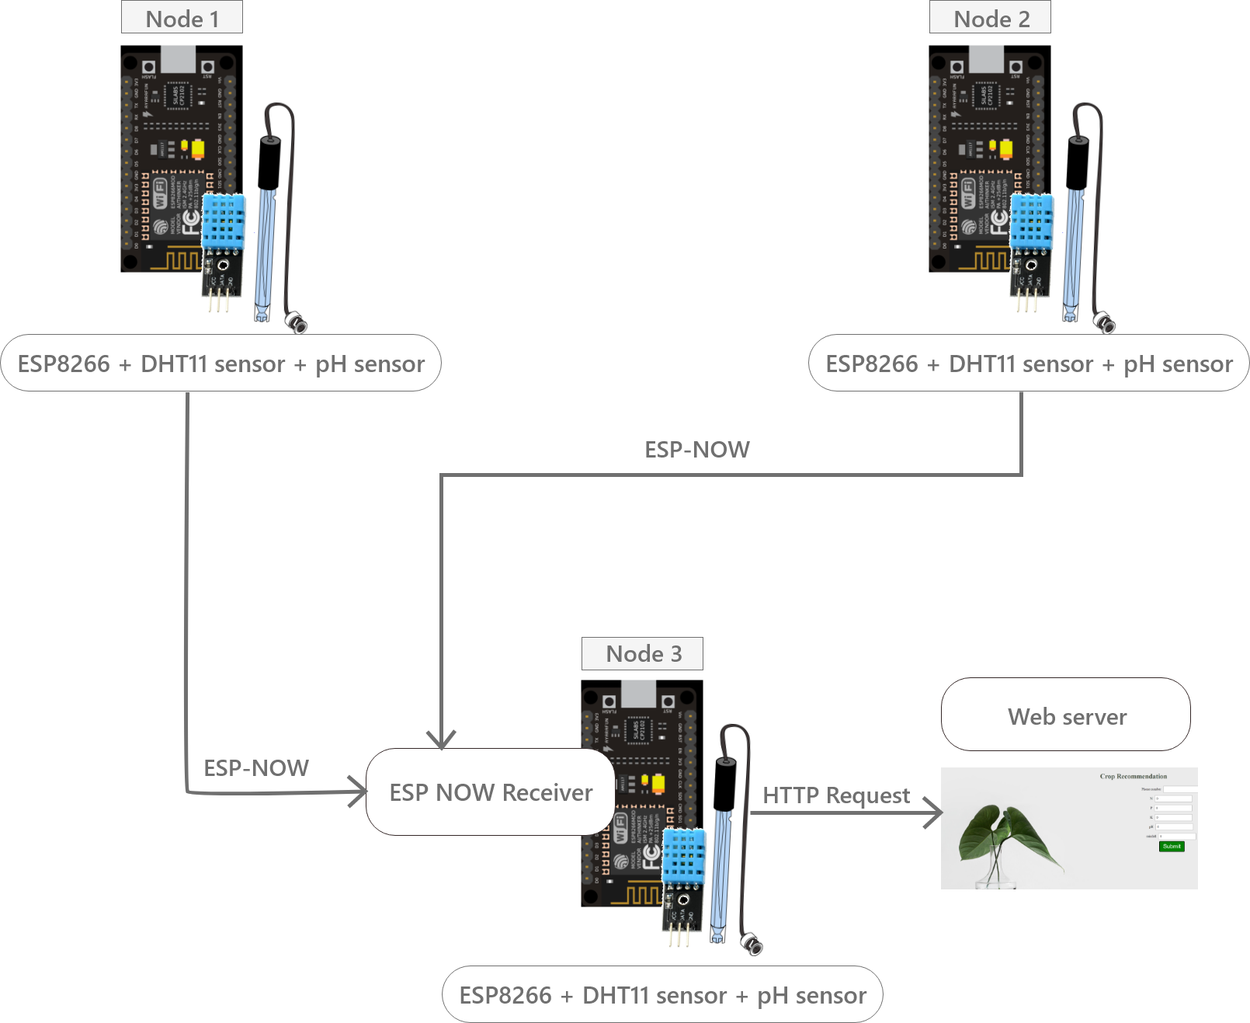
Methodology : WSN
Figure 4: Wireless Sensor Network of NodeMCU

Slide 21
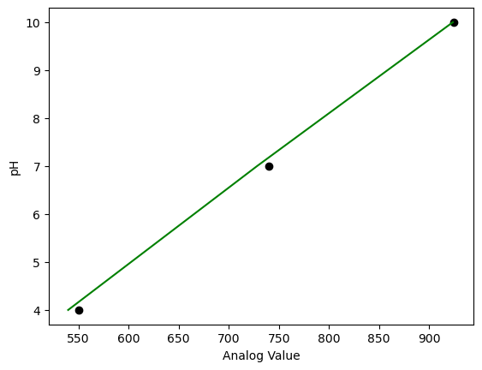
Calibration
The readings from DHT11 sensor were close to the internet readings
pH sensor was calibrated by testing it through known pH solutions
The readings were plotted and a equation was obtained
Figure 5: pH calibration graph

Slide 22
Results
Table 1 : Accuracy Comparison of ML models
Models | Train accuracy | Test accuracy
Logistic regression | 0.826 | 0.8145
3-layer Neural network | 0.936 | 0.928
SVM | 0.951 | 0.940

Slide 23
Analysis: Machine Learning
Logistic Regression is discarded due to low accuracy
Neural Network uses Relu and SoftMax activation
SVM utilizes RBF kernel, 50 epochs

Slide 24
Analysis : Neural Network
Table 2: Accuracy Comparison of Neural Network
​​ LAYERS ​​ | ​​ TRAIN ACCURACY ‘RELU’ ​​ | ​​ TEST ACCURACY ‘RELU’ ​​ | ​TRAIN ACCURACY ‘SIGMOID’ ​​ | ​​ TEST ACCURACY ’SIGMOID’ ​​
​​ 2 ​​ | ​​ 0.926 | ​​ 0.925 ​​ | ​​ 0.862 ​​ | ​​ 0.856 ​​
​​ 3 ​​ | ​​ 0.936 | ​​ 0.928 ​​ | ​​ 0.216 ​​ | ​​ 0.213 ​​
​​ 4 ​​ | ​​ 0.219 ​​ | ​​ 0.232 ​​ | ​​ 0.045 ​​ | ​​ 0.045 ​​
​​ Epoch = 1000 ​​

Slide 25
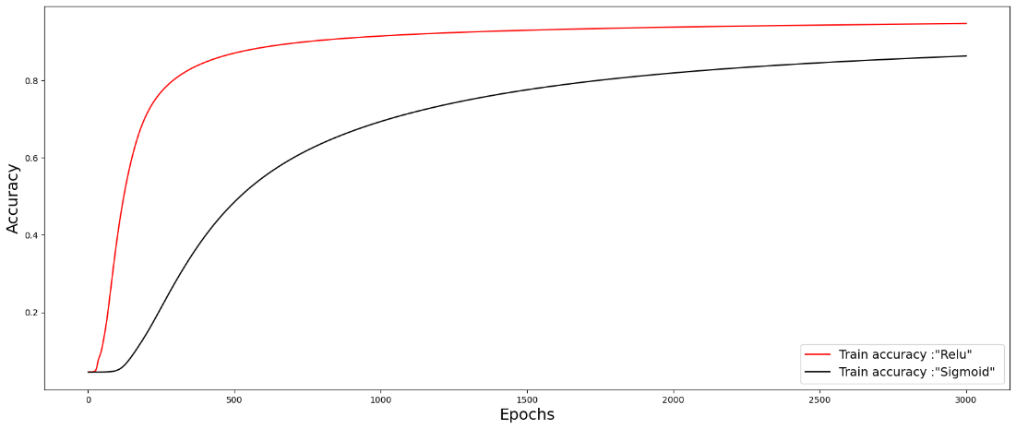
Analysis: 2-layer Neural Network
Figure 6 : Accuracy graph for 2 layers Neural Network

Slide 26
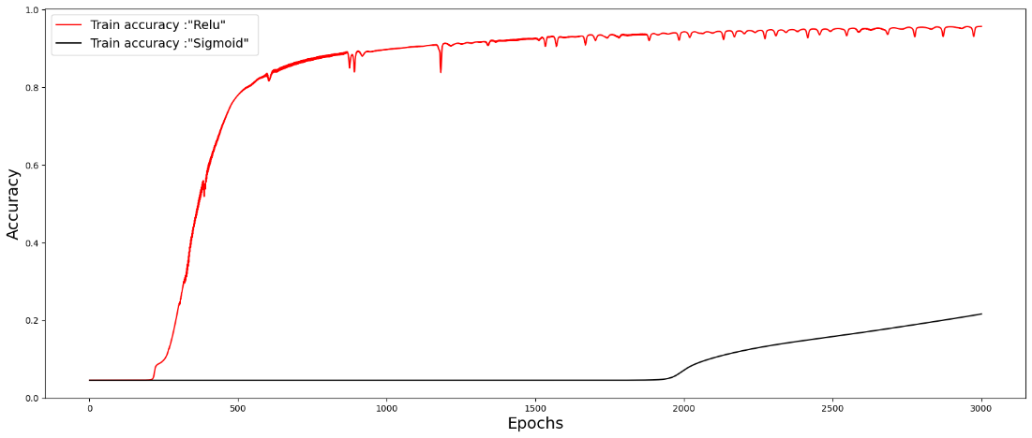
Analysis:3-layer Neural Network
Figure 5 : Accuracy graph for 3-layer Neural Network

Slide 27
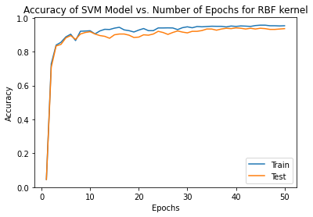
Analysis : SVM
Figure 6 : Accuracy vs Epochs graph of SVM

Slide 28
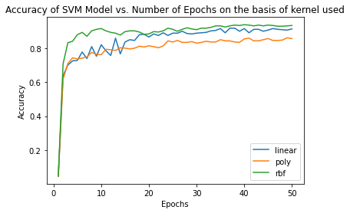
Analysis: SVM
Figure 7 : Accuracy vs Epochs graph for different kernels of SVM

Slide 29
Analysis - Networking
ESPWebServer
A web server was created in master node on port 80
The communication took place successfully in case of one server one client node
But when more client nodes were added to the network the data could not be received in the server node at the same instance
Due to this reason this approach was discarded

Slide 30
Analysis - Networking
ESP-NOW
This was implemented for communication between multiple clients and single master
This protocol uses MAC address to send data to certain nodes
The readings are read by the client nodes and sent to the MAC address stored in their memory
This supports two way communication between various nodes.

Slide 31
Future Enhancements
Connecting non-Wi-Fi zone to Wi-Fi zone using LoRa communication between field devices and control stations.
Include water level detection, irrigation, crop diseases, soil parameters, and fertilizers.
Develop feedback system to adjust model parameters based on user feedback.
Notes:
the enhancements that can be done are : analysis and designing of a client-server architecture for large fields to include LoRa communication between the field device and the control station. Smart farm care can include water level detection, smart irrigation, crop diseases, soil parameters, and feedback systems. Machine Learning models can be used to take actions based on user feedback.

Slide 32
Conclusion
Wireless sensor nodes that can sense physical quantity like temperature, humidity and pH of soil and transmit its value to a receiver is developed.
Each sensor node has four basic components: power supply, sensor, processing unit, and communication system.
The system collects data and uses SVM to analyze the data to recommend a crop
Notes:
We developed an IoT device that can recommend crops based on the NPK, pH value of soil, temperature, and humidity of the environment. Our experiments and evaluations show that the device can accurately predict the best crops to plant in a given area and has the potential to increase crop yield and quality while minimizing resource consumption. However, there are limitations such as less reliable datasets and more accurate sensors to measure soil parameters. Future work can focus on expanding the device's capabilities and integrating it with other agricultural technologies to create a more holistic and effective farming ecosystem.

Slide 33
References
[1] M. Naresh and P. Munaswamy, “Smart Agriculture System using IoT Technology,” 2019. [Online]. Available: www.ijrte.org
​[2] M. Bouni, B. Hssina, K. Douzi, and S. Douzi, “Towards an Efficient Recommender Systems in Smart Agriculture: A deep reinforcement learning approach,” Procedia Comput Sci, vol. 203, pp. 825–830, 2022, doi: 10.1016/j.procs.2022.07.124.
​[3] M. S. Farooq, S. Riaz, A. Abid, K. Abid, and M. A. Naeem, “A Survey on the Role of IoT in Agriculture for the Implementation of Smart Farming,” IEEE Access, vol.7. Institute of Electrical and Electronics Engineers Inc., pp. 156237–156271, 2019. doi: 10.1109/ACCESS.2019.2949703.

Slide 34
References
[4] “Crop Recommendation Dataset | Kaggle.” https://www.kaggle.com/datasets/atharvaingle/crop-recommendation-dataset (accessed Feb. 01, 2023).
​[5] E. Grossi and M. Buscema, “Introduction to artificial neural networks,” European Journal of Gastroenterology and Hepatology, vol. 19, no. 12. pp. 1046–1054, Dec. 2007. doi: 10.1097/MEG.0b013e3282f198a0.
​[6] S. Sharma, S. Sharma, and A. Athaiya, “ACTIVATION FUNCTIONS IN NEURAL NETWORKS,” International Journal of Engineering Applied Sciences and Technology, vol. 4, pp. 310–316, 2020, Accessed: Feb. 01, 2023. [Online]. Available: http://www.ijeast.com
[7] S. Masood, M. N. Doja, and P. Chandra, “Architectural Parameter-Independent Network Initialization Scheme for Sigmoidal Feedforward ANNs,” Arab J Sci Eng, vol. 45, no. 4, pp. 2901–2913, Apr. 2020, doi: 10.1007/s13369-019-04200-2.

