Slide 1

Sentiment analysis
up Members
Aashish Pokharel
Binod Adhikari
Tirtha Raj Poudel

Slide 2

Introduction
a view of or attitude toward a situation or event; an opinion
the process of computationally identifying and categorizing opinions
determine whether it is positive, negative, or neutral
usually given for a particular topic or a product
used to get feedback from very large audiences

Slide 3
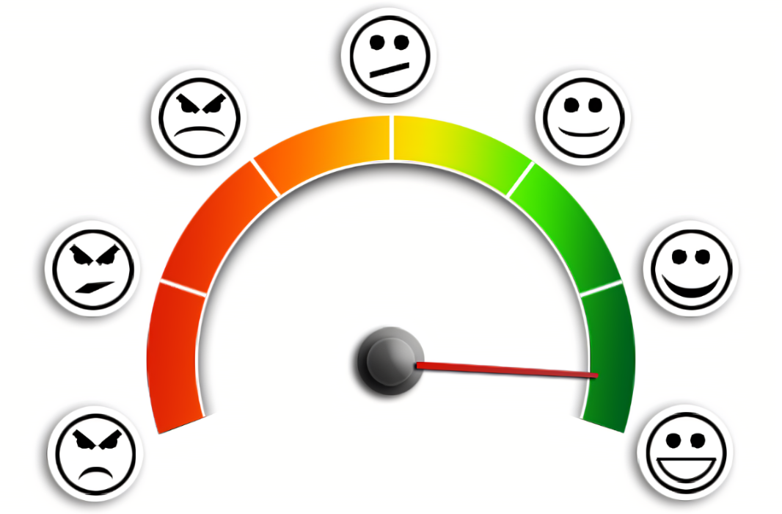
Types of Sentiment Analysis
Fine Grained Emotion Detection Aspect Based
Very-positive, positive, neutral, negative, very-negative
Happiness, Sadness, Anger, Frustration
Analyze sentiment of text

Slide 4
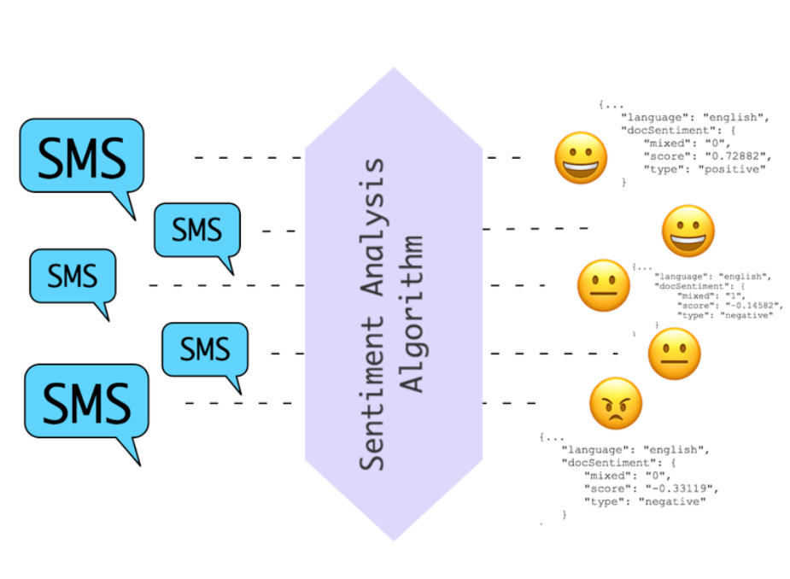
Rule Based System
Algorithm that performs sentiment
analysis based on a set of manually
crafted rules
-> preprocessing
-> tokenization
-> stemming
-> lemmatization
-> lexicons, etc

Slide 5

Target
Are we getting a state of the art
one-horned unicorn that can magically
predict the user’s sentiment when
even the user is dubious about the idea?
Spoiler alert, NO!
A simple machine learning model with satisfactory performance metrics, and good enough to land us a job, of course.

Slide 6

Applications
Helpful for large companies to get
customer reviews
To get employees feedbacks.
Helpful for improving product quality

Slide 7
Model Design & Analysis
Steps:
1. Data Collection and preparation
2. Exploratory Data Analysis
3. Data Preprocessing & Feature selection
4. Model Selection

Slide 8
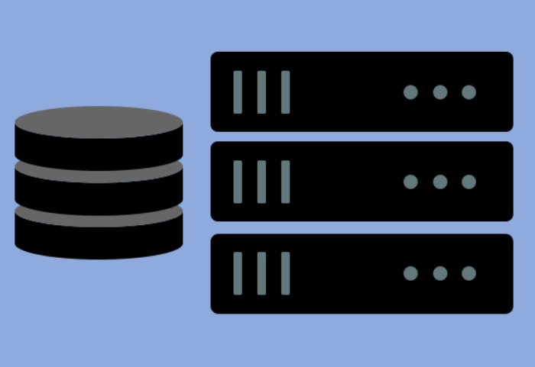
The dataset
Sentiment140 with 1.6 million tweets
1,600,000 tweets extracted using the twitter API
Annotation (0 = negative, 4 = positive)
Source of data : Kaggle / Stanford

Slide 9
Exploratory Data Analysis
Fields
target: the polarity of the tweet (0 = negative, 2 = neutral, 4 = positive)
ids: The id of the tweet
date: the date of the tweet
flag: The query (lyx). If there is no query, then this value is NO_QUERY.
user: the user that tweeted
text: the text of the tweet

Slide 10
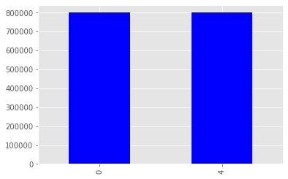
Exploratory Data Analysis
Class Distribution
Equally distributed
0 – Negative
4 - Positive

Slide 11
Data Preprocessing & Feature selection
Selected feature : ‘text’
Preprocessing:
To Lowercase
Removal of HTML tags and URLs.
Removal of Mentions(@username) and hashtags(#)
Removal of stopwords.
Stemming and Lemmatization
Vectorization

Slide 12
Model Selection
Algorithms Considered: Logistic Regression, Naive Bayes, SVM, decision Trees, XGBoost.
Metrics : Accuracy, F1 score and Confusion Matrix

Slide 13
Model Selection
Findings:
Logistic Regression & Naive Bayes: Performs well on metrics, Fast model training
Decision Trees & XGBoost: Average performance, Slow model training
SVM : Couldn’t converge.

Slide 14
Findings : For optimal Model
Optimal Model: Logistic Regression
Accuracy : ~79.6%
F1 Score: ~79.5%

Slide 15
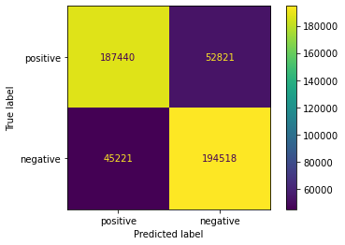
Findings : For optimal Model
Confusion Matrix:

Slide 16
Future Enhancements
Use of Classical Learning Algorithm(Logistic Regression). Deep Learning Algorithms such as RNN could increase model performance.
Implementation in the Real life scenario applications.

Slide 17



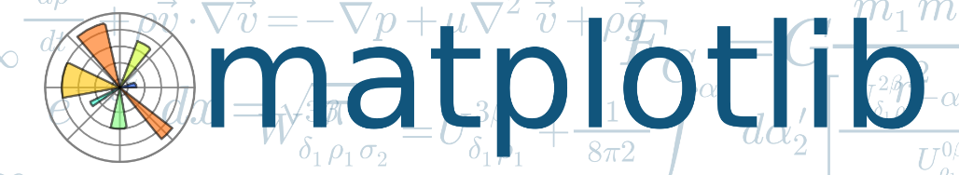

Libraries used
NumPy
Pandas
Matplotlib
Scikit Learn
Pickle
Django

Slide 18
Thank you!!!

