Slide 1



Ask design team to design a logo for 10MP Session
Ask design team to design a logo for 10MP Session
Fusemachines Logo
Fusemachines Logo
Title
Name
Position
Rossmann Store Sales Prediction
(Sprint 1)
Aashish Pokharel
ML Engineer Associate Trainee
< 10 MP Session Title >
<First Name Last Name>
<First Name Last Name>
< 10 MP Session Title >
<First Name Last Name>
<First Name Last Name>
<Date>
<Date>
Date
Feb 10, 2023

Slide 2
Overview

Slide 3
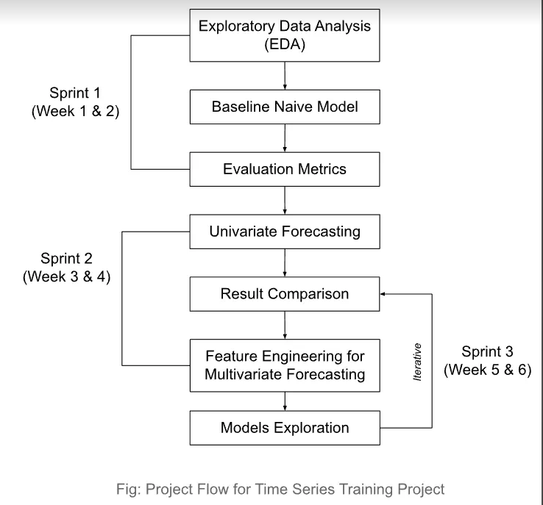
Sprint 1 Overview
Input:
Dataset
Expected Outcomes:
Data Insights
Baseline Naive Model & Performance

Slide 4
Introduction : Problem Statement

Slide 5
Introduction: data

Slide 6
Introduction : Data

Slide 7
Exploratory Data Analysis : Single Store

Slide 8
Exploratory Data Analysis : Overall Data

Slide 9
Baseline Naive Model

Slide 10
Baseline Naive Model : Predictions

Slide 11
Evaluation Metrics

Slide 12
Next Steps

Slide 13
Thank You!

