Slide 1

KSS - Trustworthy AI

Slide 2

Overview
1
Topic 1
2
Topic 2

Slide 3
Overview : (Continued)
1
2
3

Slide 4
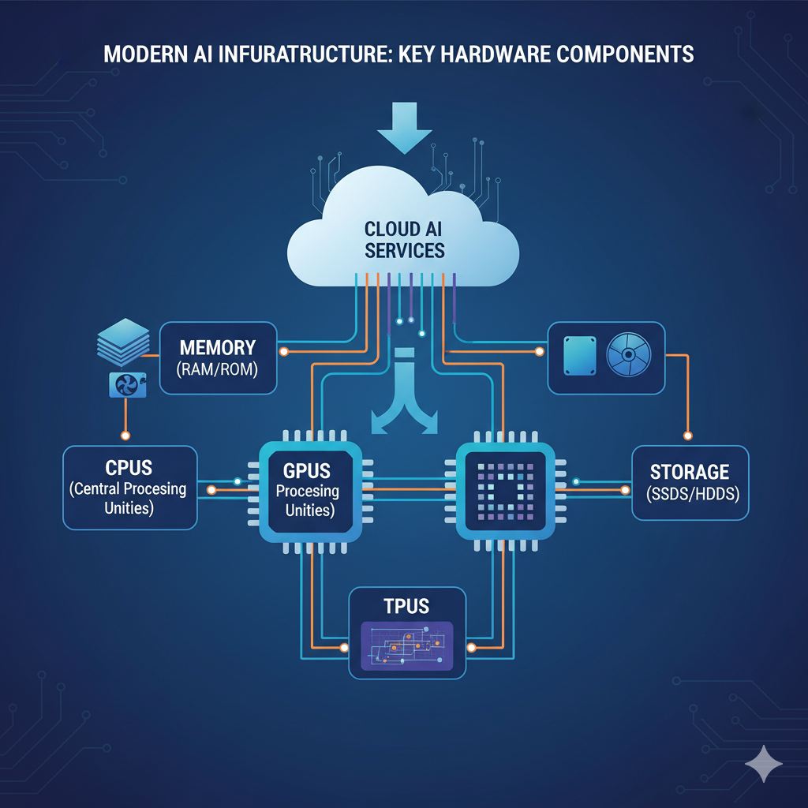
ML Infrastructures
<Text Here>
<Notes>

Slide 5
Question
Something related to question
Notes:
This slide is to introduce the concept that frontier AI model takes lot of time to train. Focus on lot then in next slide we will define the lot formally

Slide 6
But Why are we talking about CPUs & GPUs?
<Something related to question(in red)>
<The answer>
Notes:
This slide is to introduce the concept that frontier AI model takes lot of time to train. Focus on lot then in next slide we will define the lot formally

Slide 7
Comparison Table

