Slide 1
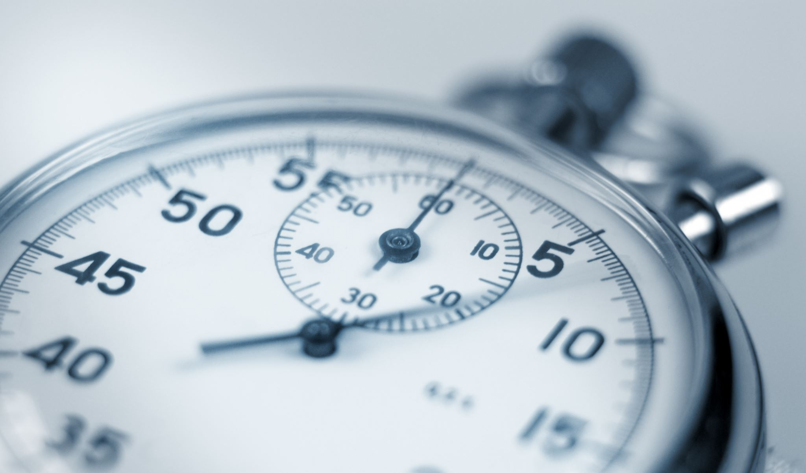
TIMER APPLICATION
- USING LPC1768 MICROCONTROLLER

Slide 2
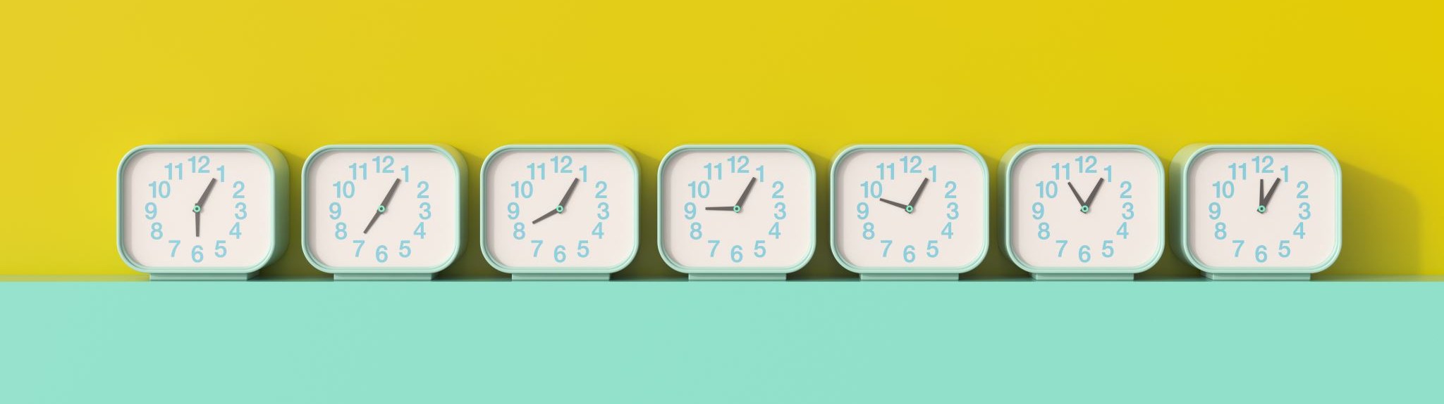

PROBLEM STATEMENT:
Write a program to interface a timer application to LPC1768 and display the timer on seven segment display.

Slide 3

ABSTRACT:
The problem statement for a timer application on a seven-segment display would be to design and implement a software program that can accurately measure and display time intervals on a seven-segment display. The application should utilize an input device such as a keypad to set the desired time interval and start the countdown. The display should be able to show the remaining time in a user-friendly format and update in real-time. The goal is to create a reliable and easy-to-use timer application that can be used in various applications, such as in kitchen appliances, sports events, or scientific experiments.

Slide 4

HARDWARE USED:
1)LPC1768 microcontroller The LPC1768 from NXP (founded by Philips) is a 32-bit CortexM3 microcontroller from ARM.
2)KEYPAD
3)SEVEN SEGMENT DISPLAY
4)BUZZER

Slide 5
ASSUMPTIONS:
The maximum input that can be given is 99 minutes 59 seconds.
PORT 2.10 TO 2.13 AS OUTPUT
PORT 1.23 TO 1.26 AS INPUT
PORT 0.4 TO 0.11 AS DATA LINES FOR SEVEN SEGMENT
PORT 0.23 TO 0.26 AS ENABLE LINES FOR SEVEN SEGMENT DISPLAY
PORT 2.0 AS SWITCH
PORT 4.28 AS CONFIGURE FOR BUZZER

Slide 6
CODE
#include<LPC17xx.h>
#include<stdlib.h>
#include<stdio.h>
#define PRESCALE (3000-1)
void scan(void);
void initTimer0(void);
void delayMS(unsigned int milliseconds);
void buzzer(int tim);
void display(void);
void delay(void);
unsigned char scan_code[16] = {0X11,0X21,0X41,0X81,
0X12,0X22,0X42,0X82,
0X14,0X24,0X44,0X84,
0X18,0X28,0X48,0X88};
unsigned char ASCII_CODE[16] = {'0','1','2','3',
'4','5','6','7',
'8','9','A','B',
'C','D','E','F'};

Slide 7
unsigned int seg_select[4] = {0<<23, 1<<23, 2<<23, 3<<23};
int dig[4]={0,0,0,0};
unsigned char seven_seg[10]={0x3F,0x06,0x5B,0x4F,0x66,0x6D,0x7D,0x07,0x7F,0x6F};
unsigned char row, var, flag, key;
unsigned long int i,j,var1,temp, temp1, temp2, temp3;
unsigned int time[4];
void delayMS(unsigned int milliseconds);
int main(void)
{
int i, j, k;
LPC_GPIO2->FIODIR |= 0x00003C00; //made output P2.10 to P2.13 (rows)
LPC_GPIO1->FIODIR &= 0xF87FFFFF; //made input P1.23 to P1.26 (cols)
initTimer0();
for(i=0;i<4;i++){
for(row=1;row<5;row++){
if(row == 1)
var1 = 0x00000400;
else if(row == 2)
var1 = 0x00000800;

Slide 8
else if(row == 3)
var1 = 0x00001000;
else if(row == 4)
var1 = 0x00002000;
temp = var1;
LPC_GPIO2->FIOCLR = 0x00003C00; //first clear the port and send appropriate value for
LPC_GPIO2->FIOSET = var1; //enabling the row
flag = 0;
scan(); //scan if any key pressed in the enabled row
if(flag == 1)
break;
} //end for(row=1;row<5;row++)
for(j=0; j<16; j++)
{
if(key==scan_code[j])
{
time[i] = ASCII_CODE[j];
time[i]=time[i]-48;
break;
}
}
}
display();
LPC_PINCON->PINSEL0 &= 0xFF0000FF;
LPC_PINCON->PINSEL1 &= 0xFFC03FFF;
LPC_PINCON->PINSEL4 &= 0xFFFFFFFC;
LPC_GPIO0->FIODIR |= 0x00000FF0;
LPC_GPIO0->FIODIR |= 0x07800000;

Slide 9
while(1){
if(LPC_GPIO2->FIOPIN & 1){
for(dig[0]=time[3];dig[0]>=0;dig[0]--){
for(k=0;k<4;k++){
LPC_GPIO0->FIOPIN=seg_select[i];
LPC_GPIO0->FIOPIN=seven_seg[dig[k]]<<4;
delayMS(1000);
}
}
time[1]--;
for(dig[1]=time[2];dig[1]>=0;dig[1]--){
for(dig[0]=9;dig[0]>=0;dig[0]--){
for(int k=0;k<4;k++){
LPC_GPIO0->FIOPIN=seg_select[i];
LPC_GPIO0->FIOPIN=seven_seg[dig[k]]<<4;
delayMS(1000);
}
}
}
time[2]--;
for(dig[2]=time[1];dig[2]>=0;dig[2]--){
for(dig[1]=5;dig[1]>=0;dig[1]--){
for(dig[0]=9;dig[0]>=0;dig[0]--){
for(k=0;k<4;k++){
LPC_GPIO0->FIOPIN=seg_select[i];
LPC_GPIO0->FIOPIN=seven_seg[dig[k]]<<4;
delayMS(1000);
}
}
}
}

Slide 10
time[3]--;
for(dig[3]=time[0];dig[3]>=0;dig[3]--){
for(dig[2]=9;dig[2]>=0;dig[2]--){
for(dig[1]=5;dig[1]>=0;dig[1]--){
for(dig[0]=9;dig[0]>=0;dig[0]--){
for(k=0;k<4;k++){
LPC_GPIO0->FIOPIN=seg_select[i];
LPC_GPIO0->FIOPIN=seven_seg[dig[k]]<<4;
delayMS(1000);
}
}
}
}
}
buzzer(2000);
}
}
}
void scan(void){
temp3 = LPC_GPIO1->FIOPIN;
temp3 &= 0x07800000; //check if any key pressed in the enabled row
if(temp3 != 0x00000000){
flag = 1;
temp3 >>= 19;//Shifted to come at HN of byte
temp >>= 10;//shifted to come at LN of byte
key = temp3|temp;//get SCAN_CODE
}
}

Slide 11
void initTimer0(void){
/*Assuming that PLL0 has been setup with CCLK = 100Mhz and PCLK = 25Mhz.*/
LPC_SC->PCONP |=(1<<1);//Power up TIM0. By default TIM0 and TIM1 are enabled.
LPC_SC->PCLKSEL0 &=~(0x3<<3);//Set PCLK for timer = CCLK/4 = 100/4 (default)
LPC_TIM0->CTCR =0x0;
LPC_TIM0->PR =PRESCALE;//Increment LPC_TIM0->TC at every 24999+1 clock cycles//25000 clock cycles @25Mhz = 1 mS
LPC_TIM0->TCR =0x02;//Reset Timer
}
void delayMS(unsigned int milliseconds)//Using Timer0
{
LPC_TIM0->TCR =0x02;//Reset Timer
LPC_TIM0->TCR =0x01;//Enable timer
while(LPC_TIM0->TC <milliseconds);//wait until timer counter reaches the desired delay
LPC_TIM0->TCR =0x00;//Disable timer
}
void buzzer(int tim)
{
LPC_PINCON->PINSEL9 = 0x00000000;
LPC_GPIO4->FIODIR = 1<<28;
LPC_GPIO0->FIOSET = 1<<28;
for(i=0;i<tim;i++);
LPC_GPIO0->FIOCLR = 1<<28;
for(i=0;i<tim;i++);
}

Slide 12
void delay(void){
int b;
for(b=0;b<5000;b++);
return;
}
void display(void){
int a;
for(a=0;a<4;a++){
LPC_GPIO0->FIOPIN = a<<23;
LPC_GPIO0->FIOPIN = seven_seg[dig[a]]<<4;
delay();
}
return;
}

Slide 13
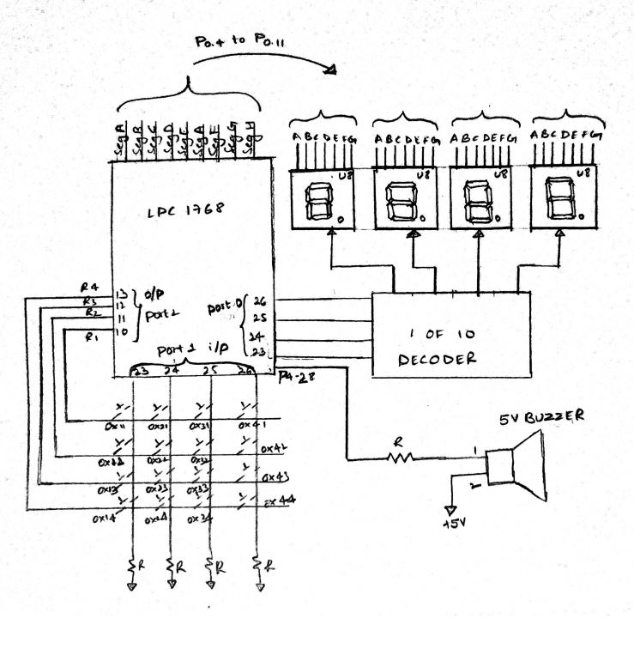
Block diagram

Slide 14

TEAM MEMBERS:
P.MOUKTHIK (210905296)
P.S.V.AASHISH (210905212)
G.SREE LAKSHMI NARASIMHA NAIDU (210905304)
S.HEMANTH BHARATH (210905178)
MAKA SATYA PRANAV GUPTA (210905302)

