Slide 1

LET US ^{RISE} ABOVE THE REST MSP Mandal’s Deogiri Institute of Engineering and Management Studies Department of Computer Science & Engineering
Online admission system
Team Members Name: 1) Ashutosh Pipriye Roll No:1) 26052
2) Ashish Rana 2) 26053
Class: SE CSE 1
Date: 2/11/2018

Slide 2
Content:
Introduction.
Need of website
Languages used.
Scope.
Advantages.
Visuals.
Role Distribution.

Slide 3
Introduction:
Online admission system is the process that can be helpful to admit student without coming to university .
It could be helpful for someone for getting from over the internet as well as admission card.

Slide 4
Need of website
Nowadays the world become so digital so this website is very useful for the college students.
This website is time consuming and easily accessible.

Slide 5

Languages used:

Slide 6
Scope:
All public university.
All engineering university.
All educational institutes have chance to use this application.

Slide 7

Visuals:

Slide 8
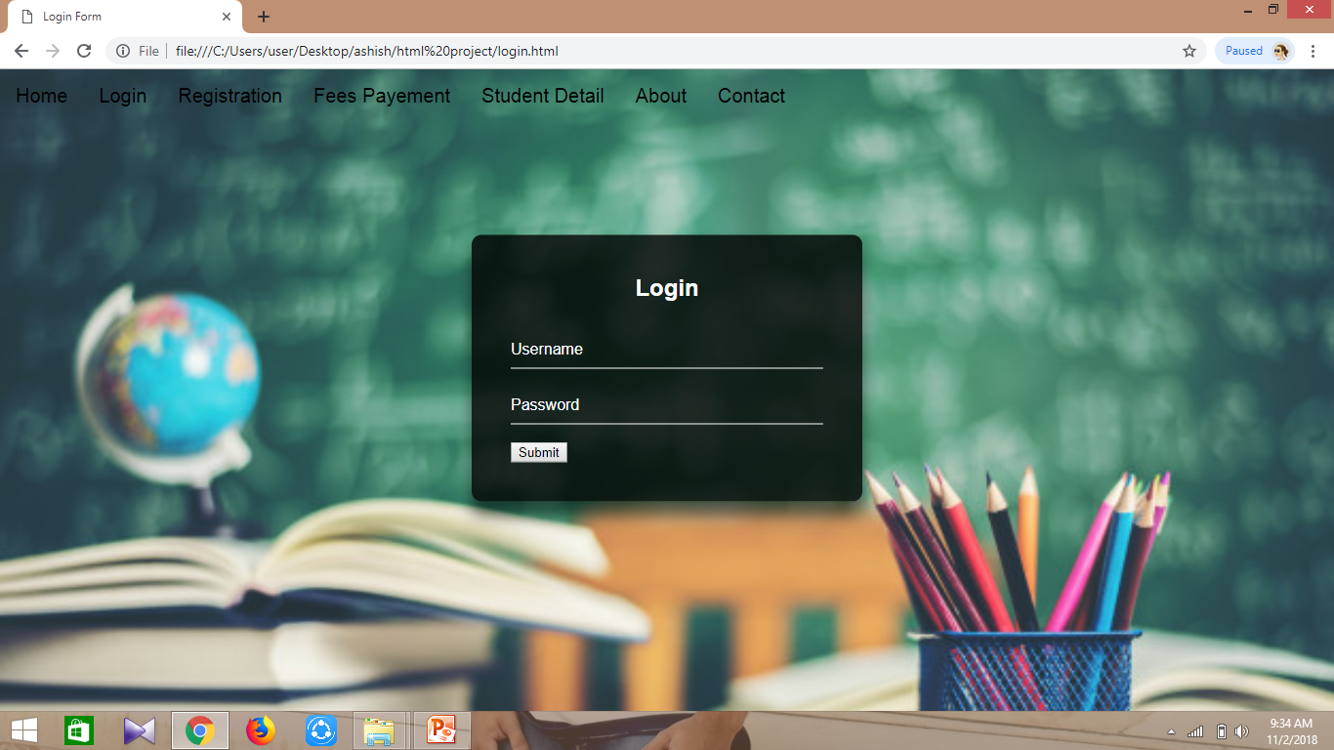

Slide 9
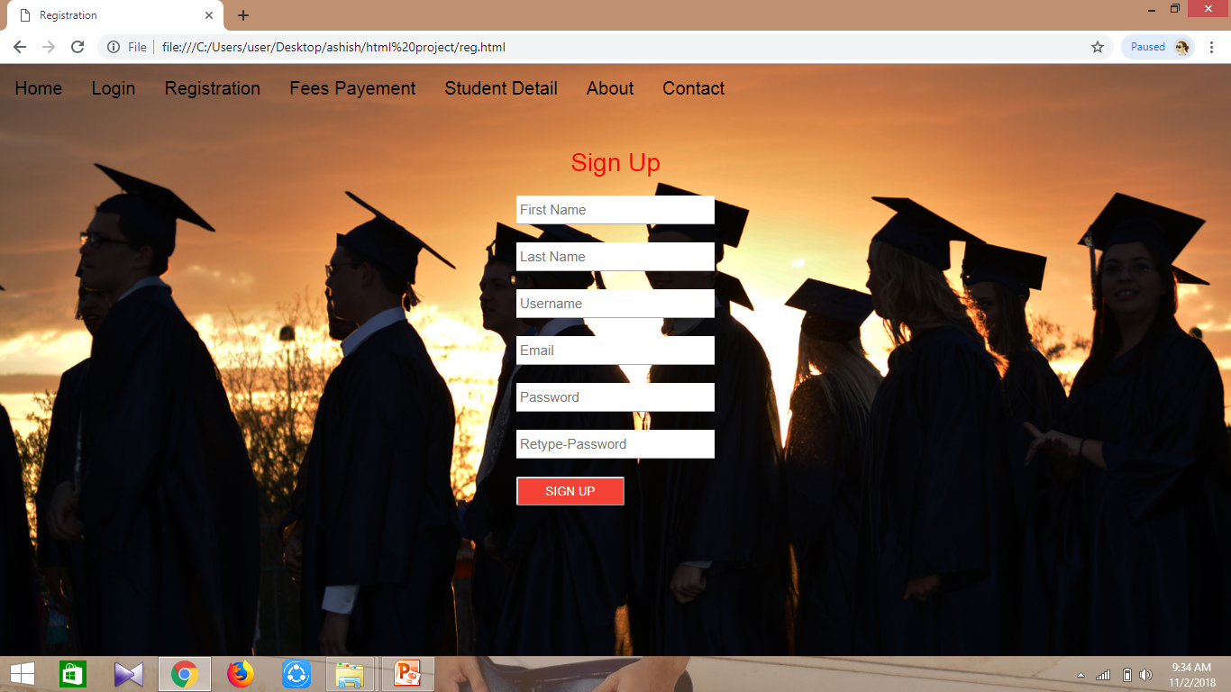

Slide 10
Role Distribution.
Ashutosh
-HTML & Coding of pages.
-Designing
Ashish
-Coding Of main page.
-CSS

Slide 11
Advantages:
No need for line to admission office.
No need to go to bank to pay admission fee.
No need to go varsity to buy the admission form.
All admission information will be show on the applicant account.

Slide 12
Thank You…

