Slide 1
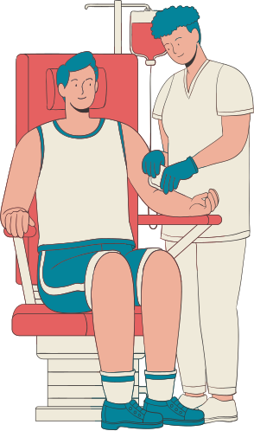


Blood Base
Blood Donation
System
CMP [209],
6TH SEMESTER
JULY, 08, 2025

Slide 2

Special Mention to
We sincerely thank our respected supervisor for your valuable guidance, continuous support, and encouragement throughout this project. Your insights and mentorship have been instrumental in helping us learn, grow, and complete this work successfully.
Er. Santosh Shrestha
Assistant Professor
United Technical College

Slide 3
Team Members
Aashish Regmi
(22070088)
Ayush Shrestha
(22070092)
Dixit Shrestha
(22070098)
Sonish Lohani
(21075549)

Slide 4
Background
Blood donation is critical for saving lives during medical emergencies.
Current systems face issues like poor communication and inefficient coordination.
Manual processes make blood management slow and unreliable.
A digital platform can streamline donor-recipient matching and communication.
The project aims to build a centralized, real-time Blood Donation System.
It will improve efficiency, accessibility, and encourage more blood donations.

Slide 5
Problem Statement
Blood donation systems are inefficient and mostly manual.
Finding suitable donors quickly is difficult during emergencies.
There is no centralized and real-time donor-recipient matching system.
Lack of timely communication leads to delays in blood delivery.
A smart, digital solution is needed to streamline the entire process.

Slide 6
Objectives
To develop a centralized platform that connects blood donors and recipients for efficient blood management.
To implement a matching system that identifies suitable donors based on blood type and location.
To maintain a secure and organized database of registered users for quick access during emergencies.

Slide 7
Scope
The system allows registration and management of blood donors and recipients.
It matches donors and recipients based on blood type and location.
It provides a user-friendly interface for easy access to blood donation services.
Limitations
The system relies on internet access for real-time functionality.
It does not support integration with external hospital or government databases.
The system does not fully support email notification system.

Slide 8
Applications
Helps recipients quickly find matching blood donors based on blood type and location, especially in emergency situations.
Allows individuals in need of blood to directly access donor information and contact them without delay.
Can be used by colleges, companies, and communities to build and maintain internal donor networks for quick access during medical needs.

Slide 9
Literature Review Overview
Traditional blood donation systems are often manual, slow, and lack efficient donor-recipient coordination.
Studies highlight the need for digital platforms to improve accessibility and response time in blood donation processes.
Research supports using centralized databases and real-time matching to reduce delays in finding suitable donors.
Existing systems that use SMS or mobile apps show improved communication but often lack user-friendly design or scalability.

Slide 10
Authors | Description | Features | Drawbacks
(Smith, 2015) | A platform for locating blood donors based on location and blood type. | Simple interface, basic search functionality. | No real-time communication or emergency handling capabilities.
(American Red Cross, 2017) | A U.S.-based app for managing blood donation schedules and tracking donation history. | Appointment scheduling, reminders, donation history tracking. | Restricted geographic coverage; lacks real-time donor-recipient matching.
(Jones, 2018) | A web-based directory for blood donors with search capabilities by location and blood type. | Directory-based search, basic functionality. | Outdated interface; not mobile-responsive; lacks real-time notifications for emergencies.
(Chen & Wang, 2019) | A mobile app designed for emergency blood donation requests using geolocation technology. | Geolocation-based matching, emergency handling capabilities. | Limited scalability; no support for large databases or advanced analytics.
(Thapa & Shrestha, 2010) | A basic SMS-based system for connecting donors and recipients through alerts. | Simple SMS alerts; accessible for non-smartphone users. | No mobile app; lacks real-time updates, secure database integration, and modern features.

Slide 11
Conclusion of Literature Review
Compared to traditional and SMS-based systems, this system provides a centralized digital platform with automated donor-recipient matching.
Instead of relying on external alerts, it directly displays matching donors to recipients, enabling faster contact.
The use of a responsive web interface improves usability over older systems with limited user experience.
The system is flexible and can be expanded with features like geo-location, notifications, and analytics for improved efficiency.

Slide 12







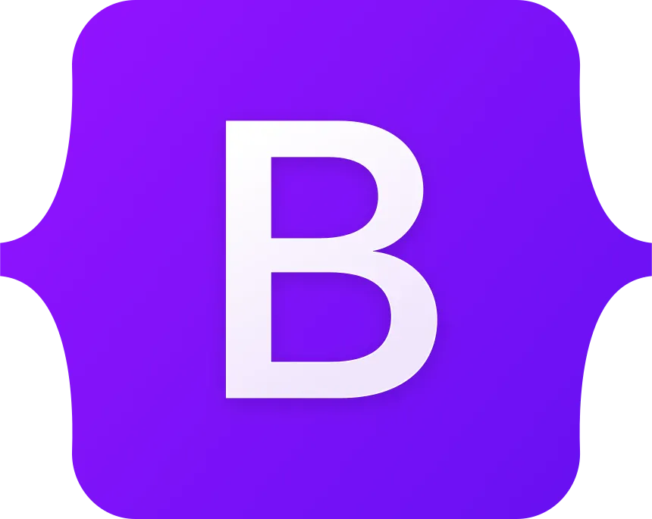


Technologies Used

Slide 13
System Architecture
The system uses HTML, CSS, JavaScript, and Django templates to create a clean and user-friendly interface where users can easily register, log in, and request or donate blood.
The Django backend takes care of all the main tasks, like handling form submissions, checking user input, and matching donors with recipients based on their blood type and location.
All important information such as users, donor and recipient details are safely stored in a SQLite3 database for quick and reliable access.
Once a request is submitted, the system displays a list of matching donors to the recipient, based on the selected blood type and location, so they can contact donors directly.
There’s also an admin panel where authorized users can manage accounts and keep track of overall system activity.

Slide 14
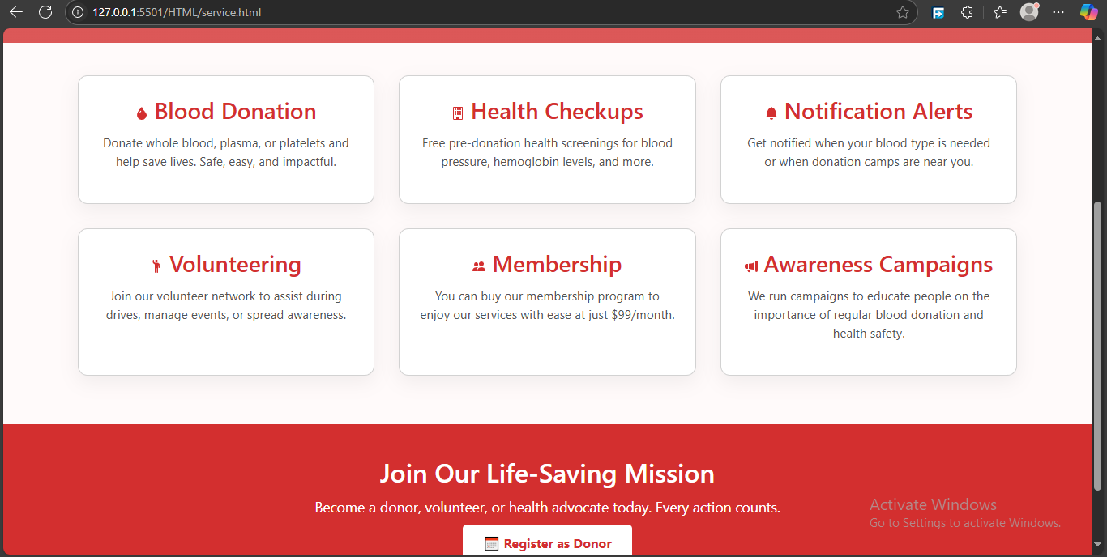
Service Page

Slide 15
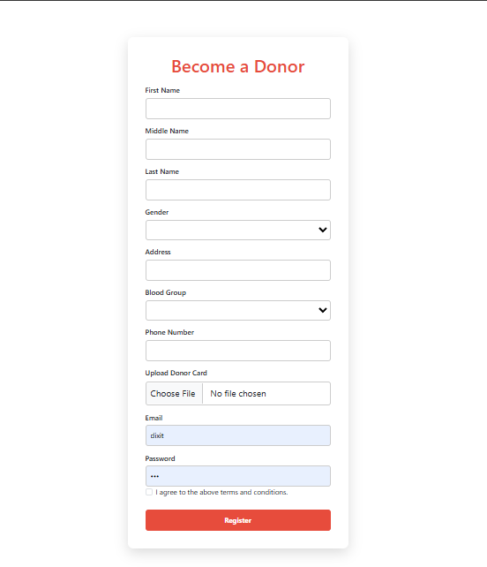
Donor Form

Slide 16
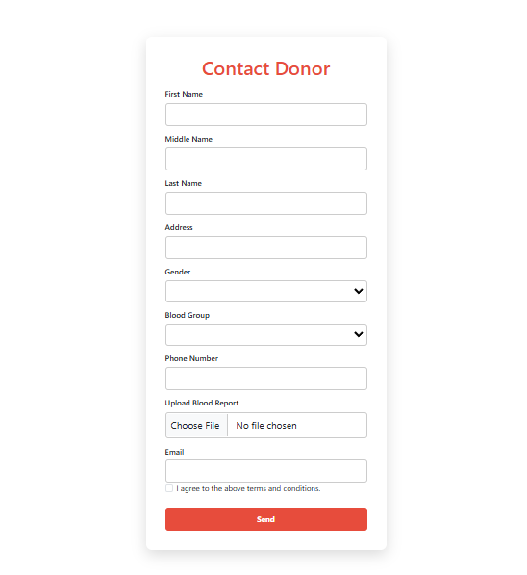
Recipient Form

Slide 17
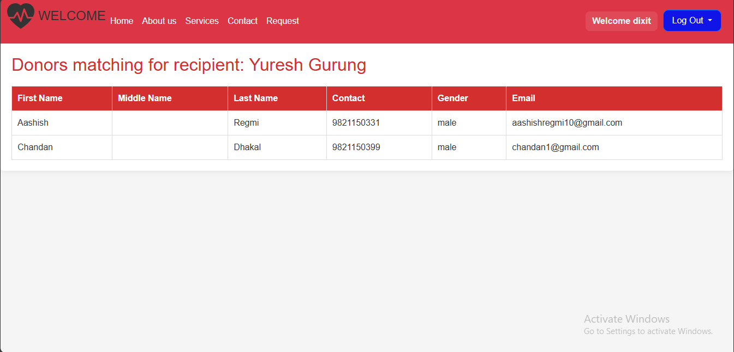
Donor List

Slide 18
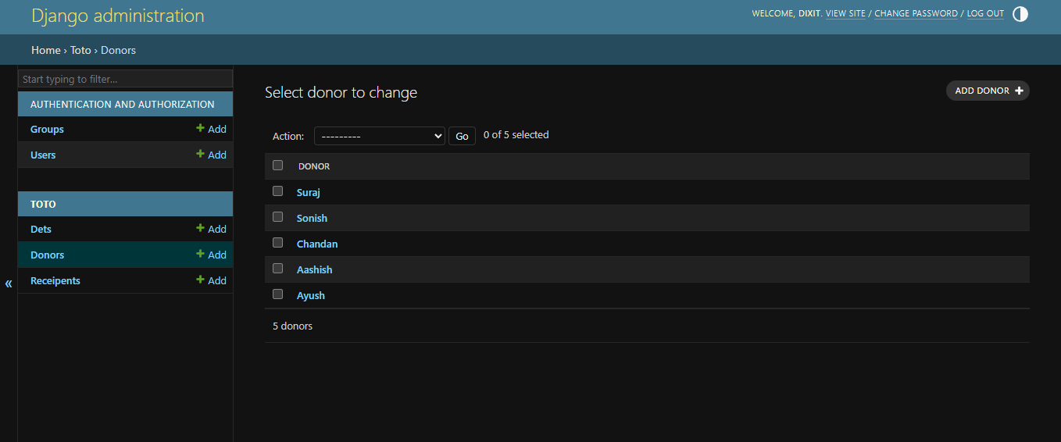
Registered Donors

Slide 19
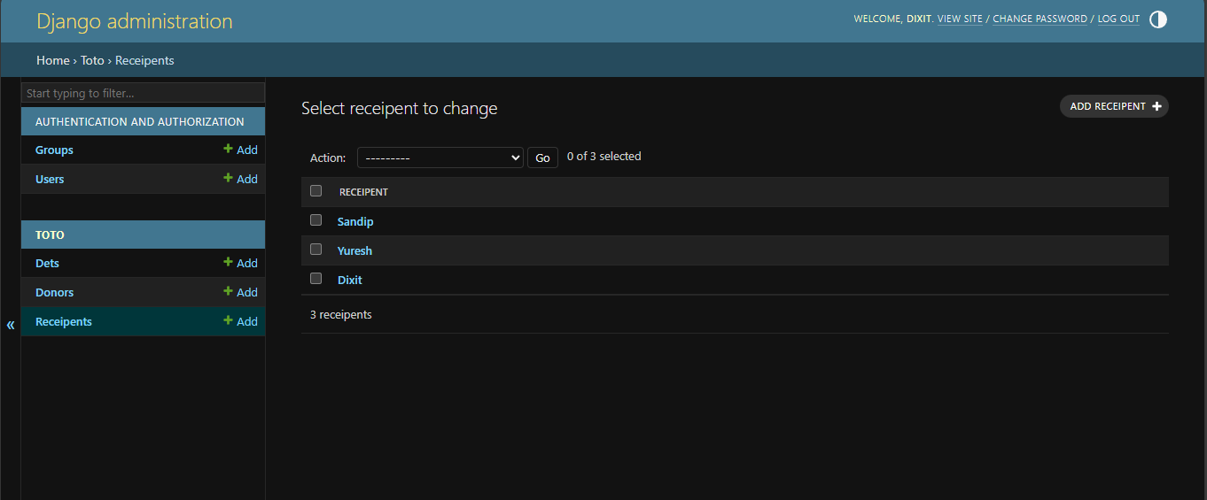
Registered Recipients

Slide 20
Key Functionalities
Users can register and log in as donor and recipient.
Recipients can submit blood requests by filling up the form.
The system matches and displays a list of suitable donors based on blood type and location.
Admins can manage users, verify requests, and oversee the system activities.
Users can search for donors by blood group and location.
All user and request data is stored securely in a SQLite3 database.
The interface is responsive and user-friendly, built with Django templates, HTML, CSS, and JavaScript.

Slide 21
Deployment and Hosting
Local server testing performed using Django’s built-in development server.
Django backend handles application logic, user, donor and recipient management and donor-recipient matching.
SQLite database used locally for storing user, donor and recipient data.
Static files (CSS, JS, images) and media served locally through Django’s static file configuration.

Slide 22
Future Enhancements
SMS and Email Notifications: Enable automated alerts to donors and recipients about new blood requests, matches, and updates for faster communication.
Donation History Tracking: Store and display past donation records for users and hospitals to improve tracking and record-keeping.
Geo-location Integration: Use map-based services to locate nearby donors and blood banks, making emergency response quicker.
Admin Dashboard with Analytics: Provide insights into donation trends, user engagement, and system performance for better management.

Slide 23
Conclusion
The system successfully connects donors, recipients, and admins through a centralized platform.
It simplifies the blood donation process with easy registration, request handling, and donor matching.
The use of Django and SQLite ensures efficient backend management and secure data storage.
Displaying matched donor lists to recipients improves accessibility and response time during emergencies.
The platform lays a solid foundation for future improvements like SMS alerts, location tracking, and analytics integration.

Slide 24
References
Ali, K. A., Jahan, I., Ariful, M. I., & Shafa-at, M. P. (2015). Blood Donation Management System. American Journal of Engineering Research.
American Red Cross. (2017). Retrieved from redcross: https://www.redcross.org/
Anish Hamlin, M. R., & Mayan, J. A. (2016). Blod Donation and Life Saver-Blood Donation app. International Conference on Control, Instrumentation, Communication and Computational Technologies.
Chen, L., & Wang, Y. (2019). BloodLink Mobile App: Geolocation-based Blood Donation for Emergency Requests. International Journal of Mobile Computing and Communications.
Hamid, K., Aziz, A., & Yusri, N. N. (2015). Development of Blood Bank Management System. World Conference on Technology, Innovation and Entrepreneurship.
Jones, R. (2018). BloodBanker: A Web-Based Platform for Blood Donor Matching. Journal of Health Informatics.
Shore, J., & Waden, S. (2021). The Art of Agile Development. O'Reilly Media, Inc.
Thapa, R., & Shrestha, S. (2010). SMS-Based Blood Donation System. International Journal of Computer Science and Technology.

Slide 25
Thank You

