Slide 1

Blood Donation Management System
Submitted by :
Dixit Shrestha
Aashish Regmi
Ayush Shrestha
Sonish Lohani

Slide 2
Content
Introduction
Problem Statement
Objectives
Literature Review
Methodology
Technology used
ER Diagram
Use Case Diagram
Expected Outcome
Conclusion
Reference
Time Estimation

Slide 3
1. Introduction
Blood donation is an essential part of healthcare that helps save millions of lives every year. But current systems are often slow, don’t securely handle donor information, and struggle to connect donors with those in need quickly.
By using modern web technologies, we have the chance to make this process faster, safer, and more efficient.
Our proposed Blood Donation Website will act as a central platform, making it easier for donors, recipients, and healthcare organizations to connect and solve these challenges smoothly.

Slide 4
2. Problem Statement
Current blood donation systems face several challenges:
Matching Problems: Many systems don’t offer real-time updates or location-based searches, leading to delays in emergencies.
Limited Features: Most platforms only focus on specific tasks instead of offering a complete solution.
Low Donor Interest: Outdated designs and a lack of awareness fail to keep donors engaged.
Data Safety Issues: Weak security measures make users hesitant to share their personal information.
Our project aims to solve these issues by creating a platform that’s simple, efficient, secure, and easy to use for everyone.

Slide 5
3. Objectives
The primary objectives of this project include:
Efficient Donor-Recipient Matching: To build a platform that matches donors and recipients based on location, blood type, and urgency.
Promote Donor Participation: To encourage regular donations with educational resources, timely notifications, and engagement features.
Support Healthcare Organizations: To enable the organization and promotion of blood donation drives.
Ensure Secure Data Management: To use robust encryption and secure databases to protect sensitive user information.
Accessibility: To develop a responsive, user-friendly platform accessible across multiple devices.

Slide 6
4. Literature Review
Several existing systems have been studied to identify their strengths and limitations:
Examples of Existing Systems:
Blood Donor Connect
Features: Simple interface with basic donor search functionality.
Drawbacks: Lacks real-time notifications and emergency handling capabilities.
Red Cross Blood Donation App
Features: Appointment scheduling, donation history tracking.
Drawbacks: Limited to the U.S.; lacks geolocation-based donor-recipient matching.
BloodLink Mobile App
Features: Geolocation-based matching for emergencies.
Drawbacks: Limited scalability and absence of advanced analytics.
SMS-Based Blood Donation System
Features: Simple alerts via SMS.
Drawbacks: No integration with apps, no real-time updates or modern features.
4.Literature Review

Slide 7
Gaps Identified:
There are no advanced tools to match donors and recipients in real-time based on their location.
The system struggles to expand globally and handle a large number of users efficiently.
The outdated design and user experience make it less appealing for donors to stay engaged.
There aren’t enough reliable tools to handle emergencies quickly or to manage data securely.

Slide 8
5. Methodology
Development Approach:
Requirements Gathering:
Interviews with stakeholders (donors, hospitals, administrators).
Research on gaps in existing systems.
Analyzing survey results to identify key user needs.
Design and Development:
Client-server architecture to manage frontend, backend, and database interactions.
Iterative Agile methodology for continuous improvement.
Data Collection:
Sources include donor information, blood bank inventory, and hospital demand records.
Data preprocessing ensures accuracy, security, and normalization.
Testing and Deployment:
Unit testing, integration testing, and user feedback incorporated into each sprint.
Final deployment on AWS for scalability and reliability.
5.Methodology

Slide 9
Technology | Purpose
HTML, CSS, JavaScript | Frontend design for intuitive user interface.
Django | Backend framework for secure, scalable operations.
MySQL | Database for structured data storage.
Google Maps API | Enables geolocation-based donor searches.
Firebase | Real-time notifications for emergencies.
AWS | Scalable hosting infrastructure.
Docker | Ensures consistent development and deployment environments.
6. Technology Used

Slide 10
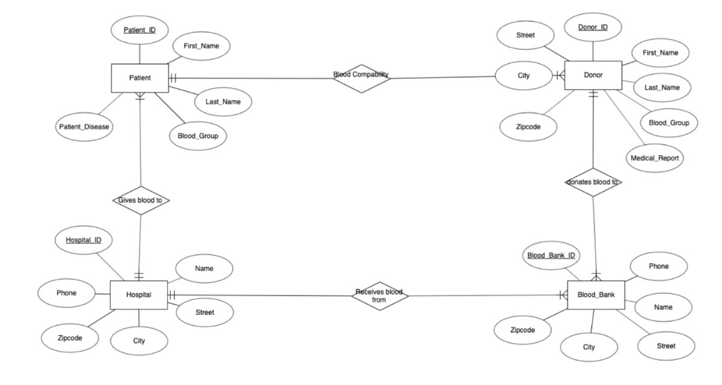
7.ER Diagram

Slide 11
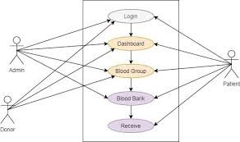
8.Use Case Diagram

Slide 12
9. Expected Outcome
A responsive, mobile-friendly platform to connect donors and recipients.
Reduced delays in blood supply during emergencies.
Increased donor engagement through notifications and educational resources.
Secure management of sensitive user data.
Efficient organization of donation drives.

Slide 13
10. Conclusion
This project focuses on creating an easy-to-use platform for managing blood donations efficiently. With tools like Django, Firebase, and Google Maps API, it ensures a seamless user experience, secure data management, and real-time updates. Hosting on AWS makes it scalable and future-ready.
By following an Agile approach, the platform is designed to be accessible, reliable, and practical, addressing the limitations of existing systems. It effectively connects donors, recipients, and administrators while fostering community engagement.
In essence, this project combines technology with purpose, making blood donation simpler, safer, and more impactful—a meaningful step toward saving lives and building stronger connections.

Slide 14
11.Reference
American Red Cross. (2017). Retrieved from redcross: https://www.redcross.org/
Chen, L., & Wang, Y. (2019). BloodLink Mobile App: Geolocation-based Blood Donation for Emergency Requests. nternational Journal of Mobile Computing and Communications.
Smith, D. (2015). Retrieved from Blood Donor Connect: https://thebloodconnection.org/
Thapa, R., & Shrestha, S. (2010). SMS-Based Blood Donation System. International Journal of Computer Science and Technology.

Slide 15
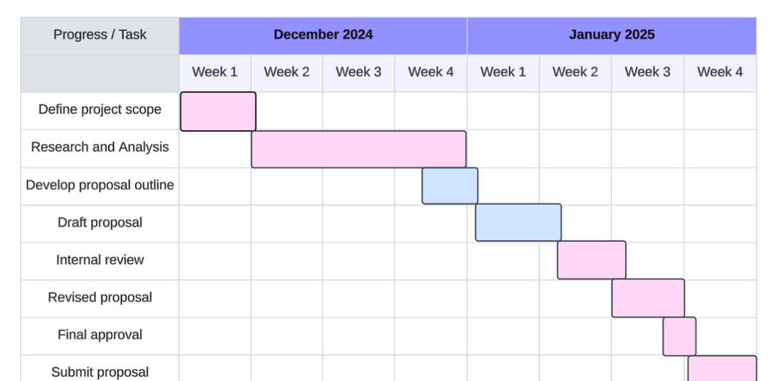
12.Gantt Chart

Slide 16
Thank you
ANY QUERIES?

