Slide 1
The Buttonwood Tree
Key features driving traffic to a competitor websites
Date: 05/19/2021

Slide 2



Executive Summary
The task in hand was to find out the key drivers responsible for the traffic to websites of competitor companies and their impact.
Increasing focus on the mentioned features will help improve traffic.
Performing Regression Analysis helped in identifying important features that drive traffic to a website.

Slide 3
Approach
Data Exploration
Data Pre-processing
Modeling
Feature Importance
Finalizing the Results
Found out correlation between different features of the Dataset and through few visualizations, better understood the Data.
Dropped features ‘investment’ and ‘acquisitions’ as they had a lot of missing values. ‘Country’ as it isn’t useful developing the model.
Developed advanced regression algorithms like Random Forest Regressor and XGBoost Regressor and analyzed their performance.
Identified important features that drove traffic to a website.
The Random Forest Regressor performed better than the XGBoost Regressor. Hence, we stick with that model. The top features that had an impact on traffic to a website were country present and keywords such as wellsfargo, venture capitalist and washington post.

Slide 4
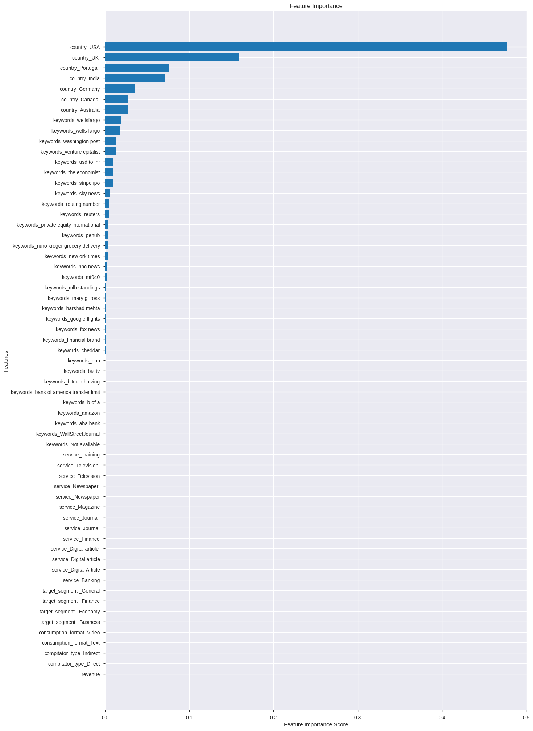
Random Forest Regressor Result
R^2 value: 78.11%
Mean Absolute Error: 63,235.43
Mean Squared Error: 7,485,982,520.0
Root Mean Squared Error: 86,521.57

Slide 5
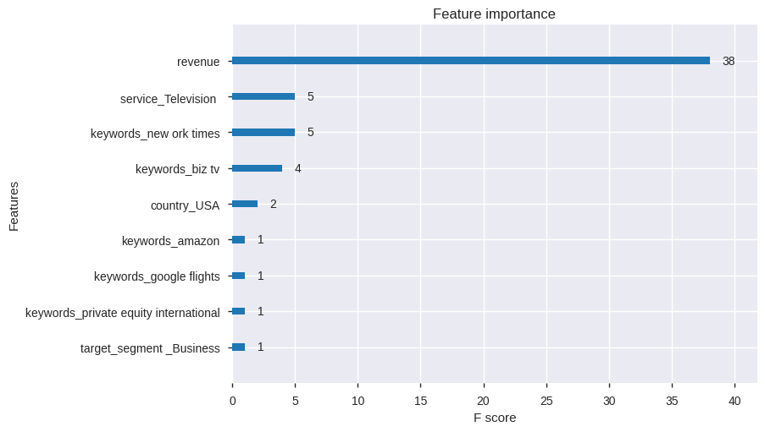
XGBoost Regressor Result
R^2 value: 46%
Mean Absolute Error: 197,731.94
Mean Squared Error: 100,927,972,487.79
Root Mean Squared Error: 317,691.63

