Slide 1
Predicting Heart Failure
Ashish Singh
Actuarial Team Meeting
April 28th, 2026

Slide 2
01
Statistical Background & Terminology

Slide 3

Research Question
Can machine learning improve mortality prediction compared with traditional methods?
Dataset Characteristics
368 heart failure patients
60 Predictors
Binary Outcome: Alive or Dead

Slide 4
THREE KEY CONCEPTS
Mortality Modeling
Mortality modeling predicts the likelihood of survival or death. For actuaries, this connects directly to pricing, reserving, underwriting, and long-term risk assessment.
Machine Learning
Machine learning uses data to identify patterns and improve predictions. In this project, it is used as a supplement to traditional actuarial methods, not a replacement.
Model Comparison
Three models are compared: Logistic Regression, SGD SVM, and Random Forest. The goal is to determine which model best predicts mortality and which health factors matter most.

Slide 5
Traditional Vs Modern Methods
Logistic Regression
SGD SVM
Random Forest
Traditional model for binary outcomes like survival vs death. Clear, interpretable, and a strong actuarial benchmark.
Modern classifier that finds the best boundary between outcomes. Useful with many predictors.
Combines many decision trees into one prediction. Strong at capturing complex relationships.
Traditional methods provide transparency. Modern methods provide flexibility and often higher accuracy.

Slide 6
02
Methodology

Slide 7
Data Preparation
Data Cleaning
Selecting Variables
Final Predictors
Removing rows w/ NAs
Replacing NAs
Reformatting to Tidy form
Removing Insignificant Variables
Evaluating VIFs
Removing highly correlated variables
White Blood Cell Count
Platelet Count
Number of Major Vessels
Number of follow-ups,
Lymphocyte Ratio
Monocyte percentage
St-Segment Depression

Slide 8
Evaluation Metrics & Model Setup
Evaluation Metrics
Model
Settings
Accuracy = Overall correct predictions
Precision = How often death predictions were right
Recall = How many true deaths identified
ROC AUC = Ability to separate alive vs death outcomes
70% train / 30% test split
Log Reg regularization = .5
SGD SVM learning rate =.001
Tuned Random Forest settings

Slide 9
03
Results

Slide 10
Accuracy Comparison
Random Forest leads the models in accuracy and is likely due to its:
Ability to handle interactions
Ability to understand nonlinear relationships
Makes less assumptions
Mortality may depend on combinations of variables, not one-factor linear effects.
Model | Accuracy Percentage
Logistic Regression | 82.9%
SGD SVM | 82.0%
Random Forest | 98.2%

Slide 11
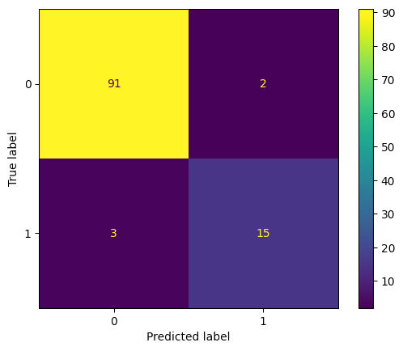
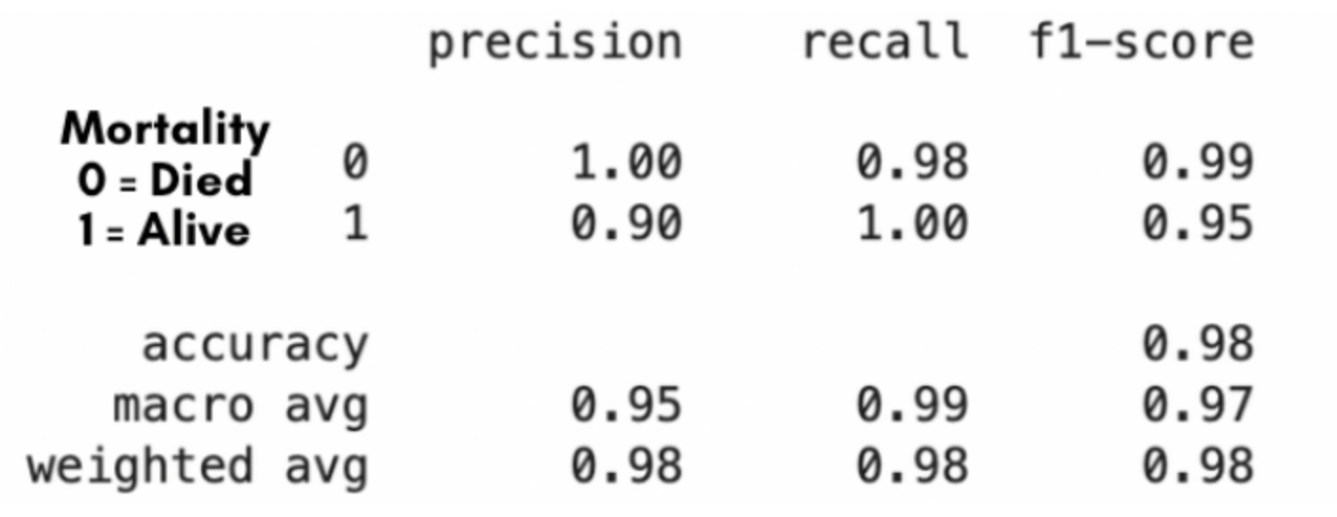
Analyzing Random Forest
Further analysis shows us promising results and concerns.
Balanced Predictability
Metrics are not very different from each other per class
Class Imbalance
93 for class 0
18 for class 1

Slide 12
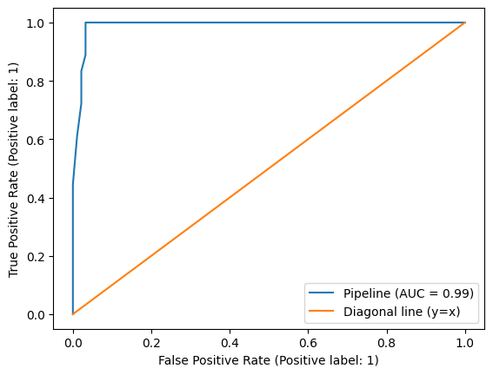
ROC Curve

Slide 13
04
Conclusion

Slide 14
Limitations and Professional Caution
Small Dataset
Single Context
Only 368 observations limits generalizability
Heart failure data may not represent broader populations
Model Risk
Interpretability
Governance Needed
High accuracy does not guarantee real-world reliability
Complex models are harder to explain to regulators
Requires validation, monitoring, and ethical oversight

Slide 15
Final Takeaways
Random Forest significantly improved mortality prediction (98.2% accuracy, 0.99 AUC)
Mortality risk is driven by interactions between variables, not just individual effects
Further testing of these models is encouraged
With further research and development:
Enhances risk segmentation beyond traditional demographic groupings
Improves pricing precision and underwriting decisions
Supports earlier identification of high-risk policyholders
Can complement GLMs and existing actuarial frameworks
Requires careful validation, interpretability, and governance

Slide 16
The future is not traditional methods or machine learning.
It is traditional actuarial expertise with machine learning assistance.

Slide 17
Thank
you

Slide 18
Questions?
Feel Free to reach out with any questions via email
ashish58906@g.ucla.edu

