Slide 1

Submitted By
Aashish Rijal
PROJECT PROPOSAL
Kedar Dhungana
Dipesh Devkota
Under the Supervision of
Futsal Booking and Management System
Mr. Surya Bam
Institution
Asian School of Management and Technology
B.Sc. CSIT | Tribhuvan University
February 15, 2026

Slide 2


Introduction & Background
Current Landscape
Proposed Solution
Futsal Growth in Nepal
Multi-Tenant SaaS Platform ^{[2]}
Rapid increase in urban futsal centers due to rising interest in indoor football and recreation.
Centralized web-based system allowing multiple businesses to operate independently on shared infrastructure.
Manual Dependency ^{[1]}
Smart Innovation
Most facilities rely on phone calls, social media, or paper registers for bookings.
Integration of AI/ML for automated review summarization and proximity-based recommendations.

Slide 3



Problem Statement
Current futsal management relies on outdated manual systems, leading to operational inefficiencies, poor customer experience, and a lack of data-driven business insights.
Operational Chaos
Discovery Barriers
Business Intelligence Gap
Manual bookings via phone/social media cause double bookings, scheduling conflicts, and inaccurate record-keeping.
No centralized platform for players to discover and compare multiple courts, prices, and verified reviews.
Owners lack access to revenue analysis, usage trends, and modern AI tools like sentiment analysis.

Slide 4




Project Objectives
Centralized Platform
Multi-Tenant SaaS
Community Features
AI/ML Integration
Develop a unified web portal for real-time discovery and court booking, ensuring accessibility for all users.
Implement a scalable architecture allowing multiple futsal facilities to operate independently within one system.
Enable verified ratings, reviews, and discussion forums to enhance user interaction and trust.
Integrate sentiment analysis and review summarization for smarter business decision-making.

Slide 5




Literature Review
Suhaimi & Sahid (2021)
DIGITAL SHIFT
Research highlights the necessity of replacing manual logbooks with database-driven platforms to improve booking visibility and scheduling clarity.
Fauzi et al. (2022)
OPERATIONAL EFFICIENCY
Web-based systems significantly increase accessibility and customer reach while reducing the risks associated with hand-written rental processes.
Modern System Design
SAAS ARCHITECTURE
Multi-tenant SaaS architecture is recommended for shared platforms to ensure proper data isolation and scalability for independent facility owners.
Machine Learning Trends
AI & ANALYTICS
Increasing application of Logistic Regression and TF-IDF for sentiment analysis and text feature extraction in user engagement platforms.

Slide 6

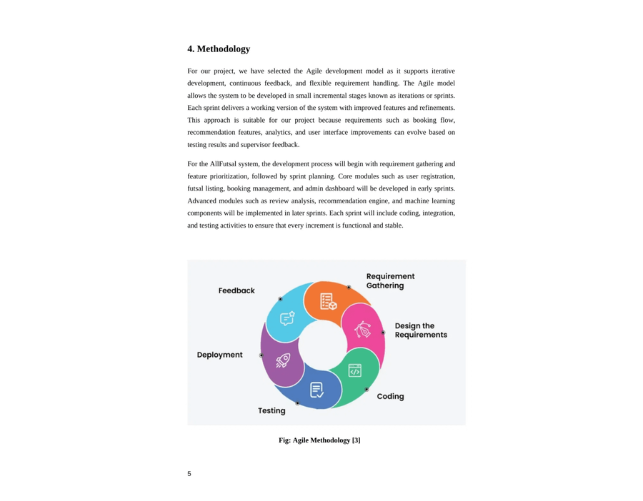
Development Methodology
The project follows the Agile Development Model ^{[3]}, emphasizing iterative progress and continuous feedback.
→
Planning:
Requirement gathering & prioritization.
→
Core Dev:
Auth, Search, and Booking engine.
→
Advanced:
AI Sentiment & Proximity Recommendations.
Fig: Agile Methodology [3]

Slide 7


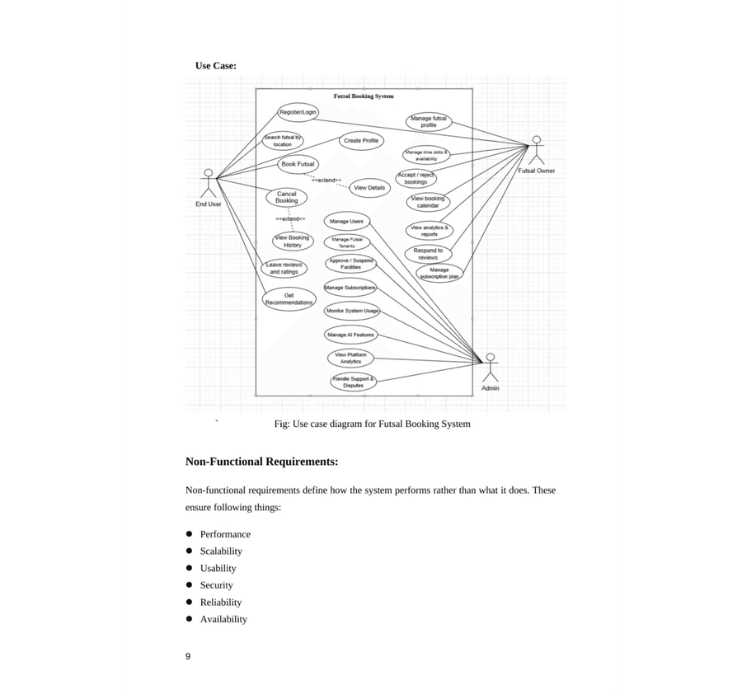


Functional Requirements
End User
•
Search futsal by location/price/slots.
•
Real-time court booking & reviews.
Futsal Owner
•
Manage court availability & pricing.
•
Analytics dashboard for revenue.
System Admin
•
Manage multi-tenant accounts.
•
System monitoring & moderation.
Fig: Use case diagram for Futsal Booking System

Slide 8




Non-Functional Requirements
Performance
Scalability
Ensuring real-time availability checks and high-speed response times for booking confirmations and slot validations.
A robust multi-tenant architecture designed to handle a growing number of futsal centers and concurrent users seamlessly.
Security
Usability
Implementation of JWT authentication and strict data isolation between tenants to ensure privacy and data integrity.
A mobile-responsive design ensuring a consistent and intuitive user experience across all devices and screen sizes.

Slide 9





Technical Feasibility
Frontend
Backend
Data Layer
AI & ML

React.js
for dynamic UI

Node.js & Express

MySQL
for persistence

Python
NLP libraries

Responsive design for mobile

Scalable RESTful API design

Redis
for slot caching

Logistic Regression model

Multi-tenant data isolation

Cloud-based file storage

TF-IDF text processing

JWT-based session handling

Slide 10

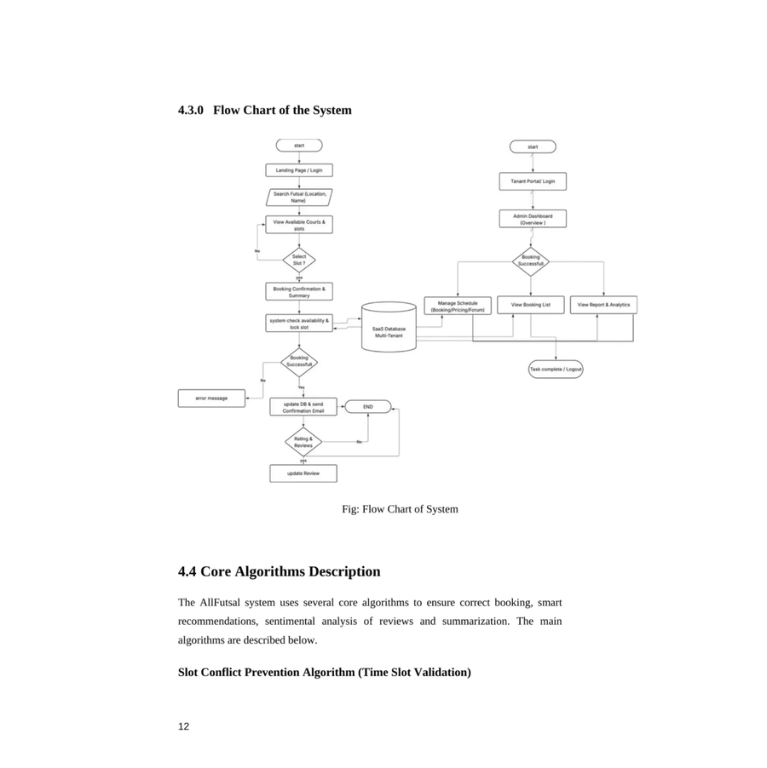

High-Level System Design
Architecture
Multi-tenant SaaS structure with React Frontend and Node.js Backend. API-driven communication.
Core Algorithms
Slot Conflict Prevention: Ensures no overlapping bookings.
Sentiment Analysis: Logistic Regression for reviews.
Fig: Flow Chart of System

Slide 11




Expected Outcomes
Operational Efficiency
Enhanced Experience
Scalable Innovation

Elimination of


and manual scheduling errors.
double bookings
One-stop platform for
real-time discovery
Robust
model ready for commercial expansion.
multi-tenant SaaS
and court comparison.

Automated revenue tracking and

Convenient booking process with instant mobile confirmations.

AI-driven insights through
sentiment analysis
business intelligence
reports.
of user feedback.

Streamlined customer communication and subscription management.

Access to

and proximity-based recommendations.
verified reviews
Secure, high-performance infrastructure for nationwide futsal management.

Slide 12
References
[1] A. N. S. Suhaimi and M. Z. Sahid, "A Development of Futsal Court Booking System," AITCS, vol. 4, no. 1, 2023.
[2] Coursera, "What is TF-IDF?" [Online]. Available: https://www.coursera.org/articles/what-is-tfidf
[3] GeeksforGeeks, "Agile SDLC" [Online]. Available: https://www.geeksforgeeks.org/agile-sdlc-software-development-life-cycle/
[4] A. Fauzi et al., "Explore Business Opportunities in the Sport Industry in Bekasi," IJESM, vol. 1, no. 2, 2023.
[5] SportsKey, "Sports Facility Booking Software Trends," 2026. Available: https://www.sportskey.com
[6] UiTM, "Progressive Web Applications for Mobile-First Systems," 2024.
[7] S. Nagar et al., "Logistic Regression Based Approach for Human Sentiment Analysis," ACROSET, 2024.
[8] IBM, "What is multi-tenant architecture?" Available: https://www.ibm.com/think/topics/multi-tenant

Slide 13
QUESTIONS?
Project Team
Aashish Rijal
Kedar Dhungana
Thank You!
Dipesh Devkota
Futsal Booking and Management System
Supervisor
Mr. Surya Bam

