Slide 1

Housing Market Trends
Kyle
Danni
Aashi
Ashley

Slide 2
Project Description
The purpose of this project was to analyze the US Housing Market. To accomplish this analysis, we first pulled data from US Census Bureau’s API, as well as the Federal Reserve Bank, and web-scraped data from Redfin.
After assembling the data in Mongo DB, we used Plotly, D3, and Leaflet to plot various aspects of the current and historical trends affecting the cost of housing in the United States. Factors we looked at included: home ownership vs renting, age, and state of residence.

Slide 3
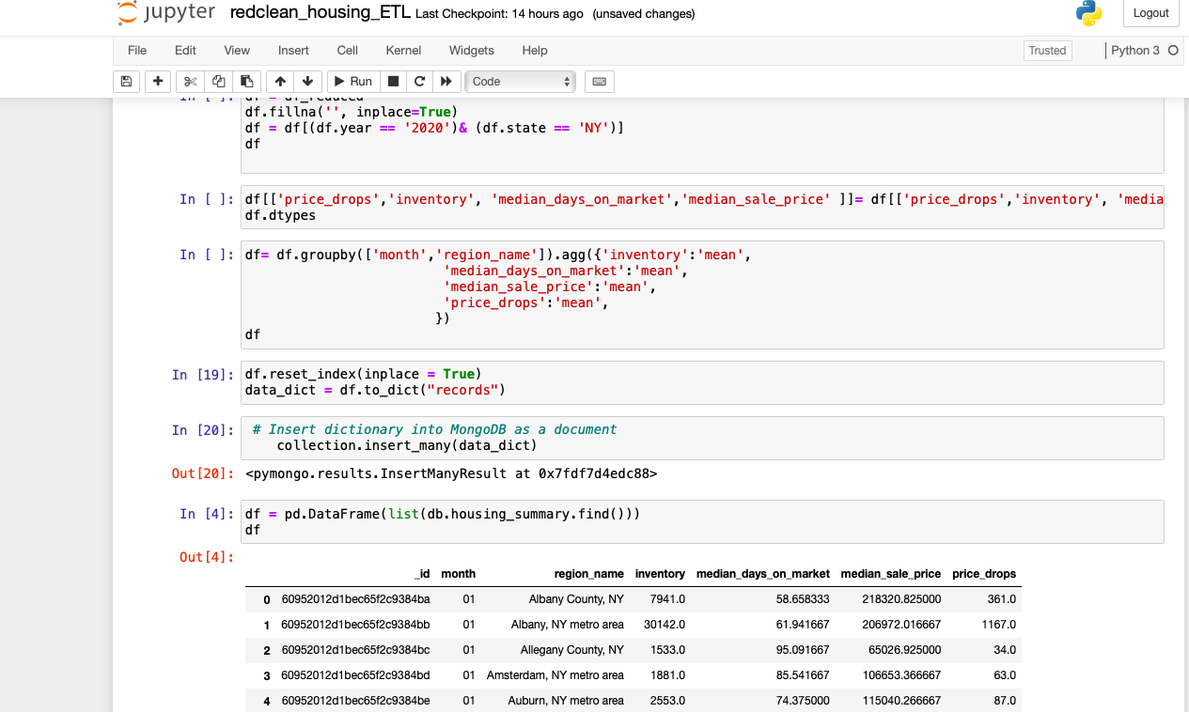
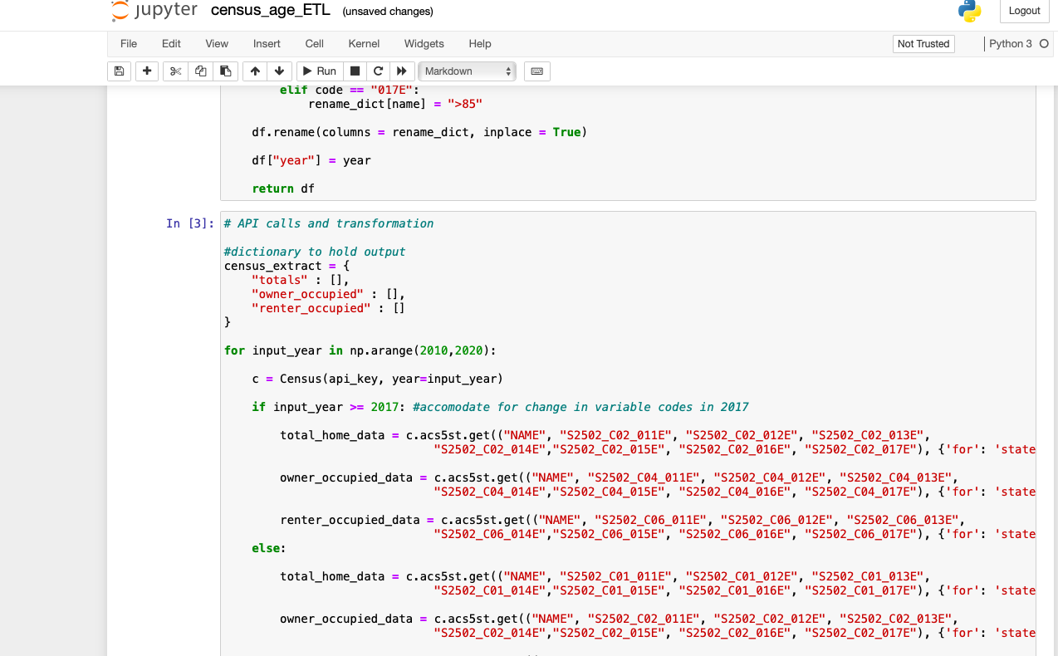

Data Extraction and Transformation

Slide 4
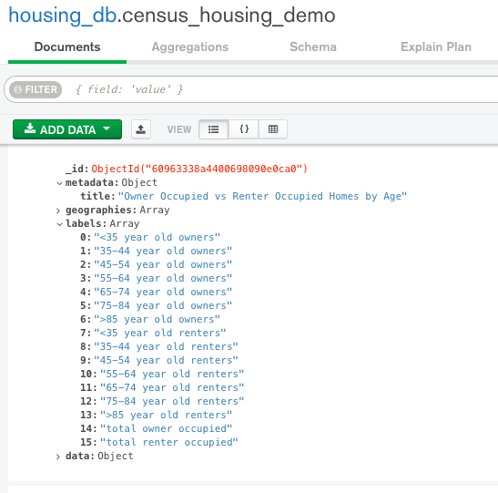
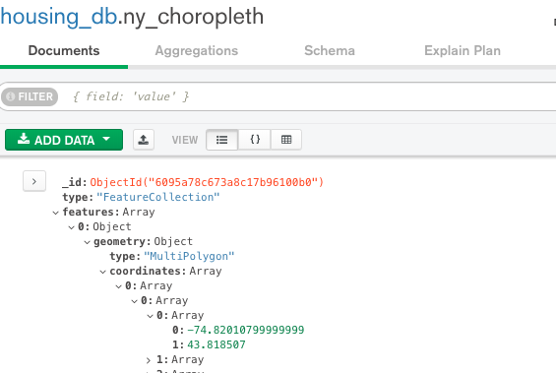
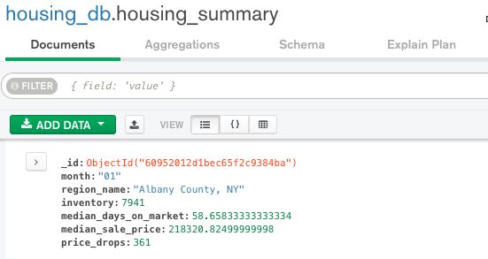

Data Loading

Slide 5
Flask Application
/
Home page
/states
Home ownership vs renters by age
/national
Housing Stats across USA
/newyork
Housing Trends in state of NY

Slide 6






Visualization Tools
Libraries:
pandas
numpy
census wrapper
fred wrapper
pymongo
Technologies
HTML/CSS/JS
Bootstrap
Mapbox
Leaflet
D3
Plotly
Leaflet

Slide 7

QUESTIONS?

