Slide 1

Seasonal Agriculture Performance Analysis
Data-Driven Analysis of Agricultural Performance Across Seasons
Aashi Tiwari
Bharati Vidyapeeth Deemed to be University, College of Engineering, Pune
AICTE STU ID : STU697df1a866be91769861544

Slide 2

PROBLEM STATEMENT
Agricultural activities are influenced by seasonal variations in environmental conditions, farming practices, resource availability and market conditions. As a result, agricultural performance may differ from one season to another.
However, raw agricultural data does not clearly explain how agricultural performance changes across seasons or what patterns can be observed in different seasonal conditions.
The problem is to analyze the given agricultural dataset and investigate seasonal differences in agricultural performance by identifying meaningful patterns, trends, relationships and variations within the available data. Agricultural performance changes with season, environmental conditions, farming practices, resource usage and market conditions.

Slide 3
Project Description
From Raw Data to Agricultural Insights
A data analytics workflow was developed to transform raw agricultural records into meaningful seasonal insights.
01 - Data Preparation Clean records, handle duplicates, standardize data and inspect data quality.
02 - Exploratory Analysis Understand crops, regions, seasons, environmental conditions and resource usage.
03 - Seasonal Analysis Compare yield, production, revenue, profit, water usage and risk across seasons.
04 - Relationship Analysis Study relationships between agricultural performance and measurable factors.
05 - Insight Generation Identify important patterns, variations and areas requiring attention.
Output
A structured, evidence-based view of agricultural performance across seasons.

Slide 4

WHO ARE THE END USERS?
Farmers & Farm Managers → Compare seasonal performance and resource usage.
Agricultural Planners → Identify high- and low-performing seasons and regions.
Agribusinesses → Evaluate crop profitability, production and resource efficiency.
Agricultural Researchers → Study seasonal patterns and relationships in agricultural data.
Data Analysts & Decision Makers → Use dashboards/analytics for evidence-based planning.

Slide 5

Technology Used
Analytical Techniques
Data Cleaning & Quality Analysis
Exploratory Data Analysis
Group-by & Aggregation
Seasonal Comparison
Correlation Analysis
Variability Analysis
Outlier Detection
Cross-Region Analysis
Python Core programming and analysis
Pandas Data cleaning, transformation and aggregation
NumPy Numerical computation
Matplotlib Data visualization
Google Colab Interactive analysis and documentation

Slide 6
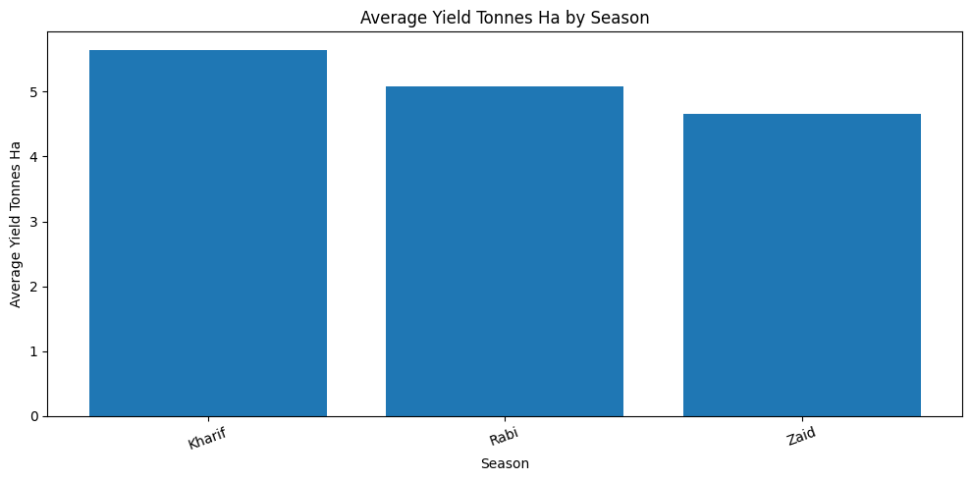
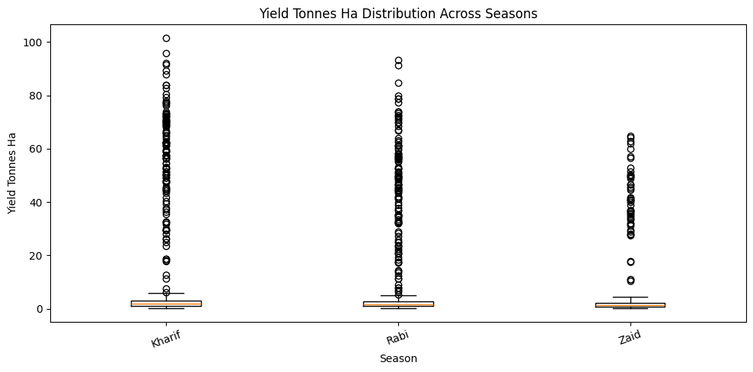
RESULTS
The chart compares the average yield across the three agricultural seasons. Kharif records the highest average yield, followed by Rabi, while Zaid has the lowest.
Conclusion
Kharif is the best-performing season in terms of average yield, whereas Zaid shows comparatively lower productivity. This highlights a clear seasonal variation in agricultural performance.
The boxplot shows the distribution and variability of yield across seasons. Kharif and Rabi have wider distributions with many high-yield outliers, while Zaid has a comparatively lower range.
Conclusion
Kharif shows the highest overall yield potential, but all seasons contain considerable variation and outliers. This suggests that agricultural performance is not uniform within a season and may depend on other factors such as crop, region, or farming conditions.

Slide 7
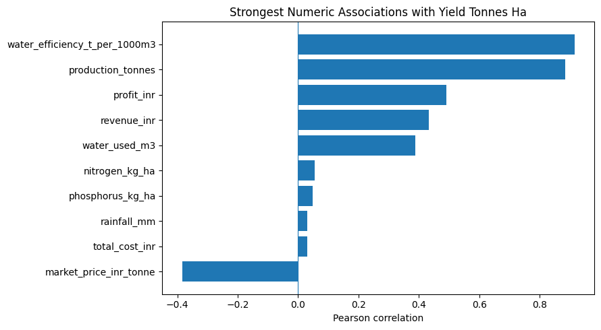
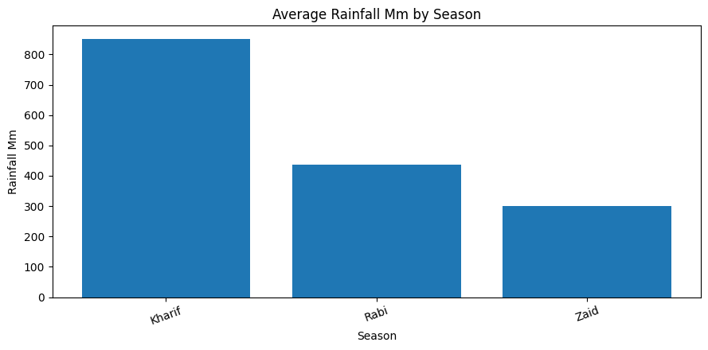
RESULTS
The chart shows the Pearson correlation between yield and other numerical factors. Water efficiency has the strongest positive relationship with yield, followed by production. Market price shows the strongest negative relationship.
Conclusion
Water efficiency is the strongest numeric factor associated with yield in this dataset. However, these correlations show relationships, not direct cause-and-effect.
The chart compares average rainfall across the three seasons. Kharif receives the highest rainfall, followed by Rabi, while Zaid receives the least.
Conclusion
Rainfall varies considerably by season, with Kharif experiencing substantially higher rainfall than Rabi and Zaid. This highlights a major seasonal difference in environmental conditions.

Slide 8
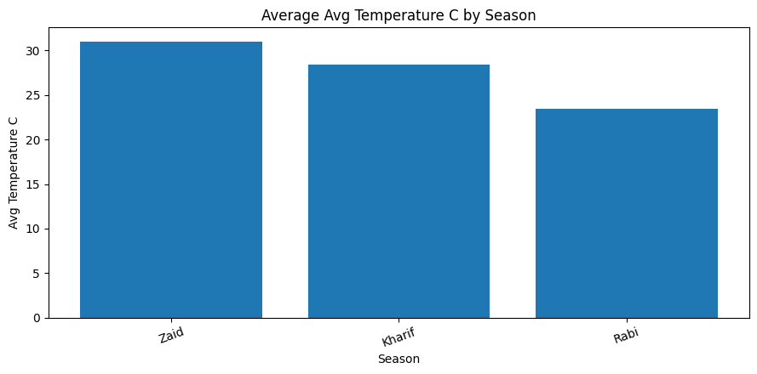
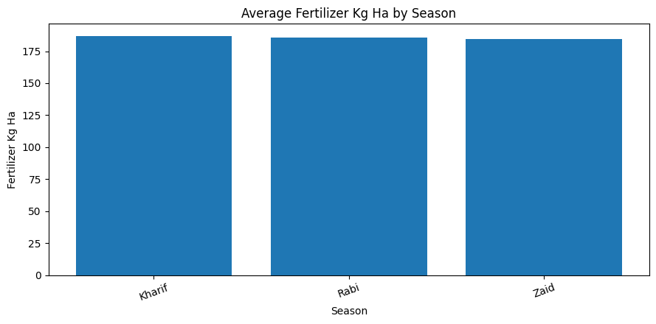
RESULTS
The chart compares average temperature across the seasons. Zaid has the highest average temperature, followed by Kharif, while Rabi has the lowest.
Conclusion
Temperature shows a clear seasonal variation, with Zaid being the warmest and Rabi the coolest season in the dataset.
The chart compares average fertilizer usage across seasons. Fertilizer use remains almost the same across Kharif, Rabi, and Zaid.
Conclusion
Fertilizer usage shows very little seasonal variation, suggesting that the differences in yield across seasons are unlikely to be explained by fertilizer quantity alone.
I prefer this response

Slide 9
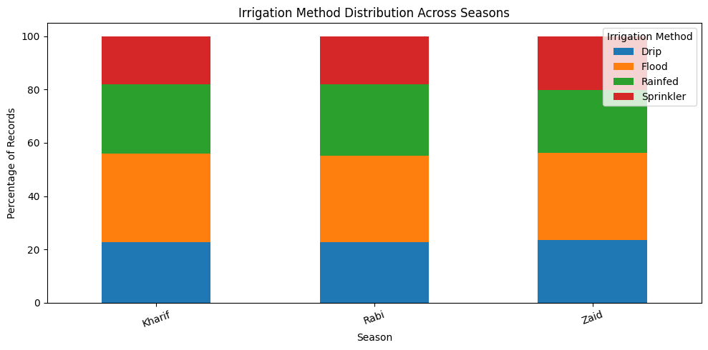
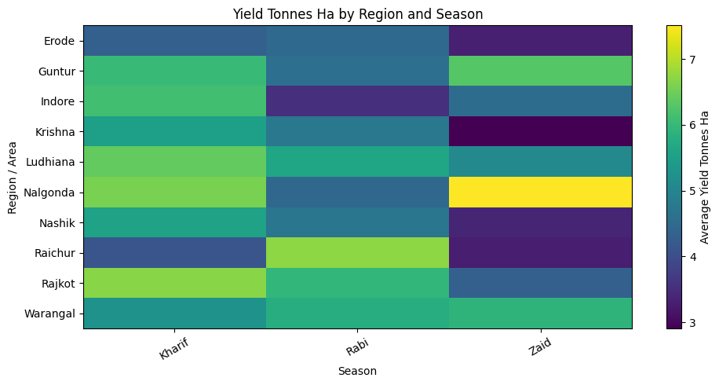
RESULTS
The chart shows the distribution of irrigation methods across Kharif, Rabi, and Zaid. The proportions are quite similar across all three seasons, with Flood and Rainfed being the most common methods.
Conclusion
Irrigation patterns remain relatively consistent across seasons, with only small differences in the use of individual methods. This suggests that season alone does not strongly change the choice of irrigation method in the dataset.
The heatmap compares average yield across regions and seasons. Yield varies noticeably between regions, and the strongest-performing season differs for some regions.
Conclusion
Seasonal performance is not consistent across all regions. While Kharif performs strongly in several regions, some regions achieve higher yields in Rabi or Zaid. This shows that regional conditions should be considered along with season when planning agricultural activities.

Slide 10
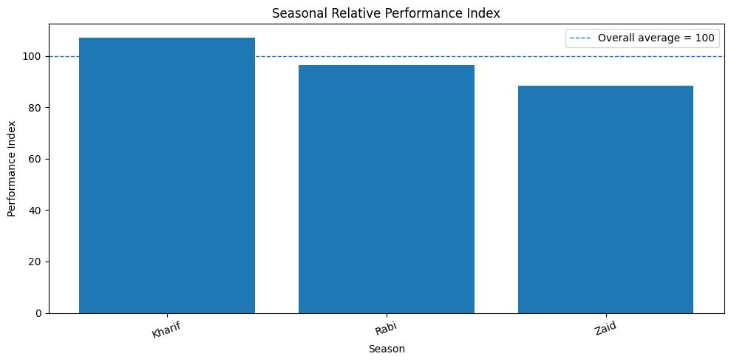
RESULTS
The index compares each season's average yield with the overall average (100). Kharif is above the overall average, while Rabi and Zaid are below it.
Conclusion
Kharif performs above the overall benchmark, whereas Rabi and Zaid perform below it. This reinforces Kharif as the strongest-performing season in the dataset.

Slide 11
Future scope
The current analysis can be extended into a more advanced agricultural decision-support system.
01 - Predictive Analytics Predict crop yield and profitability for upcoming seasons.
02 - Crop Recommendation Recommend suitable crop–season combinations using historical performance.
03 - Regional Intelligence Develop district-level performance dashboards.
04 - Risk Prediction Predict disease/pest risk using environmental and farming conditions.
05 - Interactive Dashboard Build a Power BI / Streamlit dashboard for real-time exploration.
06 - More Data Integrate multi-year weather, market-price and soil datasets for stronger analysis.

Slide 12
GitHub Link
Project Repository:
Seasonal Agriculture Performance Analysis
GitHub: https://github.com/aashitiwari555/Seasonal-Agriculture-Performance-Analysis

Slide 13

VOIS Course completion certificate - Course name- Data Visualization

Slide 14
Thank you
.
.

