Slide 1


Birla Vishvakarma Mahavidyalaya Engineering College
(An Autonomous Institution)
Managed by Charutar Vidya Mandal
IT Department
Mid-1 Examination
Project (4IT31)
Academic Year 2026-27
Group 09
Chess Playing Robotic Arm
Team:
Aashka Shah (23IT403)
Veera Agrawal (23IT431)

Slide 2
Project Definition and Objectives
Definition
Objectives
A smart chess-playing robotic system that uses computer vision to detect piece movements. The system compares previous and current board states, validates moves using a chess engine, and controls a robotic arm to perform the AI-generated move on the physical board.
Automate physical chess gameplay and help remote chess players.
Detect chess moves using camera.
Integrate AI for intelligent move generation.
Control a robotic arm for piece movement.
Demonstrate the application of AI and robotics in board games.

Slide 3
Modules
System Functionality
1
2
3
1
Player moves a chess piece.
Camera-Based Board Monitoring
Move Detection Module
Chess AI Engine
Detect piece positions using camera
Compare board states and identify moves
Validate moves and generate optimal responses
2
Camera captures board changes.
System identifies source and destination squares
3
4
Chess engine validates the move
4
5
6
Coordinate Mapping Module
Robotic Arm Control Module
Game Management Module
AI calculates the best response
5
Convert chess coordinates into robotic arm coordinates
Execute pick-and-place operations
Maintain game history and board state
6
Robotic arm executes the move
7
Board state is updated
8
Gameplay continues until completion

Slide 4










Feasibility
Tech Stack
1
2
Front End
Technical Feasibility
Economic Feasibility
Uses Raspberry Pi, Arduino, robotic arm, Python, and Stockfish AI with readily available components
Moderate cost; hardware components are affordable and easily available online
Back End
AI Engine
Database
3
4
Hardware
Operational Feasibility
Future Feasibility
Fully automated system with reliable camera-based move detection and robotic piece movement
Can be extended with multiplayer support, voice control, automatic board setup,
Dataset
Roboflow Chess Dataset
Tools

Slide 5
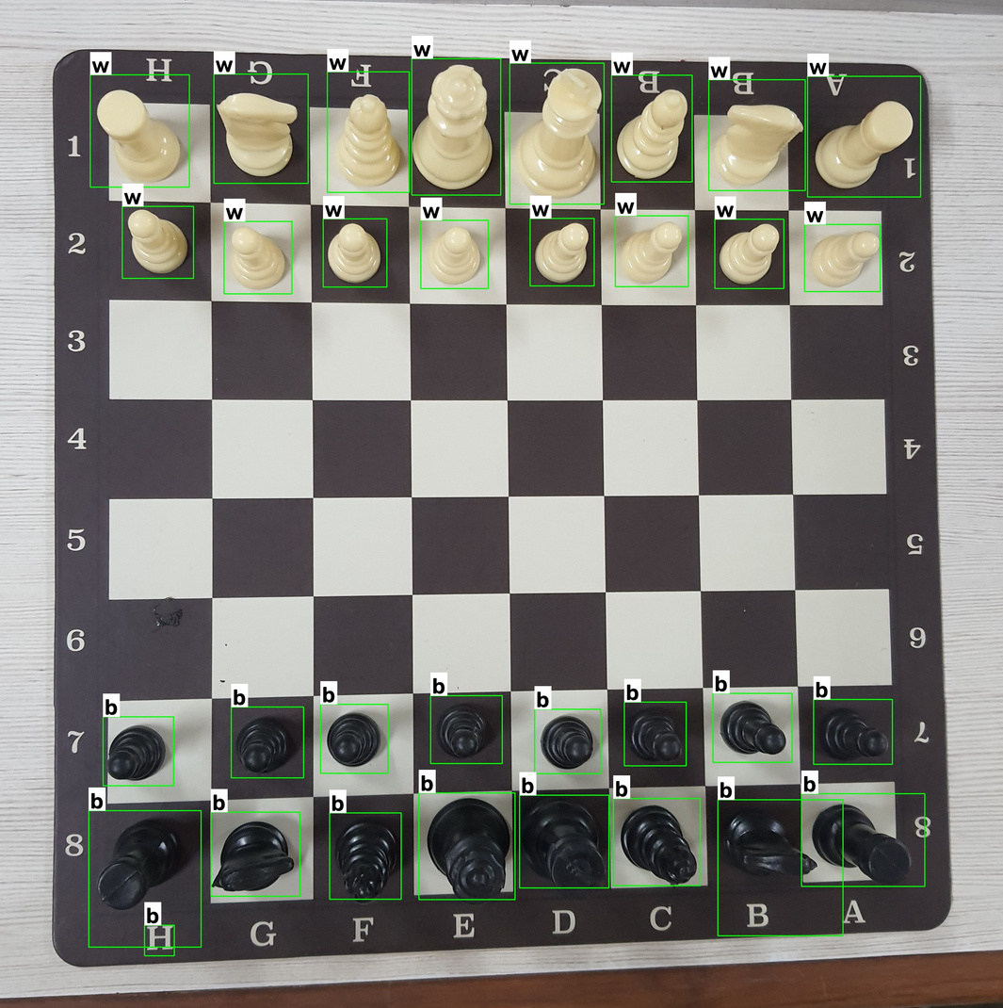
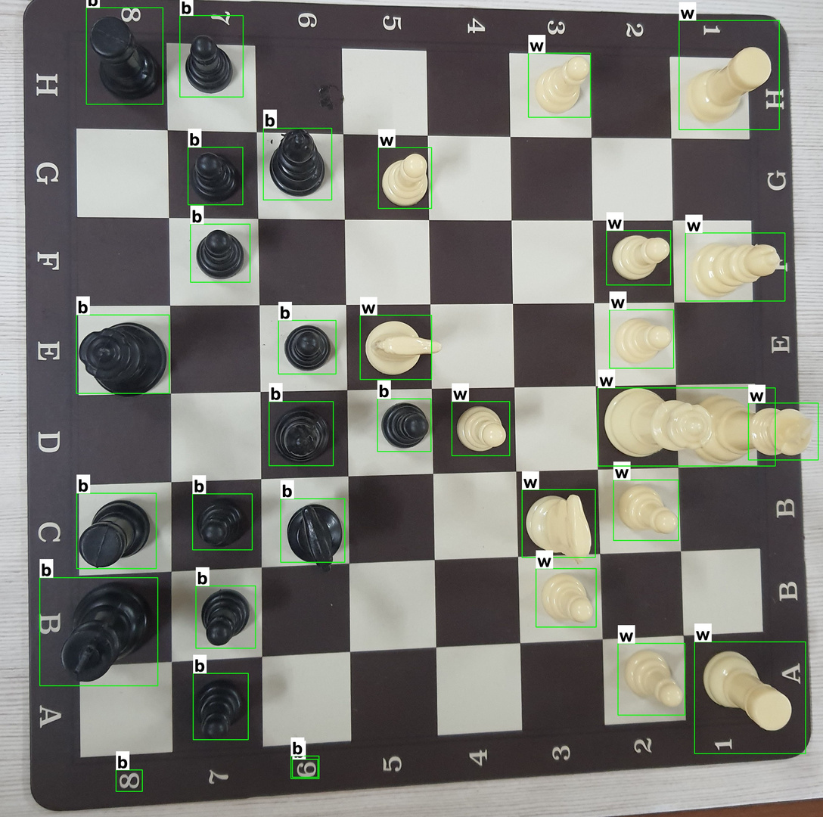
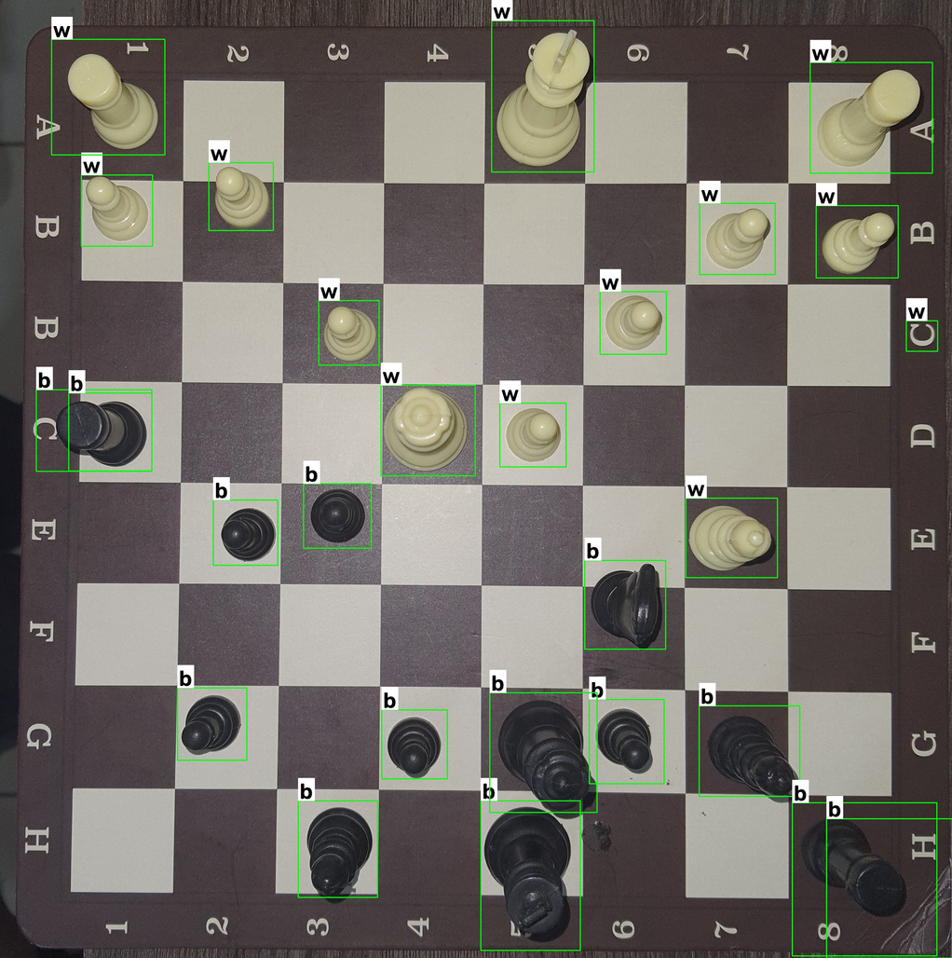
Software Implementation
Detects if piece is black or white

Slide 6
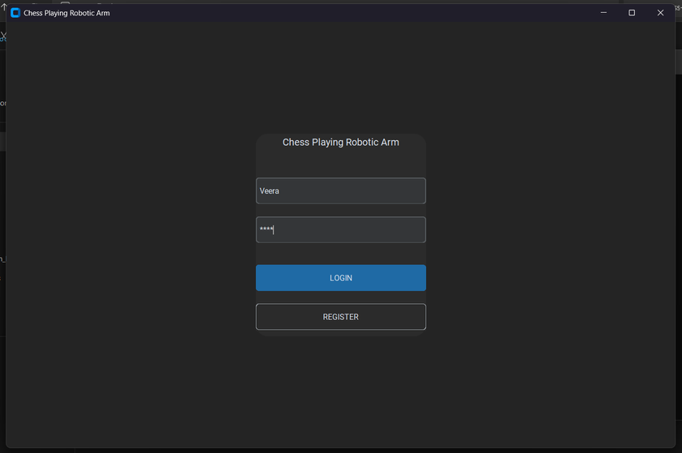
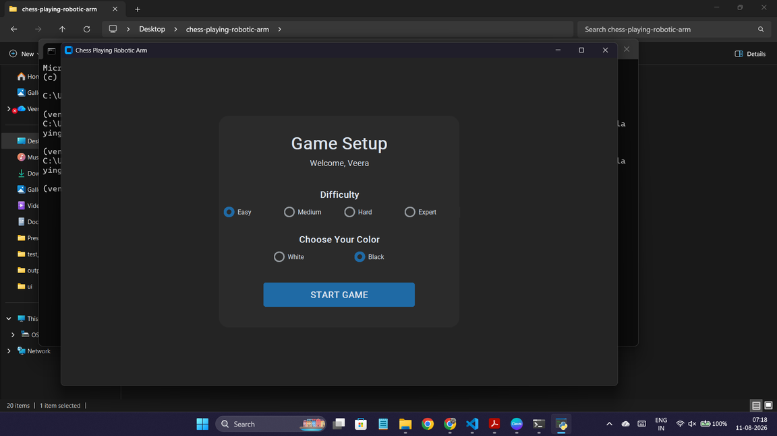
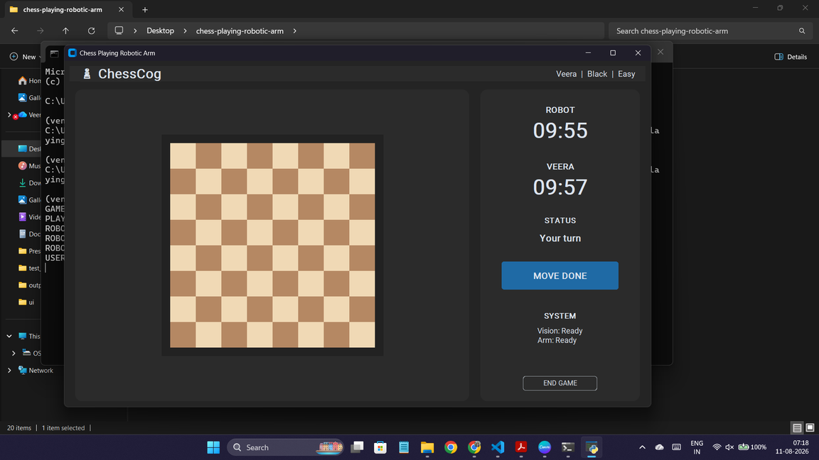
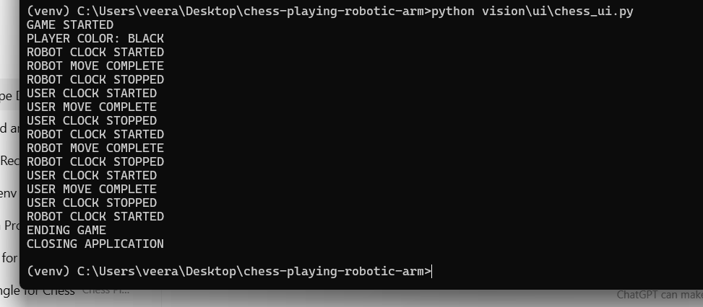
UI Implementation

Slide 7
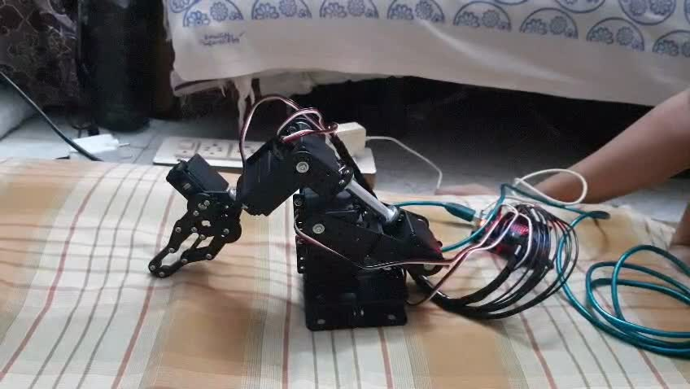
Hardware Implementation
Assembled arm going to initial position on power

Slide 8
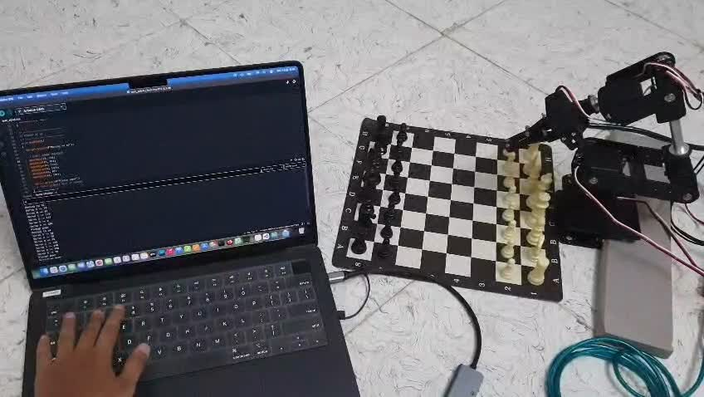
Hardware Implementation
Robotic arm move: e2-e4

Slide 9
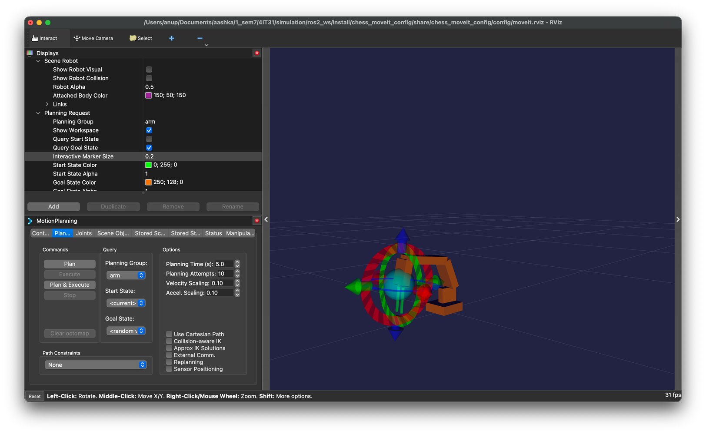
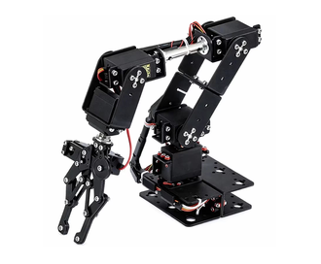
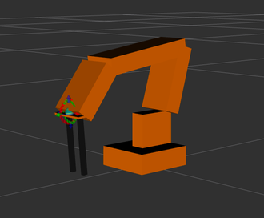
Hardware Implementation
Arm simulation

Slide 10
Current Goal
Achieve pick and place by robotic arm
Accuractely detect and recognize chess board and pieces
Generate the robotic arm move
Play move by arm
Future Goal
Enable robotic play a complete match
Handle special cases like enpassant, pawn promotion, castling
Improve accuracy and reduce move time
Develop this project as a commercial product

Slide 11
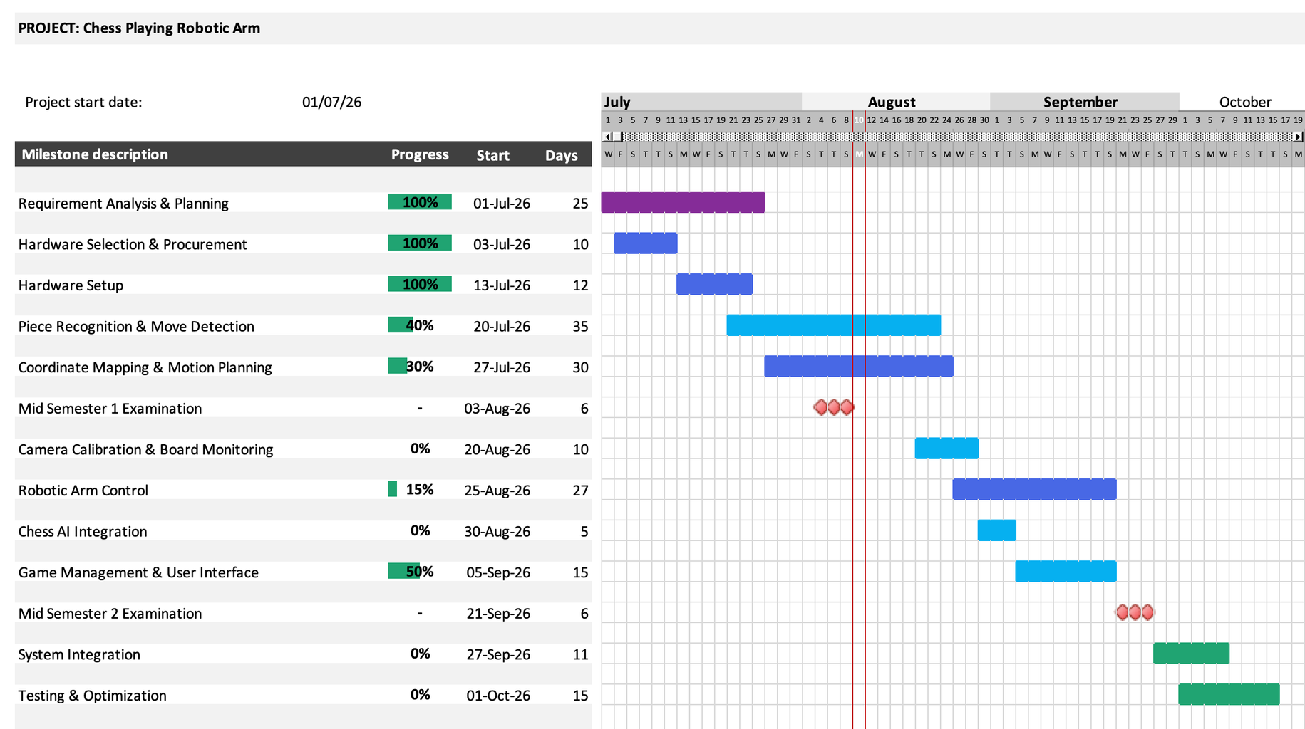
Implementation Status

Slide 12
Links to Documentation
Progress Report 1
Progress Report 2
Project SRS

Slide 13
THANK YOU

